Slide 1
Practical issues
of English Mediated Instruction
Libor Štěpánek
Masaryk University
Language Centre
libor.stepanek@cjv.muni.cz

Slide 2
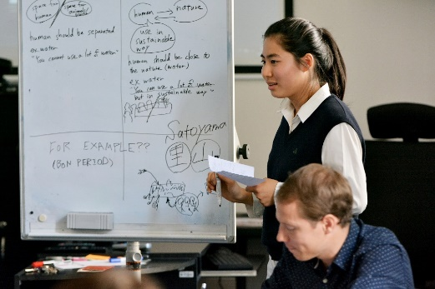
agenda
EMI and its practitioners
role of the language in EMI
practical issues

Slide 3
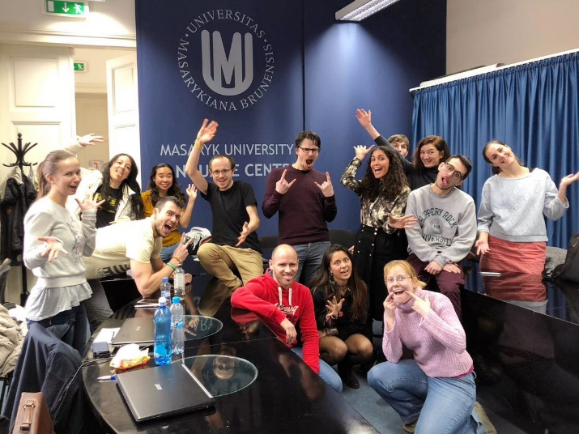
EMI
teaching of subjects (e.g. History, Sport and Chemistry) through the medium of English to mostly non-(English)native speakers in non-English speaking countries ...

Slide 4
role of the language

Slide 5
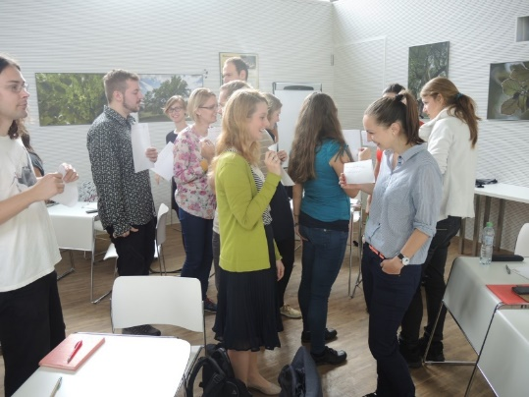
role of the language
tool
medium

Slide 6
practical issues

Slide 7
- community of practice
- Learning is a social and dialogic process, where knowledge is co-constructed rather than "transmitted" or "imported" from teacher or course book to learner. The direct route to learning is therefore located in the interactivity between teachers and learners, and between the learners themselves.
Adapted from Thornbury, S. (2005) Dogme, Dancing in the dark?
a shared detailed understanding between teacher and students of what is going on, what needs to be done, and how it will be done.
Adapted from Boomer, G. (1992), Negotiating the curriculum

Slide 8
practical issues
expliciteness
accuracy
consistence

Slide 9
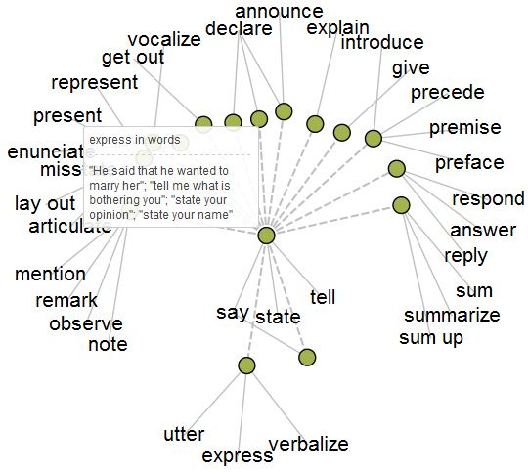
accuracy

Slide 10
accuracy
What do you do when you “shed light” and “look at” something?
shed light = drawing attention to smth; reveal some new aspect of x, previously hidden; examine something that has thus far remained in the dark; drawing attention to a topic; use different authors’ perspectives to illuminate certain parts of a phenomenon/text’; is referred to st. which has not been yet (so much analyzed)
look at = examine; Directing reader's attention to x; address a certain topic; to draw attention by analysing in greater depth; to consider a source

Slide 11
accuracy
Comments on claim and hypothesis:
…A claim is a positive statement about what the world is like;
vs
…a hypothesis is a prospective theory about the what the world is like, to be filled in with evidence and verified/falsified

Slide 12
consistency

Slide 13
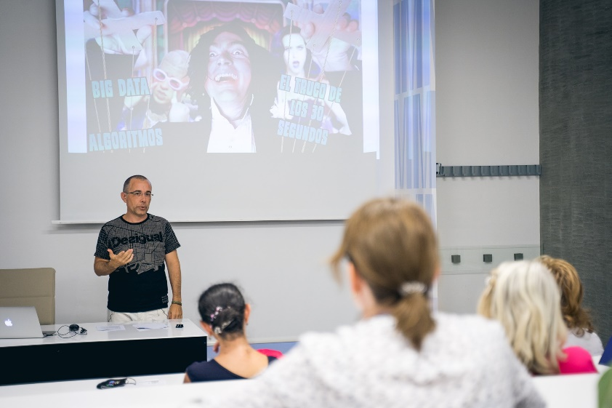
Redirecting the discussion
... is important but it's too complex for us to deal with now.
I see where you’re going but really we need to keep to the topic.
I think the aim of this seminar is to focus on ... rather than ....
That's not something we have time to deal with today, but ....
Let’s come back to that [point] later.
Interrupting to comment
If I could just come in here.
Sorry to butt in, but ....
Can I just add....
That’s a really interesting point but it’s worth remembering that…
That’s great but have you thought about…
Clarifying Questions
That's not really what I was asking. My question is about ...
Perhaps I didn't make my question clear. What I asked/meant was..
I think you've answered a slightly different question. What I would like to know is ...
I understand that but what I actually had in mind was ....
I think you’ve got the wrong end of the stick there, what I meant was…

Slide 14
explicitness

Slide 15
One of the world leading figures is the Pope.
Are you planning the trip in winter?
How old are you?

Slide 16
One of the world leading figures is the Pope. (Chinese)
What is the Pope?
Are you planning the trip in winter? (Argentinean)
Yes, I´ll arrive in August.
How old are you? (Korean)
Do you mean Korean or international age?

Slide 17
“Academic 15 minutes” means
it is tolerated if a teacher appears in class 15 minutes late.
b) it is tolerated if a student appears in class 15 minutes late.
c) the class has to start 15 minutes later than what is written in the official timetables.
d) it is just a saying that has no effect to the class management.

Slide 18
“Academic 15 minutes” means
it is tolerated if a teacher appears in class 15 minutes late.
b) it is tolerated if a student appears in class 15 minutes late.
c) the class has to start 15 minutes later than what is written in the official timetables.
d) it is just a saying that has no effect to the class management.

Slide 19
explicit accurate consistent
clarity
(EMI) effective learning

Slide 20
sources
Beinhauer, R. (2013): Diversity Management in Education, Impact Project, workshop materials,
https://impact.cjv.muni.cz/publikace-a-vystupy/materialy/
Boomer, G. Ed (1992), Negotiating the curriculum: Education for the 21stcentury. New York: Taylor & Francis Ltd.
Brooks and Grundy (1990) in Morgan, J. (2007): Academic Writing Course materials, MU
Caplan, N. A. (2012): Grammar Choices for Graduate and Professional Writers (Michigan Series in English for Academic & Professional Purposes) 1st Edition. The University of Michigan press.
Dearden, J. (2014) English as a medium of instruction: A growing global phenomenon. London: British Council.
Fasco, D. (2000-2001): 'Education and Creativity', Creativity Research Journal, 13, (317-327).
Hyland, K. (2001): English for Specific Purposes, https://www.researchgate.net/publication/226497899_English_for_Specific_Purposes
Kohonen, V. (1992). Experiential language learning: second language learning as cooperative learner education. In Nunan, D. (Ed.), Collaborative Language Learning and Teaching, pp. 14-39.9.
Little, D. (1995). Learning as dialogue: The dependence of learner autonomy on teacher autonomy. System, 23(2), 175-181. https://doi.org/10.1016/0346-251X(95)00006-6
Macaro, E. (2015) ‘English Medium Instruction: Time to start asking some difficult questions’, Modern English Teacher, 24(2), pp. 4-7.University of Southampton (2019) English as a Medium of Instruction for Academics. https://www.futurelearn.com/courses/emi-academics
Madhavan Brochier, D. (2020): Captivate! seminar materials, Masaryk University (21/07/2020)
Smith, R. C. (2003). Teacher education for teacher-learner autonomy. In J. Gollin, G. Ferguson, & H. Trappes-Lomax (Eds.), Symposium for language teacher educators: Papers from three IALS Symposia. Edinburgh: University of Edinburgh.
Swales, John M. and Feak, Christine B. (2001): Academic Writing for Graduate Students: Essential Tasks and Skills. The University of Michigan press.
Štěpánek, L., deHaaff, J.(2018): Academic English, Grada, Praha
Thornbury, S. (2005): Dogme: Dancing in the dark? Folio. 9/2, 3-5.
Notes:
20

