Slide 1
No longer sidelined? Football fandom, belonging, and the boundaries of Europe
Jonas Biel, Vincent Reinke, Tobias Finger, Arne Niemann
First Annual FORTHEM Conference FORTHEM - For the Future
Europe as a hub for inclusiveness and democratic values

Slide 2
Contents
Kick-off
Belonging and non-belonging to Europe
Identity construction through habitualisation
A Europeanised football sphere
Research design
Results & Conclusion

Slide 3
Kick-off
Europe is experiencing an ongoing (and intensifying?) ‚Polycrisis‘
Definitions of ‘Europe’ are varied and constantly changing; influenced by politics, institutions, geography, history, and socio-cultural factors
Shared European identity helps address crises
Initiatives try to build shared identity: Erasmus, ESC, etc.; Football’s broad appeal offers unique opportunities for identity constructions
How does football influence understandings of European belonging?

Slide 4
Belonging and Non-belonging to Europe
Belonging is a crucial part of collective identities
European identity entails:
Self-categorization as ‘European’
Evaluations of membership in ‘European collective(s)’
Attachments to ‘Europe’ and other ‘Europeans’
European identity manifests of different levels, i.e. civic and cultural
Requires recognition of a mutual ‘European-ness’

Slide 5
Identity construction through habitualisation
European integration enhances opportunities for identifying with Europe
European identity is shaped by — among others — habitualised contact with Europe
Two ways:
Subconscious, subliminal, subjective Europeanisation
Active, deliberate identity processes
Increasing focus on non-political, social, and cultural pathways; “everyday Europe”, “social transnationalism”

Slide 6
A Europeanised football sphere
Football fandom is a unifying cultural phenomenon
High degree of Europeanisation: Competitions, personnel, media, advocacy
Fandom induces contact with, experiences of, exchanges across Europe
‘European football sphere’ broader than other definitions of Europe

Slide 7
Research Design
H1: Fans and non-fans equally categorise countries commonly associated with Europe as European.
H2: Fans are more likely than non-fans to categorise countries not commonly associated with Europe as European.
Representative survey of 7,040 citizens from four countries
Items on football related and general social/political attitudes, key question: “Does [X] belong to Europe?” + list of 12 countries
Logistic regression models using fandom dummy and controls

Slide 8
A Europeanised football sphere

Slide 9
Results
Estimated Average Marginal Effects of Fandom on Perceived European Belonging in Logistic Regression Models
Group | Does [x] belong To Europe? | Est. %-Diff. | CI (low) | CI (high) | P
Core | Belgium | -1.05 | -2.39 | 0.29 | 0.12
Core | Germany | -0.22 | -1.38 | 0.94 | 0.71
Core | Poland | 1.00 | -0.85 | 2.85 | 0.29
Core | Spain | -1.10 | -2.51 | 0.30 | 0.12
Transitional | Serbia | 7.15 | 4.73 | 9.56 | 0.00 | ***
Transitional | United Kingdom | 3.02 | 0.84 | 5.21 | 0.01 | **
Affiliated | Norway | 1.16 | -1.01 | 3.34 | 0.30
Affiliated | Switzerland | 2.49 | 0.66 | 4.31 | 0.01 | **
Outliers | Israel | 3.89 | 2.11 | 5.67 | 0.00 | ***
Outliers | Kazakhstan | 5.00 | 3.09 | 6.91 | 0.00 | ***
Outliers | Turkey | 6.23 | 3.55 | 8.90 | 0.00 | ***
External | Morocco | 0.56 | -1.20 | 2.32 | 0.53
Note: Average Marginal Effects (AME); Est. % Diff. = Estimated difference in percentage agreement between fans and non-fans; CI (low) = Lower bound of the confidence interval; CI (high) = Upper bound of the confidence interval; P = P-value significance level.

Slide 10
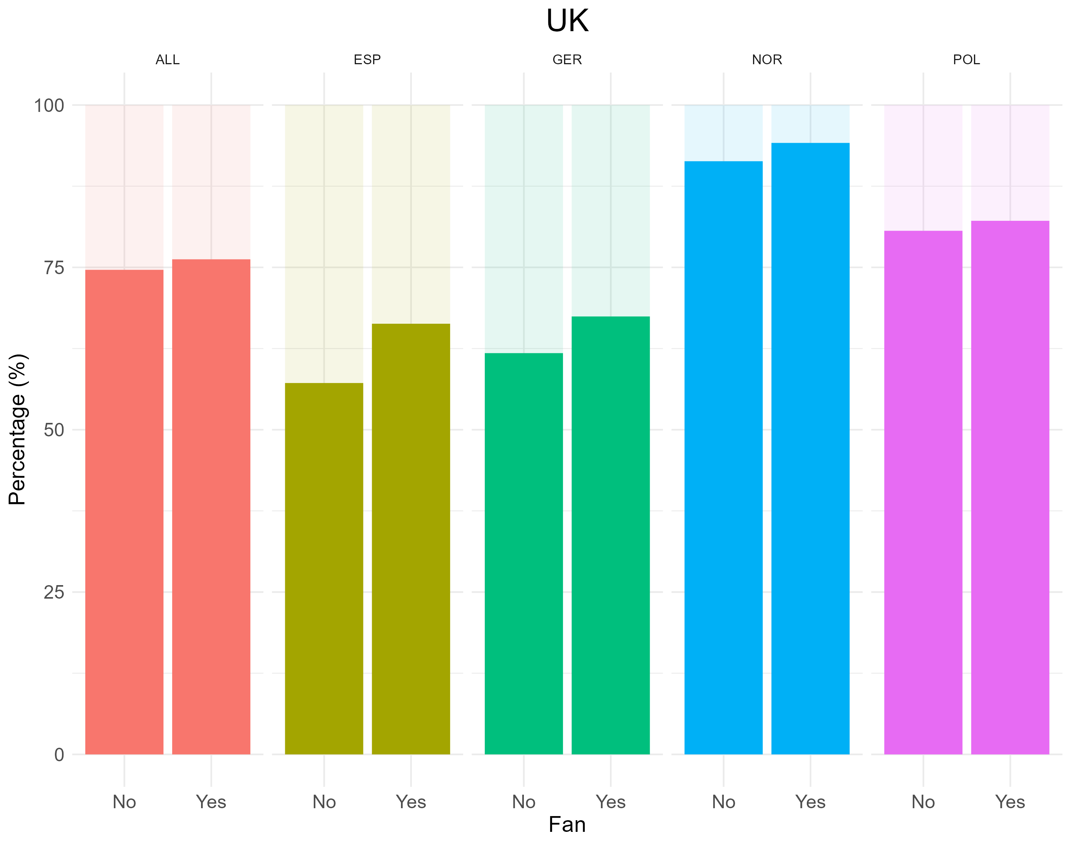
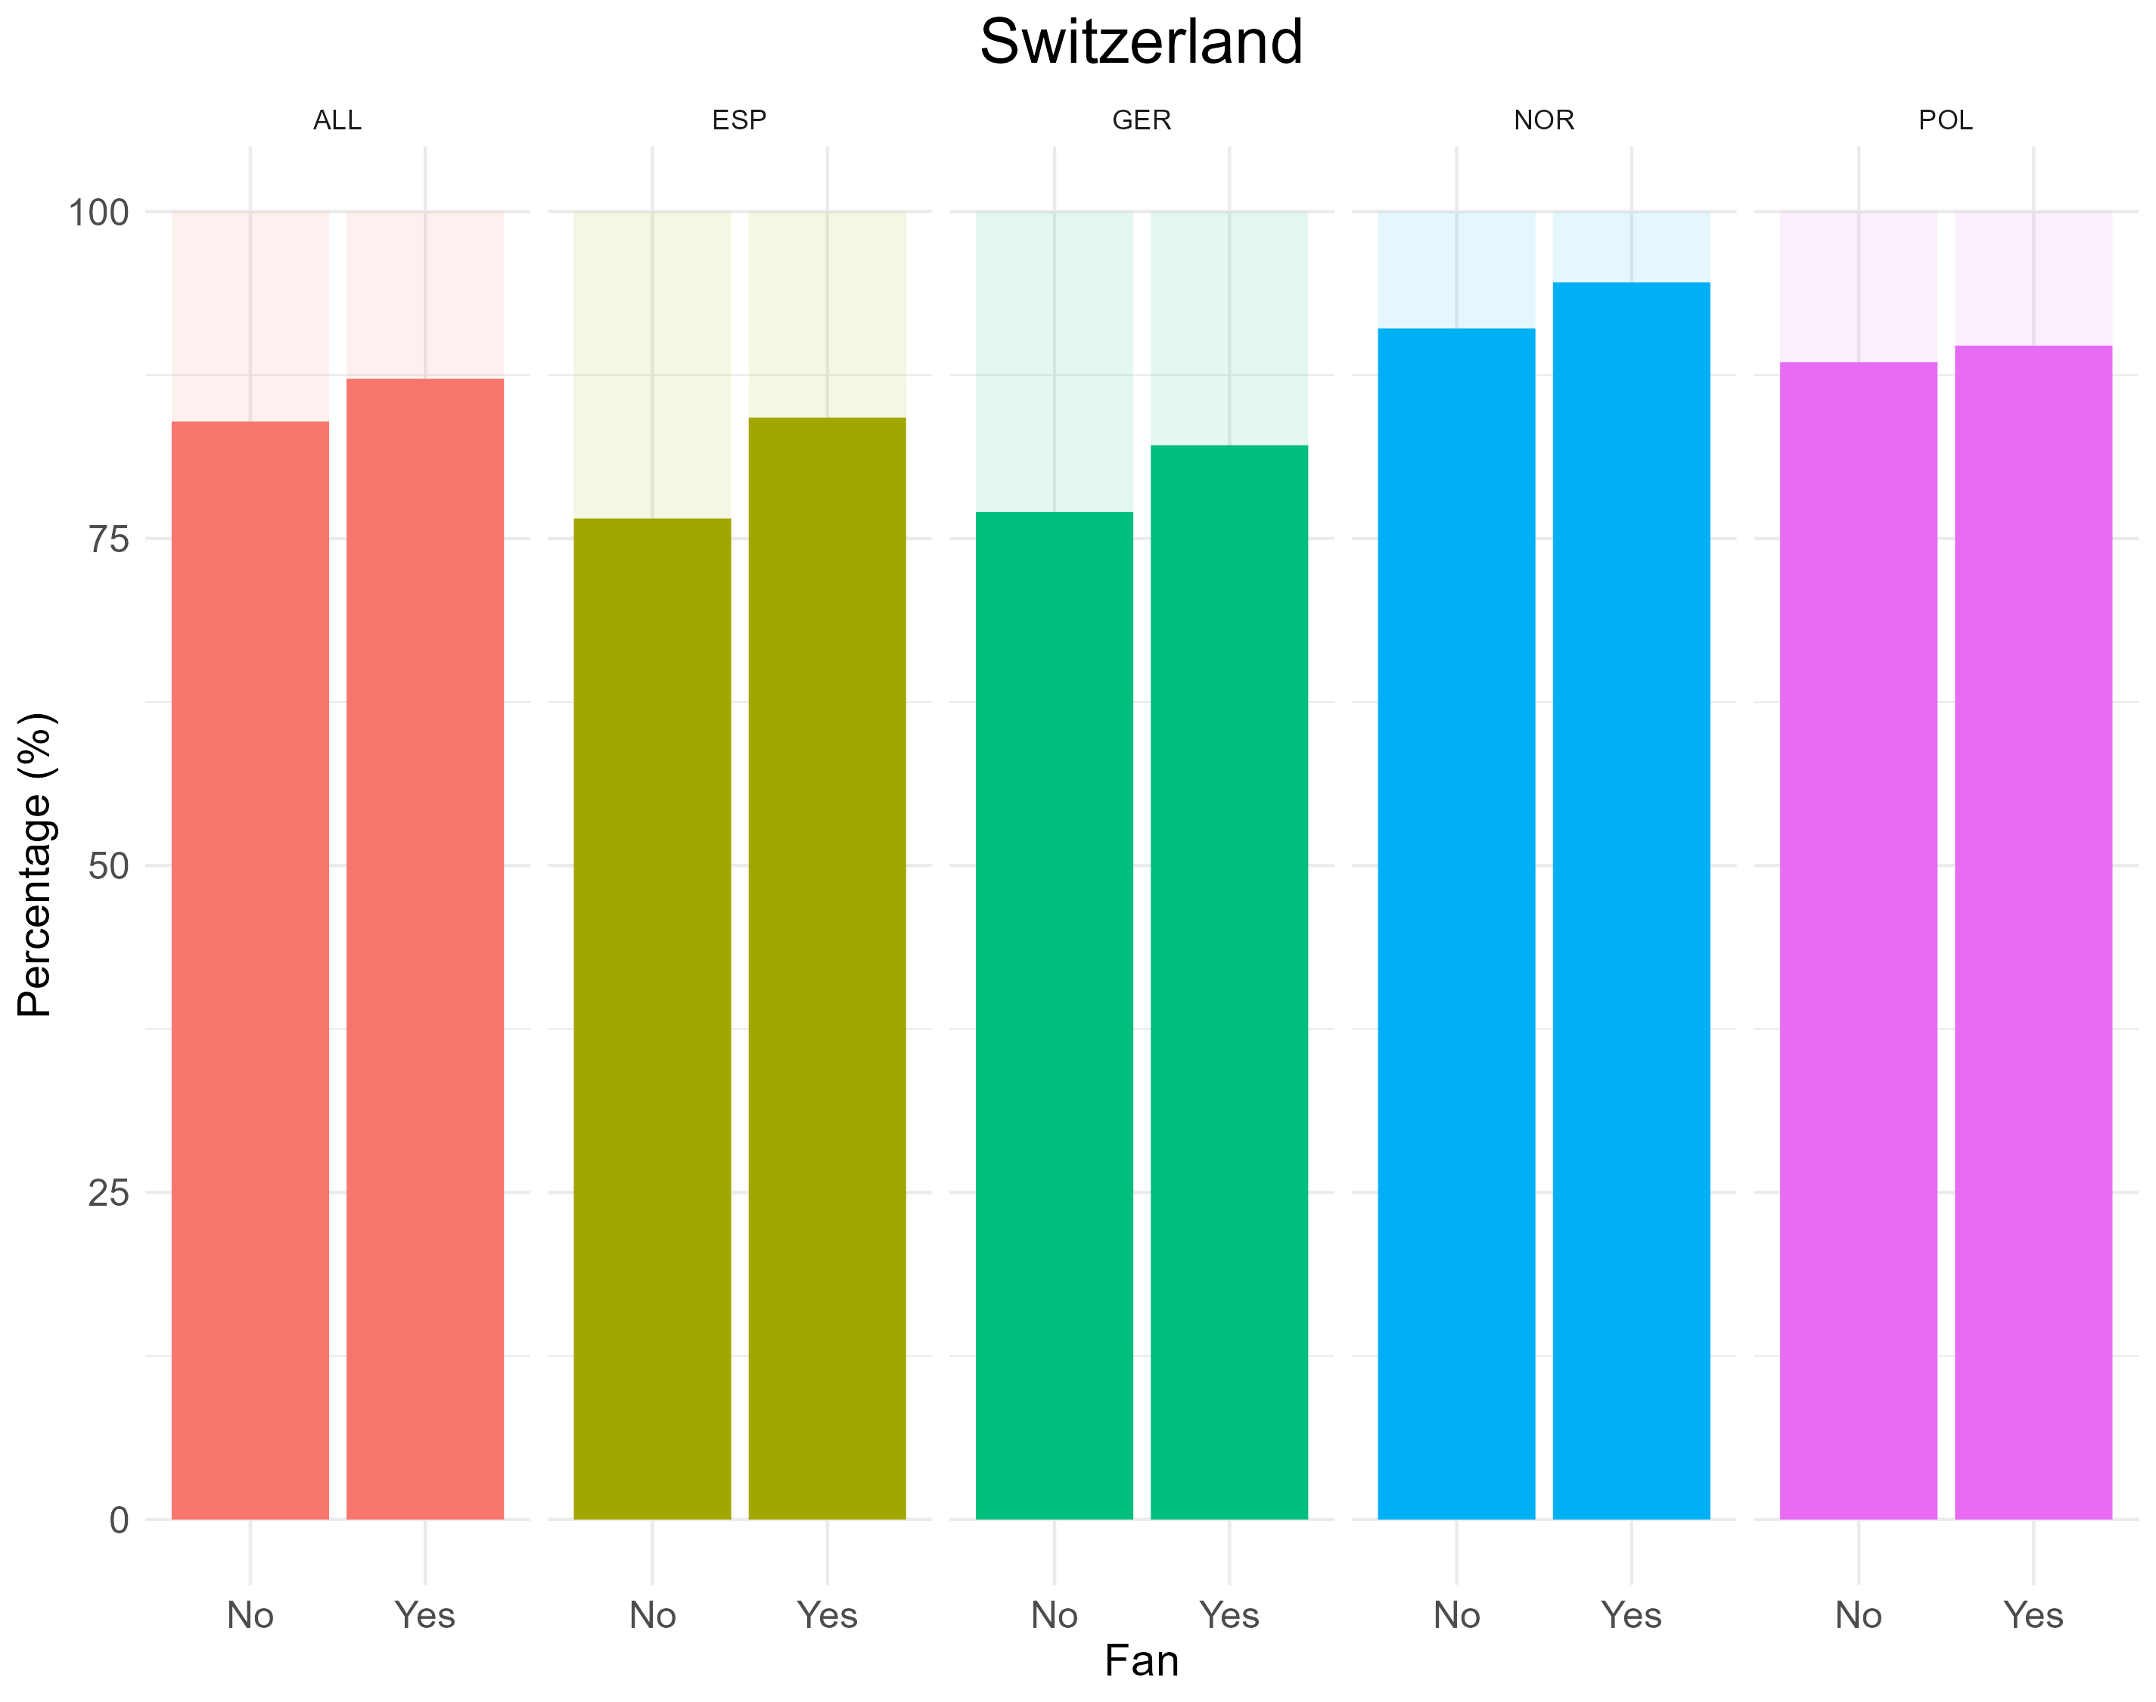
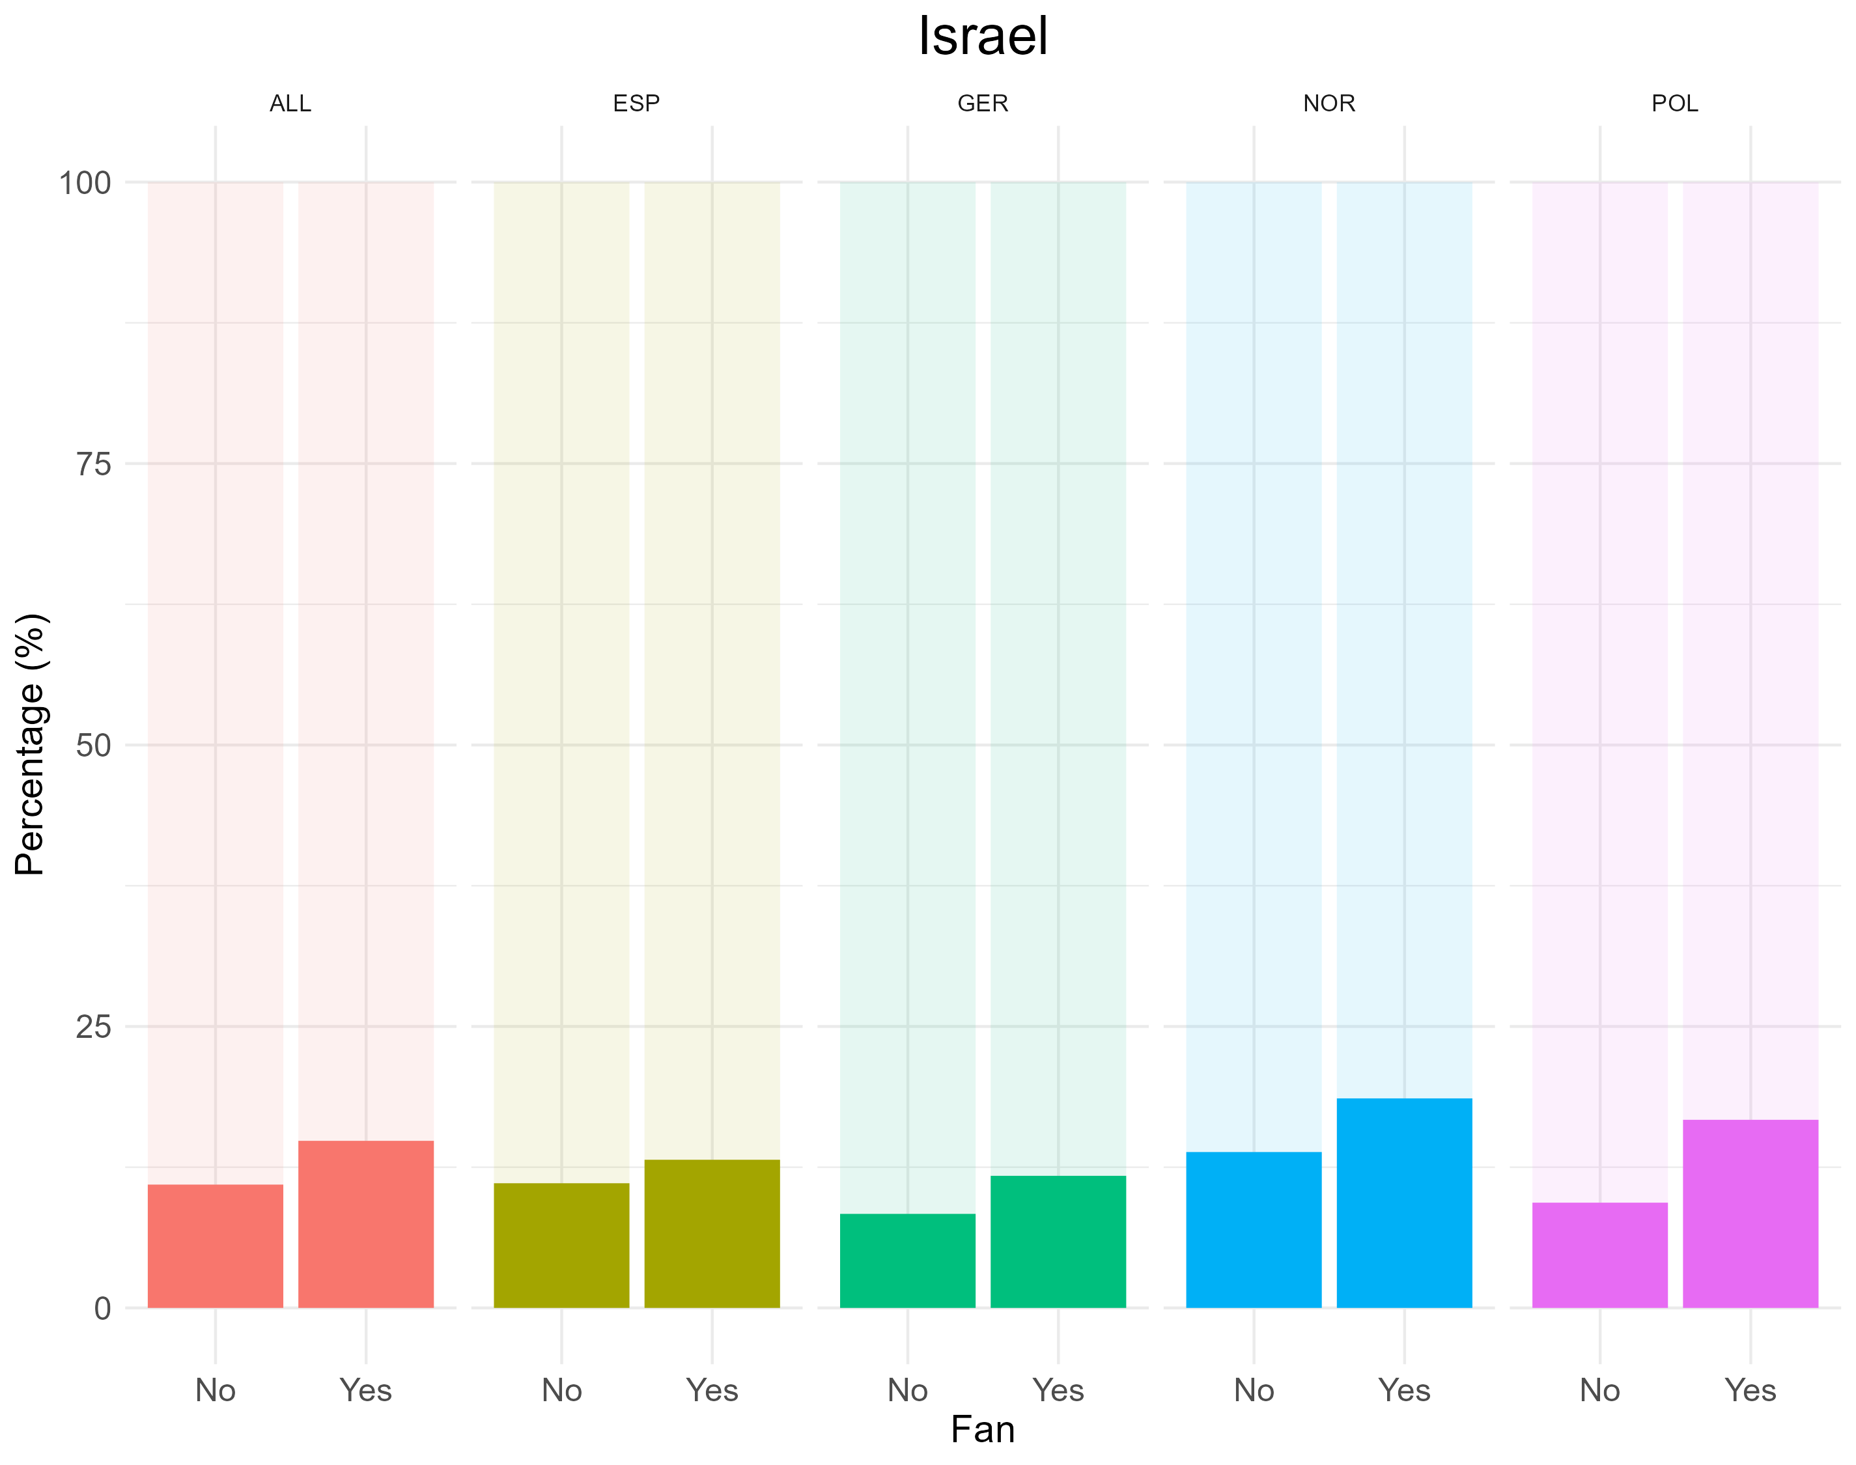
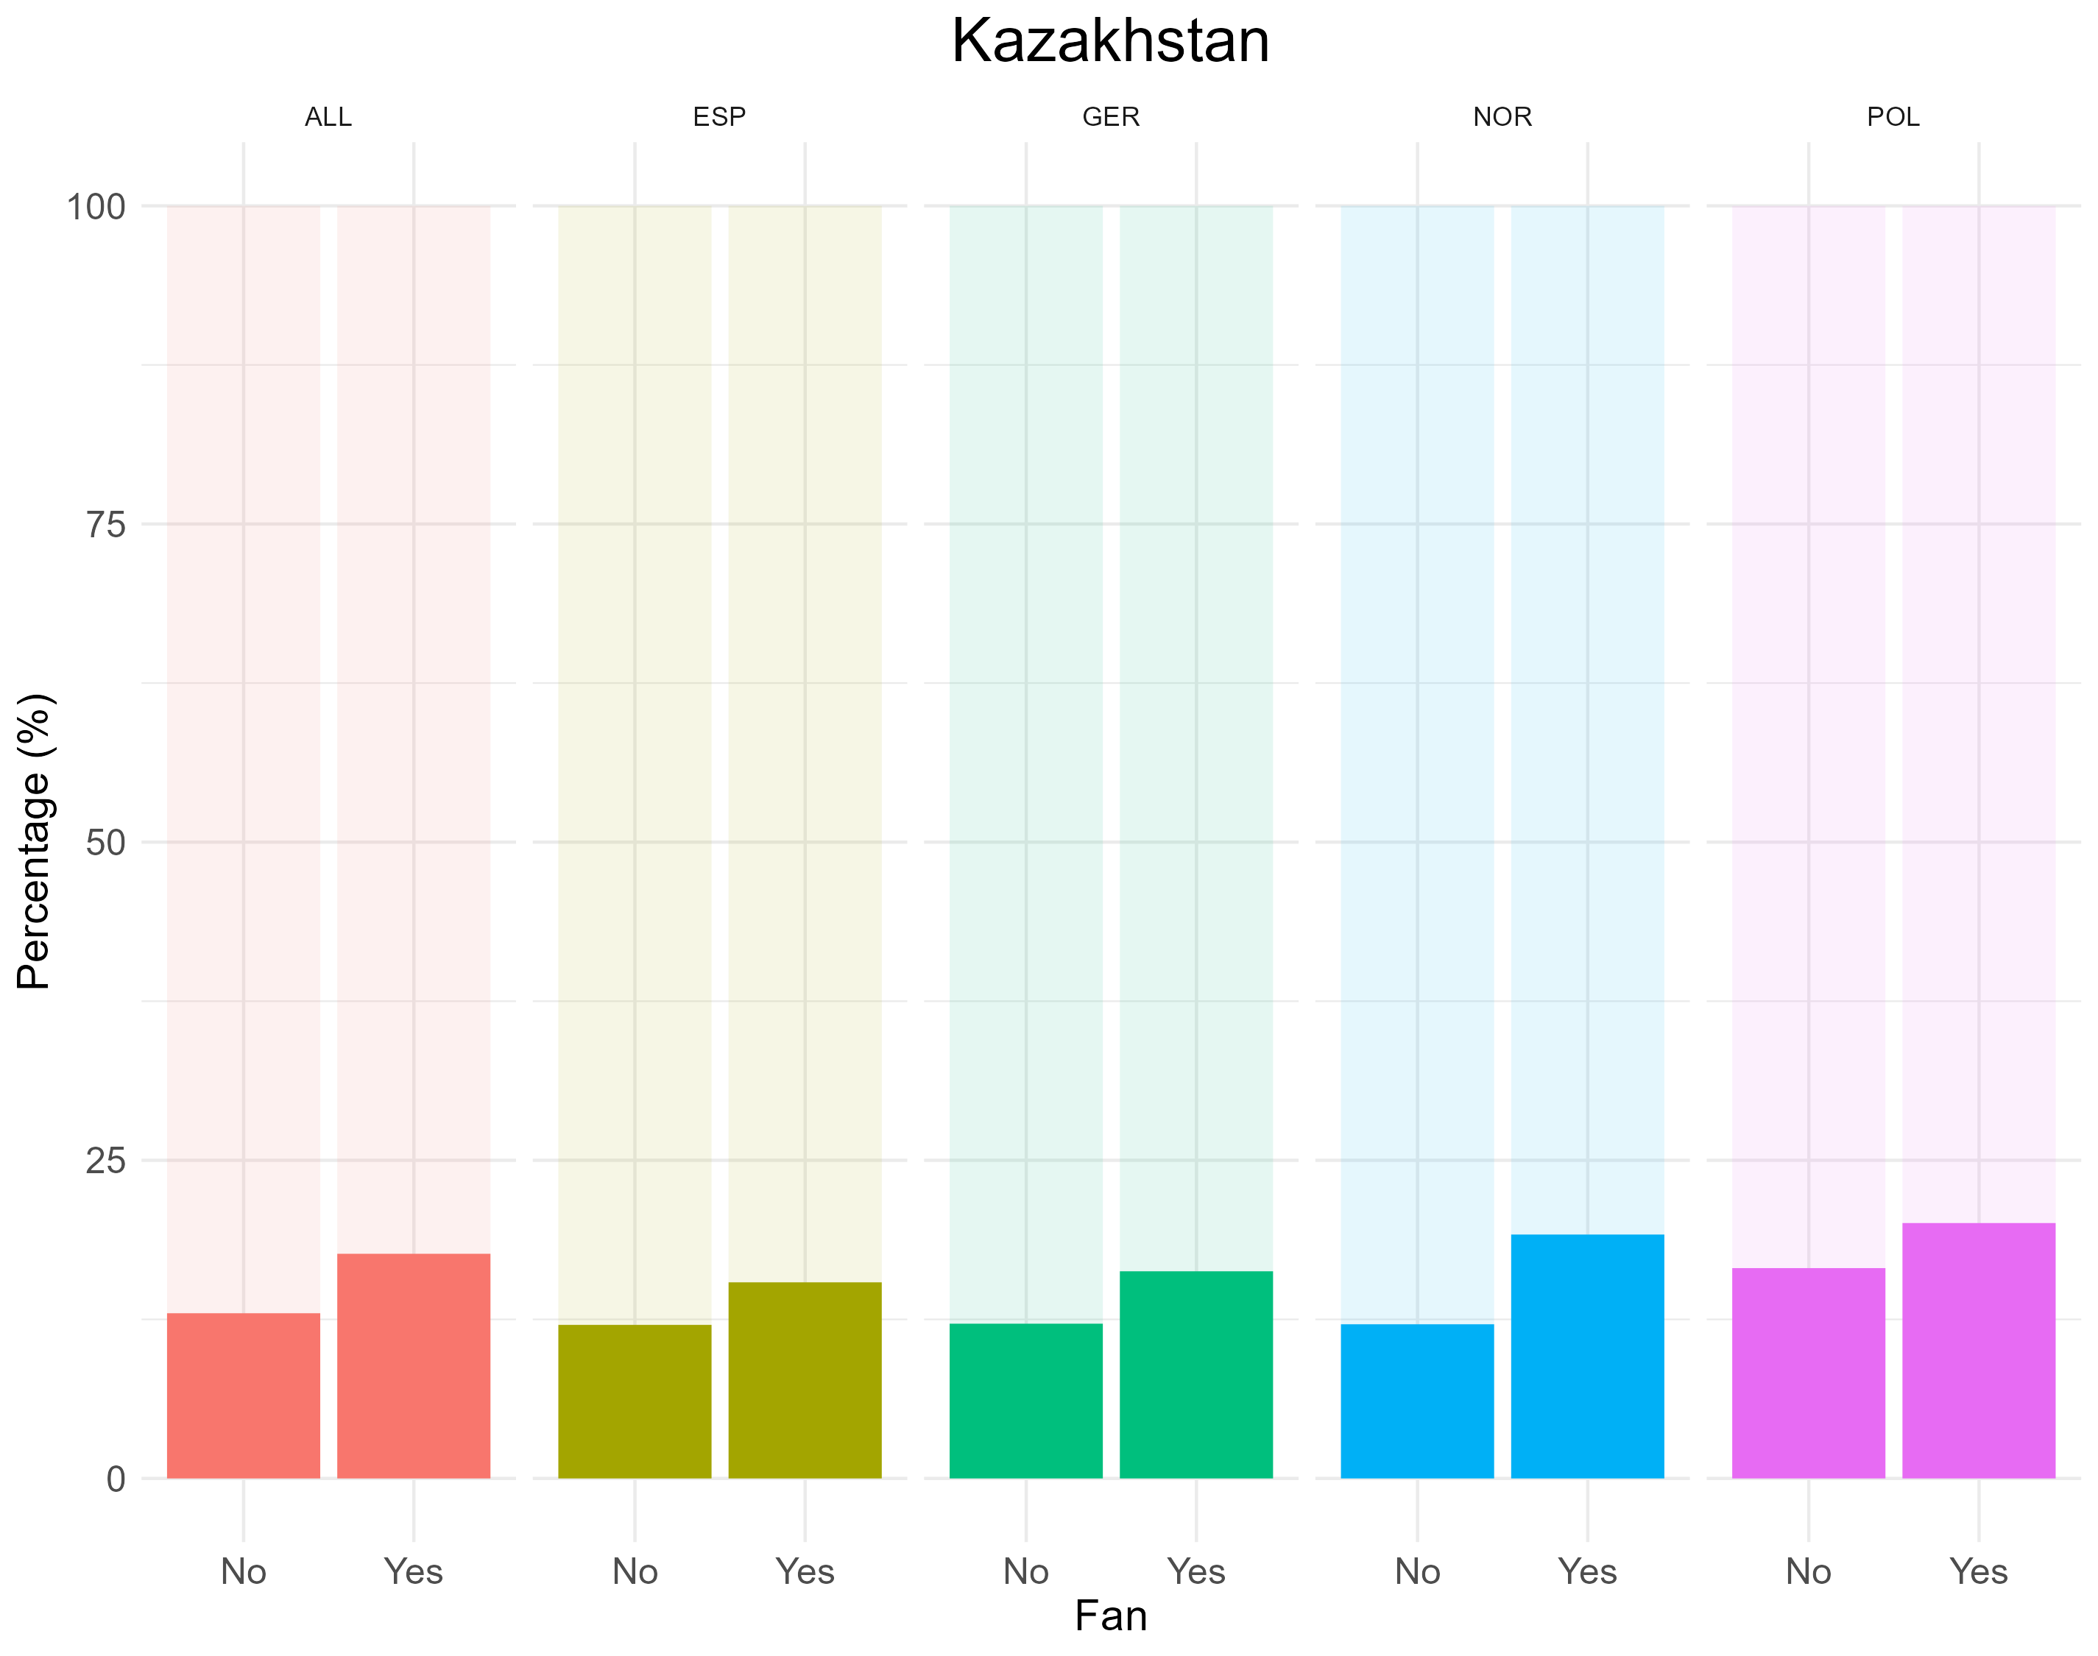
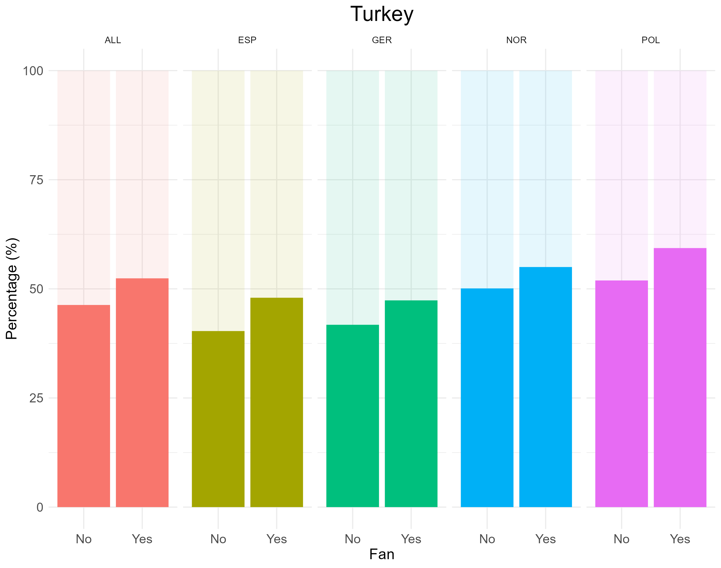
Results

Slide 11
Discussion
Football fans have increased propensity to categorise transitional, affiliated, and outlier countries as ‘European’
Football fandom contributes to more inclusive, broader conceptions of Europe
Habitualised contact with more peripheral parts of Europe normalizes their presence
Football provides an explicitly European reference frame
Limitations:
Small effect sizes
Survey question construction

Slide 12
Conclusion
Football fandom might help to alleviate crises by fostering understanding and cooperation across borders
Adds additional layer to traditional political or cultural constructions of Europe
Inclusiveness and social embeddedness of football threatened by commercialization

Slide 13
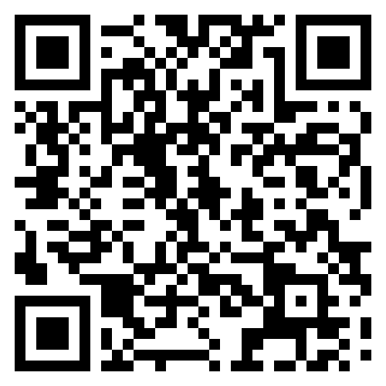
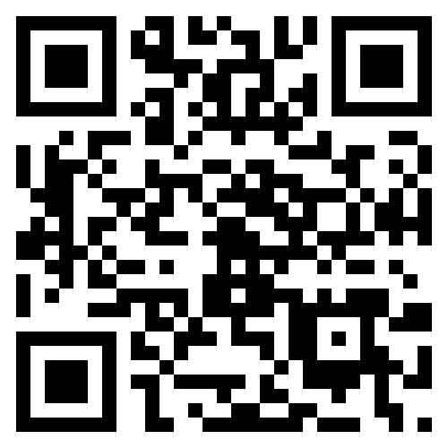
Conclusion
More info:
Website
Twitter
fanzine-research.github.io
twitter.com/eu_foot
E-Mail: jobiel@uni-mainz.de

