Slide 1
Empowering Sustainable Energy Transitions: A Comprehensive Strategy for Renewable Energy and Efficiency
Rotaru Mihaela, Isarie Claudiu Laurentiu, Stoica Augustin, Ciofu Florin, Prodea Laurentiu
Lucian Blaga University of Sibiu, Sibiu, Romania
First Annual FORTHEM conference
FORTHEM – For the Future
March 6-8, 2024

Slide 2
Introduction
Importance of sustainable energy practices
Surge in energy usage and carbon emissions raises concerns.
Debate: Urbanization vs. product/service generation.
Projections: Electricity consumption to rise significantly by 2050.
Urgent need for proactive measures to enhance energy efficiency and promote sustainability.
First Annual FORTHEM conference
FORTHEM – For the Future
March 6-8, 2024

Slide 3
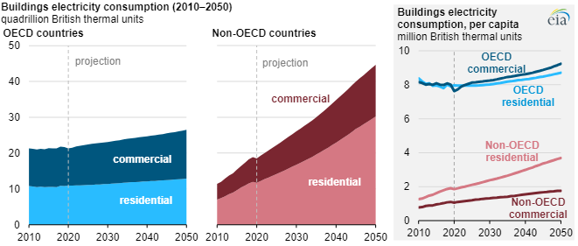
Introduction
Source: U.S. Energy Information Administration, International Energy Outlook 2021 Reference case
Note: OECD=Organization for Economic Cooperation and Development
First Annual FORTHEM conference
FORTHEM – For the Future
March 6-8, 2024

Slide 4
The methodology employed in this project
Overview of methodologies employed for data collection and ATU selection.
Combination of quantitative and qualitative methods utilized.
First Annual FORTHEM conference
FORTHEM – For the Future
March 6-8, 2024

Slide 5
The methodology employed in this project
Quantitative Data Collection:
Gathered statistical information from government reports, energy usage databases, and regional surveys.
Analyzed data to measure adoption of renewable energy and energy efficiency projects.
Consulted national and international initiatives and standards for best practices.
Developed a comprehensive guide aligned with legal and institutional frameworks.
Conducted workshops, technical study visits, and training sessions for citizens and experts.
Administered a questionnaire to assess community perceptions and knowledge.
Qualitative Data Collection:
Conducted semi-structured interviews with local officials and stakeholders.
Organized focus group discussions with diverse stakeholder groups.
Facilitated stakeholder consultations to solicit feedback on strategic planning.
Leveraged qualitative insights to complement quantitative data analysis for evidence-based decision-making.
First Annual FORTHEM conference
FORTHEM – For the Future
March 6-8, 2024

Slide 6
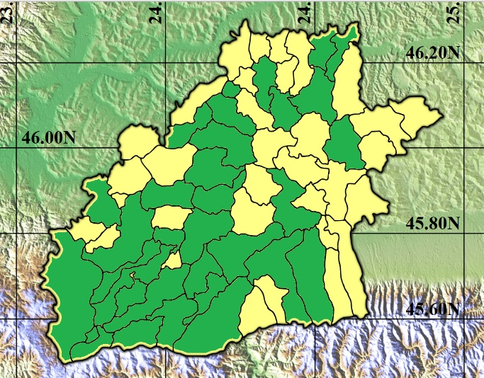
Administrative territorial unit (ATU) selection
Key Characteristics Considered
Population Density
Energy Consumption Patterns
Strategic Decision-Making
Infrastructure and Community Engagement
Strategic Significance
Policy Support
First Annual FORTHEM conference
FORTHEM – For the Future
March 6-8, 2024

Slide 7
Results and discussion
Workshops for Sibiu County Citizens were organized for citizens across more then 30 communities
Technical Experts from SMEs and Public Institutions from six pivotal communities within Sibiu County participated in three-day training sessions
A comprehensive guide was developed to raise awareness of the benefits of using renewable energy and energy efficiency in Sibiu County
An extensive awareness campaign was launched to engage stakeholders and disseminate information on sustainable energy practices
An Environmental Protection course was developed for third-year students specializing in Transport and Traffic Engineering
First Annual FORTHEM conference
FORTHEM – For the Future
March 6-8, 2024

Slide 8
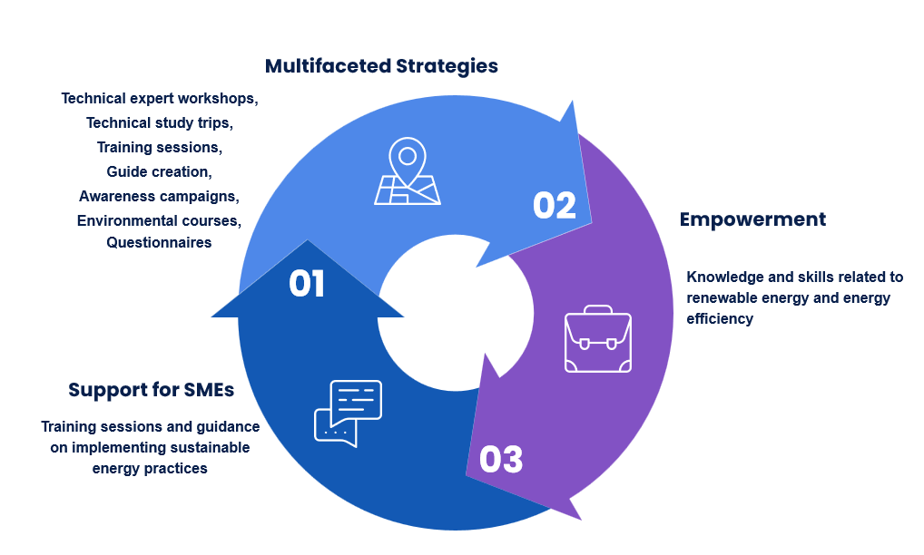
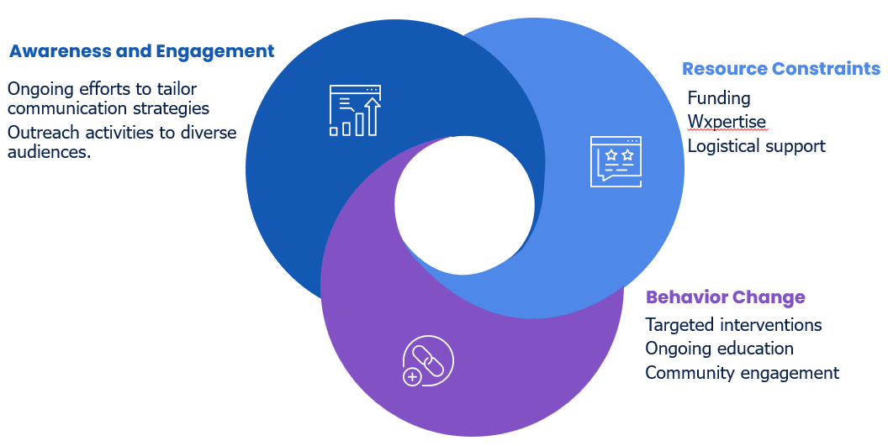
Discussing the highlighting successes, challenges, and lessons learned
First Annual FORTHEM conference
FORTHEM – For the Future
March 6-8, 2024

Slide 9
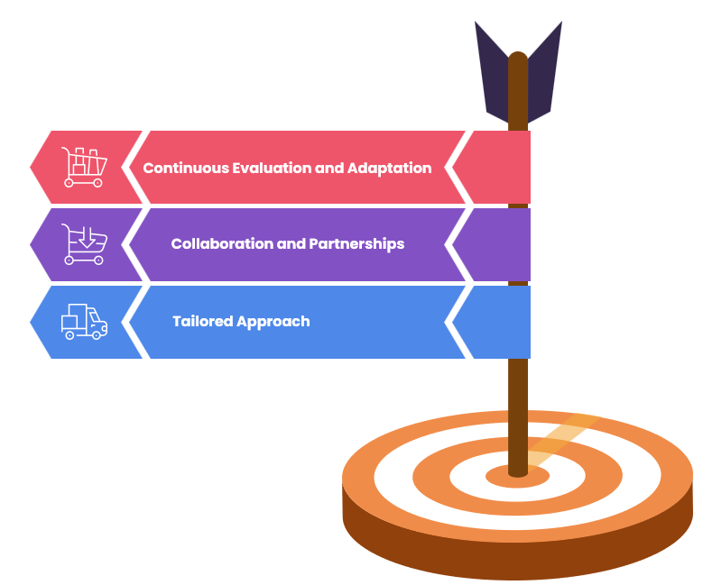
Conclusions drawn from the project and recommendations for future action
Importance of ongoing engagement and communication with stakeholders.
Need for tailored communication strategies and outreach activities.
Addressing barriers to awareness and participation.
Fostering a sense of ownership and commitment among stakeholders.
Continued investment in resources and infrastructure to support sustainable energy practices.
Priority on securing funding, expertise, and logistical support.
Emphasis on behavior change for achieving sustainable energy goals.
Providing incentives, education, and support to facilitate behavior change.
First Annual FORTHEM conference
FORTHEM – For the Future
March 6-8, 2024

Slide 10
Thank you!
Acknowledgements.
The project "Renewable energy and energy efficiency - for sustainable development in Sibiu county" is funded with the support of grants from Iceland, Liechtenstein and Norway through the EEA and Norwegian Financial Mechanisms 2014 - 2021, within the framework of the "Romanian Energy Programme".
First Annual FORTHEM conference
FORTHEM – For the Future
March 6-8, 2024

