Slide 1
AI in School: The Influence of Automatic Text Generation and Machine Translation on Language Comprehension and Translation Performance
Athanasios Breskas & Dimitrios Kapnas &
Silvia Hansen-Schirra

Slide 2
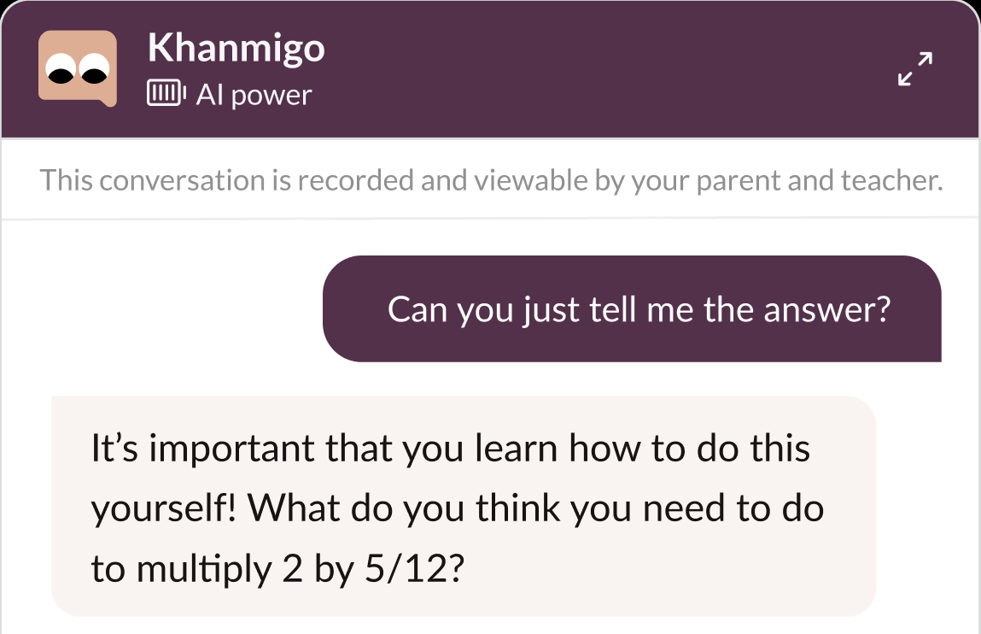
“Khanmigo was first introduced in March, and more than 28,000 US teachers and 11–18-year-old students are piloting the AI assistant this school year, according to Khan Academy. Users include private subscribers as well as more than 30 school districts. […] To protect student privacy, OpenAI has agreed not to use Khanmigo data for training.”
ChatGPT has entered the classroom: how LLMs could transform education (nature.com)
Notes:
Problem based learning
Creative use of tools
Buddz that accompanies you. Co-pilot,
Individual feedback.

Slide 3
CONTENTS
Motivation
Experimental Design
Results
Next steps
Notes:
Participants
Questionnaire
Conditions
Keylogging

Slide 4
Motivation
Explore new methods of language learning
Explore impact of AI tools in schools
Effects on foreign language and translation studies curricula
Insight into pre-academic translation processes

Slide 5
Experimental design
On-site at Rudi-Stephan-Gymnasium Worms (ForThem Alliance Partner)
~2h/session
22-point questionnaire
Language Test → Baseline English
2-min. introductory video to ChatGPT

Slide 6
Experimental design
Keylogging:
Reading comprehension task: 2 C2-level English texts (~1000-characters)
Answer 5 questions to each text
Translation task: 2 C2-level German texts (~75-word texts)
Translate DE-EN

Slide 7
EXPERIMENTAL DESIGN: CONDITIONS
Reading- & Translation-Task:
Text #1:
All online tools available except ChatGPT
(search engines, dictionaries, encyclopedias, machine translation)
Text #2: Only ChatGPT allowed
Randomization per text and participant

Slide 8
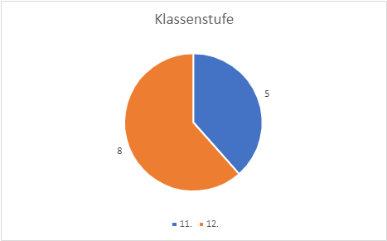
EXPERIMENTAL DESIGN: PARTICIPANTS
13 pupils of RSGW
Five 11th- & Eight 12th-grade-students

Slide 9
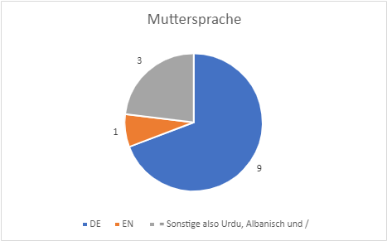
EXPERIMENTAL DESIGN: PARTICIPANTS
Most were German
native speakers

Slide 10
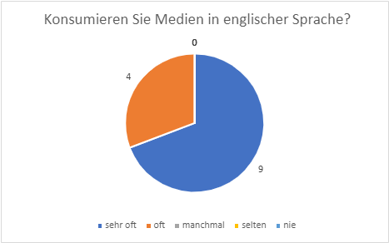
EXPERIMENTAL DESIGN: PARTICIPANTS
All consume English media
very frequently or frequently

Slide 11
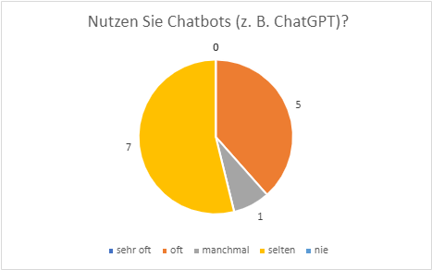
EXPERIMENTAL DESIGN: PARTICIPANTS
None use chatbots very
frequently
… but all use chatbots

Slide 12
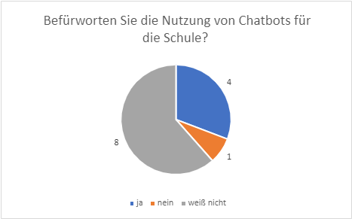
EXPERIMENTAL DESIGN: PARTICIPANTS
Most are undecided
on whether chatbots
should be used for school
work…

Slide 13
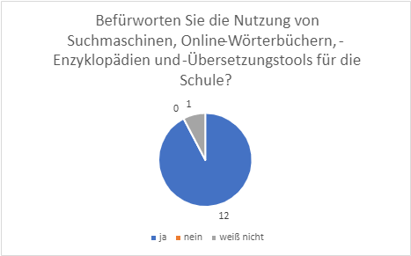
EXPERIMENTAL DESIGN: PARTICIPANTS
…however, the overwhelming majority is in favor of using other online tools for schoolwork...

Slide 14
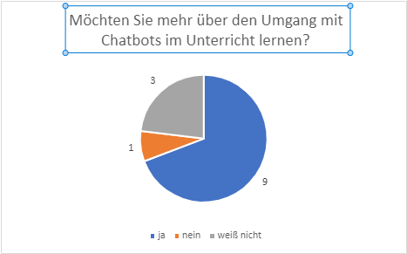
EXPERIMENTAL DESIGN: PARTICIPANTS
...most wish to know more about the usage of chatbots in school classes

Slide 15
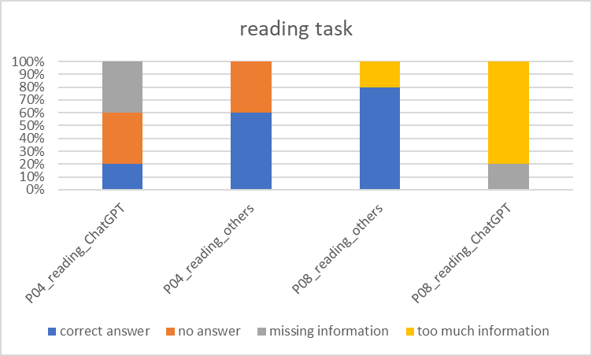
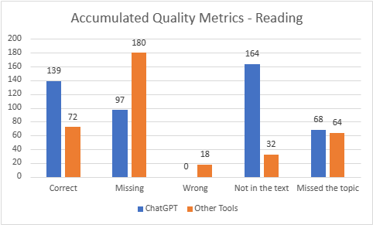
Quality: Reading TASK
Notes:
Let's talk statistics. LETS START WITH THE READING TASK. We defined what constitutes a “golden standard“, concerning the reading comp answers. On the Y-axis you can see the absolute number of errors.
Golden standard= fully correct answer (consisting of every piece of info block), and then established the following metrics Correct (all info blocks present), Missing (if one or more info blocks are missing), Wrong (if info provided is wrong), Not in text (info may be "correct" but comes from other sources), Missed topic (answer comes from text but does not answer the question). The error annotation was done by two independent sources.
In the ChatGPT condition, we observe more correct answers, less missing information, no wrong answers, but way more information that was not in the source text. Equal amount of errors that stemmed from missing the topic like in the other tools condition.
Many did not manage to answer all the questions in time, as texts were very difficult (C2 level).
We consiously did that in order to "push" them in using tools.

Slide 16
Quality: Translation TASK
Notes:
In this diagram, we can see that there were fewer annotated errors in the ChatGPT condition.
For the Translation Task, we evaluated linguistic and semantic correctness – we did that on the basis of the MQM error metrics, which is established for machine translation evaluation & post-editing.

Slide 17
Quality: Translation TASK
Notes:
And these are the annotation categories.
So what we see here is that 1) when translating with ChatGPT, the participants made less errors in total, but in more categories:
For instance Character, Cohesion, Faithfulness. What we see is that Terminology is a problem for both conditions, but in the ChatGPT condition we gather less Grammar, Syntax, Punctuation errors.
Typical Grammar mistakes will be shown later.
Grammar
Syntax
Word Form (the root is is correct but not the inflexion morphem – form of the word)
Part of Speech
Spelling
Character
Capitalization
Punctuation
Addition
Omission
Terminology
Faux Amis
Verb Form
Ambiguity
Cohesion
Faithfulness
Literalness
Misunderstanding
Indecision
Unfinished
Usage
Text Type
Register
Style

Slide 18
RESULTS: Total PROCESS TIME Reading
Notes:
Let's discuss efficiency.
The reading task's total process time is indicated here. The Total Process Time is the sum of the Research Time and the Action Time. Basically Microsoft Word – Window time.
We observe similar distribution, but varying total times. Both tasks have a roughly 20-80% distribution of time. However, when using ChatGPT, research time is reduced by approximately 1000 seconds and action time is reduced by approximately 5000 seconds.

Slide 19
RESULTS: Total PROCESS TIME Translation
Notes:
This graph shows the total process time of the translation task.
The distribution is similar, but the total times vary. Using ChatGPT reduces research time by roughly 1000 seconds and Action Time by 2000 seconds.
the distribution remained the same but the Total Process Time sank when using ChatGPT.

Slide 20
RESULTS: KEYSTROKES
Reading
Translation
Notes:
not surprisingly, in the ChatGPT- condition, we observed more typing than in the Other Tools condition. What we can gather is that they interacted much more with ChatGPT by using prompts, questioning its output, etc.

Slide 21
P11 Translation – Prompting History
Notes:
Having presented you with the quantitative analysis of our project. Here we can see a „good“ example of interaction with ChatGPT

Slide 22
P04 TRANSLATION WITH CHATGPT
Notes:
This here would be a “bad practice“ example of interaction with ChatGPT.
This is Participant 04, the person made phrase-based prompts which lead to efficiency loss, interactivity loss, quality loss.
One could have prompted the entire text instead.

Slide 23
Summary
Quality:
Reading: More “correct“ with ChatGPT, more additional information, not included in the text
Translation: Fewer mistakes with ChatGPT, terminology most problematic in both conditions

Slide 24
Summary
Human-machine interaction:
ChatGPT -> faster in both tasks
research-to-action ratio is similar in both conditions --> More efficient information processing
More interaction with ChatGPT (more keystrokes)
Notes:
More keystrokes -- as shown by my colleague a few slides ago with the prompts. More keystrokes and more interaction – data for it.

Slide 25
But...
Basic computer skills necessary ("how do I copy the text?")
Tool skills necessary to further improve efficiency
Language skills necessary to evaluate the tool
output

Slide 26
WHAT'S NEXT?
Additional data collection: comparison with translation students
Triangulation of data (questionnaire – quality – keylogging)
Recommendations for prompt-based text processing and translation
Notes:
Wir erhoffen uns unterschiede was computer skills betrifft zu studierenden.
Translation competence. Pupils may use inner translation to answer the reading comprehension questions.
We expect our translation students to use their superior language skills and translation comopetence to their advantage in terms of both efficiency and correctness. For example we expect terminology to be less of a problem, as translation students learn to how to research.

Slide 27
Athanasios Breskas
atbreska@uni-mainz.de
Dimitrios Kapnas
dikapnas@uni-mainz.de
Silvia Hansen-Schirra
hansenss@uni-mainz.de

