Slide 1
Generative Image Algorithms based on AI approach with comparative results
Chivu Georgian-Cristian

Slide 2
Table of contents
01
02
03
04
05
06
Introduction
To GEN AI
Types of Generative AI
Use Cases
Stable Diffusion
Midjounery
Comparative Results

Slide 3
Introduction to GEN AI
01
Studying the Image Generation Field

Slide 4
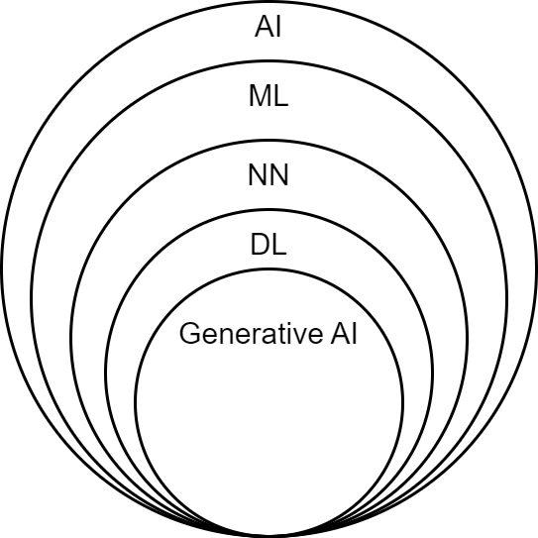
Generative AI in the modern context
Generative AI, often abbreviated as GenAI, encompasses sophisticated deep learning models. These models possess the unique capability to generate new data, spanning text, images, or other media, by leveraging learned patterns from the data on which they were trained. This transformative technology finds applications in diverse fields such as text, image, and code generation. GenAI produces human-like outputs by discerning intricate patterns within extensive datasets. Notable examples include image generators like Midjourney or Stable Diffusion, as well as large language models such as GPT-4, PaLM, or Claude, and code generation tools like Copilot.
For the actual case we will delve in the image generation.

Slide 5
Taking a look at each AI subfield
3. Deep Learning / Neural Network Models
1. Artificial Intelligence (AI)
The overarching field of AI encompasses a wide range of techniques and technologies designed to mimic human intelligence.
Deep Learning involves training artificial neural networks with multiple layers to perform complex tasks, achieving high-level abstractions from data.
2. Machine Learning (ML)
ML involves algorithms and models that enable computers to learn patterns from data and make predictions or decisions without explicit programming.
4. Generative AI (Text, Image, Code Gen.)
Generative AI involves models capable of creating new content, whether it's text, images, or code, by learning patterns from large datasets.
Give life to innovative applications such as text generation, image synthesis, and even code creation.

Slide 6
Large Language Models (LLMs)
They represent a subset of generative AI engineered specifically for comprehending and generating human language. These models, constructed on the foundation of deep neural networks, undergo training on vast datasets to grasp the nuances of language and generate contextually relevant content.
LLMs excel in tasks like text generation, translation, and code completion.
Prominent examples include GPT-4, PaLM, Claude 3, Gemini (BARD) and they serve as invaluable tools
for transforming prompts into coherent and human-like language outputs.

Slide 7
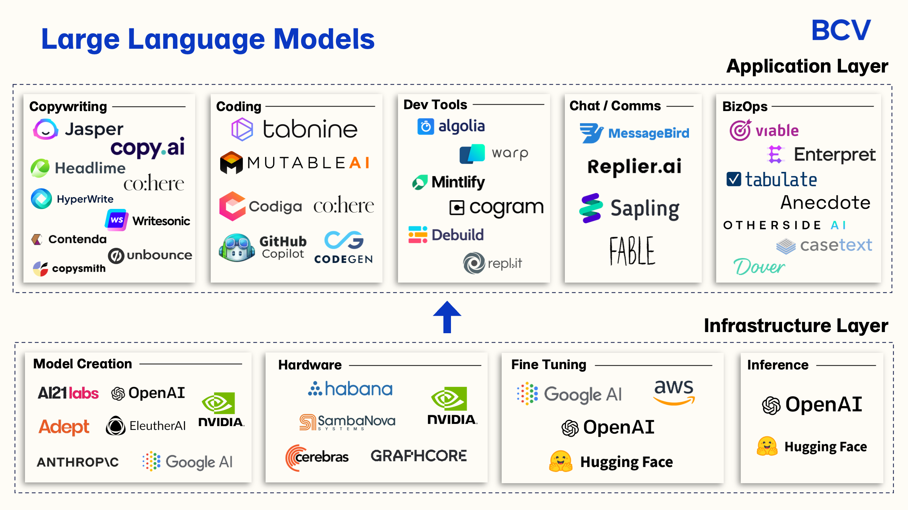

Slide 8
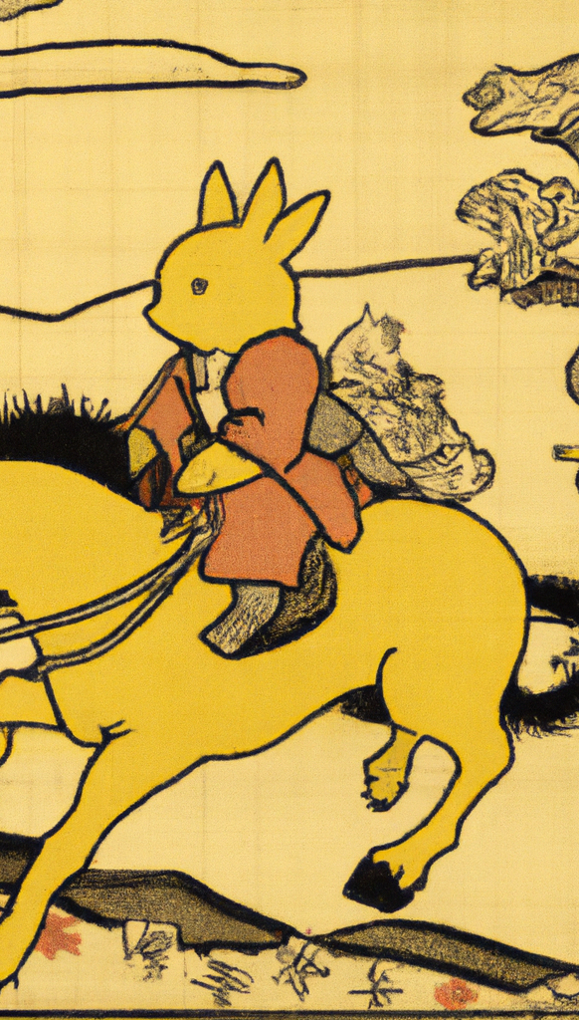
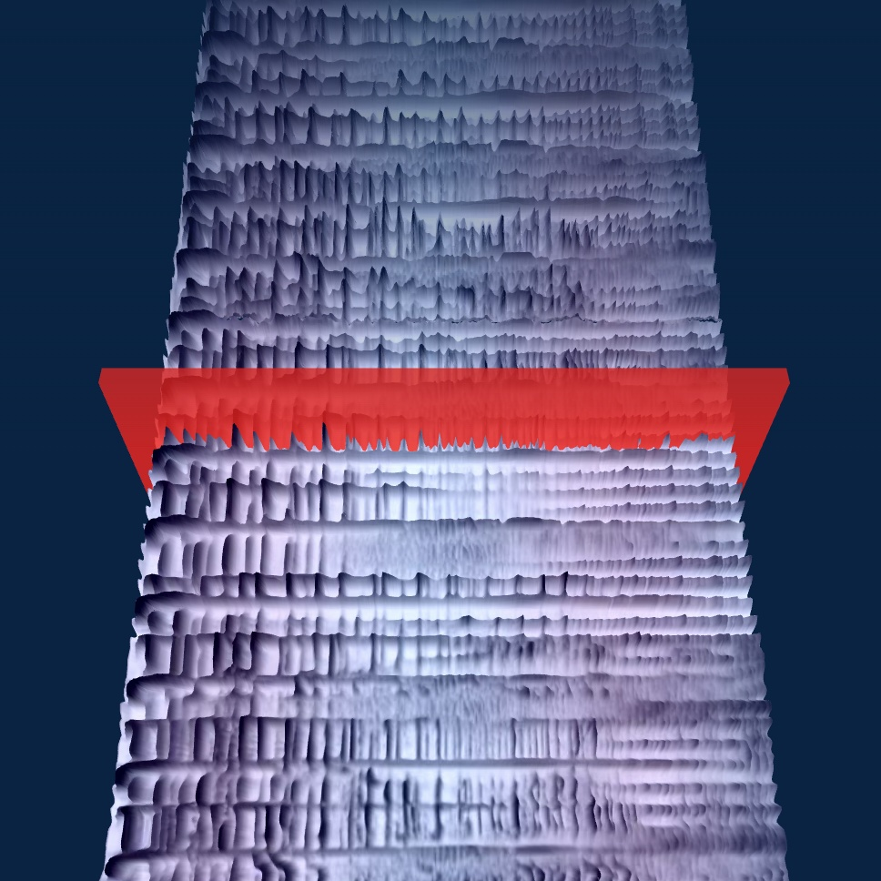
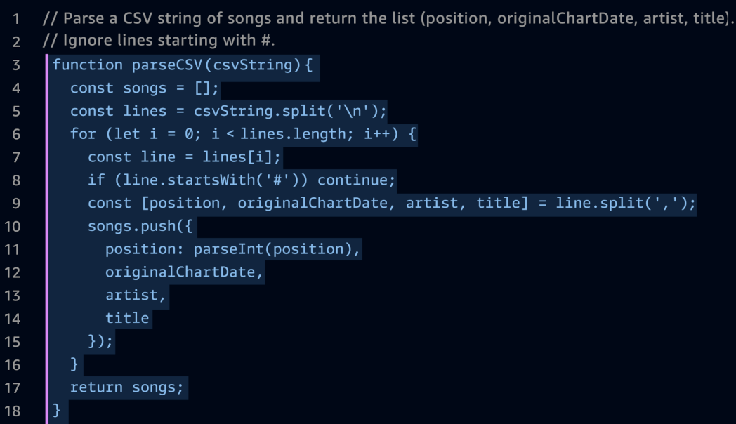
Types of Generative AI
02
Taking a look at some in-use types

Slide 9
Considering More types of Generative Models
Generative Code
This type of AI can automatically create new source code. It analyzes existing code patterns and functionalities to generate code for similar tasks or even entirely new programs. Imagine giving the AI a description of a desired program's function, and it writes the code itself! This holds immense potential for streamlining software development and automating repetitive coding tasks.
Generative Song
Get ready to unleash your inner musician with generative song AI! These models are trained on vast datasets of music, allowing them to compose new pieces in various styles. You can provide a starting point like a melody or genre, and the AI will craft a complete song based on that. This can be a game-changer for music production, inspiring new creations and aiding composers in overcoming writer's block.
Generative Text
This is a well-established area of generative AI. Text generation models, like me, are trained on massive amounts of text data. We can generate different creative text formats, like poems, code, scripts, musical pieces (lyrics), email, letters, etc., depending on the input and training data. This can be useful for writers experiencing creative roadblocks or for generating content ideas and marketing copy.

Slide 10
The field of Image Generation Models
Generative Adversarial Networks (GANs):
GANs consist of two neural networks, the generator and the discriminator, that compete against each other in a game-like setup. The generator generates synthetic data (e.g., images, text, sound) from random noise, while the discriminator’s task is to distinguish between real and fake data.
Variational Autoencoders (VAEs):
VAEs are generative models that learn to encode data into a latent space and then decode it back to reconstruct the original data. They learn probabilistic representations of the input data, allowing them to generate new samples from the learned distribution. VAEs are commonly used in image generation tasks and have also been applied to text and audio generation.
Autoregressive Models:
Autoregressive models generate data one element at a time, conditioning the generation of each element on previously generated elements. Popular examples of autoregressive models include language models like GPT (Generative Pre-trained Transformer), which can generate coherent and contextually appropriate text.

Slide 11
Recurrent Neural Networks (RNNs):
RNNs are a type of neural network that processes sequential data, such as natural language sentences or time-series data. However, RNNs are limited in generating long sequences due to the vanishing gradient problem. More advanced variants of RNNs, such as Long Short-Term Memory (LSTM) and Gated Recurrent Unit (GRU), have been developed to address this limitation.
Transformer-based Models:
Transformers, like the GPT series, have gained significant popularity in natural language processing and generative tasks. They use attention mechanisms to model the relationships between different elements in a sequence effectively.
Reinforcement Learning for Generative Tasks:
Reinforcement learning can also be applied to generative tasks. In this setup, an agent learns to generate data by interacting with an environment and receiving rewards or feedback based on the quality of the generated samples.

Slide 12
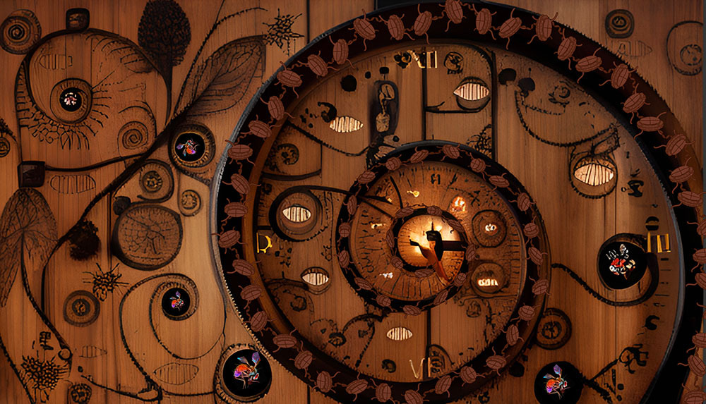
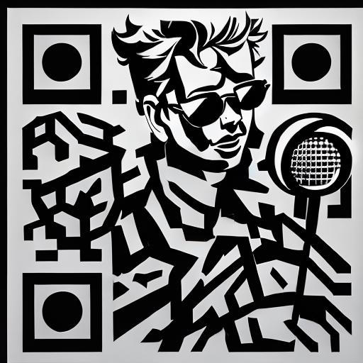
03
Use Cases Of GEN AI

Slide 13
Current Uses Cases
Text Generation
Image/Video Generation
Code Generation
Virtual Assistant
Anomaly Detection in Data
Speech Synthesis
Audio Generation
Language Translation
Video Game Content Generation
* Considering Current Technological & Hardware Limitations these use cases may not be ideal and may not offer optimal solutions

Slide 14
Stable Diffusion

Slide 15
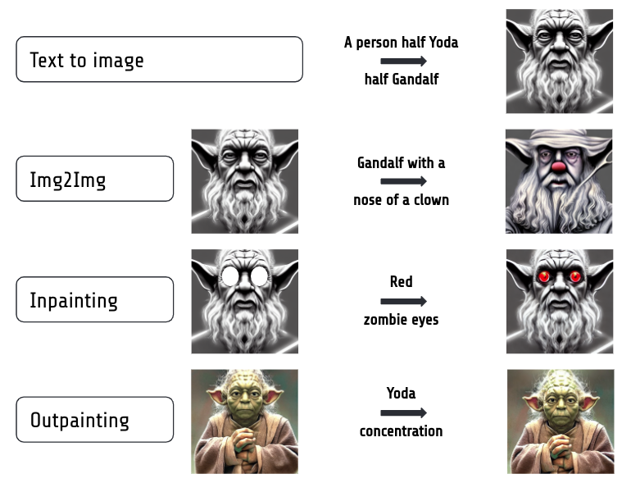
Main use of Stable Diffusion
Text-to-Image: Generate images by entering a text prompt; SD produces a corresponding image.
Image-to-Image Modification: Refine images by providing an image and a prompt; SD adjusts the image accordingly.
Inpainting: Modify specific parts of an image using a binary mask; provide the image, mask, and prompt for targeted changes.
Outpainting: Expand images at the border; provide the image, direction of extension, and a prompt. Ideal after generating an image with stable diffusion for best results in repairing cut-off elements.

Slide 16
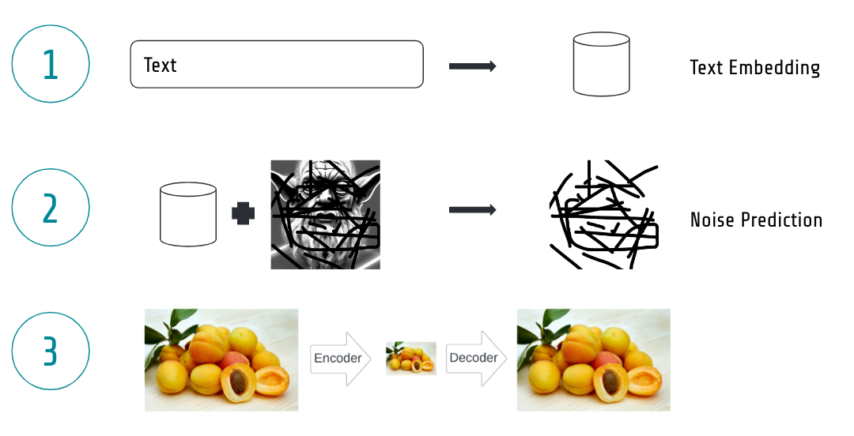
The way it works
Text Embedding Model: Generates embeddings for text inputs.
Denoising Model: Predicts image noise, enhancing image quality.
Variational Autoencoder (VAE): Accelerates processes for efficient performance.
The text embedding model transforms a given text prompt into a machine digestible representation, a so-called embedding.
The denoising model is at the core of the diffusion process. So you ask what is a diffusion process? During training we take an image and add noise to it in many steps.
VAE is likely seen a compression and decompression algorithm which can encode images very efficiently in much less information to speed up the process massively so you can have a faster generation.
All it does is to move the whole image representation to a so-called latent space. The latent space is simply much smaller, so the whole denoising process becomes much faster.

Slide 17
Diffusion Process
Diffusion models operate by gradually introducing Gaussian noise to an initial image x₀ over a series of T steps, a process referred to as the forward process. It's important to note that this differs from the forward pass of a neural network and is essential for generating target images used in training.
Subsequently, a neural network is trained to reverse this noise addition process, aiming to reconstruct the original data. This capability to model the reverse diffusion process enables the generation of new data, known as the reverse diffusion process or the sampling process of a generative model.

Slide 18
Forward Diffusion
Diffusion models, resembling variational autoencoders (VAEs), operate within a hidden continuous feature space, termed latent variables. These models are structured as a Markov chain of T steps, where each step is influenced solely by the previous one—a basic assumption. Unlike flow-based models, there's no restriction on the type of neural network employed.
Starting with a data-point x₀ drawn from the real data distribution q(x) ( x₀ ~ q(x)), a forward diffusion process is defined by iteratively adding Gaussian noise. At each step, Gaussian noise with variance β_{t} is added to the previous latent variable x_{t-1}, yielding a new latent variable x_{t} with distribution q(x_{t} | x_{t-1}). This process can be expressed succinctly as follows:
q(xt​∣xt−1​)=N (xt​; μt​=1−βt​​xt−1​,Σt​=βt​I)
Forward diffusion process. Image modified by Ho et al. 2020

Slide 19
In the multidimensional scenario, I denotes the identity matrix, indicating that each dimension shares the same standard deviation β_{t} . Note that q(x_{t} | x_{t-1}). remains a normal distribution, defined by the mean μ and the variance Σ, where μ _{t} = (1 - β_{t})x_{t-1} and Σ_{t} = β_{t}I. The covariance matrix Σ is always a diagonal matrix of variances (here β_{t} )
The variance parameter β_{t} can be set to a constant value or chosen according to a predefined schedule over the T timesteps. This schedule can take various forms such as linear, quadratic, cosine, etc.
For example, the original authors of DDPM utilized a linear schedule that increases from β₁ = 10⁻⁴ to β_{t} = 0.02.
However, Nichol et al. (2021) demonstrated that employing a cosine schedule yields even better results.
Latent samples from linear (top) and cosine (bottom) schedules respectively. Source: Nichol & Dhariwal 2021

Slide 20
Reversed Diffusion
As T → ∞ , the latent variable x_{T} approaches a nearly isotropic Gaussian distribution. Consequently, if we successfully learn the reverse distribution q(x_{t} | x_{t-1}), we can sample x_{T} from N(0, I), run the reverse process, and obtain a sample from the initial data distribution q(x₀), thereby generating a novel data point from the original data distribution.
The challenge lies in how we can effectively model the reverse diffusion process.
In practical terms, obtaining the exact form of q(x_{t} | x_{t-1}) is intractable because it involves computations with the data distribution, which are often not feasible.
To address this, we approximate q(x_{t} | x_{t-1}) with a parameterized model p_{θ} , such as a neural network. Since q(x_{t} | x_{t-1}) $ is also Gaussian, especially for small enough β_{t} we can choose p_{θ} to be Gaussian and parameterize its mean and variance:
p_{θ} (x_{t−1}​ ∣ x_{t} )=N(x_{t−1} ;μ_{θ} (x_{t}​, t),Σ_{θ}(x_{t}, t))
Reverse diffusion process. Image modified by Ho et al. 2020

Slide 21
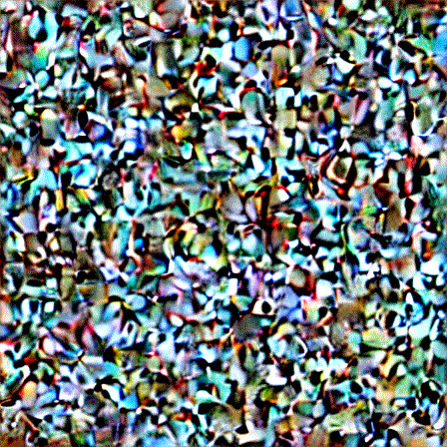

Slide 22
Midjourney

Slide 23
More about Midjounery
Midjourney is a leading example of generative AI capable of transforming natural language prompts into high-quality images. Alongside prominent counterparts like DALL-E and Stable Diffusion, Midjourney has gained significant recognition in the AI landscape.
Utilizing Midjourney, users can effortlessly create realistic images from simple text-based prompts directly within the Discord chat app, eliminating the need for specialized hardware or software. While some initial payment is required to access its features, the platform offers a low barrier to entry, enabling users to generate images swiftly and easily.
Despite the need for payment, Midjourney's user-friendly interface and rapid image generation capabilities cater to a broad audience, delivering results that range from intriguing to visually striking, depending on the input prompt.

Slide 24
More Info Regarding Closed Source
Midjourney operates on proprietary and closed-source code, keeping its inner workings undisclosed to external parties. Despite this, we can offer a general explanation based on known technology.
The system leverages two recent advancements in machine learning: large language models and diffusion models. Large language models, familiar to users of generative AI chatbots like ChatGPT, play a key role in understanding the semantics of user prompts. These prompts are then translated into vectors, numerical representations of the input. These vectors guide the diffusion process, a complex mechanism that transforms the input into high-quality images.

Slide 25
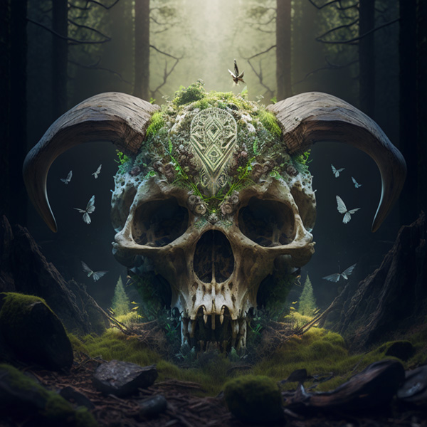
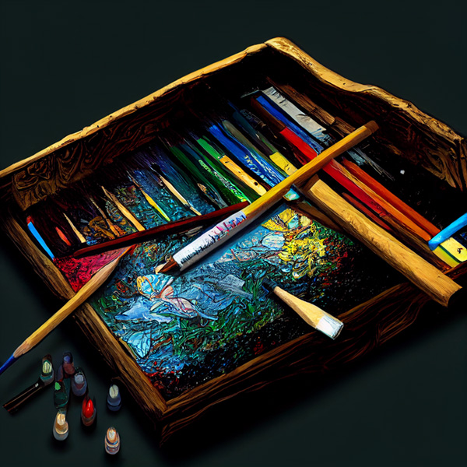
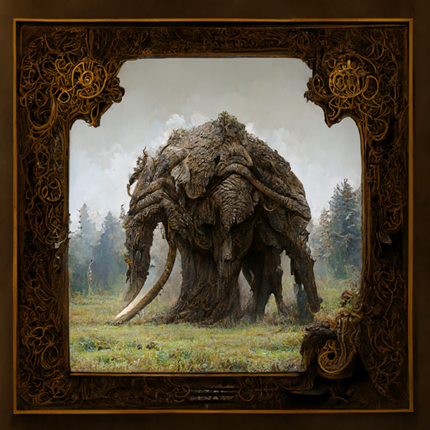
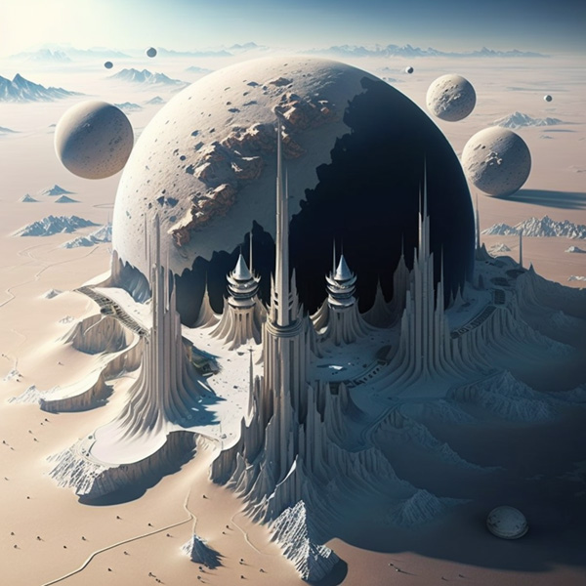
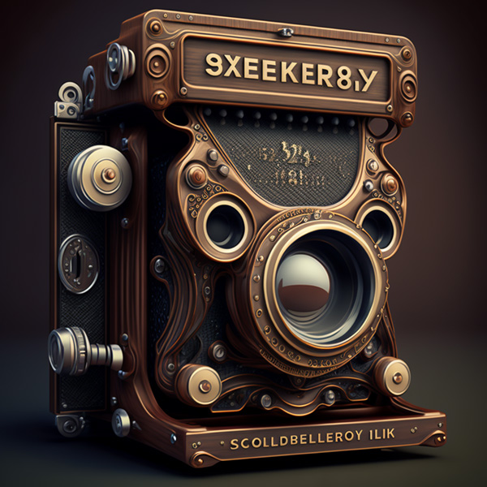
Midjourney prompts : double exposure of full portrait of a detailed skull & mushroom hybrid, mossy scales, dark environment, mushroom scales, forest god, bright eyes, sharp fangs and big horns finely detailed, surrounded by forest, cinematic lighting, 4k, 8k, unreal engine 5, octane render
Midjourney prompts : an artist desk full of drawings from the hobbit – colourful – paint spilled – brushes, pencils – high quality – 16k resolution
Midjourney prompts : giant armored mammoth, full body, two large tusk, four legs, large trunk, realistic, hyper detailed –q 2 –chaos 50
Midjourney prompts (V5) : Coast, decorative painting, horizon, modern, fashionable, full of abstract feeling, full of imagination, the picture reveals the sense of time passing, there is a feeling of the end of the world
Midjourney prompts : CCCXXVII on 329 on name plate of rolleiflex camera architecture with seikosha shutter style of Sandu Baciu, hyper realistic, film camera, cover magazine, award
Midjourney prompts (V4) : Alien planet, white planet, lots of alien skyscrapers, space waships on the sky, bird eye view

Slide 26
DALLE 2 & 3

Slide 27
What is DALLE Model
DALL-E stands for "A Discriminative Autoencoder for Language Entities".
Developed by OpenAI in 2020.
Pioneered the field of text-to-image generation using a vast dataset of text and image pairs.
Capable of generating realistic and creative images based on user prompts. DALL-E 2 marked a significant breakthrough in the realm of artificial intelligence.
This model, introduced in 2020 by OpenAI, employed a technique called a "discriminative autoencoder" to analyze massive amounts of text and image pairings. This training enabled DALL-E 2 to translate written descriptions into corresponding visual outputs, paving the way for a new era of creative exploration through AI.

Slide 28
Limits & Capabilities
Limits
Prone to generating repetitive content, especially with simple prompts.
Difficulty understanding complex relationships between objects and scenes.
Biases present in the training data can be reflected in the generated images.
While DALL-E 2's capabilities are impressive, it is not without limitations. When presented with basic prompts, the model might generate repetitive outputs. Additionally, DALL-E 2 can struggle to grasp intricate relationships within a scene.
It's crucial to remember that the model is trained on vast datasets, and any biases inherent in that data can be reflected in the generated images.
Capabilities
Generate images in various artistic styles (painting, sketch, photorealistic, etc.)
Create images based on complex concepts and scenarios.
Able to incorporate specific details into the generated images. DALL-E 2's prowess lies in its versatility. Users can provide descriptions encompassing diverse artistic styles, from the brushstrokes of Van Gogh to the blocky charm of pixel art.
The model can also translate intricate concepts and situations into corresponding visuals, making it a valuable tool for designers, writers, and anyone seeking to bring their ideas to life visually.
DALL-E 3 provides greater control and specificity alongside improved understanding of concepts by implementing and building an image captioner.

Slide 29
How DALLE works – Short View
To establish a foundational understanding, this paper will provide a high-level overview of DALL-E 2's image generation capabilities. While DALL-E 2 possesses a versatile feature set encompassing image editing and interpolation, the present discussion will concentrate on its core functionality: image creation from text descriptions.
Text Encoding: The process commences with a textual prompt fed into a pre-trained text encoder. This encoder functions by transforming the prompt into a high-dimensional vector representation within a designated embedding space.
Semantic Mapping: Following the text encoding stage, a module known as the "prior" intervenes. This component bridges the gap between the textual embedding and the visual domain.
Image Decoding: Finally, an image decoder takes center stage. It leverages the image embedding produced by the "prior" module. Employing a stochastic (randomized) approach, the decoder progressively refines a random noise distribution, transforming it into a coherent image that visually embodies the semantic information gleaned from the original text prompt.

Slide 30
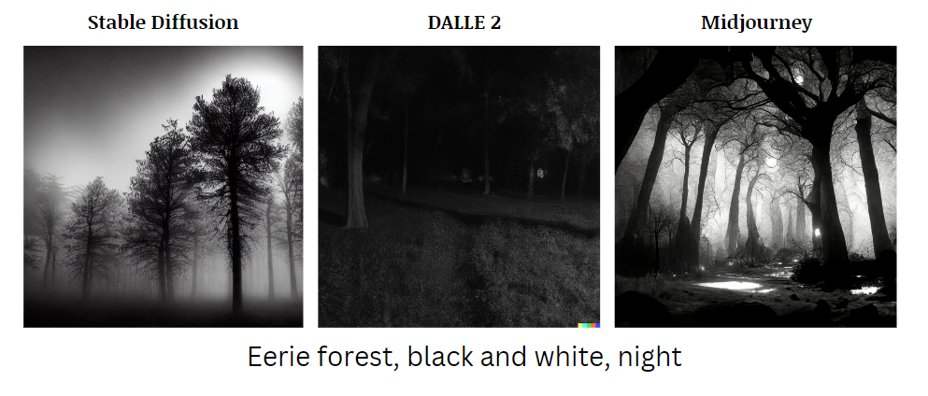
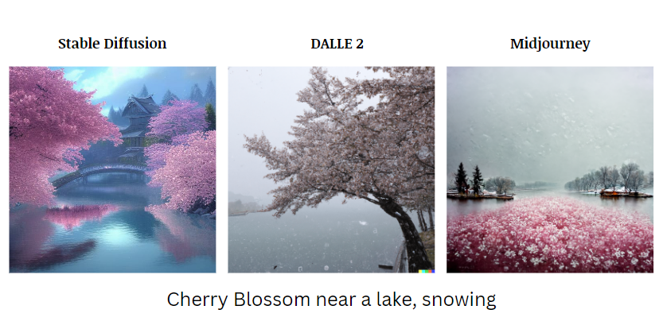
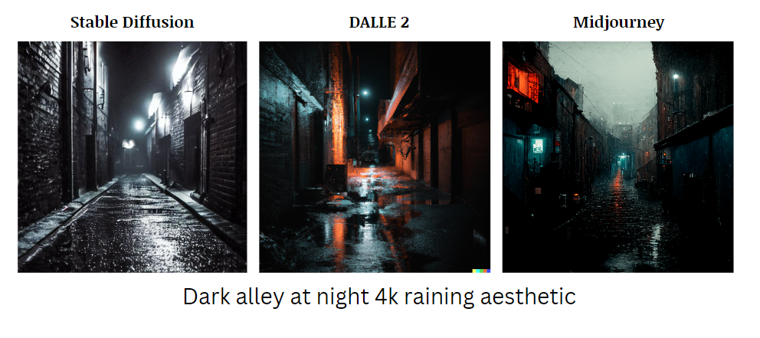
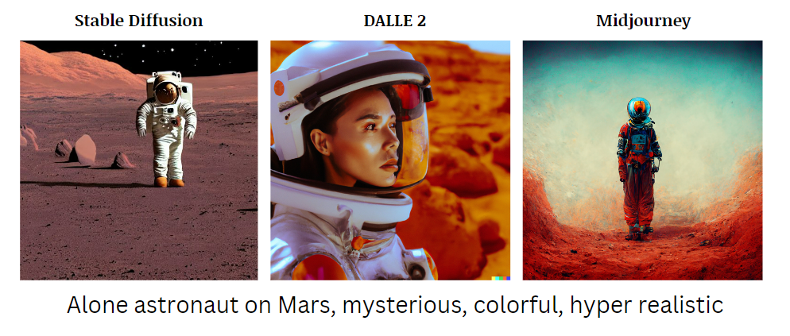
Comparing Results On Prompts

Slide 31
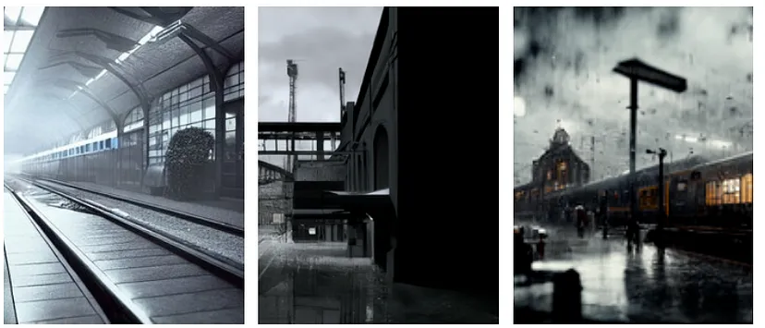
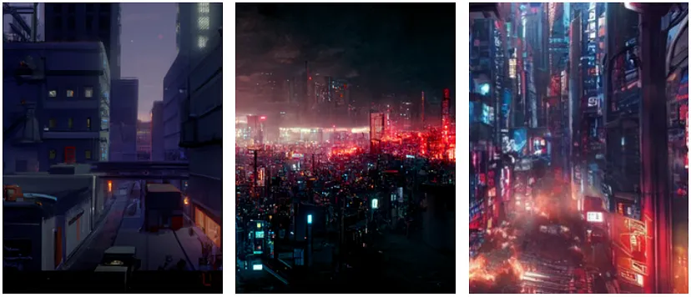
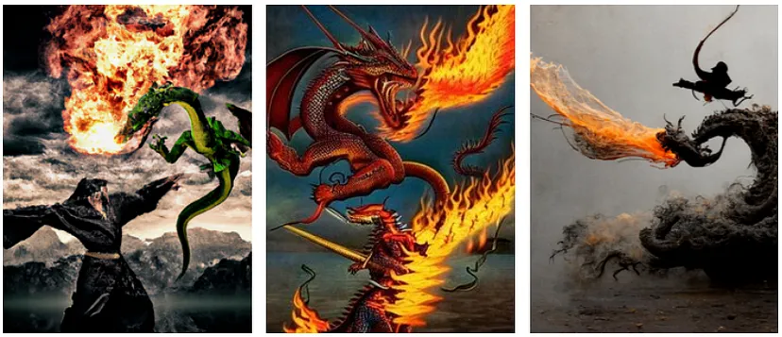
Rainy train station, noir style, 3dsmax + vray render, extremly detailed, ultra realistic, unreal engine 5
Epic style of katsuhiro otomo, wide view, filmed in amazing cinematic light, epic cyberpunk night background, 8k, high resolution, ultrarealistic, photorealistic, intricate, insanely detailed, octane render, unreal engine 5
Epic style of katsuhiro otomo, wide view, filmed in amazing cinematic light, epic cyberpunk night background, 8k, high resolution, ultrarealistic, photorealistic, intricate, insanely detailed, octane render, unreal engine 5

Slide 32
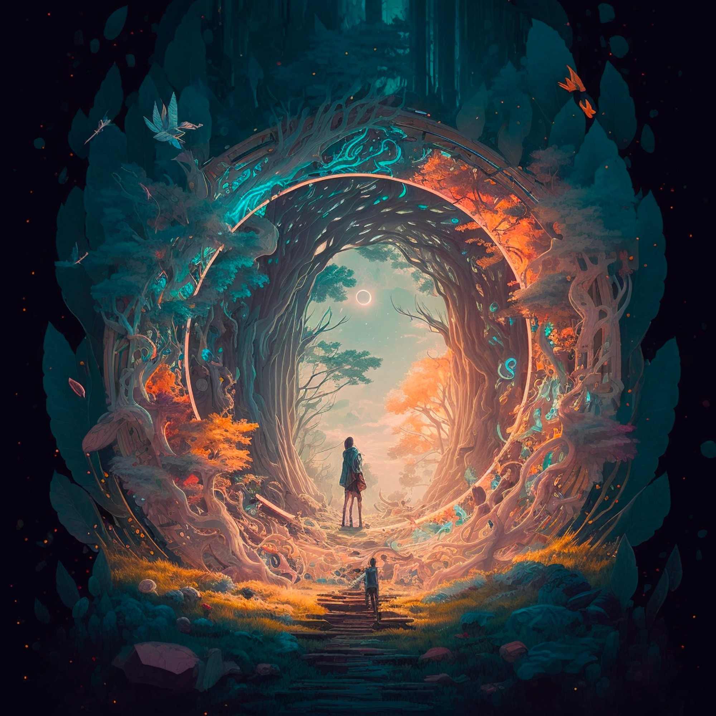
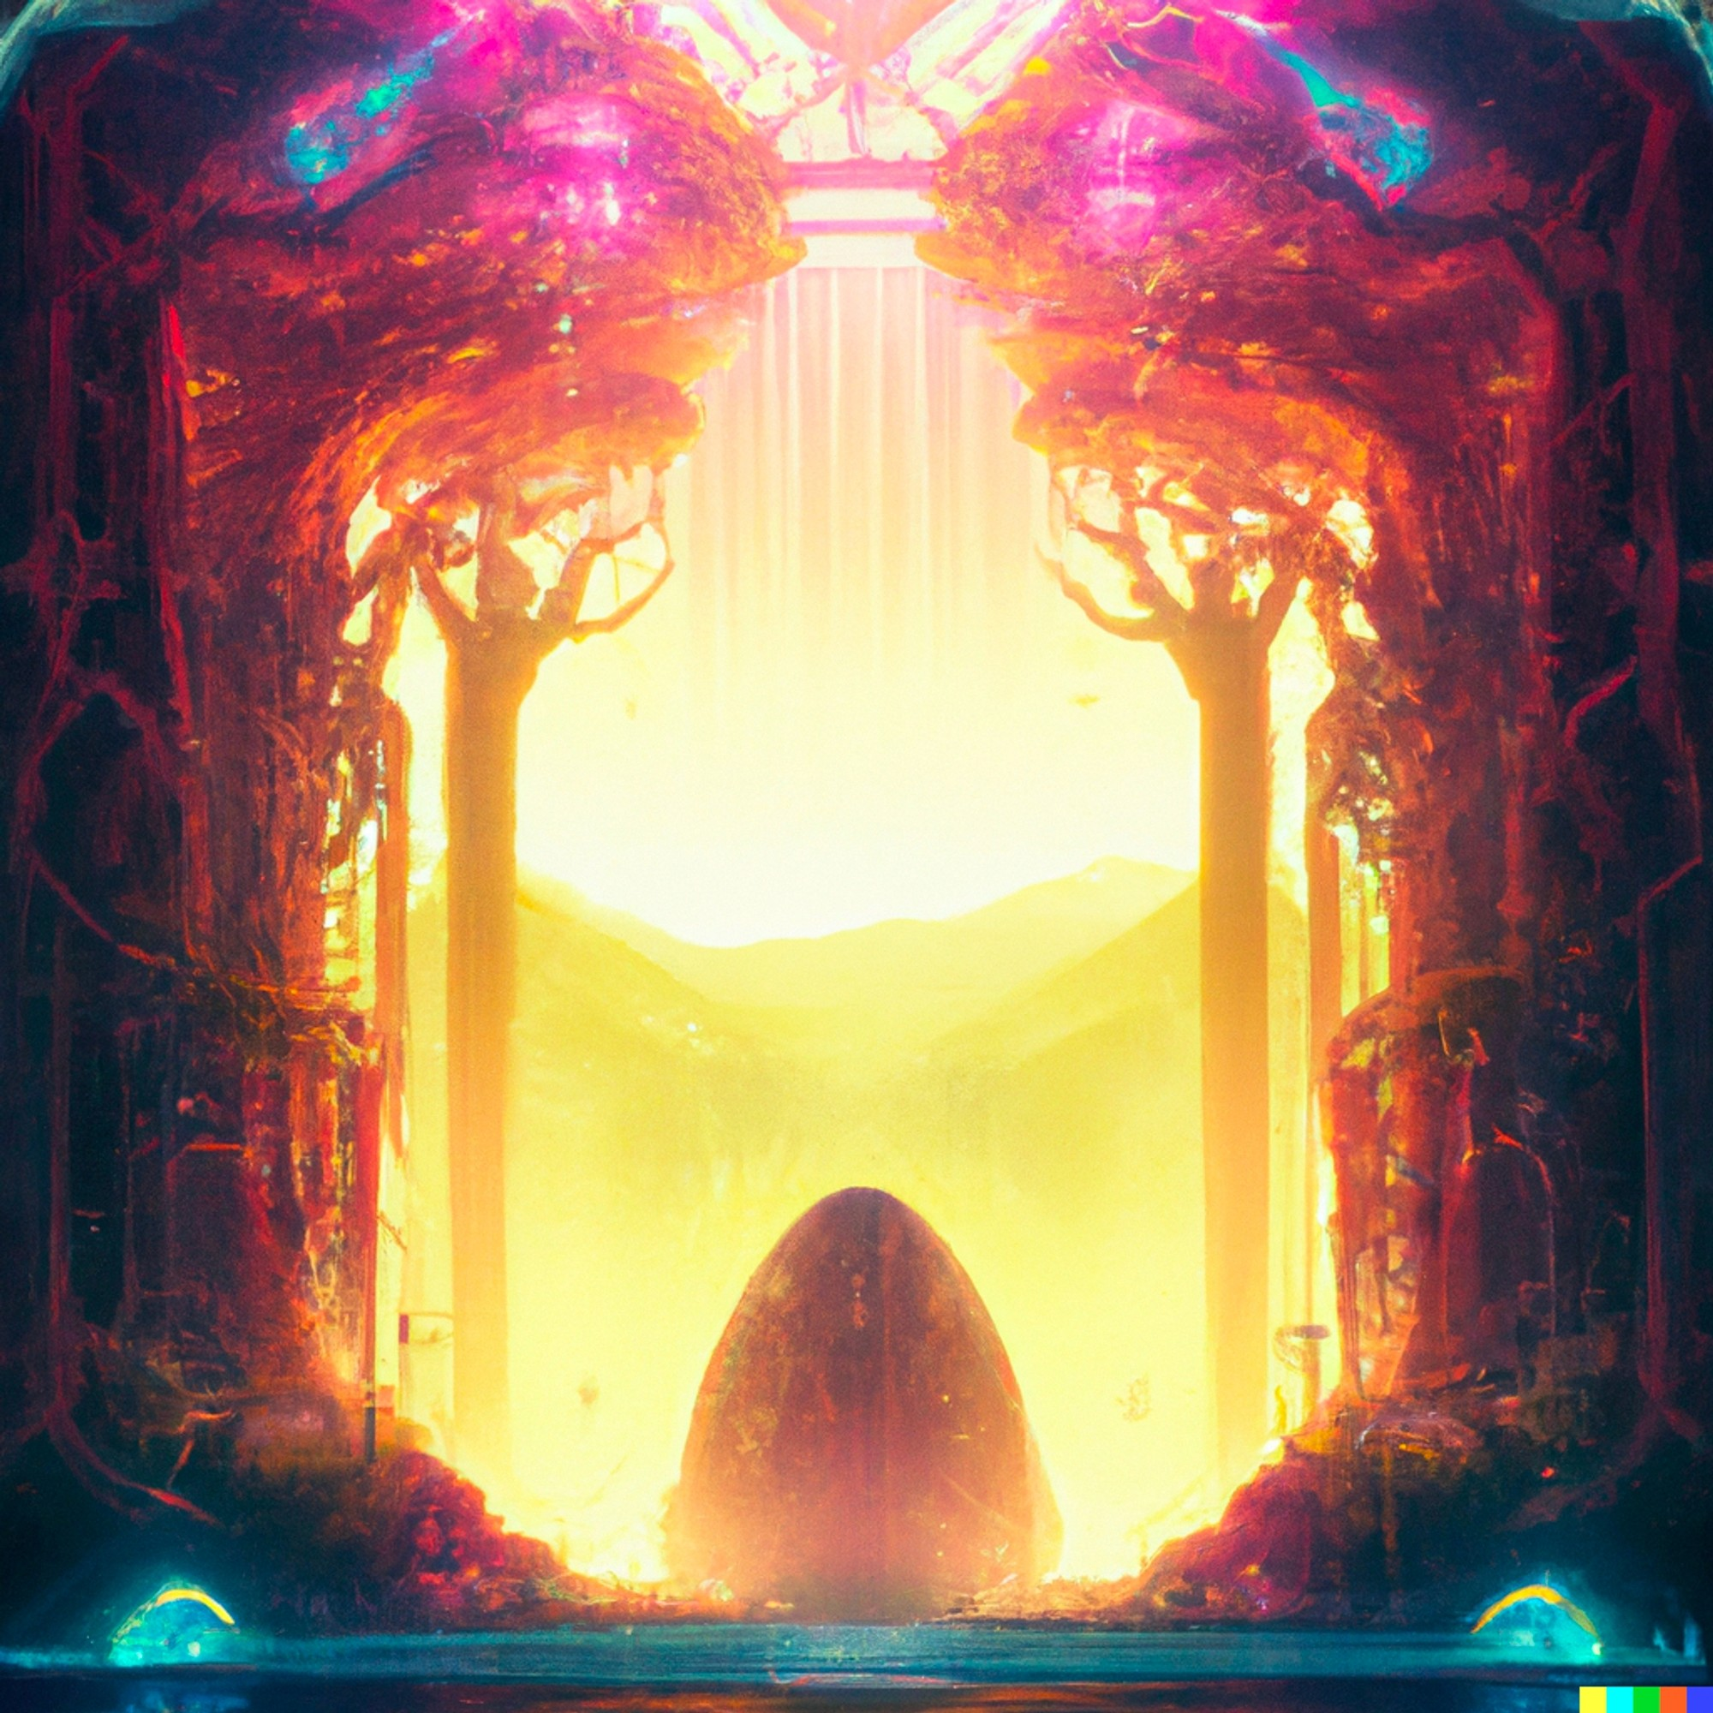
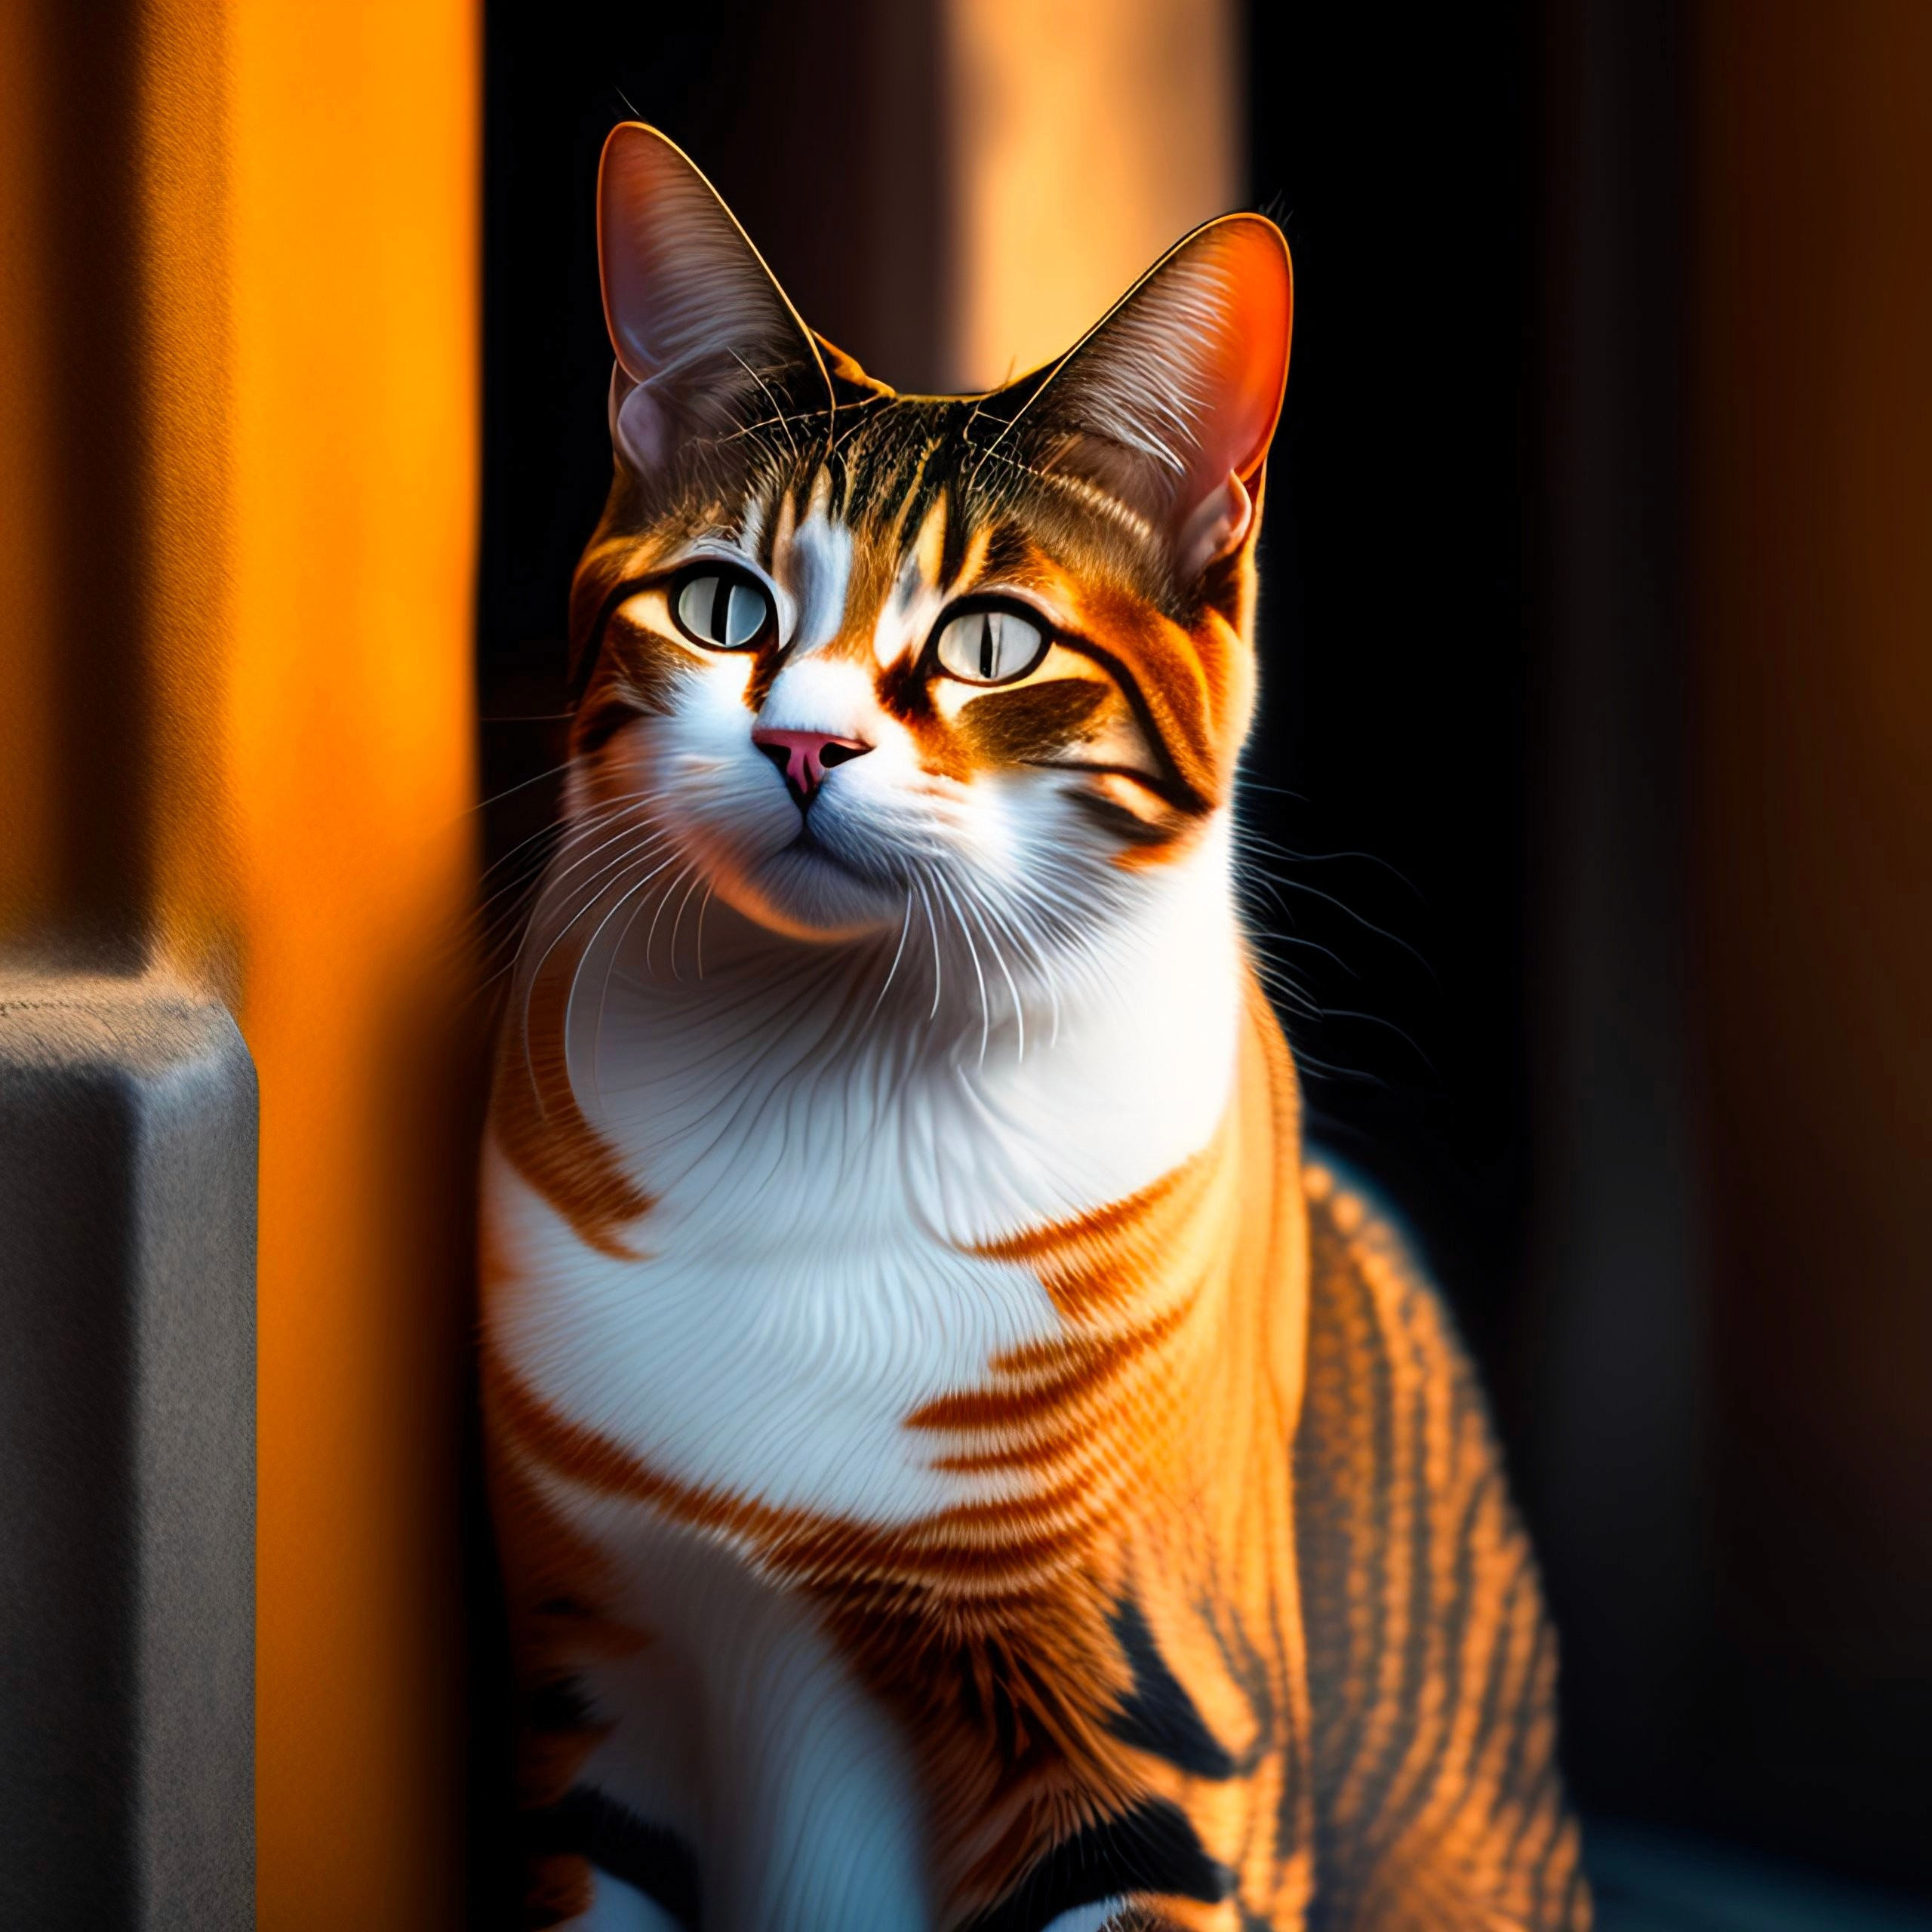
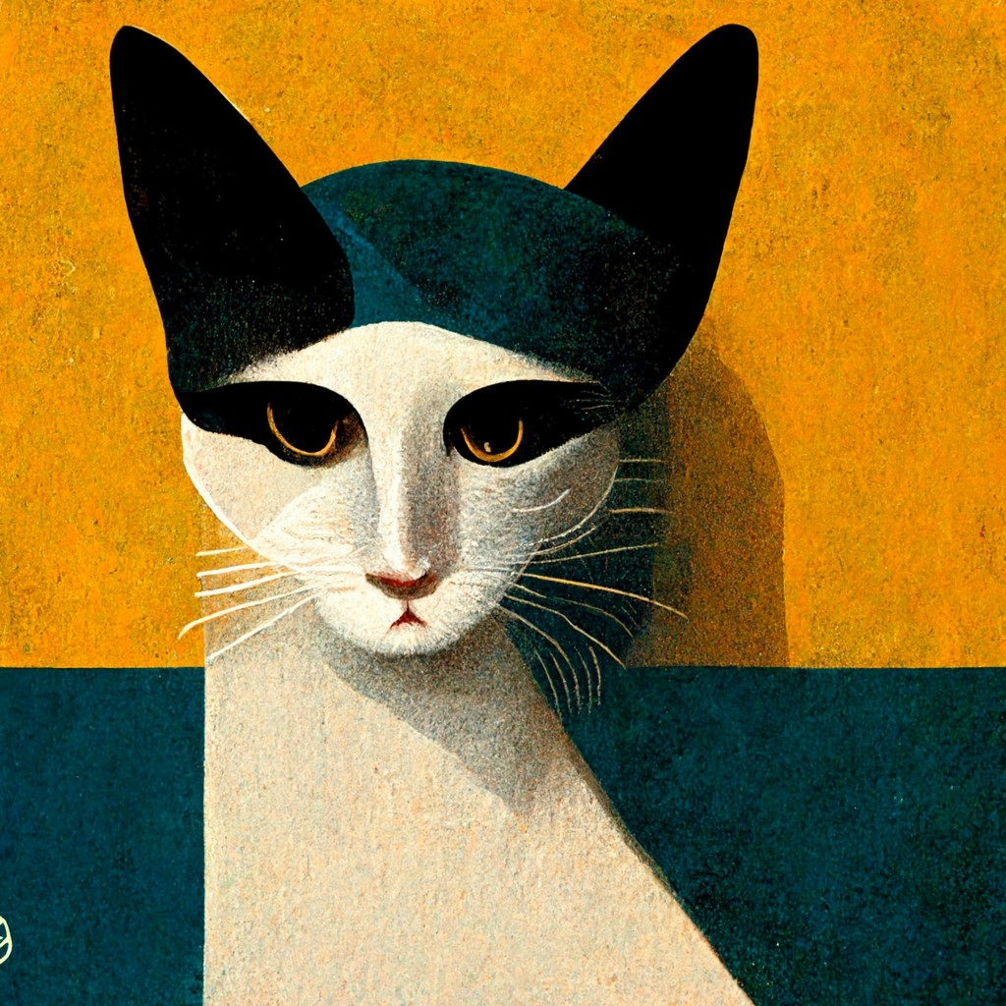
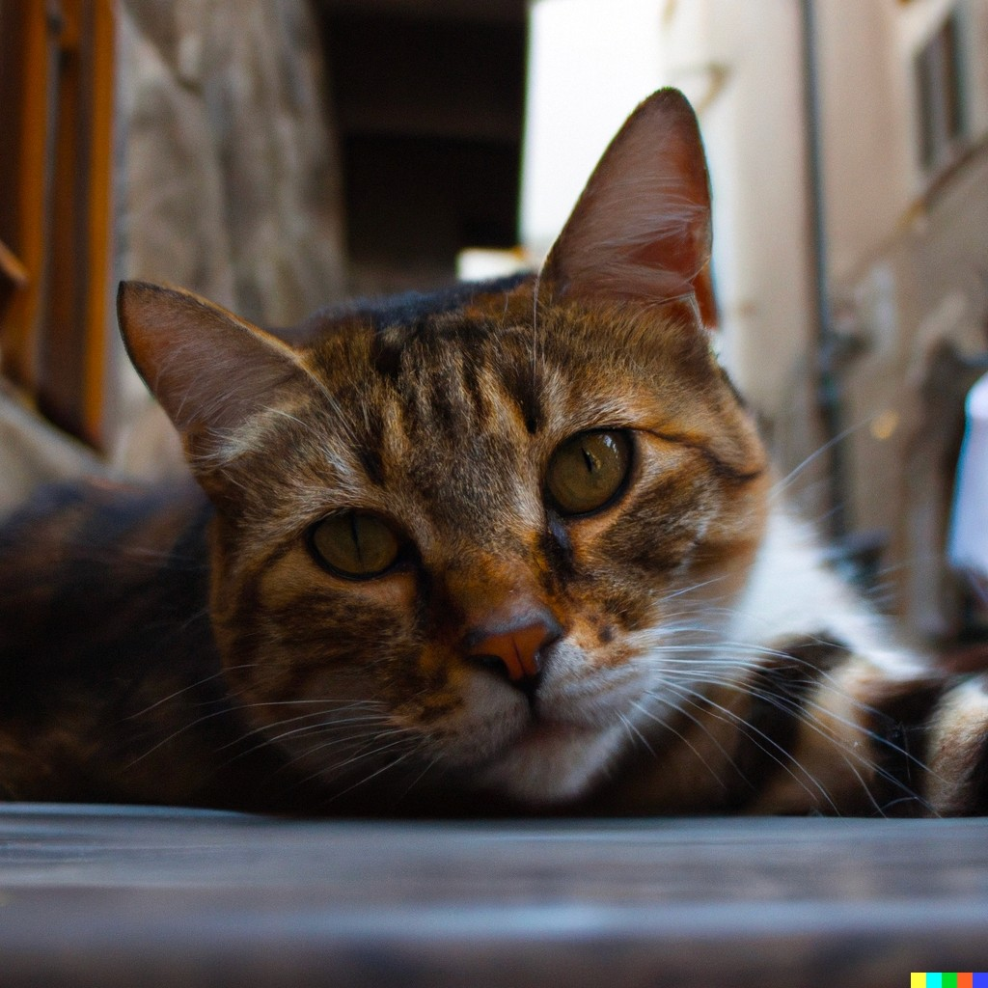
Other Prompts & Examples
Stable Diffusion
Midjourney
DALLE-2
Prompt: ethereal interdimensional portal in the forest by jean giraud + beeple + insanely detailed, illustrated by kentaro miura, poster, peter mohrbacher, pastel color, symmetrical
Stable Diffusion
Midjourney
DALLE-2
Prompt: a portrait of a cat in italy

Slide 33
Future Developments
Sora.AI – Open AI

Slide 34
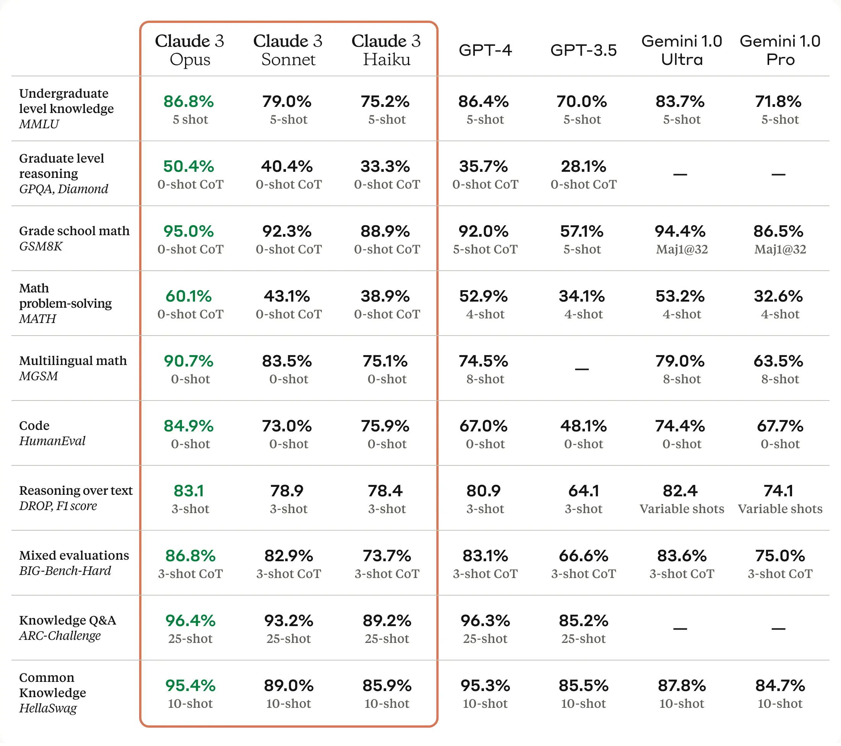
Claude 3
Comparison of the Claude 3 models to those of our peers on multiple benchmarks

Slide 35
Thank you for your time!
Do you have any questions?
georgian.chivu@ulbsibiu.ro

Slide 36
Bibliography
Main Resources:
[1] Don-Yehiya, Shachar; Choshen, Leshem; Abend, Omri. "Human Learning by Model Feedback: The Dynamics of Iterative Prompting with Midjourney." 2023.
[2] Oppenlaender, Jonas. "The Creativity of Text-to-Image Generation." 2022.
[3] Podell, Dustin; English, Zion; Lacey, Kyle; Blattmann, Andreas; Dockhorn, Tim; Müller, Jonas; Penna, Joe; Rombach, Robin. "SDXL: Improving Latent Diffusion Models for High-Resolution Image Synthesis." 2023.
[4] Rombach, Robin; Blattmann, Andreas; Lorenz, Dominik; Esser, Patrick; Ommer, Björn. "High-Resolution Image Synthesis with Latent Diffusion Models." 2021.

Slide 37
Other Resources
Websites, articles and media resources used:
https://anjanasamindraperera.medium.com/dall-e-2-vs-midjourney-vs-stable-diffusion-8eb9eb7d20be
https://www.assemblyai.com/blog/how-dall-e-2-actually-works/
https://www.androidauthority.com/what-is-midjourney-3324590/
https://theaisummer.com/diffusion-models/
https://www.marktechpost.com/2022/11/14/how-do-dall%C2%B7e-2-stable-diffusion-and-midjourney-work/
https://www.blueshadow.art/midjourney-prompt-commands/
https://buildspace.so/notes/stable-diffusion-vs-midjourney-vs-dalle-2
https://www.anthropic.com/news/claude-3-family
https://stablediffusionweb.com/
https://openai.com/dall-e-2

