Slide 1
On matrix representations of operators that are isometric with respect to generalized covariances
Denisa Nicoleta Cunțan
Laurian Suciu
,,Lucian Blaga” University of Sibiu
First Annual FORTHEM conference
FORTHEM – For the Future
March 6-8, 2024

Slide 2
First Annual FORTHEM conference
FORTHEM – For the Future
March 6-8, 2024

Slide 3
First Annual FORTHEM conference
FORTHEM – For the Future
March 6-8, 2024

Slide 4
First Annual FORTHEM conference
FORTHEM – For the Future
March 6-8, 2024

Slide 5
First Annual FORTHEM conference
FORTHEM – For the Future
March 6-8, 2024

Slide 6
First Annual FORTHEM conference
FORTHEM – For the Future
March 6-8, 2024

Slide 7
First Annual FORTHEM conference
FORTHEM – For the Future
March 6-8, 2024

Slide 8
First Annual FORTHEM conference
FORTHEM – For the Future
March 6-8, 2024

Slide 9
First Annual FORTHEM conference
FORTHEM – For the Future
March 6-8, 2024

Slide 10
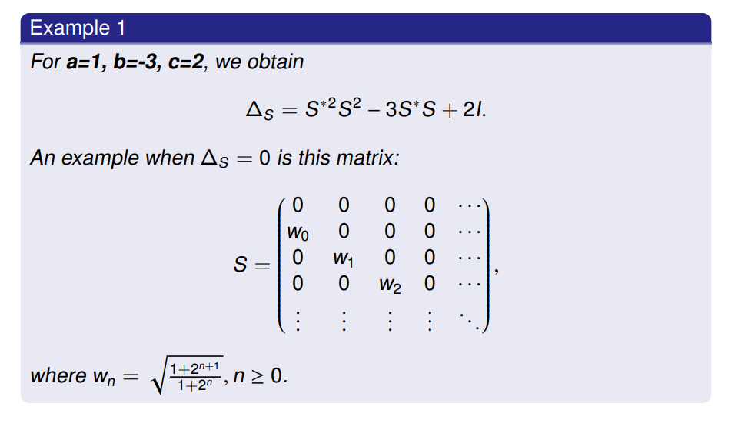
First Annual FORTHEM conference
FORTHEM – For the Future
March 6-8, 2024

Slide 11
First Annual FORTHEM conference
FORTHEM – For the Future
March 6-8, 2024

Slide 12
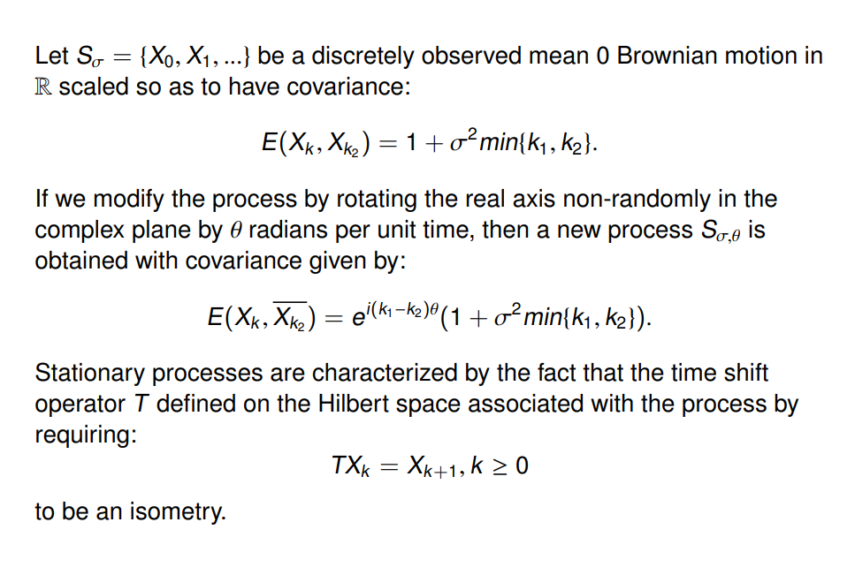
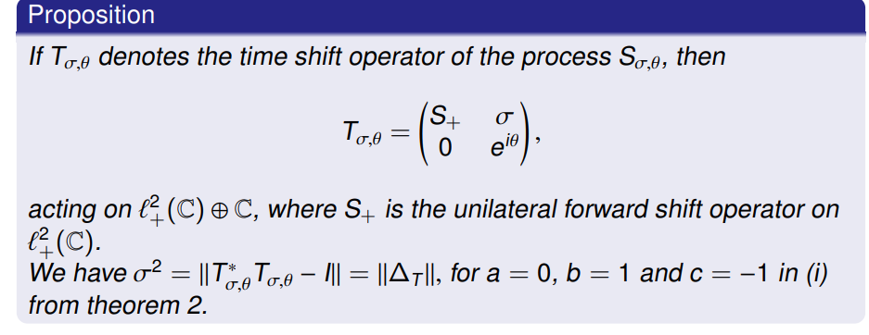
First Annual FORTHEM conference
FORTHEM – For the Future
March 6-8, 2024

Slide 13
Bibliography
[1] J. Agler, M. Stankus, m-Isometric transformations of Hilbert space, I. Integr equ oper theory 21, 383-429( 1995 )
[2] C. Badea, L. Suciu, Hilbert space operators with two-isometric dilations, J. Operator Theory, THETA, 2021
[3] S.K. Berberian, Introduction to Hilbert space, Oxford University Press, Inc. , 1961
[4] J. Charles, M. Mbekhta, H. Queffélec, Analyse fonctionnelle et théorie des opérateurs. Rappels de cours et exercices corrigés, Dunod, 2010
[5] C. Foiaș, A. E. Frazho, The commutant lifting approach to interpolation problems, Birkhäuser, 1990
[6] I. Gohberg, S. Goldberg, M.A. Kaashoek, Basic Classes of Linear Operators, Birkhäuser, 2003
[7] C. S. Kubrusly, Hilbert space operators. A problem solving approach, Birkhäuser, 2003
[8] S. McCullough, B. Russo, The 3-Isometric Lifting Theorem Integr. Equ. Oper. Theory 84, 69-87 ( 2016 )
First Annual FORTHEM conference
FORTHEM – For the Future
March 6-8, 2024

Slide 14
Thank you!
First Annual FORTHEM conference
FORTHEM – For the Future
March 6-8, 2024

