Slide 1


Influence of Personality Traits on Sustainable Tourism Consumer Behaviour
Presenter: Constantina-Alina Ilie (Milos),
Supervised by Lect. Dr. Mariana-Floricica Călin
Ovidius University of Constanta, Romania
First Annual FORTHEM conference
FORTHEM – For the Future
March 6-8, 2024

Slide 2
THEORETICAL FRAMEWORK OF THE PROBLEM
Sustainable consumption behaviour conceptualized as:
... "the pursuit of environmentally sound products and services, preference for corporations and organizations actively involved in environmental conservation, use of materials and equipment until end of life, saving resources such as water and energy, reuse of resources wherever possible" ... "the appropriate destination of materials for recycling and the inclination towards a lifestyle with less negative impact on the environment"...
(Ribeiro, Veiga & Higuchi, 2016, p. 310).
First Annual FORTHEM conference
FORTHEM – For the Future
March 6-8, 2024

Slide 3
Aim
The research aims to study the personality traits that influence consumers’ buying behaviour to sustainable tourism in a sample of Romanian citizens.
The objectives of this research consisted of identifying the influence of personality traits according to demographical variables on the purchasing behaviour of sustainable tourism products.
First Annual FORTHEM conference
FORTHEM – For the Future
March 6-8, 2024

Slide 4

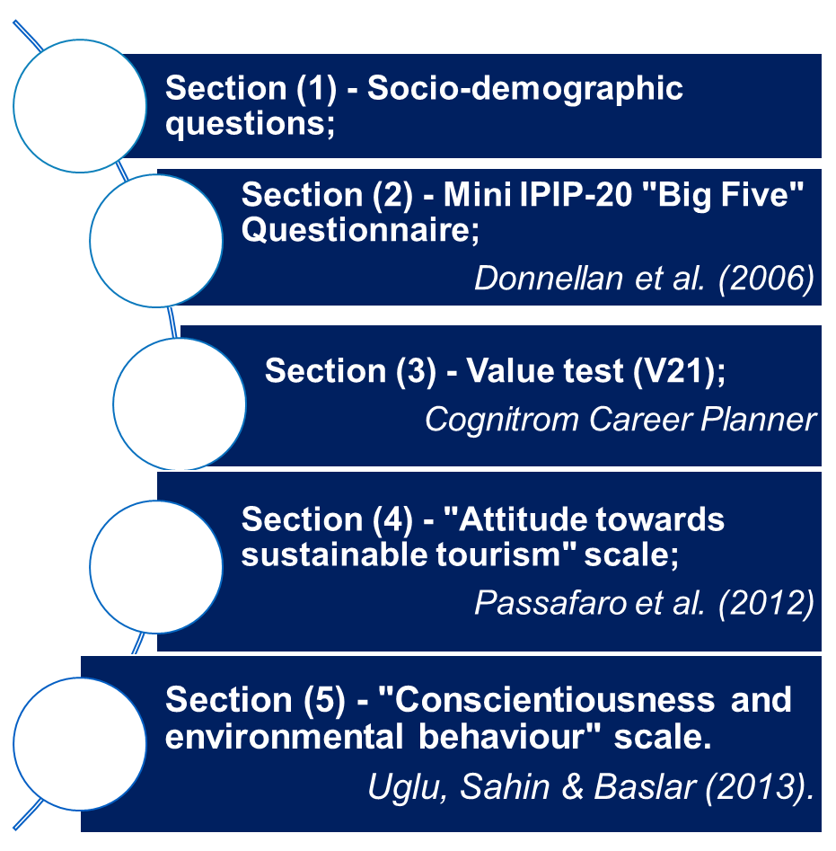
Methods and sample
I applied a Questionnaire.
The instrument applied was structured in 5 sections – applied in electronic format.
Statistical analysis by SPSS 26.
95 responses were collected from a convenience sample – of the Romanian population - with residences in Constanta and Tulcea counties.
First Annual FORTHEM conference
FORTHEM – For the Future
March 6-8, 2024

Slide 5

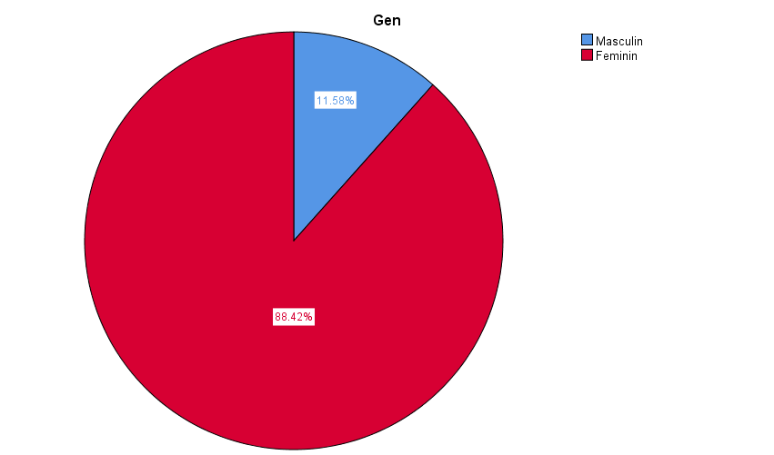
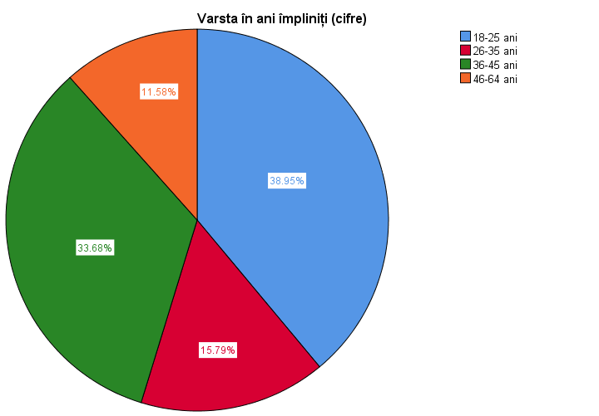

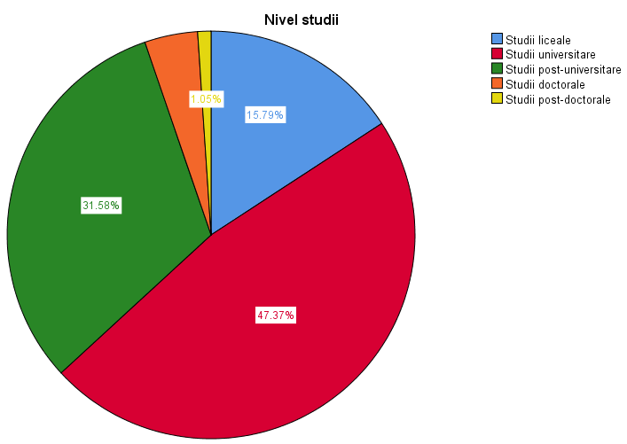
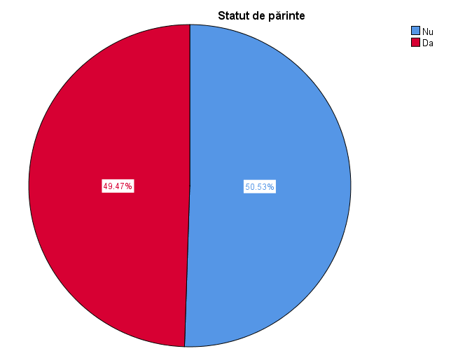
Sample structure
95 respondent
38%
18-25 years
33%
36-45 years
88% F
84% al least university studies
49% parents
First Annual FORTHEM conference
FORTHEM – For the Future
March 6-8, 2024

Slide 6

I₁ - It is assumed that there are correlations between personality factors measured on the Big Five scale and Positive Attitude towards Sustainable Tourism, with the following secondary hypotheses:
I_{1S1} - it is assumed that there is a correlation between the level of extraversion and a "Positive attitude towards sustainable tourism".
I_{1S2} - it is assumed that there is a correlation between the level of conscientiousness and the a "Positive attitude towards sustainable tourism".
I_{1S3} - it is assumed that there is a correlation between the level of agreeableness and a "Positive attitude towards sustainable tourism".
I_{1S4} - it is presumed that there is a correlation between the level of neuroticism and a "Positive attitude towards sustainable tourism".
I_{1S5} - it is assumed that there is a correlation between the level of openness to experiences and a "Positive attitude towards sustainable tourism".
Hypothesis 1
First Annual FORTHEM conference
FORTHEM – For the Future
March 6-8, 2024

Slide 7
Results – statistical analysis
Positive Attitude towards Sustainable Tourism
H1.1→H1.5
Extraversion
Agreeableness
Confirmed
Conscientiousness
Neuroticism
Openness to experience
Positive Attitude towards Sustainable Tourism
First Annual FORTHEM conference
FORTHEM – For the Future
March 6-8, 2024
Notes:
- the existence of a correlation only between the level of extraversion, the level of conscientiousness and the level of openness to experience, respectively, as personality factors and "Positive attitude towards sustainable tourism" as a component of the general attitude towards sustainable tourism, an indicator that quantifies the extent to which the individual embraces the idea of sustainable consumption behaviour.
-Hypothesis number 1 is only partially confirmed on the sample analysed.
Explanation of results - mindset, sample structure and reporting on a single indicator to quantify attitude towards sustainability - "Positive attitude towards sustainable tourism".

Slide 8
Results – statistical analysis
Concerning the first hypothesis the results of the study revealed the existence of a correlation only between the level of extraversion, the level of conscientiousness and the level of openness to experience, as personality factors and a "Positive attitude towards sustainable tourism" as a component of the general attitude towards sustainable tourism, an indicator that quantifies the extent to which the individual embraces the idea of sustainable consumption behaviour.
-Hypothesis number 1 is only partially confirmed on the sample analysed.
H1
First Annual FORTHEM conference
FORTHEM – For the Future
March 6-8, 2024
Notes:
*A number of considerations could be presented in support of the correlation between extraversion and attitude towards sustainable tourism and sustainable tourism consumption behaviour.
Milfont and Sibley (2012) - dominant worldviews → pro-environmental behaviours.
Markowitz et al. (2012) - positive relationship extraversion → positive actions towards the environment.
Gharibah & Mahfod (2022) - positive effect of extraversion → intention to visit green hotels.
**A number of considerations could be presented in support of the correlation between awareness and attitude towards sustainable tourism and sustainable tourism consumption behaviour.
Kvasova (2015) - conscientiousness →linked to greater commitment to the environment.
Hirsh (2010) - conscientious individuals → more likely to support sustainable behaviours.
Al-Gharibah & Mahfod (2022) - the conscientious → more concerned with action and its outcome.
Verma et al. (2017) - Correlation of conscientiousness - intention to use the services of an eco-friendly accommodation.
Verma & Chandra (2018) - The positive effect of conscientiousness on the intention to visit a green hotel.
Sun et al. (2018) - The positive conscientiousness-consumption intention link for green accommodation services.

Slide 9
Results – statistical analysis
For the identification of extraverts - 81 out of 95 respondents!
I₂ - It is assumed that there are statistically significant differences in "Positive attitude towards sustainable tourism" among extraverts depending on the respondents' level of education.
H2
Application of the Kruskal-Wallis test
Positive Attitude towards Sustainable Tourism
The distribution of scores on the variable "Positive attitude towards sustainable tourism" according to the respondents' level of education does not show significant differences according to the respondents' level of education. Further research will be needed.
First Annual FORTHEM conference
FORTHEM – For the Future
March 6-8, 2024
Notes:
In the literature, the topic is represented from the perspective of environmental attitudes rather than sustainability.
Grodziéska-Jurczak et al. (2006) - one of the factors influencing adults' attitudes towards the environment was education.
De Silva & Pownall (2013) - education is a more important factor for sustainability than income levels.
Meyer (2015) - highlights studies that find an association between higher education levels and environmental concern.

Slide 10
Results – statistical analysis
For the identification of extraverts - 81 out of 95 respondents!
I₃ - It is assumed that there are statistically significant differences in "Positive attitude towards sustainable tourism" among extraverts depending on the parental status of the respondents.
H3
Positive Attitude towards Sustainable Tourism
The sig coefficient shows the absence of a statistically significant difference between the respondents with parental status and those without in terms of the mean value of the score obtained for "Positive attitude towards sustainable tourism". Further research will be needed.
First Annual FORTHEM conference
FORTHEM – For the Future
March 6-8, 2024
Notes:
In the literature the evidence identified is contradictory.
Grodziéska-Jurczak et al. (2006)
parents showed favourable attitudes towards forms of tourism involving the environment, but were not always willing to change their habits.
Gibson & Yiannakis (2002, apud Hugues, 2022)
explains the variation in consumption
tourism and according to the presence or absence of children, their age and the length of their holiday, but does not show a direct influence on the form of tourism practised
Curtale (2018) - children are not seen as real decision makers, but rather as influencers (Thornton et al., 1997)

Slide 11
Results – statistical analysis
I₄ - "Positive attitude towards sustainable tourism" is presumed to correlate significantly with the Autonomy, Social Relationships, Respect for Rules and Safety scales of the Values Assessment Questionnaire (V21).
95 respondents
H4
Positive Attitude towards Sustainable Tourism
Hypothesis
confirmed!
First Annual FORTHEM conference
FORTHEM – For the Future
March 6-8, 2024
Notes:
Following the identification of the values obtained for the correlation coefficient, the existence of presumed correlations between the value dimensions autonomy, social relations, respect for rules and safety and positive attitude towards sustainable tourism is observed.
In the literature, the evidence identified indirectly supports the hypothesis.
The identification of statistically significant correlations between the expected dimensions and the positive attitude towards sustainable tourism is in line with the author M.V. Grigoruță's (2005, p. 13) claim that an attitude "once formed, influences the perception of related information".
In general, by analysing the relationship between attitudes and behaviour, it is considered that if we know a person's attitudes towards a particular issue - such as the sustainability of tourism - it becomes possible to predict their behaviour.

Slide 12


Study limitations
and future research directions
Future research directions
include a larger sample size to ensure local, regional and even national representativeness and extensive coverage of attitudes towards sustainable tourism.
Despite the limitations related to the sample size and characteristics and the limiting approach to positive attitudes towards sustainable tourism, the paper highlights the point that in the field of the influence of personality traits on consumption behaviour in sustainable tourism on the Romanian population research remains open.
First Annual FORTHEM conference
FORTHEM – For the Future
March 6-8, 2024

Slide 13
Conclusion
Some of the personality traits - extraversion, conscientiousness and openness to experiences- have proven relevant in predicting sustainable tourism consumption in the sample of Romanian population. The results indicate a statistically positive correlation between those personality traits and positive attitudes towards sustainable tourism.
Both the weak correlations obtained in the present study and the correlations confirmed in the literature by other studies can be attributed to the fact that other factors of a less dispositional and more adaptive (or contextual) nature could intervene to moderate or mediate their effects on tourism preferences and implicitly on the consumption behaviour of tourism services considered sustainable.
First Annual FORTHEM conference
FORTHEM – For the Future
March 6-8, 2024
Notes:
Such factors might include affinity to diversity, personal values.

Slide 14
Conclusion
The discussion on the influence of personality traits on consumption behaviour in the context of sustainable tourism consumption remains open, especially when this research problem is becoming more and more current.
The results pave the way for future research to explore this link in depth and obtain more representative results on larger and more diverse samples of the Romanian population.
First Annual FORTHEM conference
FORTHEM – For the Future
March 6-8, 2024

Slide 15
Thank you!
[This study was possible with the support of the SUSTENT project, number-21-COP-0031: “Development of an integrated program for sustainable entrepreneurship in the fields of health and wellness tourism” supported by EEA Grants]
First Annual FORTHEM conference
FORTHEM – For the Future
March 6-8, 2024

