Slide 1
Otsu's Method for Image Segmentation
Ilina Mihai,
Lucian Blaga University of Sibiu

Slide 2
Table of contents
01
03
02
04
Introduction in Image Segmentation
Threshold selection
Thresholding
Algorithm implementation

Slide 3
01
Introduction to Image Segmentation

Slide 4
3 Important Applications of Image Segmentation
Medical Imaging
Industrial Automation
Computer Vision Applications
Image segmentation is utilized in medical diagnosis for precise identification and delineation of regions of interest in medical images such as CT scans or MRI scans.
In manufacturing industries and process automation, image segmentation is employed for object detection and classification in images, thereby facilitating production processes and quality inspection.
Image segmentation is crucial in computer vision applications such as object recognition, autonomous vehicle navigation, and scene interpretation in fields like autonomous vehicles and augmented reality.

Slide 5
Image Segementation
Computer vision and recognition plays an important role on intelligent control.
For an intelligent system, it is necessary to acquire the information of the external world by sensors, to recognize its position and the surrounding situation.
Camera is one of the most important sensors for computer vision.

Slide 6
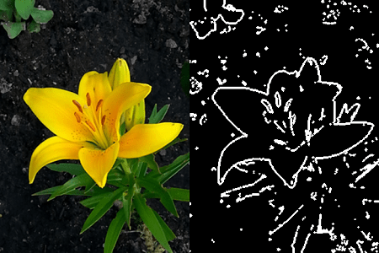
For image analysis, image segmentation is needed, which means to partition an image into several regions that have homogeneous texture features.
This process is usually realized by the region-based, boundary-based or edge-based method. And from the viewpoint of clustering, it is divided into supervised and unsupervised texture segmentation.
Edge-Based

Slide 7
02
Thresholding

Slide 8
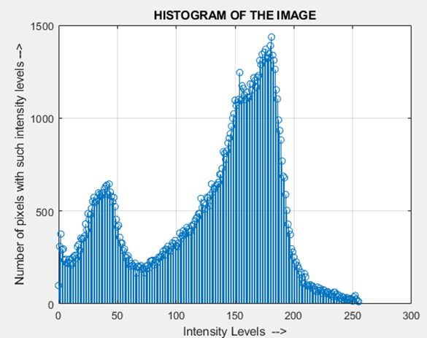
Thresholding
Thresholding is one of the segmentation techniques that generates a binary image from a given grayscale image by separating it into two regions based on a threshold value.

Slide 9
In general the intensity value T (threshold),
𝑇=𝑇[𝑥, 𝑦, 𝑝(𝑥,𝑦), 𝑓(𝑥,𝑦)]
If T is a function of 𝑓(𝑥,𝑦) only, we obtain the Global thresholding.
If T is a function of 𝑓(𝑥,𝑦) with the local properties 𝑝(𝑥,𝑦) we obtain the Local thresholding.
If T depends on the coordinates (𝑥,𝑦) we obtain the Adaptive thresholding.

Slide 10
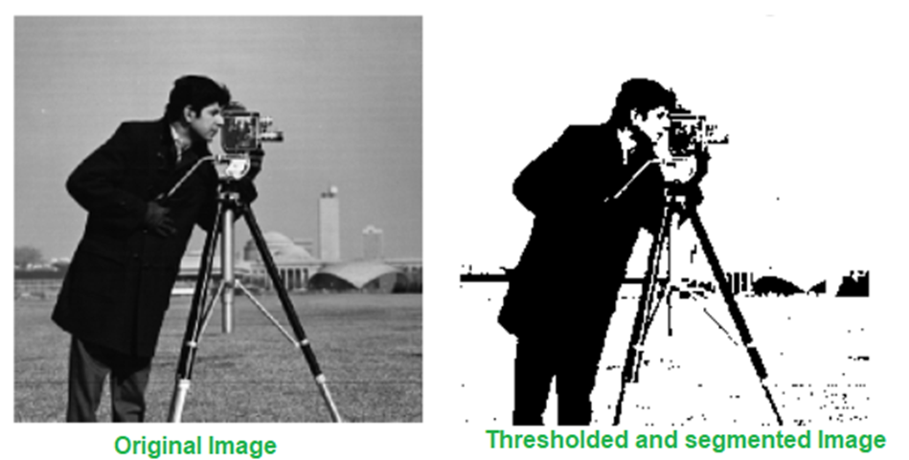
Global Thresholding
This thresholding method is used when the intensity distribution of objects and background are sufficiently distinct, it is possible to use a single or global threshold applicable over the entire image.

Slide 11
Global thresholding (G.T.) has the form:
$$g\left(x,y\right)=\left\{\begin{aligned}0, for f\left(x,y\right)<T \\ 1 for f(x,y)≥T\end{aligned}\right.$$

Slide 12
Threshold Selection
03
Based On Otsu’s Method

Slide 13
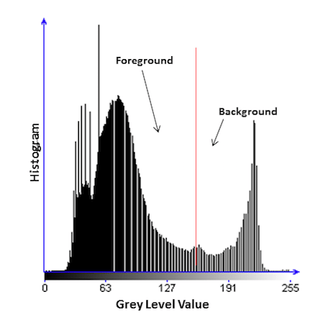
Otsu’s method is aimed in finding the optimal value for the global threshold. The main drawback of Otsu’s method of threshold selection is that it assumes that the histogram is bimodal.

Slide 14
In Otsu's method, we exhaustively search for the threshold that minimizes the intra-class variance (the variance within the class), defined as a weighted sum of variances of the two classes:
The weighted within class variance is:
$$ _{W}^{2}= ω_{0}\left(t\right)σ_{0}^{2}\left(t\right)+ ω_{1}(t)σ_{1}^{2}\left(t\right)$$

Slide 15
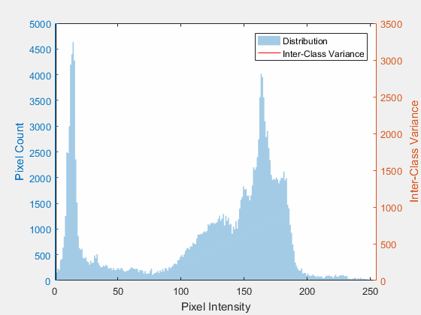
$$ω_{0}(t)=∑_{i=0}^{t−1} p(i)$$
$ω_{1}(t)=∑_{i=t}^{L−1} p(i)$
Also,
$σ_{B}^{2}(t)=σ^{2}−σ_{W}^{2}(t)$,
which means
$$ω_{0}(t){\left(μ_{0}−μ_{T}\right)}^{2}+ω_{1}(t){\left(μ_{1}−μ_{T}\right)}^{2}$$

Slide 16
With $μ_{0}(t)=\frac{∑_{i=0}^{t−1} ip(i)}{ω_{0}(t)}$
$μ_{1}(t)=\frac{∑_{i=t}^{L−1} ip(i)}{ω_{1}(t)}$
and $μ_{T}=∑_{i=0}^{L−1} ip(i)$.

Slide 17
The total variance of levels:
$$σ_{T}^{2}=∑_{i=0}^{L−1} {\left(i−μ_{T}\right)}^{2}p_{i}$$
The criterion measures:
$$λ=\frac{σ_{B}^{2}}{σ_{W}^{2}}, κ=\frac{σ_{T}^{2}}{σ_{W}^{2}}, η=\frac{σ_{B}^{2}}{σ_{T}^{2}}$$
The following relation always holds:
$σ_{W}^{2}+σ_{B}^{2}=σ_{T}^{2}$

Slide 18
$σ_{T}^{2}$ is independent of the threshold t.
Finally the optimal threshold $t^{∗}$ that maximizes $η$, or equivalently maximizes $σ_{B}^{2}$, is selected in the following sequential search by using the simple cumulative quantities $ω\left(t\right)$and $μ(t)$.
$$η(t)=\frac{σ_{B}^{2}(t)}{σ_{T}^{2}}$$
and so
$σ_{B}^{2}(t)=\frac{{\left[μ_{T}ω(t)−μ(t)\right]}^{2}}{ω(t)[1−ω(t)]}$ .
Therefore the optimal threshold $t^{∗}$ is:
$$σ_{B}^{2}\left(t^{∗}\right)=\max_{1≤t<L} σ_{B}^{2}\left(t\right).$$

Slide 19
04
Algorithm

Slide 20
Algorithm Implementation

Slide 21
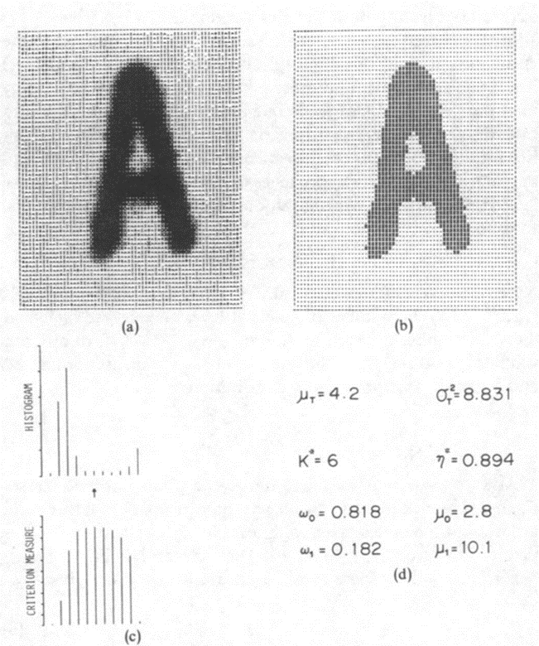
Examples

Slide 22
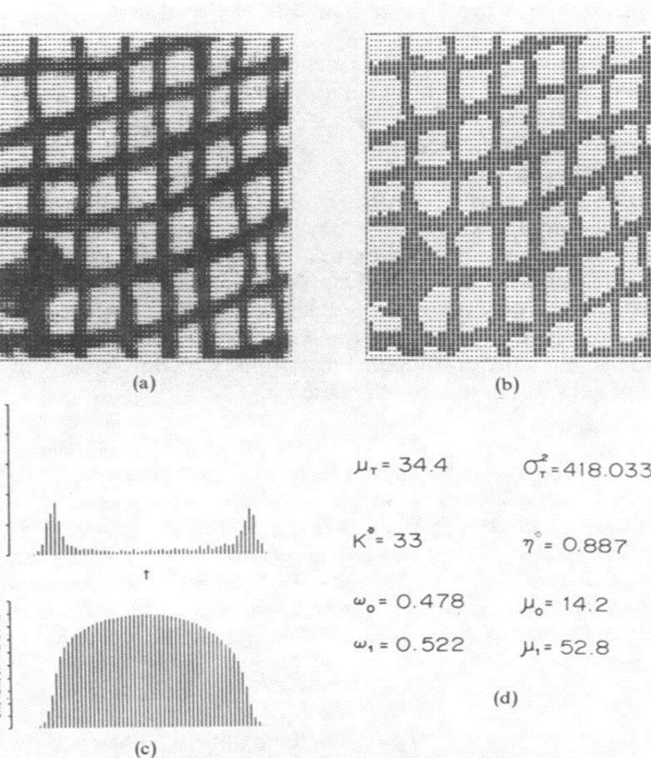
Examples

Slide 23
Bibliography
References
[1] Afreen Shaikh, Sharmila Botcha, Murali Krishna, Otsu based Differential Evolution Method for Image Segmentation, 2022.
[2] Chunshi Sha, Jian Hou, Hongxia Cui, A robust 2D Otsu’s thresholding method in image segmentation, 2015.
[3] Jun Zhang, Jinglu Hu, Image Segmentation Based on 2D Otsu Method with Histogram Analysis, 2019.
[4]Nobuyuki Otsu, "A threshold selection method from gray-level histograms". IEEE Transactions on Systems, Man, and Cybernetics, 1979.
[5] Walaa Ali H. Jumiawi, Ali El-Zaart, Otsu Thresholding Model Using Heterogeneous Mean Filters for Precise Images Segmentation, 2022.

Slide 24
Thank you for your time!
Find me at
mihai.ilina@ulbsibiu.ro
Ilina Mihai

