Slide 1
Prospective Effects of Artificial Intelligence on Burnout Syndrome: Reducing Risks and Enhancing Psychological Well-being
By:
Marwan Babiker
(PhD candidate, Human factors, occupational safety and health)
Supervisor: Prof. Eda Merisalu
Co-Supervisor: Prof. Ženija Roja

Slide 2
background
Burnout is a type of prolonged response to chronic emotional and interpersonal stressors on the job.
It can be exacerbated by the adoption of AI if organizations do not take adequate measures to prevent associated risks.
In this article, we will explore the evolution of burnout and potential impact of AI on workplace burnout and propose solutions to foster a healthy and thriving work environment.
Notes:
increasingly prevalent phenomenon in the professional world

Slide 3
Evolution of burnout
“Burnout” was first invented by Herbert Freudenberger in 1974.
Describe the occupational severe emotional stress consequences affected certain professionals.
Jobs that requires an intense involvement with people & dedicating themselves for the well-being of others.
Type of occupations.
Chapter 34 of the ILO Encyclopedia of Occupational Health and Safety (particularly the article entitled “Burnout” by Christina Maslach).
Notes:
-health care, social services, mental health, criminal justice and education.
-It is an issue of particular concern for human services occupations where:
the relationship between providers and recipients is central to the job;
the provision of service, care, treatment or education can be a highly emotional experience.

Slide 4
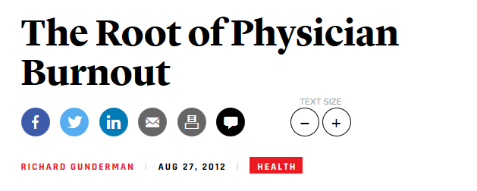
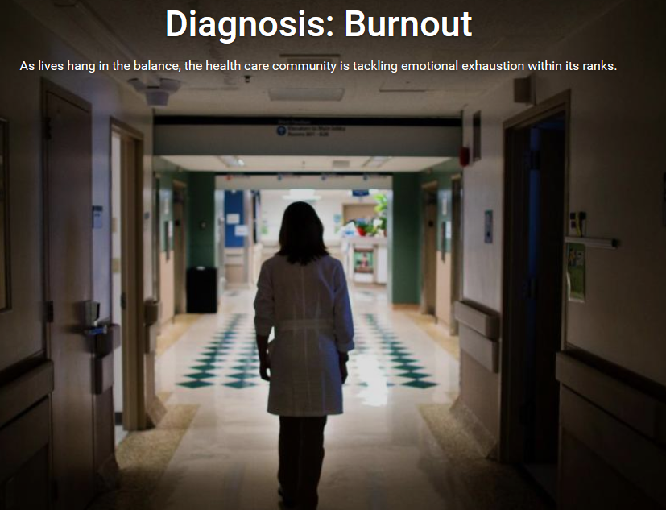
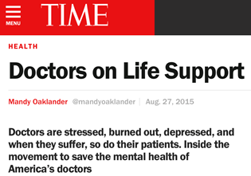
New York Times
The Atlantic
US News and World Reports
The Nations Health- a publication of American health association

Slide 5
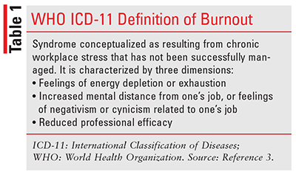
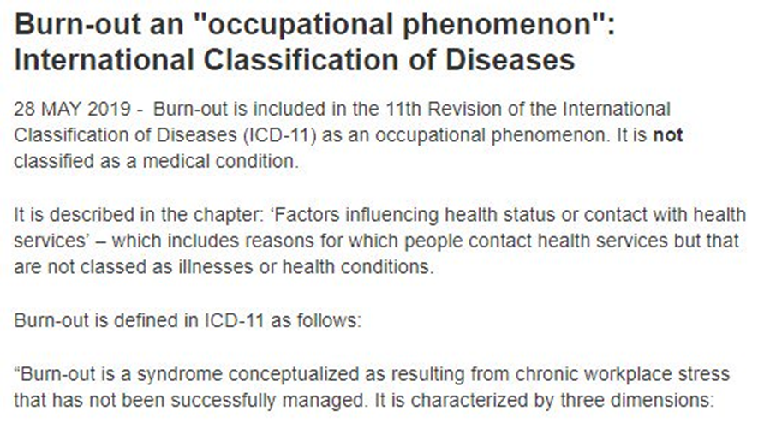
Burn-out an ‘Occupational phenomenon’: International Classification of Diseases (no date) World Health Organization. Available at: https://www.who.int/news/item/28-05-2019-burn-out-an-occupational-phenomenon-international-classification-of-diseases
Notes:
emotional exhaustion: feelings of being emotionally overextended and depleted of one’s emotional resources;
depersonalization: negative or excessively detached response to the people who are usually the recipients of one’s service or care;
reduced personal accomplishment: a decline in one’s feelings of competence and successful achievement in one’s work

Slide 6
Emotional exhaustion
Score < 17: Low
18-29: Moderate
> 30: High
Depersonalization
Score < 5: Low
6-11: Moderate
> 12: High
Personal accomplishment
Score < 33: High burnout
34-39: Moderate burnout
> 40: Low burnout
Am I Burned Out? How is burnout identified?
Maslach Burnout Inventory is one of the most used assessments.
Validated
22 items on a 7-point Likert scale
Maslach Burnout Inventory (MBI) - assessments, tests: Mind garden (no date) Mind Garden. Available at: http://www.mindgarden.com/117-maslach-burnout-inventory
Notes:
It was developed by Christina Maslach and Susan Jackson in the late 1970s and has since become the gold standard

Slide 7
burnout among HCWs
Healthcare workers are more prone to burnout; they are exposed to high-stress levels at work and dedicated themselves to the wellbeing of others.
The health care environment—with its packed workdays, demanding pace, time pressures, and emotional intensity—can put HCWs at high risk for burnout.
Healthcare organizations that prioritize productivity over patient care may contribute to feelings of burnout in their employees.
Physician burnout (no date) AHRQ. Available at: https://www.ahrq.gov/prevention/clinician/ahrq-works/burnout/index.html#:~:text=The%20health%20care%20environment%E2%80%94with,at%20high%20risk%20for%20burnout.
Notes:
Workplace factors associated with higher emotional exhaustion:
High demands
Low job control
High workload
Low Reward
Job insecurity
Individual factors
Conscientiousness
Commitment to patients
Staying current
Cognizant of patient’s trust
Difficulty relaxing
Work-life imbalance
Sense of responsibility beyond one’s control
Feeling inadequate
Difficulty with boundaries and limit-setting
Difficulty taking leisure time
Conflict between selfishness versus healthy self-interest
It is important for healthcare organizations and those who lead them to recognize the significant role they play in creating a work environment that supports employee well-being and reduces burnout
Symptoms:
Emotional Exhaustion and mental fatigue
Dissatisfaction with work
Lack of interest or apathy
Frequent distress
Depressive symptoms
Anger, frustration, or irritation
Withdrawal from social interaction or increase in conflicts (especially at work)
Health problems (proneness to headaches, insomnia, back pain, etc.)
Difficulty concentrating on work
Reduced productivity
Increase in or starting of substance abuse (such as smoking, alcohol consumption)
Cynicism and negativity towards work
Feeling inferior and helpless
Increase in absenteeism
Chronic anxiety due to work

Slide 8
Burnout among HCWs: study problem
In 2022, Dr. Tait Shanafelt et. al found that physicians experience higher rates of burnout and lower job satisfaction than the general population.
A 2023 Medscape survey of 9,100 physicians found burnout among clinicians at a high of 53%.
Early-stage Advanced Practice Providers (APPs) reported having burnout at a large urban medical center surveyed by Meredith P. Ashooh et. al in 2019, which was attributed to facing the challenges of working in healthcare as an inexperienced provider before establishing proper coping mechanisms.
Proven, effective strategies to Prevent & Treat Provider burnout (no date) Proven, effective strategies to prevent & treat provider burnout | Wolters Kluwer. Available at: https://www.wolterskluwer.com/en/expert-insights/proven-effective-strategies-to-prevent-and-treat-provider-burnout

Slide 9
Burnout among HCWs (cont.)
Nurses experience high rate of burnout. A national survey of 22,316 nurses reported three-fourths of nurses experiencing it.
The impact of burnout can be significant in an era already rife with nurse staffing shortages, with 18-34% of nurses in the survey saying they planned to leave nursing.
Proven, effective strategies to Prevent & Treat Provider burnout (no date) Proven, effective strategies to prevent & treat provider burnout | Wolters Kluwer. Available at: https://www.wolterskluwer.com/en/expert-insights/proven-effective-strategies-to-prevent-and-treat-provider-burnout
Notes:
US physician survey (N=20,627) showed burnout rate has been on the rise during the COVID-19 pandemic up to 60% in late 2021 compared to 45% in 2019.

Slide 10
Burnout among HCWs (cont.)
Dr. Brianna McQuade et. al reported in 2022 an 88% burnout rate among hospital and ambulatory pharmacists, with the group reporting worsened burnout during the pandemic.
In addition to COVID-19 precautions, the report also cited challenges that caused burnout including managing insurance, paperwork, and physician demands.
A cross-sectional study on social workers demonstrated 61% burnout, with many participants citing increasing isolation from patients and coworkers as a significant factor. (depersonalization)

Slide 11
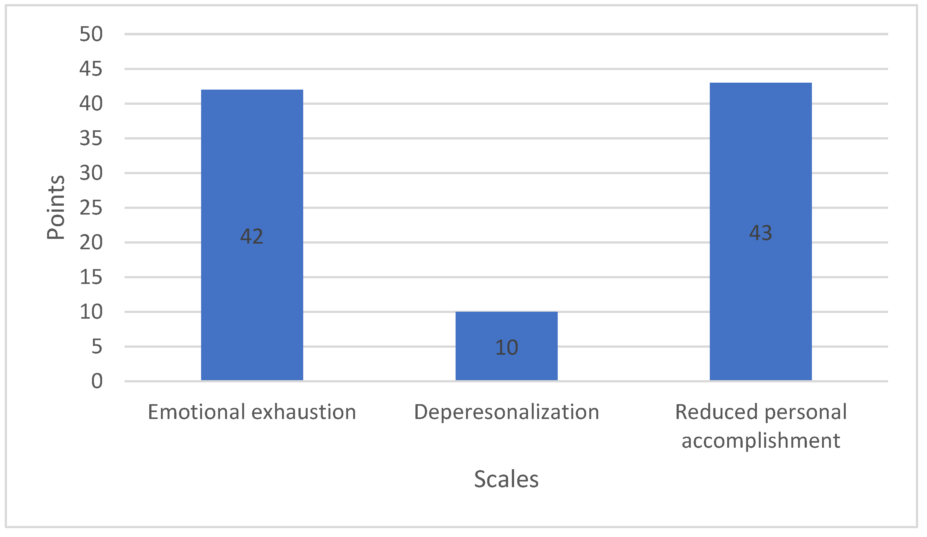
Burnout among HCWs (cont.)
In Latvia, a study by (Nagle et la, 2023) of 195 HCWs, MBI; in traumatology and orthopedics hospital in Latvia, results showed a high level of emotional exhaustion, a medium level of depersonalization, and a low level of personal achievement reduction, concerned about the mental well-being of HCWs and the quality of healthcare service provision.
Nagle, E. et al. (2023) The Burnout and professional deformation of Latvian healthcare workers during the COVID-19 pandemic at the Traumatology and Orthopedics Hospital, MDPI. Available at: https://www.mdpi.com/2076-0760/12/3/175
Notes:
Evija nagle

Slide 12
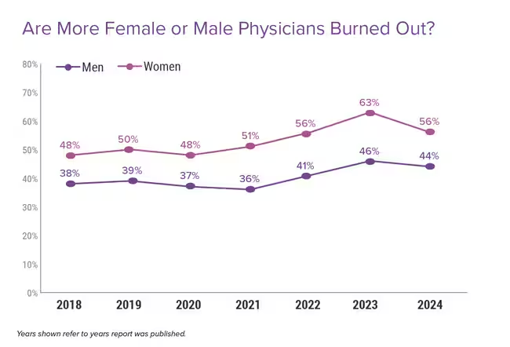
Gender differences in physician burnout
For the report, Medscape surveyed 9,226 physicians in over 29 specialties between July 5 and Oct. 9, 2023, to assess their current feelings of burnout, stress, and more.
56 % of female physicians as compared to 44% of male physicians experienced burnout in one study
Burnout symptom prevalence in physicians:
Women are more likely to report emotional exhaustion
Men are more likely to describe depersonalization
Medscape Access (no date) Medscape. Available at: https://www.medscape.com/slideshow/2024-lifestyle-burnout-6016865?icd=login_success_email_match_norm#4

Slide 13
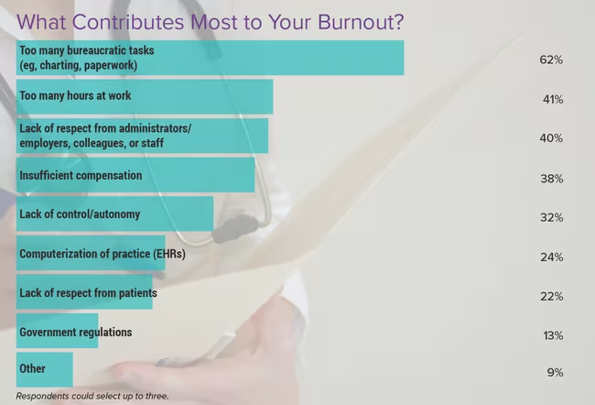
Known Contributors to Hcws Burnout
Medscape Access (no date) Medscape. Available at: https://www.medscape.com/slideshow/2024-lifestyle-burnout-6016865?icd=login_success_email_match_norm#8
Notes:
causes:
Excessive workload
Time pressure, such as urgent or unrealistic timelines
Role ambiguity or role conflict
Insufficient control of their job
Unfair treatment at work
Lack of communication and support from the managers
Absence of spaces to communicate distress
Lack of recognition
Insufficient rewards and compensation
Poor working relationships or community

Slide 14
HCWS burnout: consequences
Negative consequences of BS affect the quality of patient care HCWs health, and the health care system
Journal of Internal Medicine, Volume: 283, Issue: 6, Pages: 516-529, First published: 05 March 2018, DOI: (10.1111/joim.12752)
Notes:
Turnover: According to the US economy, a cost of $500 billion.

Slide 15
Reduce burnout level-prevention
Medscape Access (no date b) Medscape. Available at: https://www.medscape.com/slideshow/2024-lifestyle-burnout-6016865?icd=login_success_email_match_norm#8
Notes:
Workplace VS. Individual
Monitor the Stress: HR departments can utilize various resources to understand the current state of job satisfaction and burnout in the employees. If stress and exhaustion levels are high, then programs can be introduced at an organizational level to address them.
Check Work Overload and Time Pressure: Too many tasks and endless to-do lists can increase stress for the employee. Ensure that the tasks are manageable and expected within a realistic timeline.
Managers Assist in Prioritizing: Organizations where there is an urgency culture cause higher stress. Instead of terming all tasks as urgent, managers can prioritize work for the employees in daily or weekly meetings. This will clarify expectations and help employees feel more in control.
Make it Safe to Communicate: Employees will share their challenges and issues if they find a psychologically safe and supportive environment. They can also share insights and expectations from the company. If, on the other hand, their managers or bosses invalidate their inputs, are not open to feedback, and are not willing to communicate, dissatisfaction will grow. Companies can train managers to coach and support employees and mediate communication effectively between top and bottom levels.
Promote Transformational Leadership: When managers and leaders spend time to promote individual attention, motivate employees, and provide support and opportunities for growth, employees are more likely to be satisfied.
Establish Work-Life Boundaries: While this can be done at an employee level, a culture that values balance and boundaries between work time and personal time can ensure that employees have enough time to relax and rejuvenate. This will reduce stress.
Encourage Breaks and Vacations: Regular breaks and vacations where employees are away from stress can help in building resilience. Encouraging breaks within the day where work no one discusses work or employees can relax for some time. Also, promote the use of vacation days so that employees retain their capacity to work.
Provide More Control to the Employee: When employees are clear in their roles and expectations, they are likely to work better. At the same time, some flexibility in the role where employees can choose how they wish to structure their jobs can be helpful for reducing frustration with the job.
Provide Mental Health Resources: It is important that employees have ready access to resources such as EAPs, counselors, and self-help material. If they are experiencing some stress, ready access can equip them to intervene quickly and work on the issue.
Help Employees Identify with the Company: Humans are more passionate when they work for things they believe in or when they work for a community they identify with. Spending time in team building, building an identity, and building a community within the company can be useful in this regard.

Slide 16
Evolution of Artificial intelligence
The studies for AI have been started since the 1950s, adopted by organizations to boost business performance in the past twenty years, with the development of machine learning, deep learning, and neural networks
According to (Berente et al., 2021), AI defined “as the frontier of computational advancements that references human intelligence in addressing ever more complex decision-making problems.”
AI provide quicker and validated decisions in challenging situations by making large amounts of data usable and accessible. The interaction roles between humans and AI can be explained as AI can outperform humans (Shen et al., 2019) and human crowds (Fu et al., 2021).

Slide 17
AI contribution in burnout
Overwork is one dimension of burnout that employers, policymakers, and individuals need to consider in the age of AI.
Digital overload e.g. ChatGPT usher in shorter workweeks, overwhelming that people will need a day of rest to reset, according to the ESG team at Jefferies, an investment bank.
Shifting lower-level tasks to an AI can come with advantages, but it can also mean more people are practicing at the top of their license. This is the experience of doing work at the highest level for which one is trained.

Slide 18
AI contribution in burnout (Cont.)
Job insecurity:
CNBC/SurveyMonkey Workforce Survey 24% of workers are worried AI will take away their jobs, according to. a study of hospitality industry workers in China revealed that anxiety about AI-driven job losses increases the likelihood of burnout.
Workers with a high level of knowledge about AI perceive a very uncertain future for themselves; they fear that AI will be able to replace them with ease.
They experience stress and emotional exhaustion because they feel that their jobs are insecure. (Ito and Brotheridge, 2001)

Slide 19
AI contribution in burnout (Cont.)
Lack of role clarity
According to Gallup, AI could make it more difficult for teams to know what is expected of them in terms of responsibilities and performance. Workers will need answers to these questions, and management might not know how to address them.
Social isolation
chatbots are like eager coworkers who are always available to answer questions. AI system and less time in face-to-face communication with colleagues could lead to feelings of isolation or detachment from a team or project. A study from Simon Fraser University found that loneliness and lack of social support were leading contributors of burnout.
Notes:
Lack of role clarity:
Should I be producing documents faster now? Am I expected to close more or different types of deals?

Slide 20
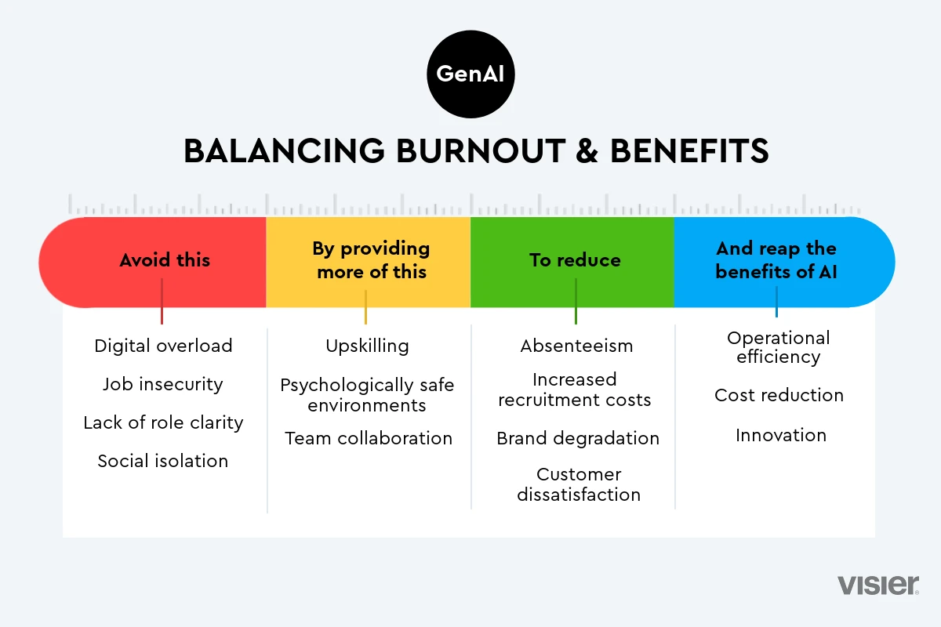
propose solutions of AI applications on workplace burnout
Visier (no date) Is ai exhaustion the new employee burnout?, Visier. Available at: https://www.visier.com/blog/ai-exhaustion-the-new-burnout
Notes:
Anticipate changes related to automation and invest in employee training to acquire new skills. Proactive human resource management to balance workload
Ensure that the algorithms used are fair and transparent. Regular data analysis and careful monitoring of AI outcomes can help identify and correct potential biases.
Ensure that AI does not completely replace social interactions, maintaining open channels of human communication and encouraging in-person collaboration moments.
Establish clear policies regarding working hours. Encouraging employees to take regular breaks and disconnect after working hours can help prevent exhaustion.

Slide 21
conclusion
Burnout is prevalent across health care settings and may impair HCWs ability to maintain safe practices and detect emerging safety threats.
Prospective, longitudinal studies are needed to explore further causes of development of burnout, identify the specific instruments to measure physician’s well-being and identify effective interventions of burnout syndrome.
AI offers a wealth of possibilities to combat burnout and create a healthier work environment with burnout free workplace to address global challenges and create a better world for all.

Slide 22
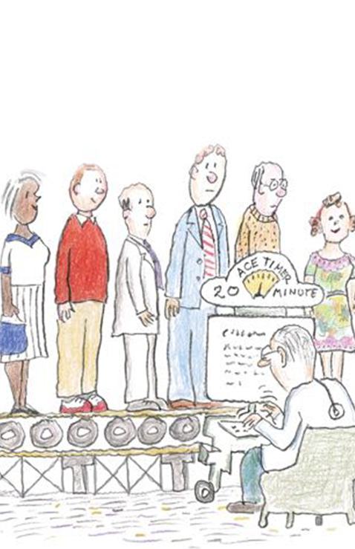
Thank you

