Slide 1


APPLICATION OF WASTEWATER – BASED EPIDEMIOLOGY FOR TRACKING HUMAN EXPOSURE TO DEOXYNIVALENOL AND ENNIATINS and further research options
Zane Berzina ^{1,2}, Romans Pavlenko ^{1,2}, Laura Elina Ikkere ², Vadims Bartkevics^{1,2}
¹ Department of Analytical Chemistry, University of Latvia, Riga, Latvia
² Institute of Food Safety, Animal Health and Environment “BIOR”, Riga, Latvia
This work was supported by the Latvian Council of Science under project No. lzp-2020/2-0128
and “Strengthening of the capacity of doctoral studies at the University of Latvia within the framework of the new doctoral model”, identification No. 8.2.2.0/20/I/006
11.02.2022, Riga, Latvia
Notes:
Uz notekūdeņiem balstītas epidemioloģijas pieejas izmantošana, lai noteiktu mikotoksīnu dienas devu, kas uzņemta ar pārtiku un turpmāko pētījumu virzieni

Slide 2












Wastewater based epidemiology principle

Slide 3
Aim of this study:
Use wastewater based epidemiology for tracking human exposure to deoxynivalenol and enniatins
  Analyse wastewater samples to determine the mycotoxins and 5-hydroxyindoleacetic acid (5-HIAA) content;
  For data normalisation use 5-HIAA as a population biomarker;
  Calculate daily intake of mycotoxins for population of Riga city.

Slide 4
DON - from a food contaminant to a biomarker
DON intake from food
DON excretion via urine
20-30%
Deoxynivalenol in 24h
Deoxynivalenol 15 glucuronide 73%
Deoxynivalenol 3 glucuronide 27%
Deoxynivalenol
70-80%
Deoxynivalenol 3 glucoside
24%
49%
15%
4%
7%
Deoxynivalenol
Deoxynivalenol 15 glucuronide
Deoxynivalenol 3 glucuronide
Deoxynivalenol 3 glucoside
De-epoxy-deoxynivalenol
3 Acetyldeoxynivalenol
15 Acetyldeoxynivalenol

Slide 5
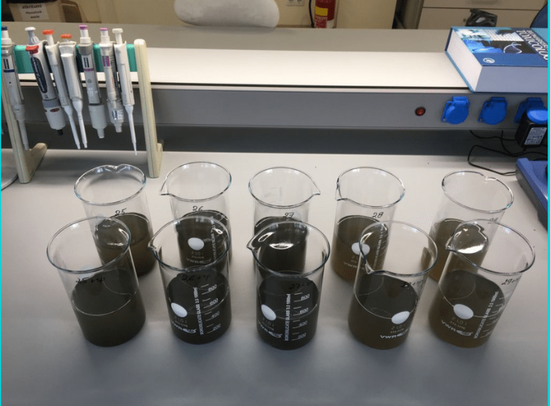
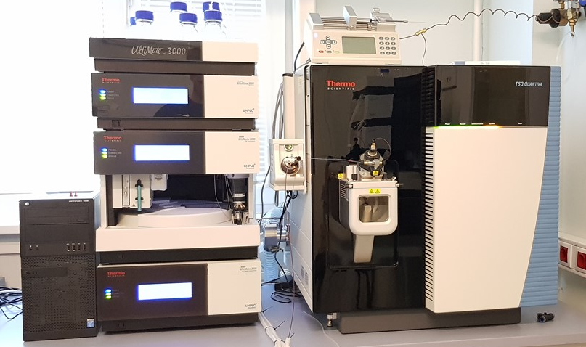
Structure of the Research
29 samples colected in period of 29.06.2021-06.08.2021 every working day
Sample preparation with SPE
Dillute and shoot sample preparation for 5-HIAA analysis
HPLC-QqQ-MS/MS quantification
Data analysis and daily intake calculation
Fig. 1. Wastewater samples before sample preparation
Fig. 2. HPLC-QqQ-MS/MS

Slide 6
Results I – mycotoxins in wastewater
1.table
The concentrations of mycotoxins measured in urban wastewater
Mycotoxin | Frequency of detection | Average, ng/L | Range, ng/L | Median, ng/L
DON | 100% | 51.7 ± 8.8 | 23.2 – 76.9 | 52.9
ENNA | 90% | 3.0 ± 1.3 | LOQ – 16.7 | 2.0
ENNA1 | 86% | 4.2 ± 1.5 | LOQ – 27.7 | 2.5
ENNB | 100% | 4.6 ± 2.0 | 0.6 – 9.9 | 4.1
ENNB1 | 100% | 3.9 ± 1.6 | 1.4 – 10.1 | 3.4
BEA | 14% | < LOQ | < LOQ | < LOQ
Fig. 3. The concentrations of DON and ENN group mycotoxins measured in urban wastewater

Slide 7
Calculations
$${DON}_{Intake}=\frac{{Conc}_{DON in WW sample}\left(\frac{ng}{L}\right)∙ {Average excretion rate}_{5−HIAA}\left(\frac{mg}{day}per person\right) ∙{CF}_{DON}}{{Conc}_{5−HIAA in ww sample}\left(\frac{ng}{L}\right)}$$
4.16 ± 0.56 mg/day/person
CF_{DON} average: 1,5
Chen, C.; Kostakis, C.; Gerber, J. P.; Tscharke, B. J.; Irvine, R. J.; White, J. M. Towards finding a population biomarker for wastewater epidemiology studies. Sci. Total Environ. 2014, 487, 621–628. DOI: 10.1016/j.scitotenv.2013.11.075.
Gracia-Lor, E.; Zuccato, E.; Hernández, F.; Castiglioni, S. Wastewater-based epidemiology for tracking human exposure to mycotoxins. J. Hazard. Mater. 2020, 382, 121108. DOI:10.1016/j.jhazmat.2019.121108. CF_{DON}=1,4
Mengelers, M.; Zeilmaker, M.; Vidal, A.; De Boevre, M.; De Saeger, S.; Hoogenveen, R. Biomonitoring of deoxynivalenol and deoxynivalenol-3-glucoside in human volunteers: renal excretion profiles. Toxins (Basel). 2019, 11, 466. DOI: 10.3390/toxins11080466. CF_{DON}=1,6-1,7

Slide 8
Results II – estimated daily intake of Deoxynivalenol
2.table
Estimated value of DON intake and data characteristics (mg/day/person)
Average | Sn | Min | Max | Median
0.023 | 0.0072 | 0.012 | 0.039 | 0.021
Fig. 5. The concentrations of DON measured in urban wastewater and estimated daily intake values

Slide 9
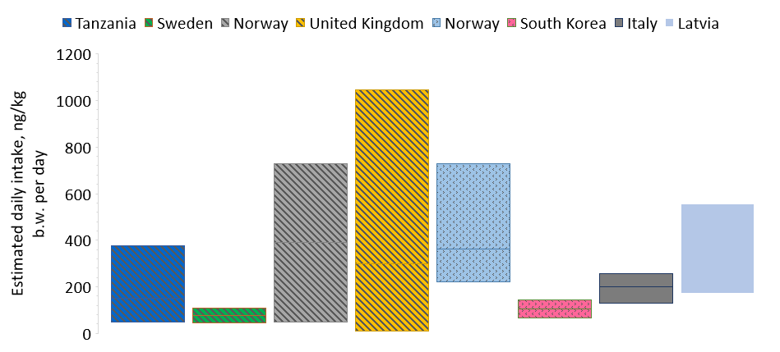
Comparison with other studies
PMTDI: 1014 ng/kg b.w. day
Joint FAO/WHO Expert Commitee on Food Additives, 2011
Chronic dietary exposure: 214 - 1014 ng/kg b.w. day
European Food Safety Authority , 2013
EDI: 325 ng/kg b.w. day in this study
Urinary biomarker studies
Occurrence data studies
WBE studies
Fig. 6. Comparison of the estimated daily intake of DON with other studies and with the reported health-based guidance values

Slide 10
Results III – estimated daily intake for sum of enniatins – worst case scenario
In worst case scenario (if excretion factors are 5% or lower for each enniatin) the sum of average provisional daily intake of enniatins is 1.35 μg/kg b.w. day, indicating a potential risk of chronical exposure.
Fig. 4. Estimated daily intake for sum of enniatins if excretion factors are 5% or lower for each enniatin

Slide 11
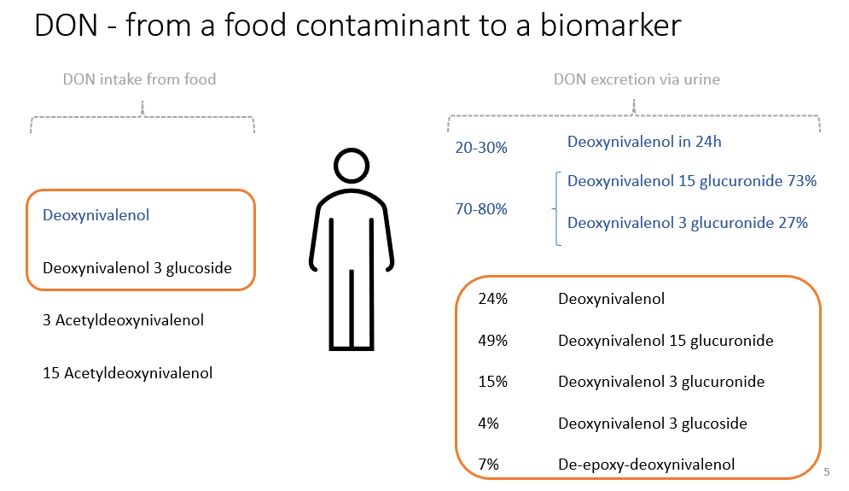
Further research

Slide 12
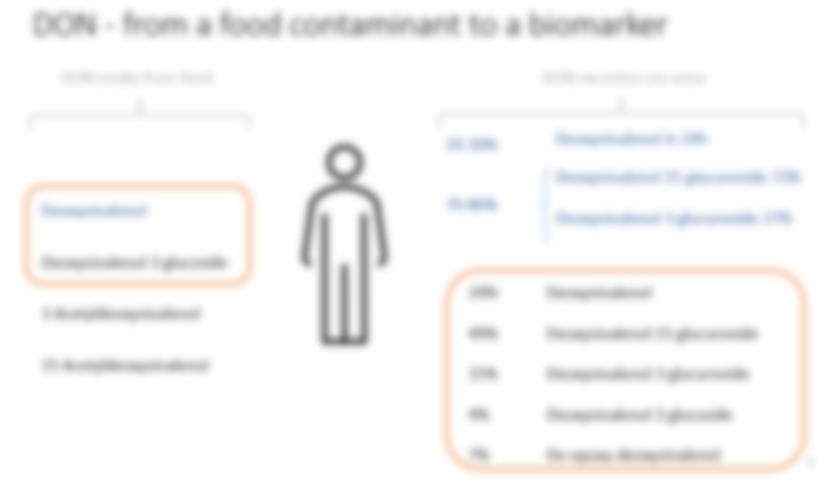

Further research

Slide 13


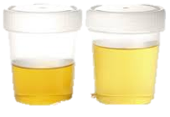
Further research
Deoxynivalenol
Deoxynivalenol-3-glucuronide
Deoxynivalenol-15-glucuronide
Fumonisine B1
Zearalenone-14-glucuronide
α-zearalenol
β-zearalenol
Zearalenone
Ochratoxin A
Ochratoxin-glucuronide
Ochratoxin α
4-OH-OTA (hydroxylated form of OTA)
Aflatoxin M1
Nivalenol
De-epoxy-nivalenol
NIV-3-glucoside
NIV-glucuronide
Citreoviridin
HT-2 toxin
HT-2–4-glucuronide
T2 glucuronide
T-2 triol
T-2 tetraol
Neosolaniol
15-acetoxy tetraol
Alternariol-glucuronide
Deoxynivalenol
Deoxynivalenol-3-glucoside
Fumonisine
Zearalenone
Ochratoxin
Aflatoxin B1
Nivalenol
Citreoviridin
T-2
HT-2
Alternariol
Enniatin's
Deoxynivalenol
Enniatin's
Fumonisine B1
… ?

Slide 14
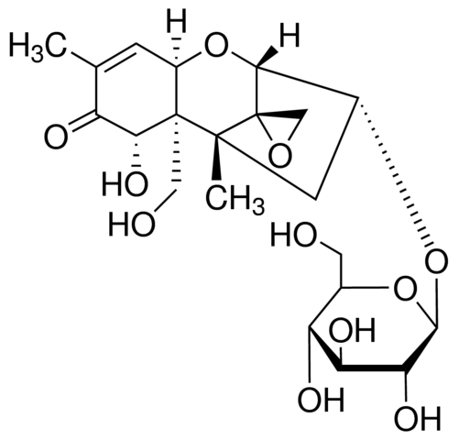
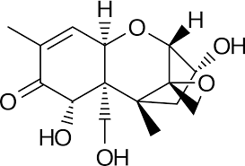
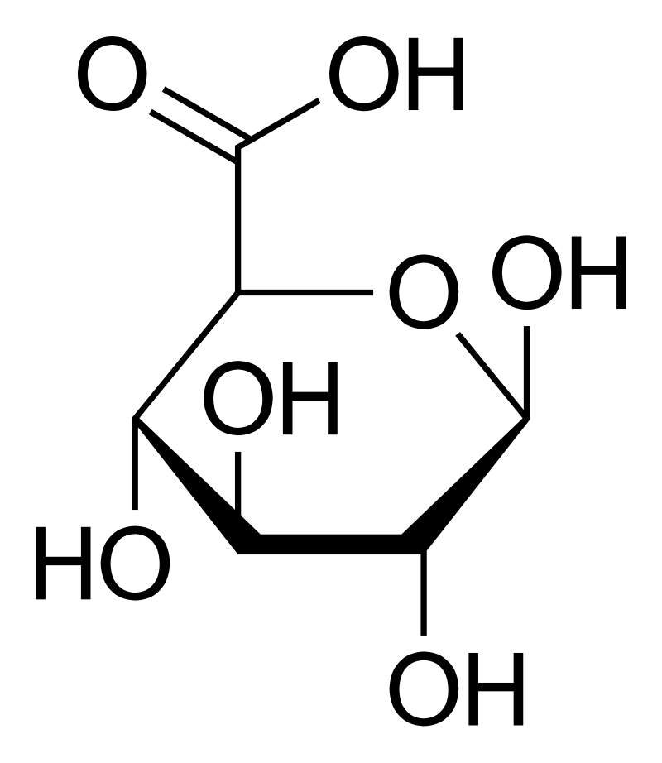
Challenges and the field of study
β-Glucuronidase
+
Deoxynivalenol-3-glucuronide
Glucuronic acid
Deoxynivalenol
Stability of metabolites in waste water
Reaction conditions
Sample preparation and analysis

Slide 15
Conclusions
The WBE approach can be used to obtain comparable data on population exposure to mycotoxins
More data of the excretion mechanisms and metabolism of other mycotoxins in humans are required
Based on Joint FAO/WHO Expert Committee on Food Additives provisional maximum tolerable daily is not exceeded, although European Food Safety Authority (EFSA) for chronic dietary exposure has set a limit of 0.015 – 0.071 mg/day/person that might raise a concern for human health in Riga.

Slide 16
Thank you for your attention!

Slide 17
References I
Thai, P. K.; O’Brien, J. W.; Banks, A. P. W.; Jiang, G.; Gao, J.; Choi, P. M.; Yuan, Z.; Mueller, J. F. Evaluating the in-sewer stability of three potential population biomarkers for application in wastewater-based epidemiology. Sci. Total Environ. 2019, 671, 248–253. DOI: 10.1016/j.scitotenv.2019.03.231.
Chen, C.; Kostakis, C.; Gerber, J. P.; Tscharke, B. J.; Irvine, R. J.; White, J. M. Towards finding a population biomarker for wastewater epidemiology studies. Sci. Total Environ. 2014, 487, 621–628. DOI: 10.1016/j.scitotenv.2013.11.075.
Gracia-Lor, E.; Zuccato, E.; Hernández, F.; Castiglioni, S. Wastewater-based epidemiology for tracking human exposure to mycotoxins. J. Hazard. Mater. 2020, 382, 121108. DOI: https://doi.org/10.1016/j.jhazmat.2019.121108.
Mengelers, M.; Zeilmaker, M.; Vidal, A.; De Boevre, M.; De Saeger, S.; Hoogenveen, R. Biomonitoring of deoxynivalenol and deoxynivalenol-3-glucoside in human volunteers: renal excretion profiles. Toxins (Basel). 2019, 11, 466. DOI: 10.3390/toxins11080466.
Srey, C.; Kimanya, M. E.; Routledge, M. N.; Shirima, C. P.; Gong, Y. Y. Deoxynivalenol exposure assessment in young children in tanzania. Mol. Nutr. Food Res. 2014, 58, 1574–1580. DOI: https://doi.org/10.1002/mnfr.201400012.
Warensjö Lemming, E.; Montano Montes, A.; Schmidt, J.; Cramer, B.; Humpf, H. U.; Moraeus, L.; Olsen, M. Mycotoxins in blood and urine of swedish adolescents—possible associations to food intake and other background characteristics. Mycotoxin Res. 2020, 36, 193–206. DOI: 10.1007/s12550-019-00381-9.
Eriksen, G. S.; Knutsen, H. K.; Sandvik, M.; Brantsæter, A.-L. Urinary deoxynivalenol as a biomarker of exposure in different age, life stage and dietary practice population groups. Environ. Int. 2021, 157, 106804. DOI: https://doi.org/10.1016/j.envint.2021.106804.
Turner, P.; White, K.; Burley, V.; Hopton, R.; Rajendram, A.; Fisher, J.; Cade, J.; Wild, C. A comparison of deoxynivalenol intake and urinary deoxynivalenol in uk adults. Biomarkers 2010, 15, 553–562. DOI: 10.3109/1354750X.2010.495787.
Ok, H. E.; Kim, H. J.; Cho, T. Y.; Oh, K. S.; Chun, H. S. Determination of deoxynivalenol in cereal-based foods and estimation of dietary exposure. J. Toxicol. Environ. Health. A 2009, 72, 1424–1430. DOI: 10.1080/15287390903212832
EFSA CONTAM Panel Scientific Opinion on the risks to human and animal health related to the presence of beauvericin and enniatins in food and feed. EFSA J. 2014, 12, doi:10.2903/j.efsa.2014.3802.
Puntscher, H., Hankele, S., Tillmann, K., Attakpah, E., Braun, D., Kütt, M. L., Del Favero, G., Aichinger, G., Pahlke, G., Höger, H., Marko, D., & Warth, B. (2019). First insights into Alternaria multi-toxin in vivo metabolism. Toxicology Letters, 301, 168–178. https://doi.org/10.1016/j.toxlet.2018.10.006
Food, E.-D. S.-S. C. on. (2000). Opinion of the Scientific Committee on Food on Fusarium Toxins. Part 41: Nivalenol. 10 pp.
Schwartz-Zimmermann, H. E., Binder, S. B., Hametner, C., Miró-Abella, E., Schwarz, C., Michlmayr, H., Reiterer, N., Labudova, S., Adam, G., & Berthiller, F. (2019). Metabolism of nivalenol and nivalenol-3-glucoside in rats. Toxicology Letters, 306, 43–52. https://doi.org/10.1016/j.toxlet.2019.02.006
Uchiyama, Y., Takino, M., Noguchi, M., Shiratori, N., Kobayashi, N., & Sugita-Konishi, Y. (2019). The In Vivo and In Vitro Toxicokinetics of Citreoviridin Extracted from Penicillium citreonigrum. Toxins, 11(6), 360. https://doi.org/10.3390/toxins11060360
Wang, D. S., Sun, H. L., Xiao, F. Y., Ji, X. H., Liang, Y. X., & Han, F. G. (1991). Distribution and excretion of 3H-sterigmatocystin in rats. IARC Scientific Publications, 105, 424–426.
Viegas, C., Nurme, J., Piecková, E., & Viegas, S. (2020). Sterigmatocystin in foodstuffs and feed: aspects to consider. Mycology, 11(2), 91–104. https://doi.org/10.1080/21501203.2018.1492980
Sintov, A., Bialer, M., & Yagen, B. (1987). Pharmacokinetics of T-2 tetraol, a urinary metabolite of the trichothecene mycotoxin, T-2 toxin, in dog. Xenobiotica; the Fate of Foreign Compounds in Biological Systems, 17(8), 941–950. https://doi.org/10.3109/00498258709044192
Welsch, T., & Humpf, H.-U. (2012). HT-2 toxin 4-glucuronide as new T-2 toxin metabolite: enzymatic synthesis, analysis, and species specific formation of T-2 and HT-2 toxin glucuronides by rat, mouse, pig, and human liver microsomes. Journal of Agricultural and Food Chemistry, 60(40), 10170–10178. https://doi.org/10.1021/jf302571y
Qiao, X., Zhang, J., Yang, Y., Yin, J., Li, H., Xing, Y., & Shao, B. (2020). Development of a simple and rapid LC-MS/MS method for the simultaneous quantification of five Alternaria mycotoxins in human urine. Journal of Chromatography B: Analytical Technologies in the Biomedical and Life Sciences, 1144(January), 122096. https://doi.org/10.1016/j.jchromb.2020.122096
Deng, C., Li, C., Zhou, S., Wang, X., Xu, H., Wang, D., Gong, Y. Y., Routledge, M. N., Zhao, Y., & Wu, Y. (2018). Risk assessment of deoxynivalenol in high-risk area of China by human biomonitoring using an improved high throughput UPLC-MS/MS method. Scientific Reports, 8(1), 3901. https://doi.org/10.1038/s41598-018-22206-y

Slide 18
References II
Mengelers, M., Zeilmaker, M., Vidal, A., De Boevre, M., De Saeger, S., & Hoogenveen, R. (2019). Biomonitoring of Deoxynivalenol and Deoxynivalenol-3-glucoside in Human Volunteers: Renal Excretion Profiles. Toxins, 11(8), 466. https://doi.org/10.3390/toxins11080466
Vidal, A., Claeys, L., Mengelers, M., Vanhoorne, V., Vervaet, C., Huybrechts, B., De Saeger, S., & De Boevre, M. (2018). Humans significantly metabolize and excrete the mycotoxin deoxynivalenol and its modified form deoxynivalenol-3-glucoside within 24 hours. Scientific Reports, 8(1), 5255. https://doi.org/10.1038/s41598-018-23526-9
Vidal, A., Bouzaghnane, N., De Saeger, S., & De Boevre, M. (2020). Human mycotoxin biomonitoring: Conclusive remarks on direct or indirect assessment of urinary deoxynivalenol. Toxins, 12(2), 1–10. https://doi.org/10.3390/toxins12020139
Riley, R., Torres, O., Showker, J., Zitomer, N., Matute, J., Voss, K., Waes, J., Maddox, J., Gregory, S., & Ashley-Koch, A. (2012). The Kinetics of Urinary Fumonisin B1 Excretion in Humans Consuming Maize-Based Diets. Molecular Nutrition & Food Research, 56, 1445–1455. https://doi.org/10.1002/mnfr.201200166
Fodor, J., Balogh, K., Weber, M., Mézes, M., Kametler, L., Pósa, R., Mamet, R., Bauer, J., Horn, P., Kovács, F., & Kovács, M. (2008). Absorption, distribution and elimination of fumonisin B1 metabolites in weaned piglets. Food Additives and Contaminants - Part A Chemistry, Analysis, Control, Exposure and Risk Assessment, 25(1), 88–96. https://doi.org/10.1080/02652030701546180
Warth, B., Sulyok, M., Berthiller, F., Schuhmacher, R., & Krska, R. (2013). New insights into the human metabolism of the Fusarium mycotoxins deoxynivalenol and zearalenone. Toxicology Letters, 220(1), 88–94. https://doi.org/https://doi.org/10.1016/j.toxlet.2013.04.012
Gerding, J., Ali, N., Schwartzbord, J., Cramer, B., Brown, D. L., Degen, G. H., & Humpf, H. U. (2015). A comparative study of the human urinary mycotoxin excretion patterns in Bangladesh, Germany, and Haiti using a rapid and sensitive LC-MS/MS approach. Mycotoxin Research, 31(3), 127–136. https://doi.org/10.1007/s12550-015-0223-9
Rodríguez-Carrasco, Y., Narváez, A., Izzo, L., Gaspari, A., Graziani, G., & Ritieni, A. (2020). Biomonitoring of Enniatin B1 and Its Phase I Metabolites in Human Urine: First Large-Scale Study. In Toxins (Vol. 12, Issue 6). https://doi.org/10.3390/toxins12060415
Rodríguez-Carrasco, Y., Izzo, L., Gaspari, A., Graziani, G., Mañes, J., & Ritieni, A. (2018). Urinary levels of enniatin B and its phase I metabolites: First human pilot biomonitoring study. Food and Chemical Toxicology, 118(May), 454–459. https://doi.org/10.1016/j.fct.2018.05.052
Solfrizzo, M., Gambacorta, L., & Visconti, A. (2014). Assessment of multi-mycotoxin exposure in southern Italy by urinary multi-biomarker determination. Toxins, 6(2), 523–538. https://doi.org/10.3390/toxins6020523
Solfrizzo, M., Gambacorta, L., Lattanzio, V. M. T., Powers, S., & Visconti, A. (2011). Simultaneous LC-MS/MS determination of aflatoxin M 1, ochratoxin A, deoxynivalenol, de-epoxydeoxynivalenol, α and β-zearalenols and fumonisin B 1 in urine as a multi-biomarker method to assess exposure to mycotoxins. Analytical and Bioanalytical Chemistry, 401(9), 2831–2841. https://doi.org/10.1007/s00216-011-5354-z
Shephard, G., Burger, H.-M., Gambacorta, L., Gong, Y. Y., Krska, R., Rheeder, J., Solfrizzo, M., Srey, C., Sulyok, M., Visconti, A., Warth, B., & Van der Westhuizen, L. (2013). Multiple mycotoxin exposure determined by urinary biomarkers in rural subsistence farmers in the former Transkei, South Africa. Food and Chemical Toxicology, 62, 217–225. https://doi.org/10.1016/j.fct.2013.08.040
Ahna, J., Kima, D., Kima, H., & Jahngb, K. Y. (2010). Quantitative determination of mycotoxins in urine by LC-MS/MS. Food Additives and Contaminants - Part A Chemistry, Analysis, Control, Exposure and Risk Assessment, 27(12), 1674–1682. https://doi.org/10.1080/19440049.2010.505201
Rubert, J., Soriano, J. M., Mañes, J., & Soler, C. (2011). Rapid mycotoxin analysis in human urine: A pilot study. Food and Chemical Toxicology, 49(9), 2299–2304. https://doi.org/https://doi.org/10.1016/j.fct.2011.06.030
Warth, B., Sulyok, M., Fruhmann, P., Mikula, H., Berthiller, F., Schuhmacher, R., Hametner, C., Abia, W. A., Adam, G., Fröhlich, J., & Krska, R. (2012). Development and validation of a rapid multi-biomarker liquid chromatography/tandem mass spectrometry method to assess human exposure to mycotoxins. Rapid Communications in Mass Spectrometry : RCM, 26(13), 1533–1540. https://doi.org/10.1002/rcm.6255
Njumbe Ediage, E., Diana Di Mavungu, J., Song, S., Wu, A., Van Peteghem, C., & De Saeger, S. (2012). A direct assessment of mycotoxin biomarkers in human urine samples by liquid chromatography tandem mass spectrometry. Analytica Chimica Acta, 741, 58–69. https://doi.org/10.1016/j.aca.2012.06.038
Gerding, J., Cramer, B., & Humpf, H. U. (2014). Determination of mycotoxin exposure in Germany using an LC-MS/MS multibiomarker approach. Molecular Nutrition and Food Research, 58(12), 2358–2368. https://doi.org/10.1002/mnfr.201400406
Ouhibi, S., Vidal, A., Martins, C., Gali, R., Hedhili, A., De Saeger, S., & De Boevre, M. (2020). LC-MS/MS methodology for simultaneous determination of patulin and citrinin in urine and plasma applied to a pilot study in colorectal cancer patients. Food and Chemical Toxicology, 136(August), 110994. https://doi.org/10.1016/j.fct.2019.110994

