Slide 1
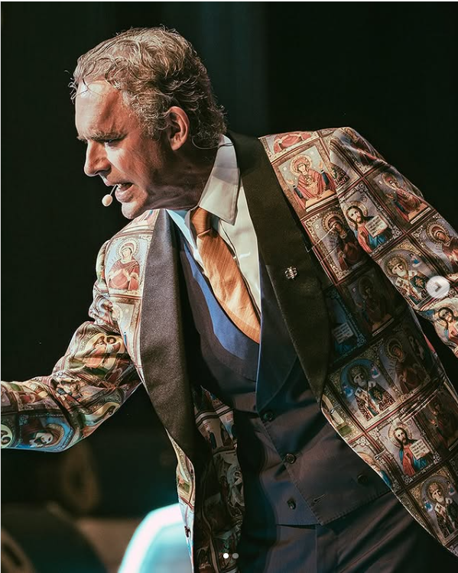
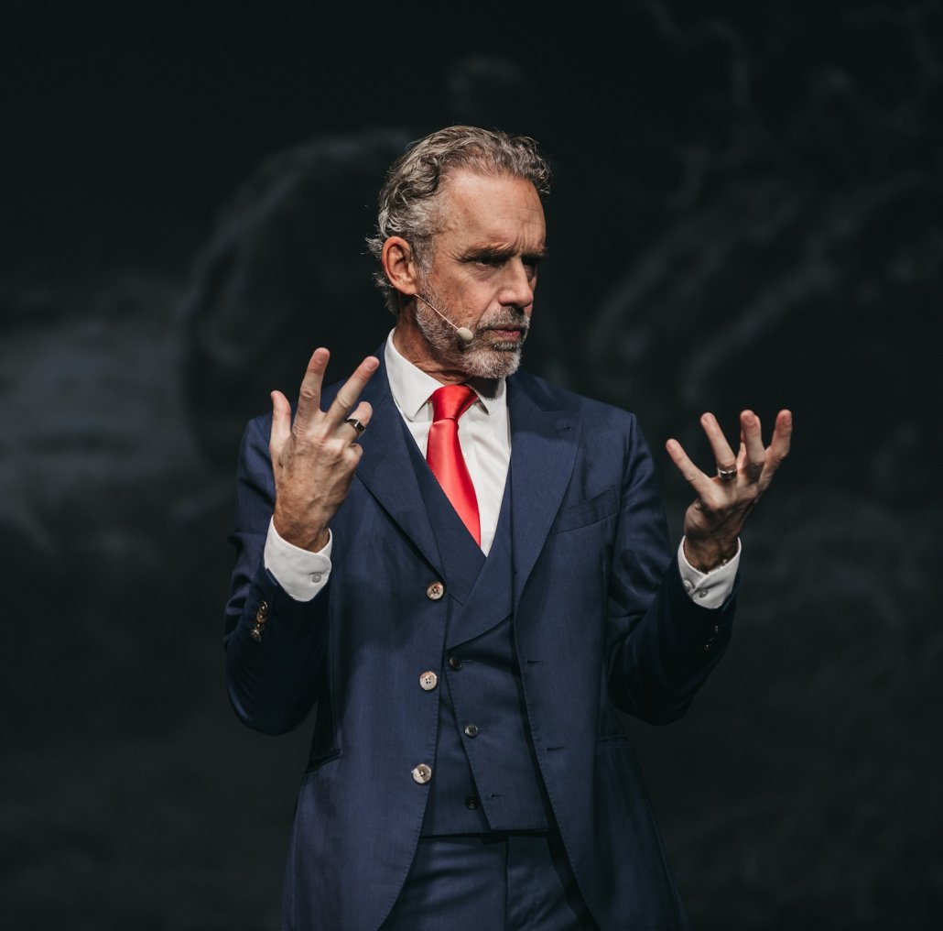
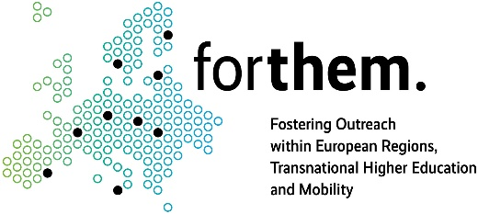
A Rigorous Intellectual or a Manipulative Provocateur? Jordan Peterson’s Rhetorical Navigation of Gender Inequality in Digital Discourse
Artur Piotr Cedzich, University of Opole
Second Annual FORTHEM conference
FORTHEM – Connecting Worlds of Science and Society
January 29-31, 2025

Slide 2
Research questions and rationale
1. What dominant patterns of discursive and rhetorical strategies can be identified? 2. How do these identified patterns influence the persuasive construction of the influencer’s persona? 3. Influencer discourses shape our understanding of gender (in)equality 4. Influencer discourses legitimate actions with direct impact on our lives 5. Influencer discourses reflect and shape our understanding of our society
Second Annual FORTHEM conference
FORTHEM – Connecting Worlds of Science and Society
January 29-31, 2025

Slide 3
Dataset and… who is Jordan Peterson?
1. Dataset: 2 Interviews with Cathy Newman (Channel 4, 2018) and Helen Lewis (British GQ, 2018)
2. Corpus criteria: 1) parameter of popularity, 2) thematic parameter of feminism, 3) parameter of discursive and rhetoric strategies
3. Methodology: Critical Discourse Analysis (CDA; Eemeren, 2010; Fairclough & Fairclough 2012), Neo-Aristotelian rhetoric (Perelman & Olbrechts-Tyteca 1969; Burke 1969)
4. Jordan Peterson is a Canadian psychologist, educator, and bestselling author on topics related to existentialism, personality, society. Regarded as a public intellectual due to his frequent appearances in the media, lectures, and social media engagement have earned him both supporters and critics.
Second Annual FORTHEM conference
FORTHEM – Connecting Worlds of Science and Society
January 29-31, 2025

Slide 4
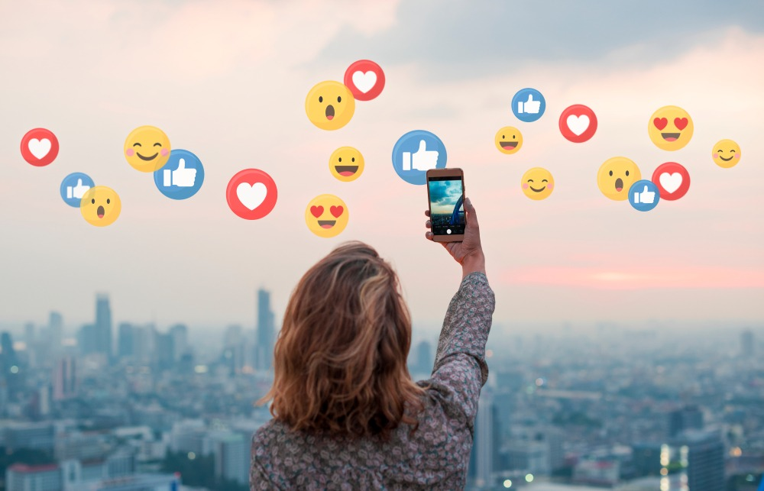
Strategies employed by other influencers
Adoption of “traditional” mainstream media roles (e.g delivering news, interviewing)
Linguistic: imperatives, repetition, praise, deictic expressions (this, that, these, those, now, then, here) for inclusion and exclusion, allusions, slanguage, prayer: youth-focused (Balagun & Akano, 2021)
Stylistic ambiguity, therefore evading platform regulations and fact-checkers (Soriano & Gaw, 2022)
Casual, inclusive language, narratives (Prudencio et al. 2023), calls to action (Nnaemeka & Udoh, 2024), emoji use (Ge & Gretzel, 2018) to produce a relatable persona
Second Annual FORTHEM conference
FORTHEM – Connecting Worlds of Science and Society
January 29-31, 2025

Slide 5
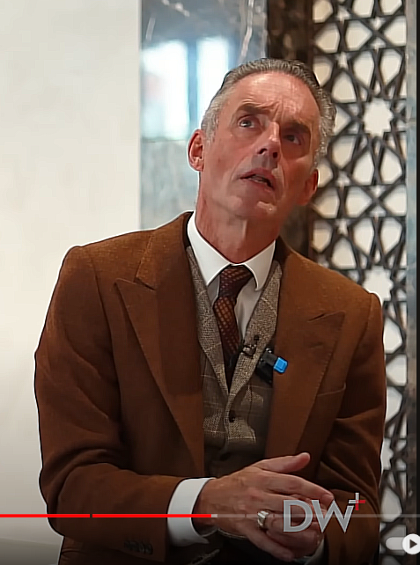
and… strategies found in Peterson’s discourse
1. Life as a game metaphor Framing life as a structured yet flexible chess game, where rules provide order, but individuals keep the power to make decisions (individuals planning moves ahead). Image of an intellectual mentor encouraging careful, calculated thinking, yet within systemic hierarchies. 2. Psychological reframing of gender pay gap Gender pay gap linked to traits like agreeableness, presented as more common among women and influencing their career paths and salary negotiations. Contrasts with feminist claims that attribute the gap to patriarchal oppression. Projection of psychological expertise to challenge his opponents positions.
Second Annual FORTHEM conference
FORTHEM – Connecting Worlds of Science and Society
January 29-31, 2025

Slide 6
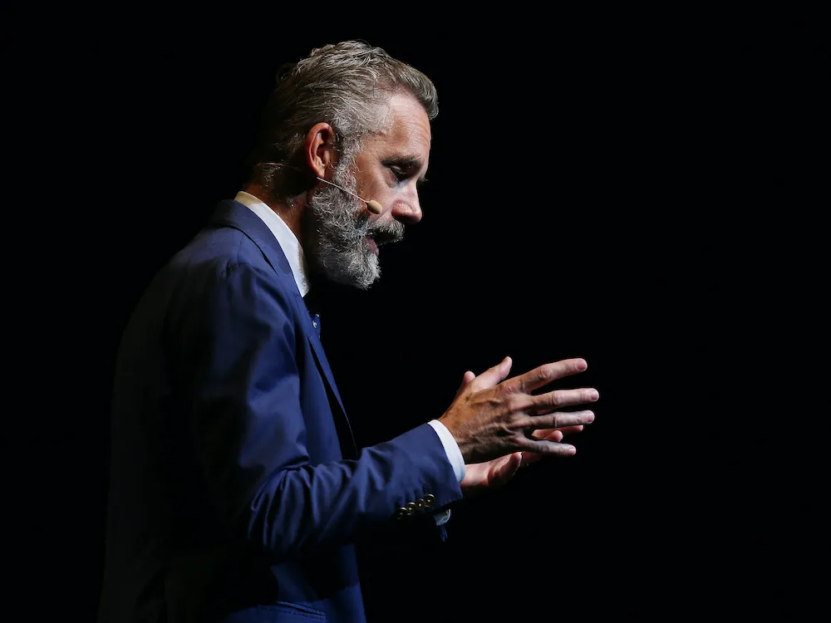
and… strategies found in Peterson’s discourse
3. Strawman argument Simplifying gendered hierarchies as roving bands of tyrannical plumbers to mock the feminist interpretations as inherently oppressive. Shift to functionality and competence, stressing everyday services. Positioning as an intellectual provocateur, grounding his arguments in vicious humour. 4. Feminism as a by-product of male-driven material progress Feminist activism rebranded as secondary to male-driven material progress (the pill, tampons, sanitary facilities). Introducing timelines (1920s feminism) to argue that technological advancements enabled women’s liberation movement with women as the main beneficiaries. Image of a paradoxical intellectual relying on material progress and temporal perspective to discredit feminist narratives
Second Annual FORTHEM conference
FORTHEM – Connecting Worlds of Science and Society
January 29-31, 2025

Slide 7
Bibliography
Prudencio, Aubrey B., Chrisente C. Sherwin, Janice A. Barcelona, Bryan Niduaza, and Princess Faith C. Tongawan. "Stylistic and Discourse Analysis of the Language of Social Media Influencers." Iconic Research and Engineering Journals 7, no. 1 (2023): 322–325 Balogun, Temitọpẹ, and Richard Akano. "Discursive strategies in the tweets and comments of virtual# Endsars protesters." Ihafa: A Journal of African Studies 12.1 (2021): 11-45. Bhatia A. 2018. Interdiscursive Performance in Digital Professions: The Case of YouTube Tutorials. Journal of Pragmatics 124: 106–20. Burke K. 1969. A Rhetoric of Motives. University of California Press.
Dan V & Arendt F. 2021. Visual Cues to the Hidden Agenda: Investigating the Effects of Ideology-Related Visual Subtle Backdrop Cues in Political Communication. The International Journal of Press/Politics 26(1): 22–45.
Dijk van T A. 1998. Ideology: A Multidisciplinary Approach. Sage
Ebben M & Bull E. 2023. Constructing Authenticity: Social Media Influencers and the Shaping of Online Identity. An Essential Guide.
Eemeren, van F. 2010. Strategic Maneuvering in Argumentative Discourse: Extending the Pragma-Dialectical Theory of Argumentation. John Benjamins.
Fairclough N. 1993. Critical Discourse Analysis and the Marketization of Public Discourse: The Universities. Discourse & Society 4(2): 133–68.
Frobenius M. 2014. Audience Design in Monologues: How Vloggers Involve Their Viewers. Journal of Pragmatics 72: 59–72.
Ge, Jing, and Ulrike Gretzel. "Emoji rhetoric: a social media influencer perspective." Journal of marketing management 34.15-16 (2018): 1272-1295.
APA
Hilkens L, Cruyff M, Woertman L, Benjamins J & Evers C. 2021. Social Media, Body Image and Resistance Training. Sports Medicine - Open 7(1): 81
Kemp S. 2024. Digital 2024: Global Overview Report. DataReportal. Accessed July 13, 2024.
Kövecses Z. 2005. Metaphor in Culture: Universality and Variation. Cambridge University Press.
Leeuwen van T. 2007. Legitimation in Discourse and Communication. Discourse & Communication 1(1): 91–112.
Melnyk, A. 2024. Professionally Focused Vlog in Pre-Service Foreign Language Teacher Education’. Teaching Languages at Higher Educational Establishments at the Present Stage. Intersubject Relations, 44: 122–37.
Messaris P. 2012. Visual Literacy in the Digital Age. Review of Communication, 12(2), 101–117.
Mısır, H. 2024. Design and Construction of a Social Media Corpus: Influencers’ Speech in Vlogs. Research in Corpus Linguistics 12(2): 203–19.
Nnaemeka, Chinso Rejoice, and Chinwe Udoh. "DISCURSIVE STRATEGIES IN SOCIAL MEDIA DISCOURSE: A STUDY OF NIGERIAN SOCIAL MEDIA INFLUENCERS." INTERDISCIPLINARY JOURNAL OF AFRICAN & ASIAN STUDIES (IJAAS) 10.3 (2024).
Soriano, C. R. R., & Gaw, M. F. (2022). Broadcasting anti-media populism in the Philippines: YouTube influencers, networked political brokerage, and implications for governance. Policy & Internet, 1– 17. https://doi.org/10.1002/poi3.322
Perelman Ch & Olbrechts-Tyteca Lucie. 1969. The New Rhetoric: A Treatise on Argumentation. University of Notre Dame Press.
Roberts W R. 2004. Aristotle’s Rhetoric. Dover Publications.
Roozenbeek J & Linden van der S. 2019. The Fake News Game: Actively Inoculating against the Risk of Misinformation. Journal of Risk Research, 22(5), 570–580.
https://www.youtube.com/watch?v=gqS1ov4lSI0
Wodak R & Meyer M. 2009. Critical Discourse Analysis: History, Agenda, Theory, and Methodology. Methods for Critical Discourse Analysis: Sage: 1-33.
https://www.google.com/url?sa=i&url=https%3A%2F%2Fwww.legalshield.ca%2Fblog%2Fdo-you-need-an-influencer-to-market-your-business%2F&psig=AOvVaw1ffpMkgyTQv9VbKqkES5yV&ust=1737993781596000&source=images&cd=vfe&opi=89978449&ved=0CBQQjRxqFwoTCNDImMPhk4sDFQAAAAAdAAAAABA5
https://www.google.com/url?sa=i&url=https%3A%2F%2Fseodigitalgroup.com%2Finfluencer-definition%2F&psig=AOvVaw1ffpMkgyTQv9VbKqkES5yV&ust=1737993781596000&source=images&cd=vfe&opi=89978449&ved=0CBQQjRxqFwoTCNDImMPhk4sDFQAAAAAdAAAAABBJ
https://www.google.com/url?sa=i&url=https%3A%2F%2Fjaaqob.pl%2Finfluencer-marketing-w-social-media-poznaj-skuteczne-strategie-i-praktyki%2F&psig=AOvVaw1ffpMkgyTQv9VbKqkES5yV&ust=1737993781596000&source=images&cd=vfe&opi=89978449&ved=0CBQQjRxqFwoTCNDImMPhk4sDFQAAAAAdAAAAABBR
https://tourismregina.com/wp-content/uploads/2024/11/Jordan-Peterson-F-1030x1016.jpg
https://www.instagram.com/jordan.b.peterson/p/DCZzWezSc1e/?img_index=1
Second Annual FORTHEM conference
FORTHEM – Connecting Worlds of Science and Society
January 29-31, 2025

Slide 8
Which one is he? Manipulative Provocateur or a Rigorous Intellectual? Thank you!
Second Annual FORTHEM conference
FORTHEM – Connecting Worlds of Science and Society
January 29-31, 2025

