Slide 1
Beyond spectatorship: performativity, interactivity and social transformation in the Sibiu International Theatre Festival (FITS)
Andreea Ciortea, “Lucian Blaga” University from Sibiu, Romania
Second Annual FORTHEM conference
FORTHEM – Connecting Worlds of Science and Society
January 29-31, 2025
Notes:
The topic of my research is Beyond spectatorship: performativity, interactivity and social transformation in the Sibiu International Theatre Festival (FITS). This is a part of my PhD thesis, on performativity and the traits of the festival public sphere built within the Sibiu Theatre Festival. I chose this topic due to the literature gap in defining performing arts festivals essentially by means of their performative component, understood as embedding the public in their construction. The curatorial perspective at play here illustrates how values, norms and interactions are designed to illustrate a distinct public sphere where everything can be questioned, but within cultural norms.

Slide 2
Introduction
The research intrigue: the silence regarding performativity in the theatrical public sphere
Research goal: analyzing the extent to which the organizers of the International Theatre Festival from Sibiu configure the foundations of a performative arena
Research subjects: the organizers of the Sibiu International Theatre Festival
Findings
Second Annual FORTHEM conference
FORTHEM – Connecting Worlds of Science and Society
January 29-31, 2025
Notes:
While performativity stands as a fundamental cornerstone of performing arts, shaping everything from the actor-audience relationship to the creation of meaning itself, empirical research has often overlooked its centrality. Contemporary studies focus on more readily quantifiable aspects of performing arts production and reception, thus creating a significant gap between theoretical frameworks and evidence-based studies that could validate and enrich our understanding of how performativity actually functions in contemporary performing arts practice. Drawing on Fischer-Lichte's theoretical framework, which positions performativity at the intersection of aesthetic and social dimensions, we examine the extent to which the organizers of the International Theatre Festival from Sibiu configure the foundations of a performative arena. Thus, the research objectives reside in understanding the festival's curatorial vision and programming strategies; the approaches to audience engagement and participation; the implementation of interactive elements in performances and festival activities; the festival's impact on local and international communities; and its envisagesdcontribution to social and cultural development. The findings reveal how FITS serves as a laboratory for experimenting with new forms of theatrical expression and audience engagement, while balancing artistic innovation with community development goals. The festival's programming demonstrates a strategic approach to fostering cultural dialogue and social transformation through performing arts.

Slide 3
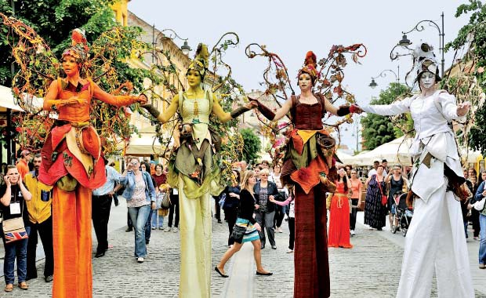
Performativity: the theoretical blueprint
The origins and original meaning of performativity
Ephemerality and the mediatization of performance
Repetition and subversion (Judith Butler)
Participation and co-creation
The political and social dimension
Second Annual FORTHEM conference
FORTHEM – Connecting Worlds of Science and Society
January 29-31, 2025
Notes:
The concept of performativity in the performing arts has been approached from multiple theoretical perspectives, each contributing to a more nuanced understanding of how artistic actions and events produce and transform social, cultural and political realities. The origin of the term is closely linked to the theory of speech acts developed by J.L. Austin, who introduced the notion of 'performative act' to describe linguistic expressions that not only describe but also perform an action. This idea was later taken up and adapted in the field of performing arts, where performativity has come to refer not only to the action character of art, but also to its capacity to bring about change in the real world.In the context of performing arts, performativity has been associated in particular with the artist's body and how it becomes a medium through which ideas, emotions and social relations materialize. Theorists such as Peggy Phelan have emphasized the importance of ephemerality and physical presence in performance, arguing that the essence of performativity lies in its uniqueness and unrepeatability. Phelan emphasized that the performance exists only in its moment of production, which distinguishes it from other art forms that can be reproduced or documented without losing its integrity. This perspective has been criticized by other theorists, such as Philip Auslander, who has argued that performance can be mediatized and reproduced without losing its performative character entirely, thus emphasizing the complexity and diversity of forms of performativity in the digital age. Another central aspect of performativity in the performing arts is related to the concept of 'citation' and 'repetition', introduced by Judith Butler in the context of her theorizing on gender and identity. Butler extended the notion of performativity beyond the linguistic sphere, applying it to analyze how gendered identities are constructed and perpetuated through repeated practices. In the performing arts, this idea has been taken up to explain how performance can destabilize social and cultural norms through repetition and reinterpretation. By quoting and recontextualizing gestures, attitudes or discourses, performance can reveal their conventional and unsettled character, opening up the possibility of social transformations.Performativity has also been associated with the notion of 'participation' and 'co-creation' in the performing arts. Theorists such as Nicolas Bourriaud have explored how performance can function as a space of exchange and interaction between artist and audience, transforming performance into a collective event. In this context, performativity is not limited to the actions of the artist, but extends to the involvement of the audience, who become active participants in the production of meaning. This perspective has also been developed in postdramatic theatre theory, where Hans-Thies Lehmann has emphasized that performativity in contemporary theatre goes beyond the limits of the dramatic text, focusing on direct experience and the relationship between stage and auditorium.In addition, performativity was analyzed in relation to the concept of liveness, which has been the subject of intense debate in performing arts theory. While some theorists, such as Phelan, have argued that performance is essentially linked to physical presence and its moment of production, others, such as Auslander, have argued that the notion of liveness has been redefined in the digital age, where performance can be transmitted and experienced through screens. This discussion opened up new research directions on how technology influences and reconfigures performativity in the performing arts. Another important aspect of performativity in the performing arts is its political dimension. Theorists such as Jacques Rancière have explored how performance can function as a space of contestation and emancipation, opening up the possibility of new forms of subjectivity and collectivity. Rancière introduced the concept of the 'distribution of the senses' to describe how performing arts can redistribute social roles and positions, thereby challenging existing hierarchies and norms. In this sense, performativity is not only a tool of artistic expression, but also a means of political and social intervention.Performativity has also been analyzed in relation to the notion of 'corporeality' and 'embodiment'. Theorists such as Erika Fischer-Lichte have explored how the artist's body becomes a site for the negotiation of meanings and social relations in performance. Fischer-Lichte has emphasized that performativity involves not only physical actions, but also transformations of the spectator's perception and experience. Through its curatorial vision, performance can provoke changes in the way we perceive and understand the world, opening up the possibility of new forms of knowledge and experience.

Slide 4
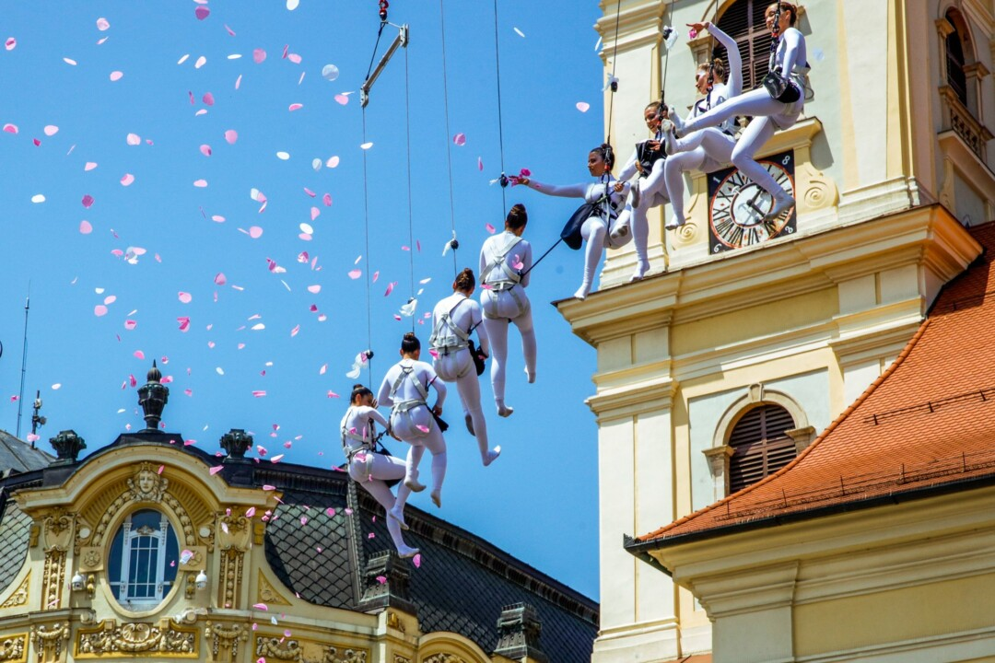
Festivals in the cultural public sphere
The salience of performativity in the cultural public sphere
Performative dimensions explored in contemporary festivals
The educational character of FITS
Second Annual FORTHEM conference
FORTHEM – Connecting Worlds of Science and Society
January 29-31, 2025
Notes:
The performative dimension of cultural public space is becoming increasingly salient in understanding how festivals reconfigure the public sphere. Sack, Meier, and Bürgisser (2025) explore the idea of intermediate spaces as sites of transition and possibility, where norms can be renegotiated and collective identities reformulated. These spaces are not fixed but emergent, constituted through fluid interactions and ongoing contestations.
Dundjerovic and Martínez Sánchez (2020) discusses the companies "Teatro Oficina" (Brazil) and "La Fura dels Baus" (Spain), which use performative processes based on ritual and collective participation, challenging dominant social structures and integrating spectators in performative actions that include explicit sexual acts. The audience is placed in unconventional contexts (e.g. slaughterhouses, abandoned industrial spaces) and exposed to violence, nudity and simulated sexual acts.
It is important to highlight, though, that the performative dimension of each festival has its cultural limitations, as there are certain publics who consider subjects like sexuality to be taboo and offensive
Rahău (2019) approaches the educational character of the public cultural space established by the Sibiu International Theatre Festival- but without explicitly mentioning this aspect- problematizing both the types of education implicit in the festival (formal, non-formal, informal) and the emergence of a new type of audience through the existence of the volunteer program. What emerges from Rahău's (2019) approach is that education through culture is the performative one here, and thus education is the essence of the cultural public space.

Slide 5
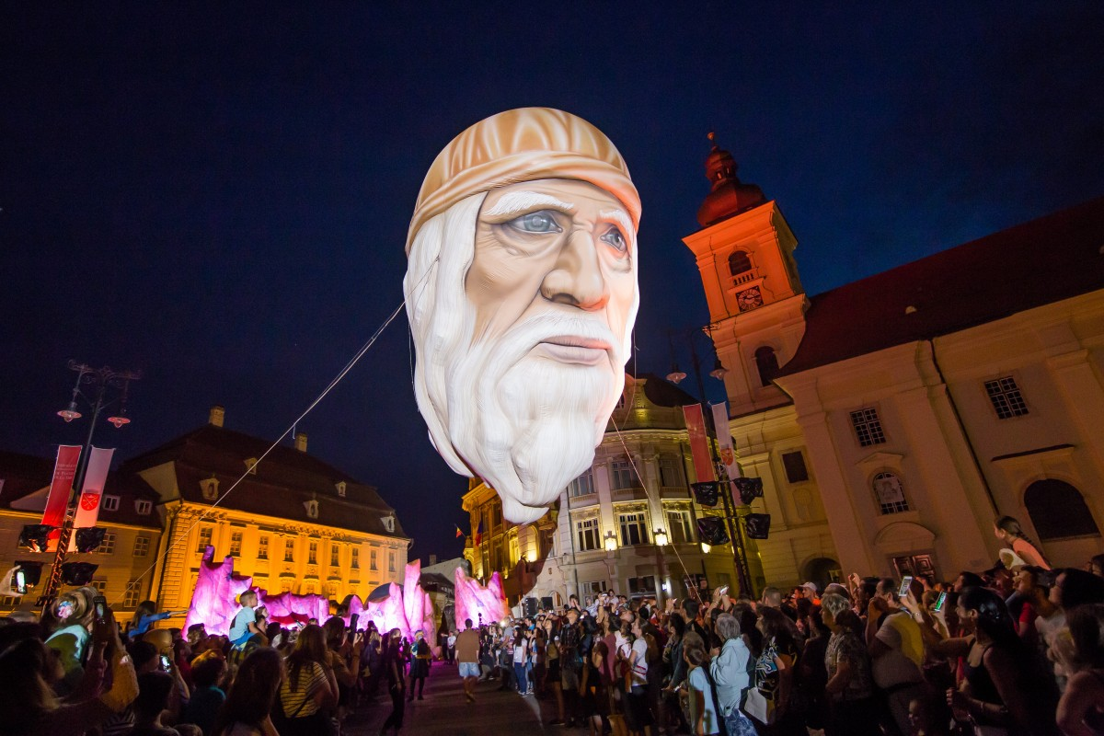
Shaping the theatrical public sphere- curatorial visions
Trends in curatorial perspectives
Examples of innovative curatorial practices
Implications for the theatrical public sphere
Second Annual FORTHEM conference
FORTHEM – Connecting Worlds of Science and Society
January 29-31, 2025
Notes:
The curator is an influential figure in determining visibility and funding in the performing arts
At the same time, curatorial neutrality is questioned
There is a transition from the traditional to a more participatory model in curatorial practices
The theater space becomes a forum for debate and negotiation of the curatorial role
The boundaries between curators, artists and audiences become more fluid. Example: The Curators' Piece. The performance puts curators in front of the public to justify their decisions. This is illustrative of a broader trend of questioning curatorial practices
This transforms the theatrical space into a place for dialog and empowerment

Slide 6
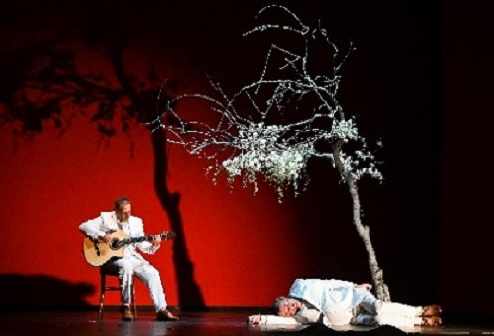
Research methodology
Objectives
Subjects of the research:
the president of Sibiu International Theatre Festival
the coordinator of the outdoor section
the coordinator of the indoor section
Coordinator: Romanian companies, performance-reading
Method: structured interviews
Second Annual FORTHEM conference
FORTHEM – Connecting Worlds of Science and Society
January 29-31, 2025
Notes:
Objectives:
Assessing the role and importance of an international theater festival in the current socio-cultural context
Identifying the curatorial lines of the last years
Analyzing the motivations and rationale behind the promotion of the festival themes.
Examining the criteria and methodology for curating the festival sections
Determining how organizers define and segment target audiences
Investigating the status and role that organizers assign to audiences within the festival
Exploring the creation of social & cultural capital for the audiences

Slide 7
Findings: embedding the public in the festival fabric (1)
📌 The festival has been framed within a historical narrative (Greek festivals, Avignon, Edinburgh)
📌FITS functions as a space of cultural diplomacy and artistic dialogue
📌 Its global legitimacy is built through his performative storytelling
Second Annual FORTHEM conference
FORTHEM – Connecting Worlds of Science and Society
January 29-31, 2025

Slide 8
Findings: embedding the public in the festival fabric (2)
📌 Performance-reading - a space where audiences can shape meaning through discussions
📌 There is an increasing emphasis on interactive festival formats
📌 The festival curates audience engagement as a dialogic process
Second Annual FORTHEM conference
FORTHEM – Connecting Worlds of Science and Society
January 29-31, 2025

Slide 9
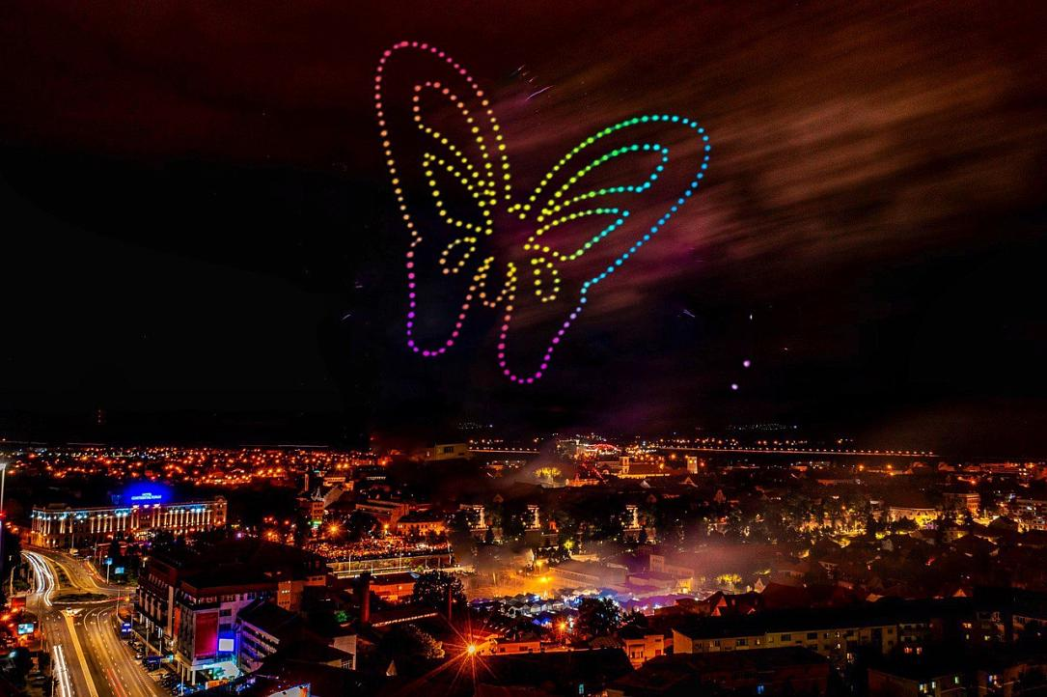
Findings: embedding the public in the festival fabric (3)
📌 FITS repurposes public squares, churches, and industrial spaces into performance venues
📌 The Culture Factory: an adaptive space for large-scale immersive productions (Faust)
📌 Site-specific performances shape audience movement and interaction
Second Annual FORTHEM conference
FORTHEM – Connecting Worlds of Science and Society
January 29-31, 2025

Slide 10
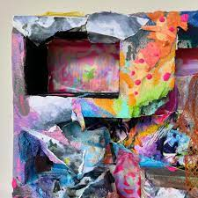
Findings: embedding the public in the festival fabric (4)
📌 Outdoor performances make FITS more accessible, reaching non-traditional audiences
📌 The festival as a “gift” → inclusion is staged but also limited by logistical and cultural barriers
Second Annual FORTHEM conference
FORTHEM – Connecting Worlds of Science and Society
January 29-31, 2025

Slide 11
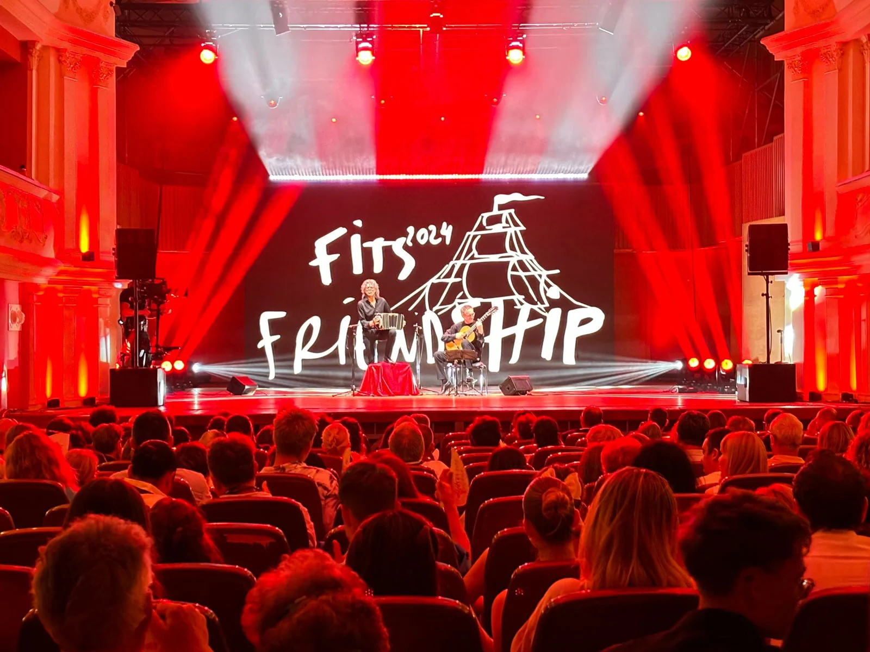
Findings: embedding the public in the festival fabric (5)
📌 Local audiences may be hesitant toward avant-garde or experimental performances
📌 The festival plays an educational role by gradually introducing new art forms to a traditionally conservative audience
📌 Educational initiatives at FITS should be expanded to cultivate openness to experimental and international artistic forms.
Second Annual FORTHEM conference
FORTHEM – Connecting Worlds of Science and Society
January 29-31, 2025

Slide 12
Selective bibliography
Dundjerovic, A. S., & Martínez Sánchez, M. J. (2018). Festival and the City: Performativity of Sexual Acts in Public Spheres. Architecture and Culture, 6(3), 457–471.
Dundjerovic, A. S., & Martínez Sánchez, M. J. (2018). Festival and the City: Performativity of Sexual Acts in Public Spheres. Architecture and Culture, 6(3), 457–471.
Ferdman, B. (2014). Role Inversion. The Curator Takes the Stage. PAJ: A Journal of Performance and Art, 36(1), 53-58.
Habermas, J. (1996). The public sphere. Media studies: A reader, 2, 92-97.
McGee, K. (2013). Promoting affect and desire in the international industrial world of smooth jazz: The case of Candy Dulfer. Jazz Perspectives, 7(3), 251-285.
Négrier, E., & Bonet, L. (2018). The participative turn in cultural policy: Paradigms, models, contexts. Poetics, 66, 64-73.
Póvoa, D. (2023). ‘The festival is ours’: Power dynamics of community participation in the Alter do Chão Film Festival. International Journal of Cultural Studies, 26(2), 200-215.
Rahău, V. (2019). Sibiu International Theatre Festival. In Lluís Bonet Agustí, Giada Calvano, Luisella Carnelli, Félix Dupin-Meynard, Emmanuel Négrier. Be SpectACTive! Challenging Participation in Performing Arts, Editoria & specttacolo, 87-94.
Sack, M., Meier, M., & Bürgisser, A. (Eds.). (2025). Performative Arts and Social Transformation: The Potential of InBetween Spaces (Theater). Bielefeld: Transcript Verlag.
Saleh, F., & Ryan, C. (1993). Jazz and knitwear. Factors that attract tourists to festivals. Tourism Management, 14(4), 289-297.
Tamisari, F. (2016). A space and time for a generation to react: The Gattjirrk Cultural Festival in Milingimbi. Oceania, 86(1), 92-109.
Second Annual FORTHEM conference
FORTHEM – Connecting Worlds of Science and Society
January 29-31, 2025

Slide 13
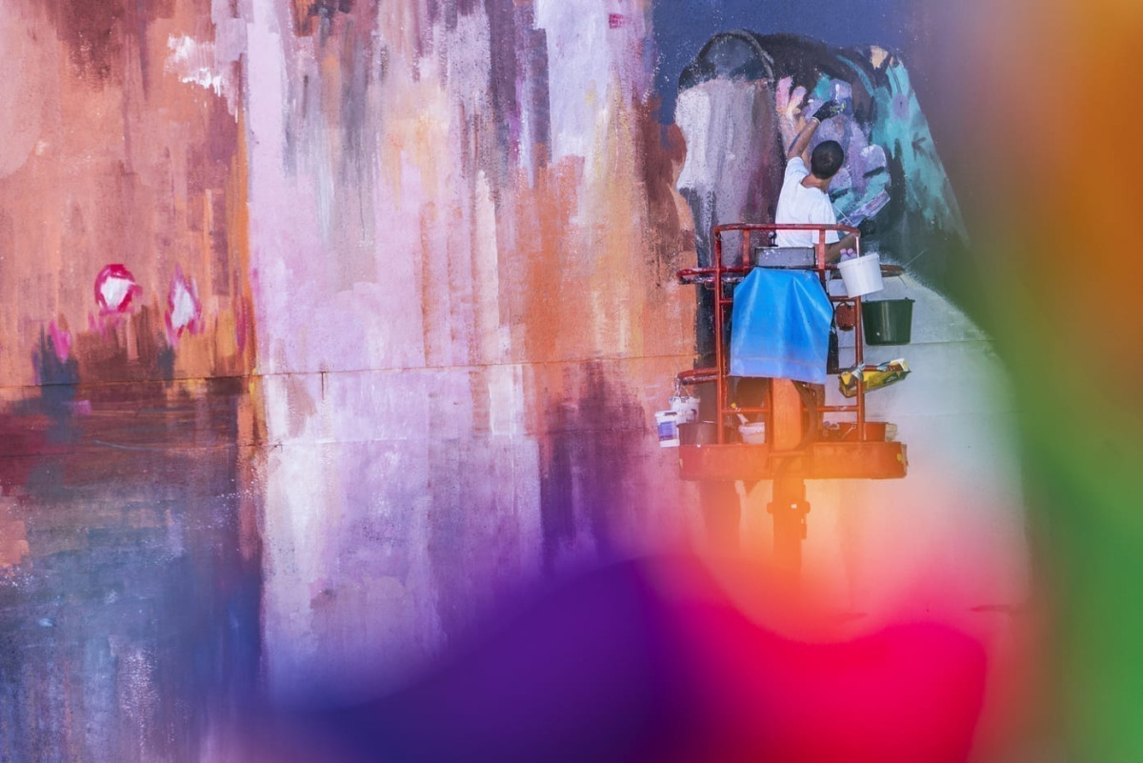
Thank
you!
Second Annual FORTHEM conference
FORTHEM – Connecting Worlds of Science and Society
January 29-31, 2025

