Slide 1
Development of a Plant-Based Alternative to Animal Milk from Chickpeas (Cicer arietinum L.)
Presented by: Sarra SAMMOUD
“Laboratory of Innovation and Valorization for Sustainable Food Industry, Higher school of food industries of Tunis (ESIAT)”
author, institution$
Second Annual FORTHEM conference
FORTHEM – Connecting Worlds of Science and Society
January 29-31, 2025

Slide 2
01
02
Introduction, issues and work’s aims
Plan
Chickpea milk’s extraction
Chickpea milk’s characterization
Conclusion
03
04
Second Annual FORTHEM conference
FORTHEM – Connecting Worlds of Science and Society
January 29-31, 2025

Slide 3
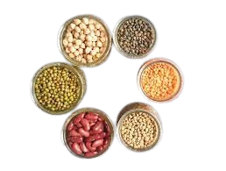
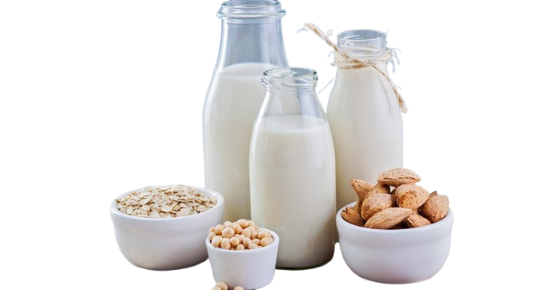
Introduction, issues and work’s aims
Surching for other alternatives
Plant-based milk
Lactose intolerance
➔ In this work, we studied an innovative extraction of a plant-based milk based on chickpeas.
Second Annual FORTHEM conference
FORTHEM – Connecting Worlds of Science and Society
January 29-31, 2025

Slide 4
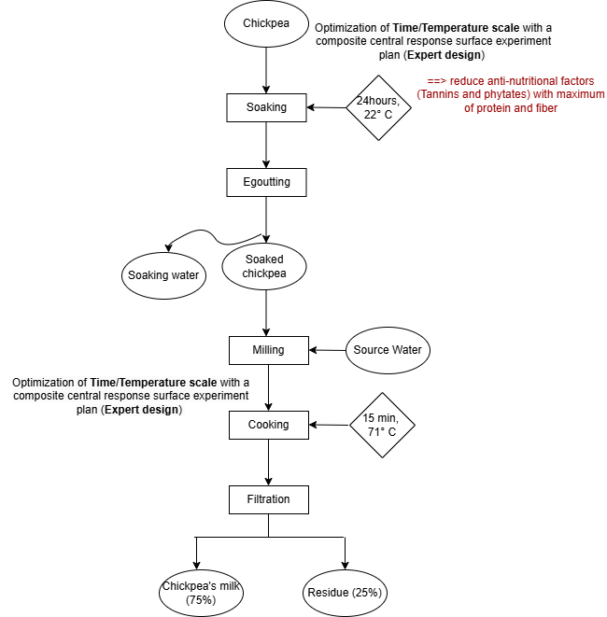
Chickpea milk’s extraction
Level | -1,414 | -1 | 0 | +1 | 1,414 | Step
Soaking Temperature actual values | 11,7°C | 22 | 41 | 60 | 68,3°C | 20,01
Soaking Time actual values | 2,3 h | 6 | 15 | 24 | 27,7h | 8,98
Cooking Temperature actual values | 63,79°C | 70 | 85 | 100 | 106,21°C | 15
Cuisson Time actual values | 2,93 min | 5 | 10 | 15 | 17,07 min | 5
Second Annual FORTHEM conference
FORTHEM – Connecting Worlds of Science and Society
January 29-31, 2025

Slide 5
Chickpea milk’s characterization
pH | 6,46
Conductivity (µs/ cm) | 2615
Moisture (%) | 92,05
Fatty acidity (mg NaOH/ g DM) | 92,05
L* | 74,69
a* | 0,45
b* | 24,19
Protein (%) | 3,2
Concentration in mg / g DM
 | Ribose | Fructose | Glucose | Galactose | Saccharose | Raffinose | Stachyose | Total
Chickpea milk | 4,52 | 17,36 | 2,42 | 37,37 | 60,82 | 17,46 | 683,61 | 823,55
Second Annual FORTHEM conference
FORTHEM – Connecting Worlds of Science and Society
January 29-31, 2025

Slide 6
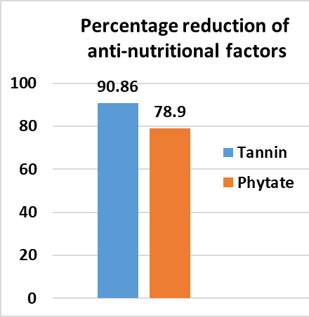
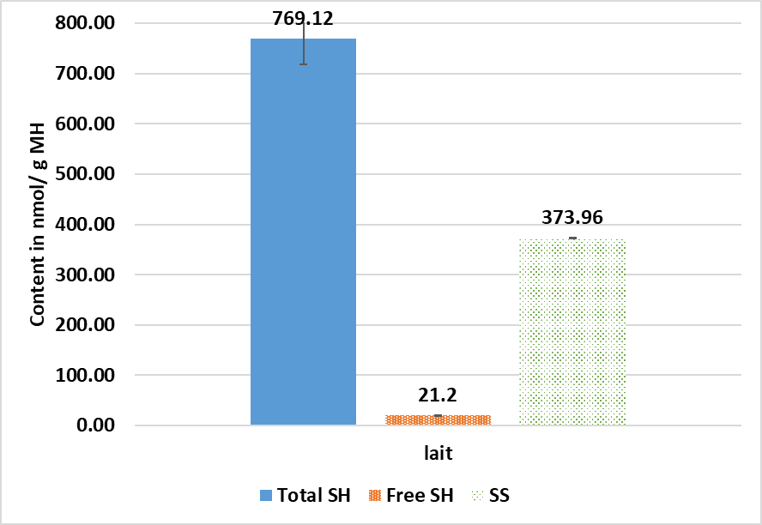
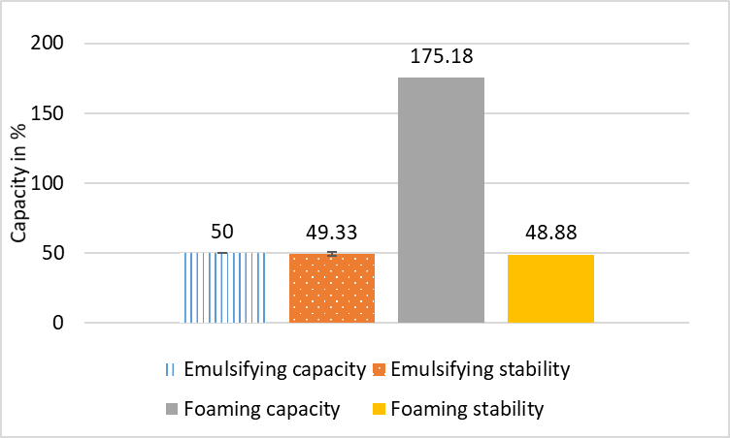
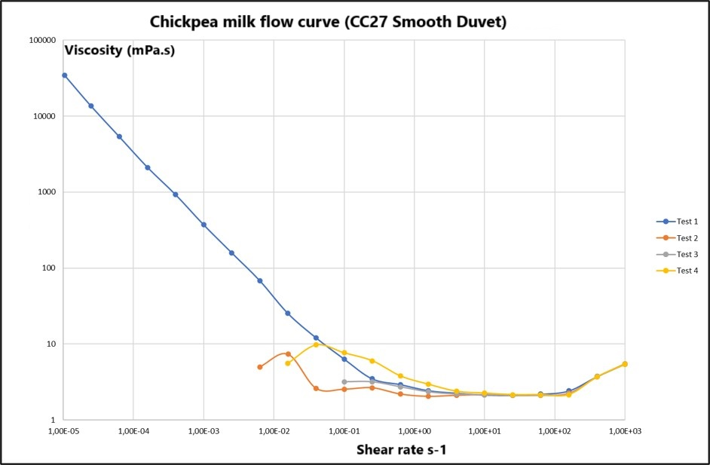
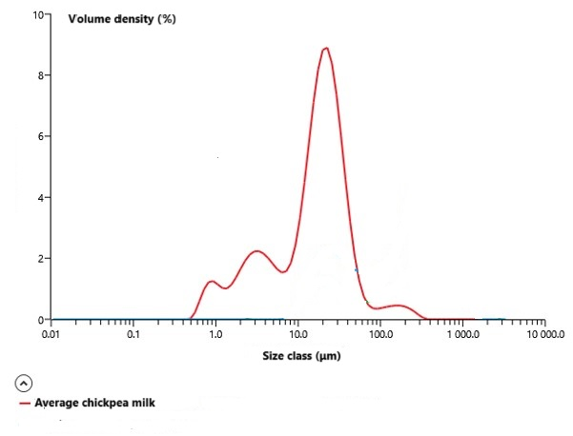
Total polyphenol= 45,71 mg EAG/ g DM
Second Annual FORTHEM conference
FORTHEM – Connecting Worlds of Science and Society
January 29-31, 2025

Slide 7
Conclusion
Based on the results obtained, we can conclude that our chickpea milk has a high nutritional value, with a minimum of anti-nutritional factor and for its valorization. functional and rheological properties interesting
Future studies will be established to investigate the potential for upgrading milk from chickpea obtained
Second Annual FORTHEM conference
FORTHEM – Connecting Worlds of Science and Society
January 29-31, 2025

Slide 8
Thank you!
Second Annual FORTHEM conference
FORTHEM – Connecting Worlds of Science and Society
January 29-31, 2025

