Slide 1
A framework for capturing student learning in challenge-based learning
Rotaru Mihaela, Kifor Claudiu-Vasile, Andron Daniela
Lucian Blaga University of Sibiu, Romania
Second Annual FORTHEM conference
FORTHEM – Connecting Worlds of Science and Society
January 29-31, 2025

Slide 2
Introduction and background
The Shift in Higher Education
Traditional higher education is evolving into a student-centered and community-responsive model.
Why Innovation in Education Matters
Universities must bridge the gap between theory and practice by fostering active, experiential learning.
The Learn.Inc Project
Second Annual FORTHEM conference
FORTHEM – Connecting Worlds of Science and Society
January 29-31, 2025

Slide 4
LEARN.INC
https://learn-inc.eu/
Meeting Stakeholders
Challenges / problems identified
PR1
Virtual Open Common Inter-university Sandbox (VOCIS)
O F T R A I N E R S
STUDENT PROJECTS (MA and PhD), approaching challenges
2 competitions
-Student applications: 83
- Projects selected for support: 59
- Final project evaluation - best projects reccomended as support for course development
Dissemination
MEs, final conference, students / scientific conferences, Research events
> 500 participants
T
R
A
I
N
I
N
G
PR2.
Project-based Teaching Incubator
(PROTINC)
COURSES - 12 courses
- information sessions
- call of proposals
- course selection and approval (criteria, deans, department chairs...)
- feedback – student survey
MOOCs and SPOCS
In-line with the EU Agenda 2019-2024 - G.I.F.T Lectures
(Green, Inclusive, Fit for Digital, Transparent)
PR3. Open Access Archive of Digital Courses (OPENARC)

Slide 5
Aim of the Study
What was the study designed to evaluate?
Student-centered learning impact
Cross-institutional collaboration
Innovative e-learning solutions addressing societal issues
Second Annual FORTHEM conference
FORTHEM – Connecting Worlds of Science and Society
January 29-31, 2025

Slide 6
What is it? A platform for cooperation, sharing and interaction of students and faculty with local stakeholders (at each partner university), as well as between the universities.
How it works? Students and staff will be able to propose pilot projects for testing innovative solutions to local challenges.
What is its added-value? It will help HEIs to improve the quality of student-led and student centered learning through digital tools
60
students have
participated in VOCIS

Slide 7
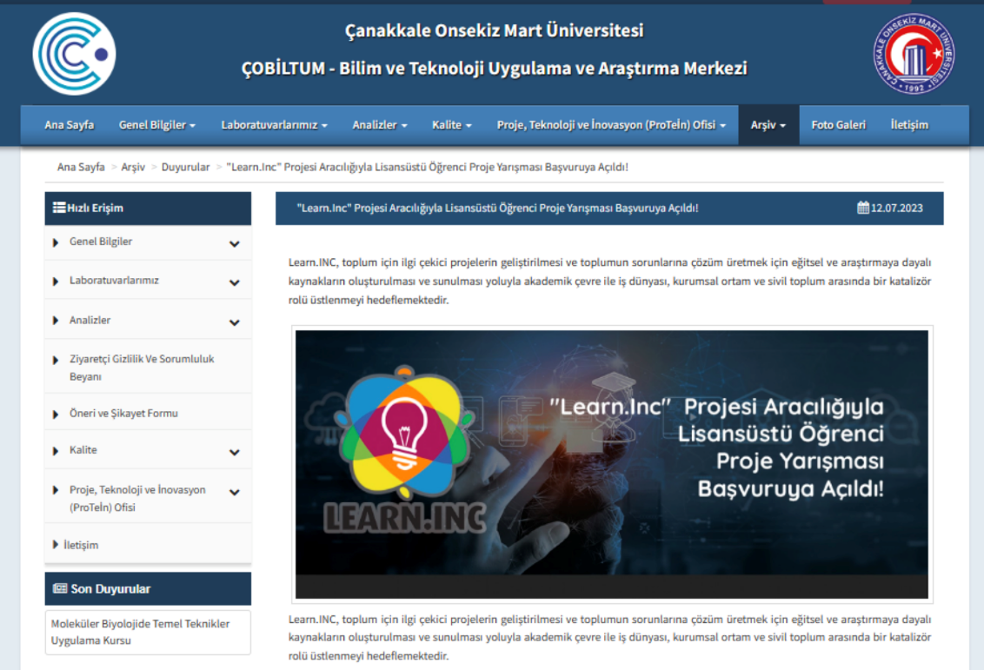
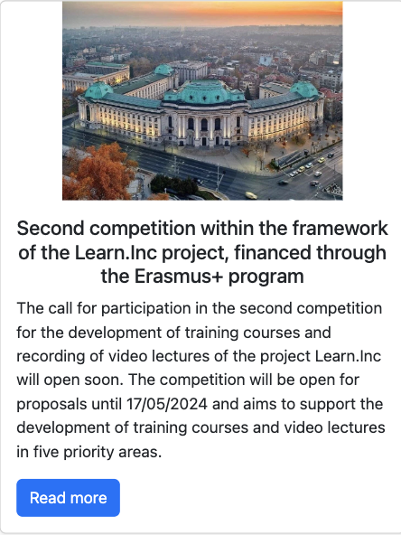
Competition for small scale projects Call for competition – 2 rounds

Slide 8
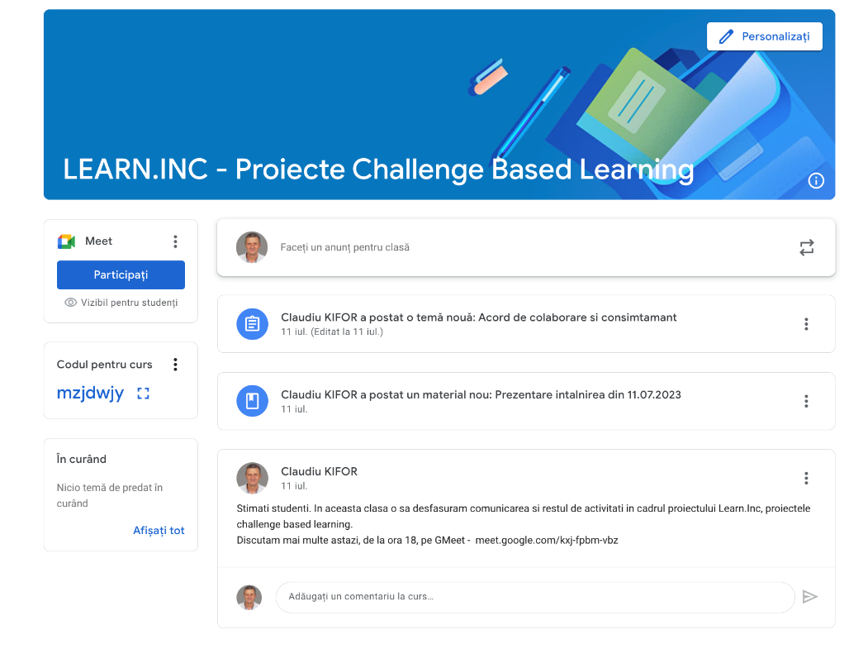
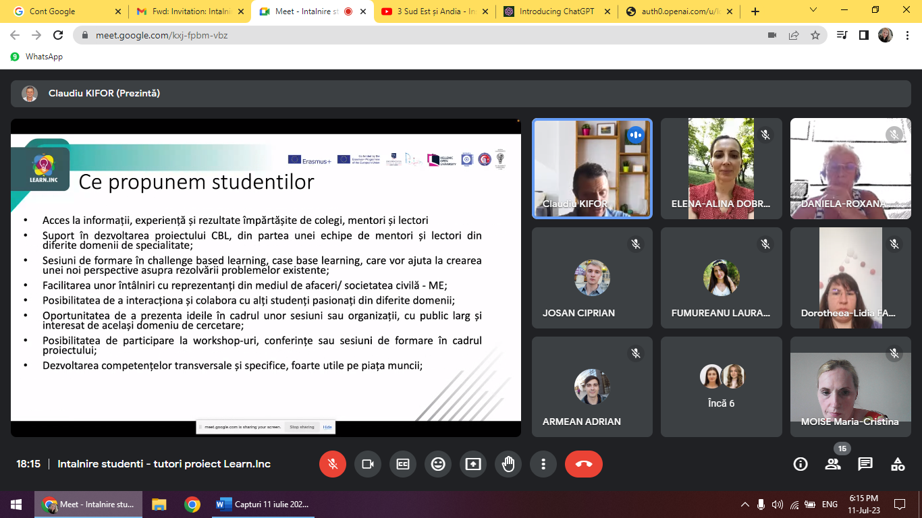
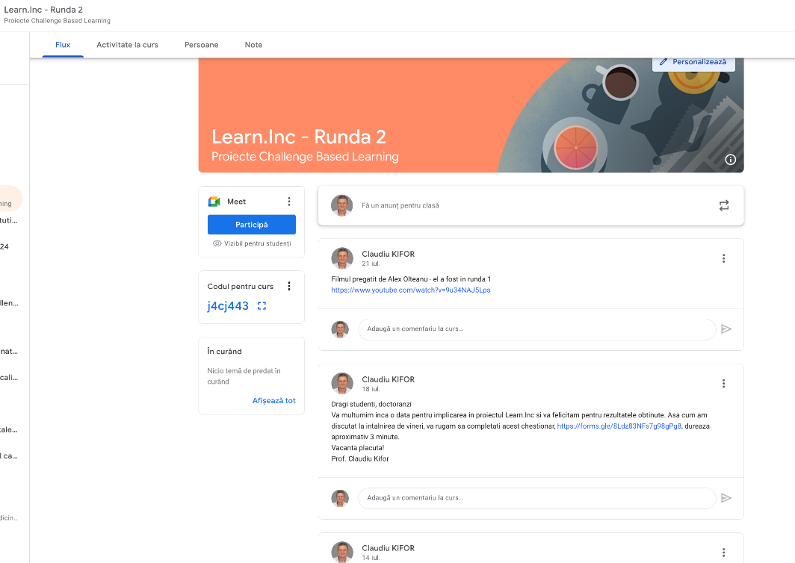
Running the projects
Communication with students
Mentoring the students
Other activities – conferences,...
Courses the students - CBL,...
Project monitoring
Projects requirements – structure, no of pages
Project evaluation
Selection – projects that support courses

Slide 9
Students coordinating small-scale projects. Satisfaction survey

Slide 10
Student Satisfaction survey

Slide 11
Student Satisfaction survey – open answers
More detailed explanation of the rules and the goal
May be the competition can be extended with some award management system
Mentor list can involve stakeholders also. Not just academics
More exchange information with other students
Wider network of Universities participating to relevant competitions
Further IT support and tools could better enhance the whole process
Improve IT tools for communication and collaboration
To add more students to the program
It would be great to share all projects which participated in one place and follow their development in time and in different regions.

Slide 12
What is it? Institutionalized set of procedures enabling the transformation of challenge-based ideas into formal learning content.
How it works? Faculty members and students will be able to develop new course content based on VOCIS results and to pilot new learning resources.
What is its added-value? It ensures that the course content responds to societal needs and encourages active participation of students.
12
proposals supported and developed in full courses

Slide 13
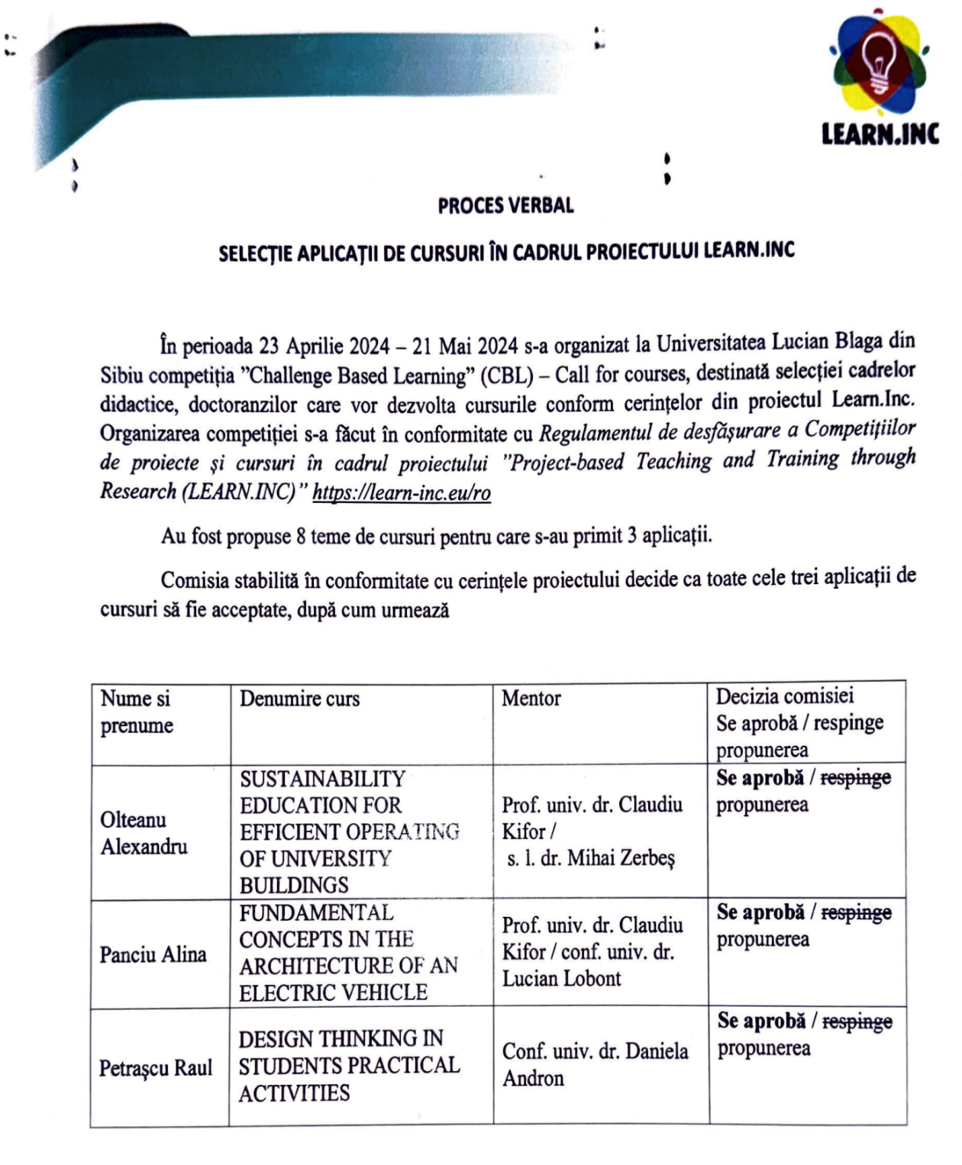
PR2 - Protinc
R2/A3. Gather teams of faculty mentors to work with faculty/students, wishing to design a course.
R2/A4. Open a call for proposals at each HEI (and at consortium level), complete with selection procedures.

Slide 14
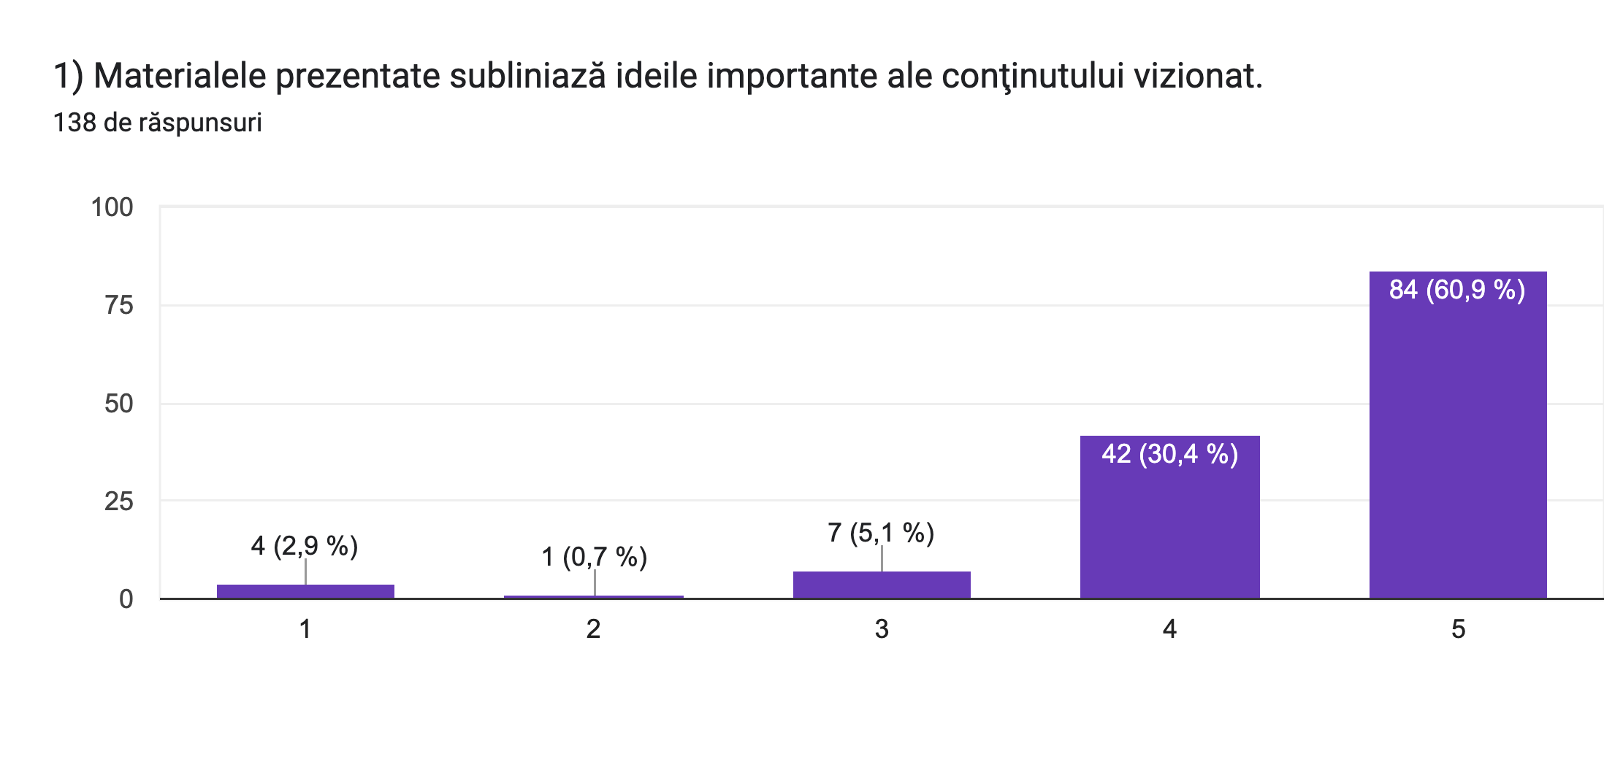
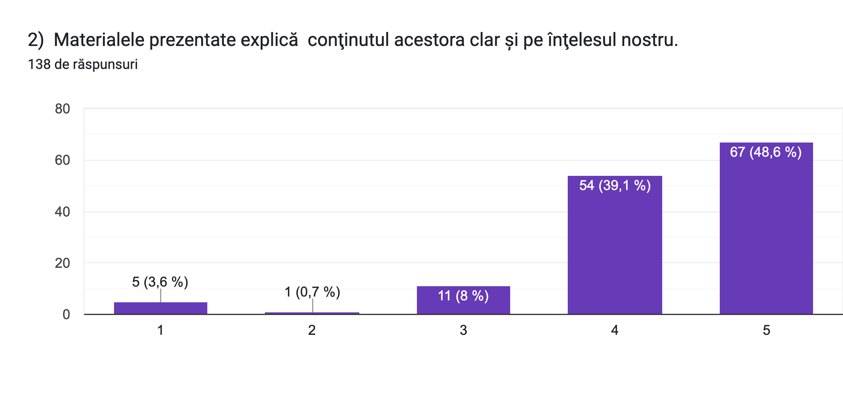
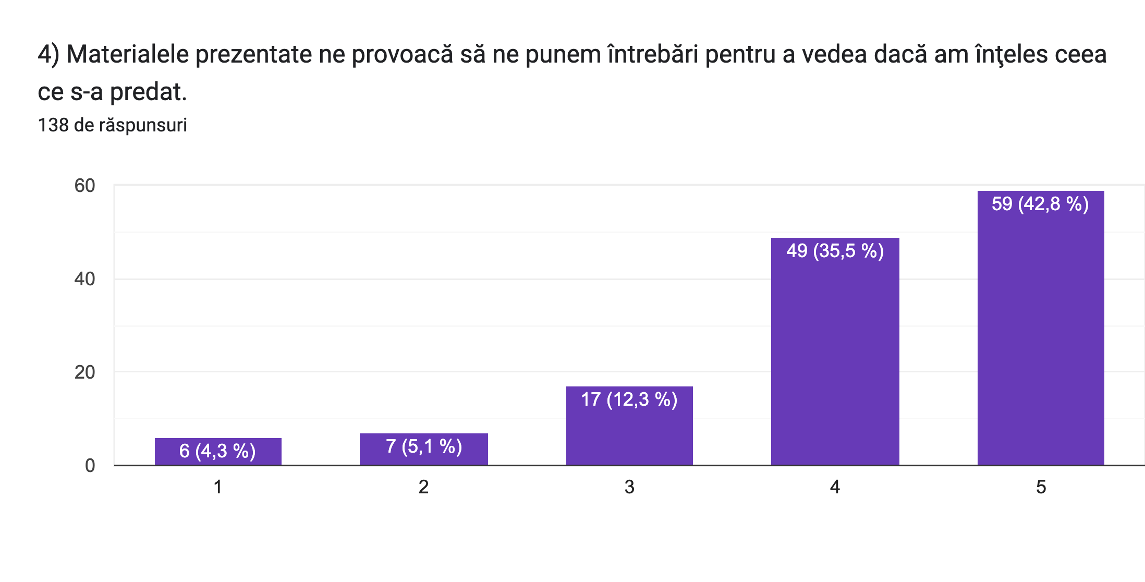
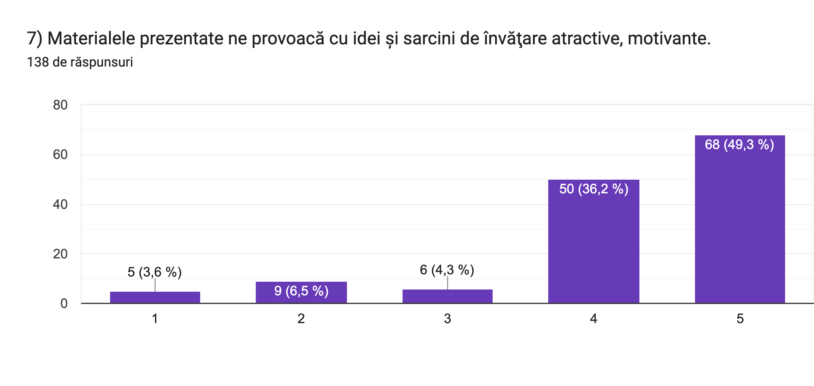
Feedback. Courses evaluation by students.

Slide 15
What is it? A collection of accessible and shareable video format lectures.
How it works? Series of joint open access e-learning short intense courses with a more specialized content or short online courses in video formal will be generated.
What is its added-value? It is targeted at students, but its format (practice-oriented, going beyond certain formal academic borders) make it suitable for a larger group of trainees.
Open Access Archive of Digital Courses Created

Slide 16
Key Findings
Cross-institutional collaboration was strengthened
Students actively co-designed flexible, modular e-learning solutions
Mentorship & stakeholder engagement were highly valued
Real-world problem-solving boosted learning relevance
Second Annual FORTHEM conference
FORTHEM – Connecting Worlds of Science and Society
January 29-31, 2025

Slide 17
Areas for Improvement
Broader dissemination of project outcomes
Need for better IT support
Expanded networking opportunities
Second Annual FORTHEM conference
FORTHEM – Connecting Worlds of Science and Society
January 29-31, 2025

Slide 18
Thank you!
[Acknowledgements]
EU Erasmus+ Programme funding
Project code: Learn.Inc 2021-1-RO01-KA220-HED-000031136
Thank you to all consortium members, students, and stakeholders
Second Annual FORTHEM conference
FORTHEM – Connecting Worlds of Science and Society
January 29-31, 2025

Slide 19
PR2. Courses / Videos - LBUS
Design thinking for seminar activities in technical disciplines https://www.youtube.com/@LEARNINCGRANT/playlists Fundamental concepts in the architecture of an electric vehicle https://www.youtube.com/@LEARNINCGRANT/playlists Sustainability in the efficient operation of higher education institutions buildings based on Smart energy systems https://www.youtube.com/@LEARNINCGRANT/playlists Challenge based learning https://www.youtube.com/playlist?list=PLnlRBOOJAtvmr2TRuGjWPvsKiiKqJKw4h

Slide 20
PR2. Courses / Videos – Sofia Uni
Climate change and green transition: https://youtube.Com/playlist?List=plgxfyuvzmjulatobrjsskm7_bfxsgzn8c&feature=shared
Resilience and crises: https://youtube.com/playlist?list=PLGxfyuvzMjUL6aAba18rMGgulhAxz3MYG&feature=shared
Knowledge and innovation: https://youtube.com/playlist?list=PLGxfyuvzMjUItPXMdaB9aFxUVfmvmdl_3&feature=shared

Slide 21
PR2. Courses / Videos – HOU - Patras
Design thinking in adaptive organizations. 4 Units:
https://www.youtube.com/watch?v=LT63jVQyoH8
https://www.youtube.com/watch?v=Iy6JQo0B3jY
https://www.youtube.com/watch?v=LCmGOLS-9E0
https://www.youtube.com/watch?v=jv-4LpqAjEM
2. Fundamental concepts in organisation’s change. 4 units:
https://www.youtube.com/watch?v=lhBo9MTKlvE
https://www.youtube.com/watch?v=3D5c0gQ7Am4
https://www.youtube.com/watch?v=-xF-q8kpfCQ
https://www.youtube.com/watch?v=4fAuWobWcNw
3. Managing resistance to change / Sustainability education for effective decision making. 4 Units
https://www.youtube.com/watch?v=SmzrRt2vhLQ
https://www.youtube.com/watch?v=c6zFnZFg7yk
https://www.youtube.com/watch?v=iaigKG7XCwE
https://www.youtube.com/watch?v=kyDL0OVRWTY

Slide 22
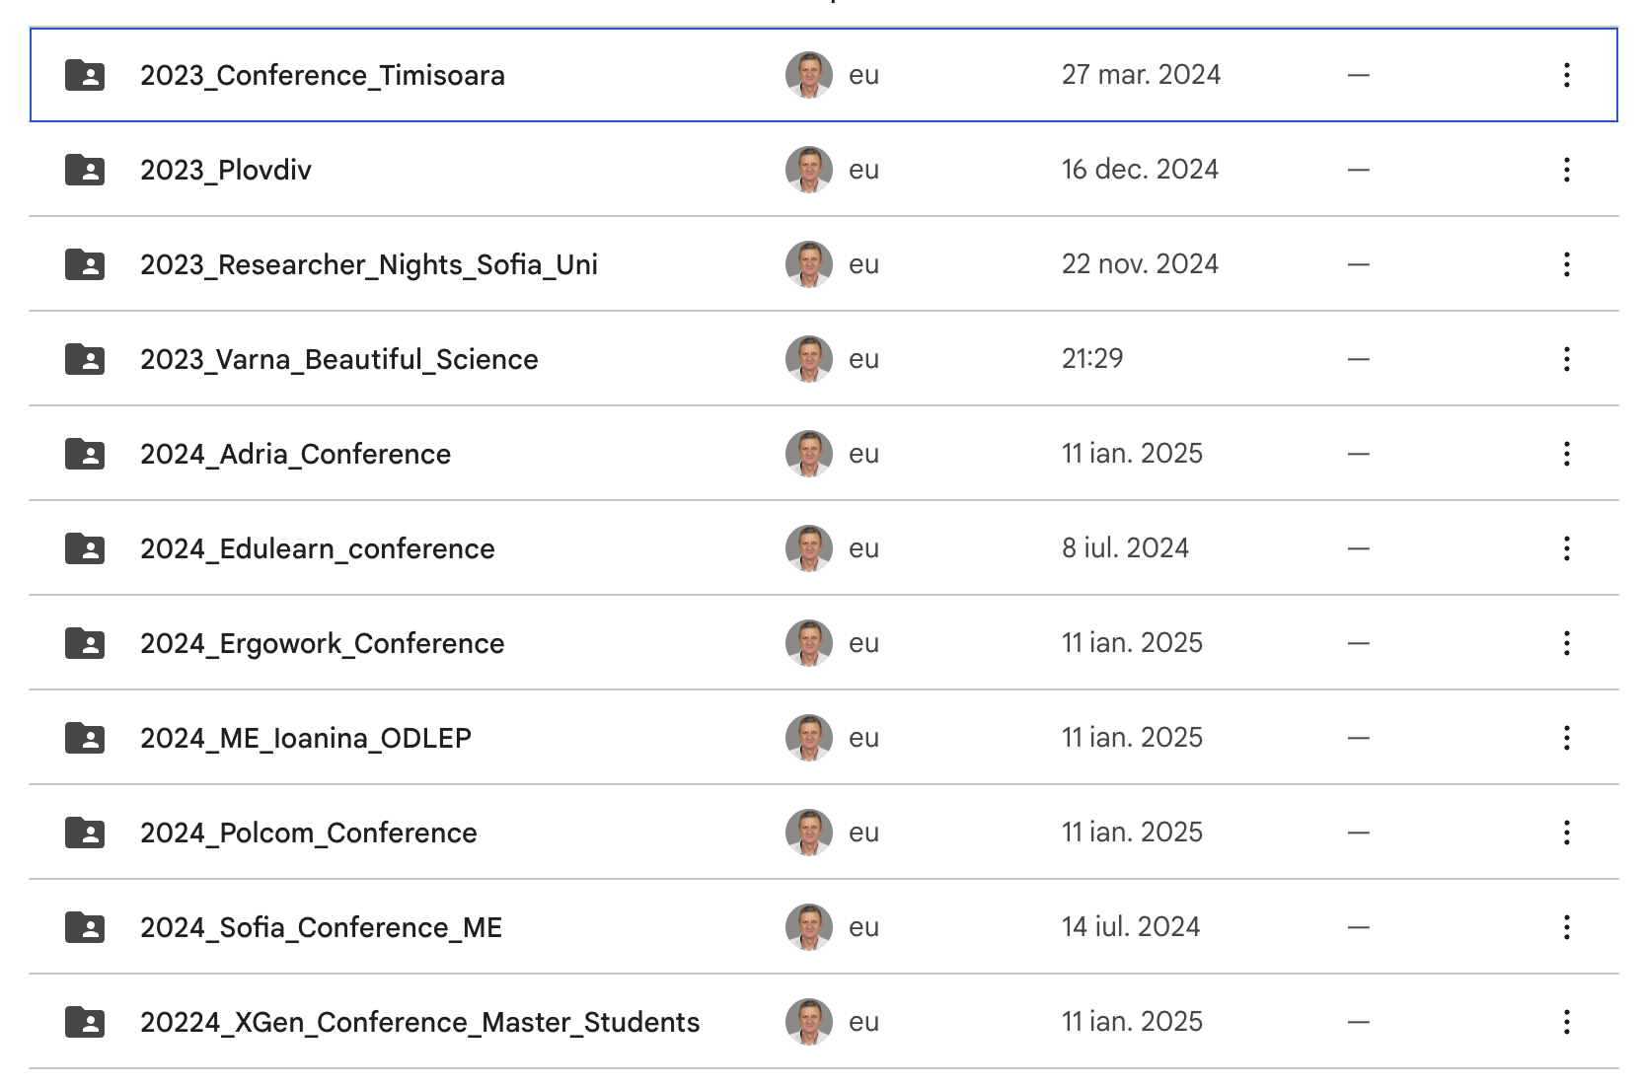
Dissemination

Slide 23
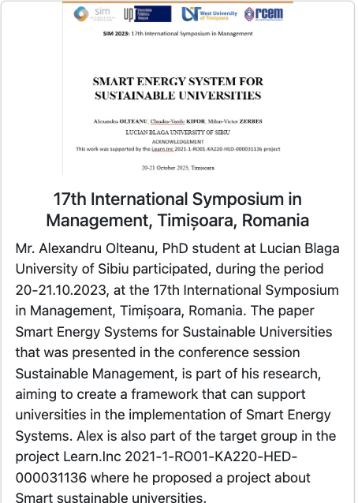
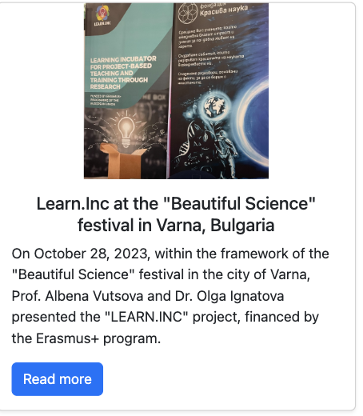
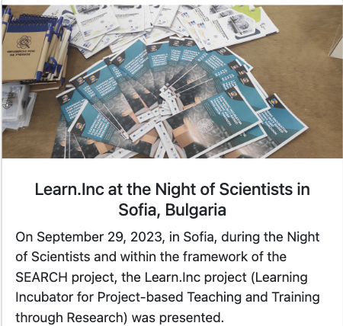
Dissemination

Slide 24
Conferences, journals where we published the results
Kameas, A., Takouli, V., Kifor, C. V., Vutsova, A., Celik, K., Learning incubator for project-based teaching and training through research, EDULEARN24, Spain, July 2024. https://iated.org/edulearn/
Barsan R. M.,, Kifor, C. V., Kifor, S., Participatory research using a design thinking approach, EDULEARN24, Spain, July 2024. https://iated.org/edulearn/
PhD and postgraduate students projects presented to international conferences
Olteanu, A. (phd student in Learn.Inc), Kifor, C. V., Zerbes M., Smart Energy System For Sustainable Universities, 17th International Symposium in Management, Timisoara, 20-21 October, 2023 https://www.sim2023.eu. (to be published in WoS journal)
Petrascu, R. M. (phd student in Learn.Inc), , Racz, S. G., Avrigean, E., Examining Bending Deformation in 3D Printed Polylactic Acid: A Comparative Study of a Sample with and without Copper Wire Integration, 40th Danubia-Adria Symposium on Advances in Experimental Mechanics, Gdańsk, September 24 - 27, 2024 https://das2024.pl.
Petrascu, R. M. (phd student in Learn.Inc), , Racz, S. G., Avrigean, E., Joule Heating-Induced Self-Deformation of 3D-Printed Electrically Conductive PLA for Smart Gripping Applications, Polcom conference, 2024.
Alina Panciu (PhD student in Learn.Inc) and Lucian Lobont, The relation between ergonomic factors, employee turnover and customer complaints. An empirical case study in an auto repair shop, 3rd International Conference of the Romanian Society on Ergonomics and Workplace Management, Bucharest, Romania, October 2024 https://www.mpt.upt.ro/cercetare/conferinte/ergowork.html
Alina Panciu (PhD student in Learn.Inc), Lucian Lobonț and Mihai Victor Zerbes, Is the European infrastructure ready for long haul electric transportation? An analysis of a freight transport from Romania to Germany using an electric semi-trailer truck, UNIVERSITARIA SIMPRO 2024, Petroșani, Romania, October 2024, https://www.upet.ro/simpro/2024/
Caibar, Cosmina (student, in Learn.Inc), Contributions to the study of the diversity of edafic beetle populations in sub-Arini park in Sibiu, Romania, XGEN International Conference on Science Communications. 20-24 Mai, Baia-Mare, Romania https://events.universitas.ro/event/4/. Coordinator Cristina Moise
Cata, Daniela (student, in Learn.Inc) The natural and anthropogenic impact on water quality: a preliminary view on the Sebeș river, Alba county, XGEN International Conference on Science Communications. 20-24 Mai, Baia-Mare, Romania https://events.universitas.ro/event/4/Coordinator Cristina Moise
Rusu Roxana (student, in Learn.Inc), The study on the sources of environmental pollution in the city of zlatna, Alba County, XGEN International Conference on Science Communications. 20-24 Mai, Baia-Mare, Romania https://events.universitas.ro/event/4/Coordinator Cristina Moise

