Slide 1
Urban Preparedness
Baltic Sea Region
Dr.sc.pol. Ieva Birka
Dr.sc.pol. Didzis Kļaviņs
University of Latvia

Slide 2

Civil Preparedness for Emerging Risks: Riga, Helsinki, German cities
The research is financed by the Recovery and Resilience Facility project "Internal and External Consolidation of the University of Latvia" (No.5.2.1.1.i.0/2/24/I/CFLA/007).

Slide 3
Survey: Urban Preparedness
Implemented in Latvia, Finland, and Germany by NORSTAT
Online, Computer Assisted Web Interviews
18-74 y.o. Riga, Helsinki, Berlin/Hamburg/Munich
1000 each
April-May 2024
Further planned April-May 2025

Slide 4
Total Defence Approach
Total defence approach to national security strategy entails the active involvement and preparedness of all sectors of society and individuals taking responsibility for their own level of readiness to respond to crisis and security challenges.
But are residents aware of their role?

Slide 5
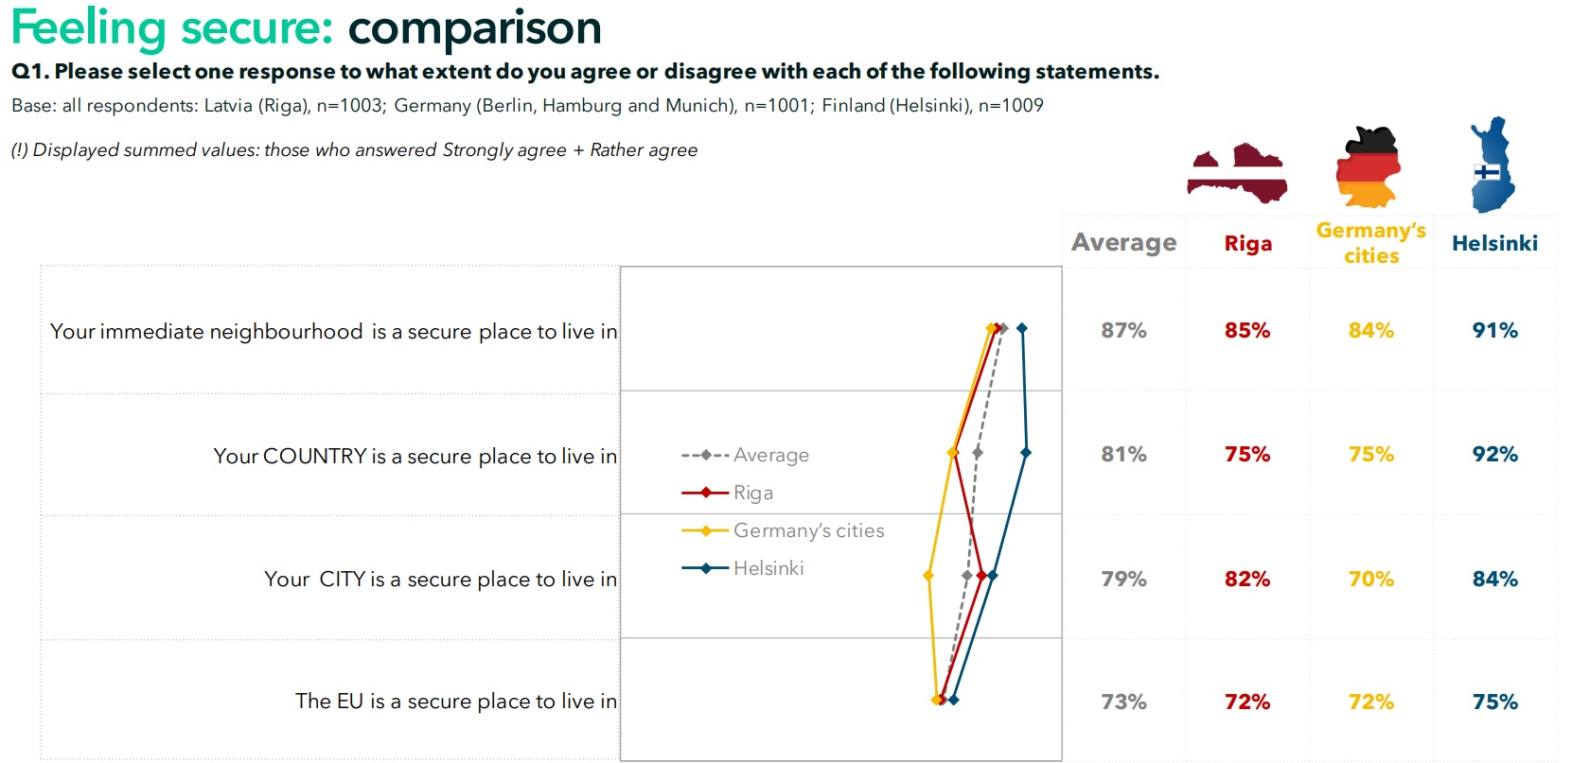
Feeling secure: Comparison
Notes:
For Latvia, it is interesting that Latvia as such, is below the avarage in terms of being a secure place to live, but Riga is considered a safe place to live.

Slide 6
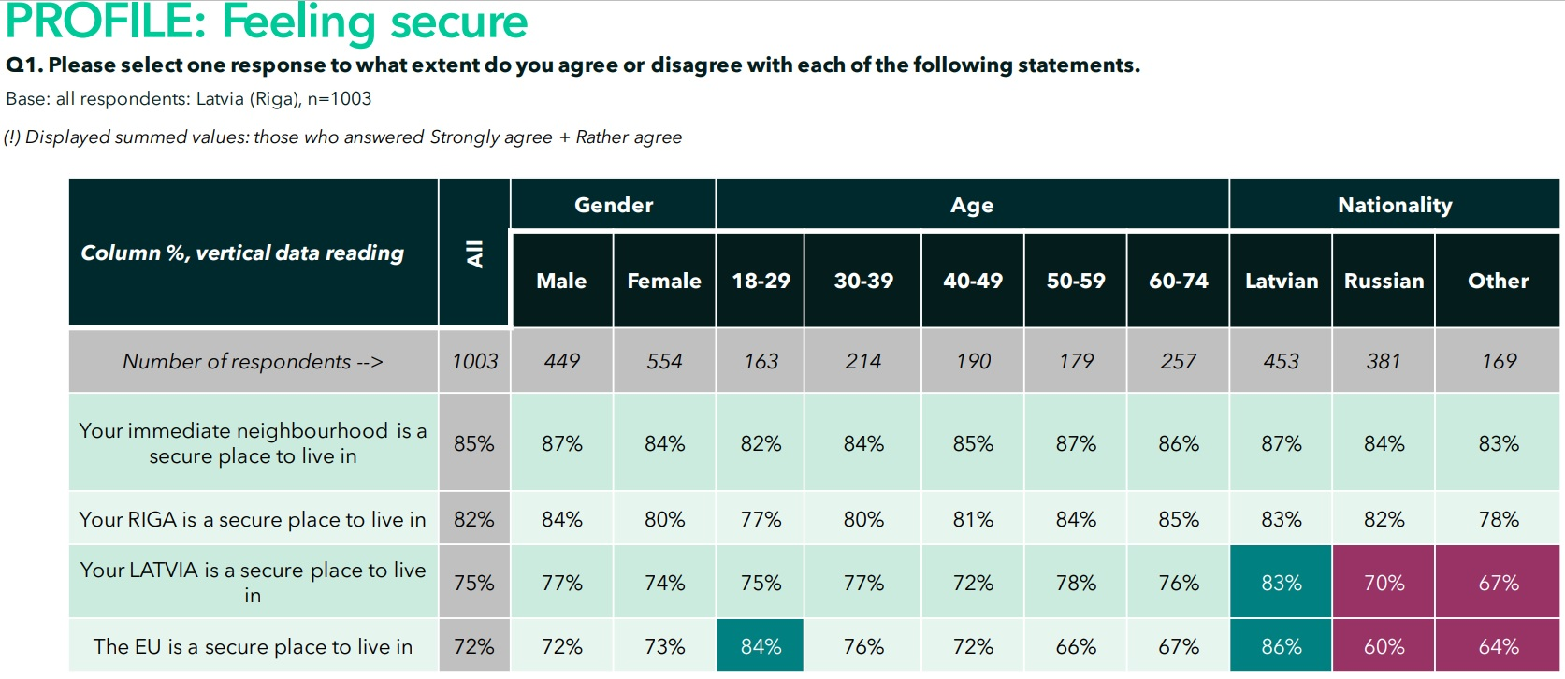
Feeling secure - Riga
Notes:
If we look at the profile of who feels secure or un/secure, the data shows that Latvian speakers feel secure living in Latvia, but Russian speakers and others, do not. The same applies for the marker of the EU being a secure place to live. Here, we do not have the background info of why this is so, but we can guess that disinformation is probably playing a part, as well as attitudes towards foreigners.

Slide 7
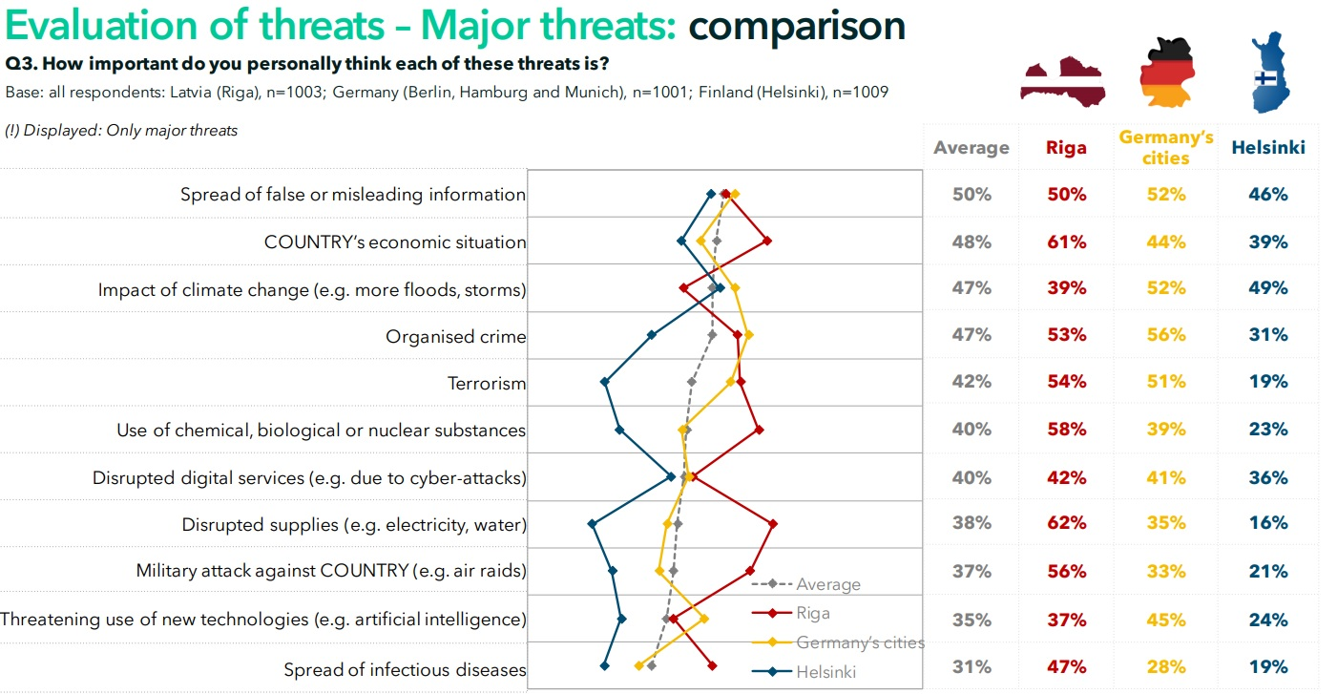
Major threats: Comparison
Notes:
Very evident, that Finns are much less concerned about everything, except for climate change. In Riga, the major concerns are disruption to critical supplies, use of chemical, nuclear, biological substances, military attacks, and all that coupled with a concern for the country’s economic situation.

Slide 8
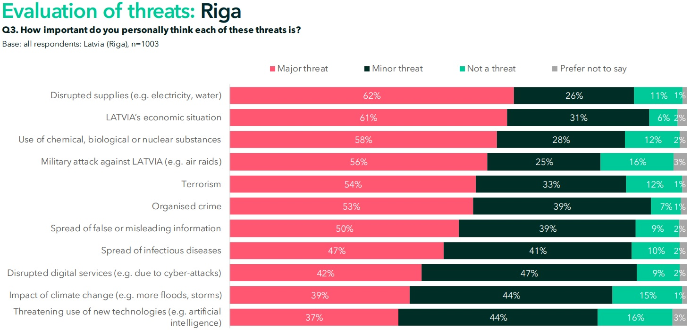
Major threats: Riga

Slide 9
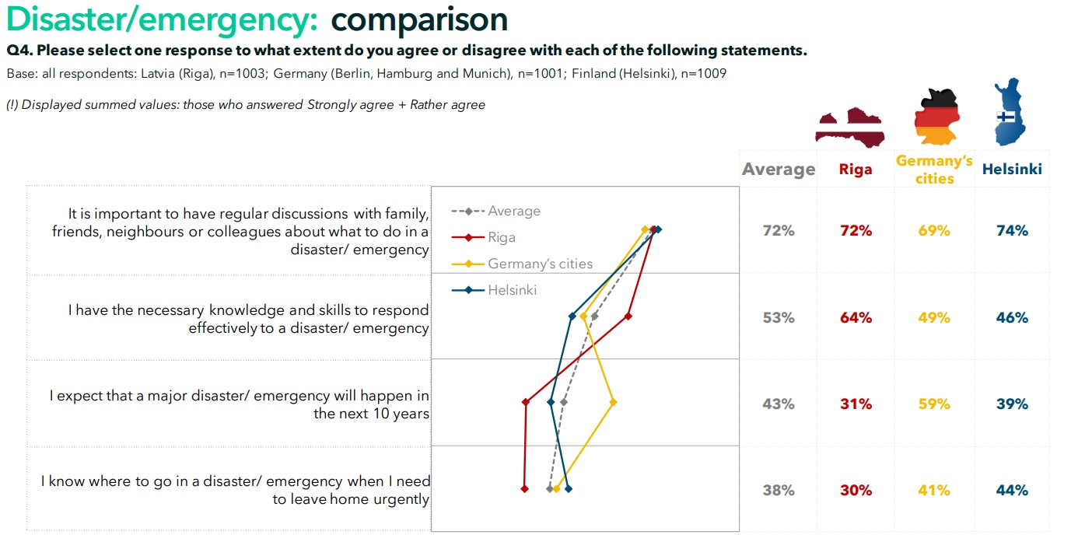
Disaster/emergency: Comparison
Notes:
What is interesting from this slide, and the data, is that Riga residents feel more confident than their German or Finnish counterparts in terms of having the skills/knowledge to respond to disasters/emergencies. While at the same time, they don’t know where to go in such a situation. Further, they are also quite optimistic, in thinking that nothing major will happen in the next 10 years. The lack of preparedness of Riga residents, will become even more evident further on.

Slide 10
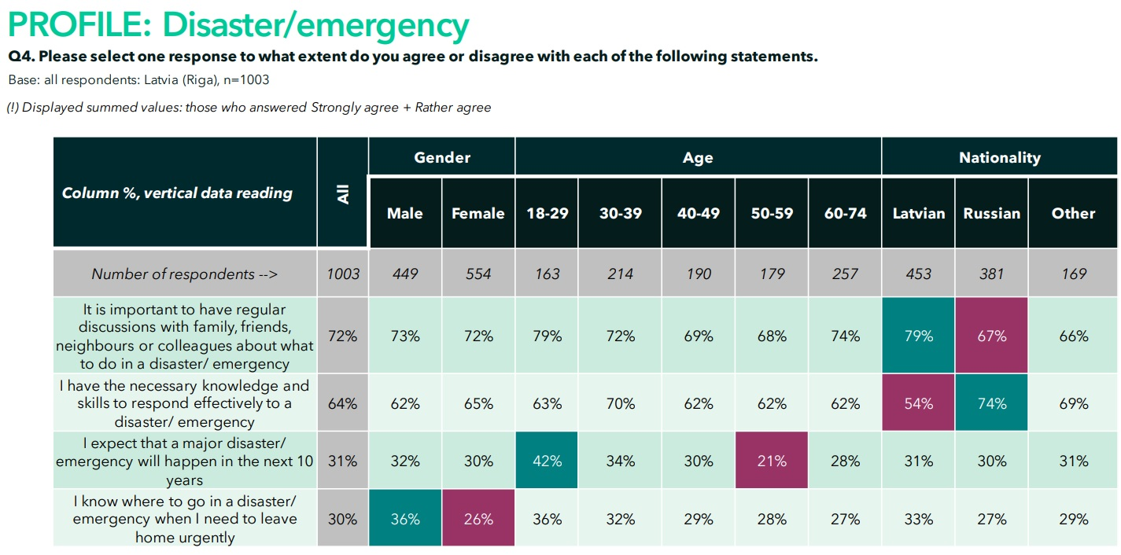
Disaster/emergency: Profile Riga
Notes:
Looking closer, we see that Latvians are less self-sure of having the skills and knowledge necessary to deal with a disaster/emergency. Where Russians are really confident. The older generation think the next 10 years will be without major disasters, where it is the youth, who are less optimistic. In terms of evacuation, no one is aware of where to go, but it is specifically the female population that is less knowledgable.

Slide 11
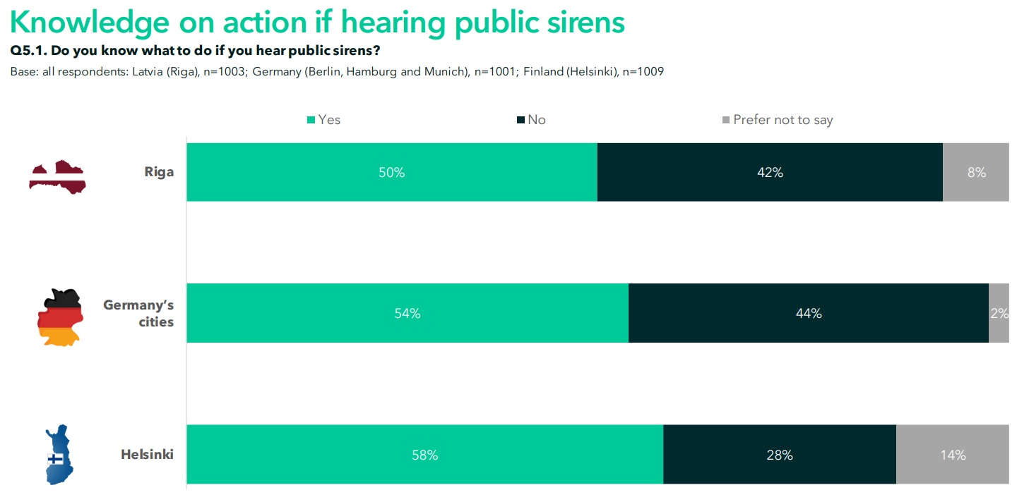
Sirens
Notes:
Next in our survey we asked some specific preparedness questions. The first was about knowing what to do if you hear sirens. Riga residents lagged slightly behind German and Finnish urban residents.

Slide 12
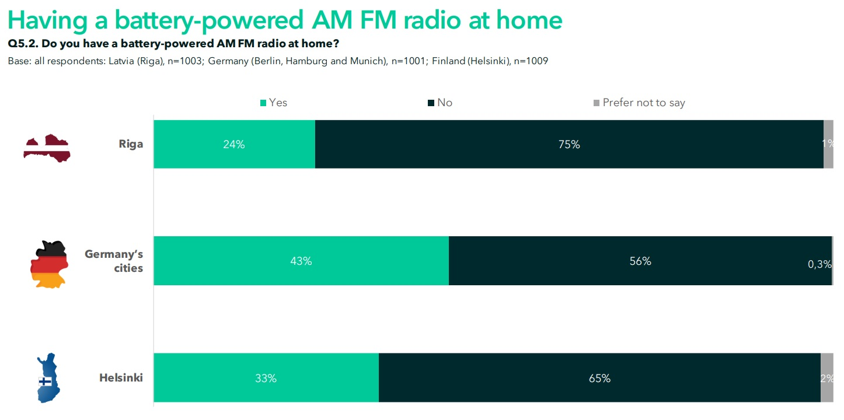
Radio
Notes:
The correct answer to the previous question, what should you do when you hear sirens, is actually to go inside and turn on the radio. But here we also have a gap in Riga residents preparedness. A radio with batteries is one of the key items of the preparedness list, in case electricity is disrupted, to be able to receive further instruction from the authorities. Only 24% of our respondents, said they had such a radio at home.

Slide 13
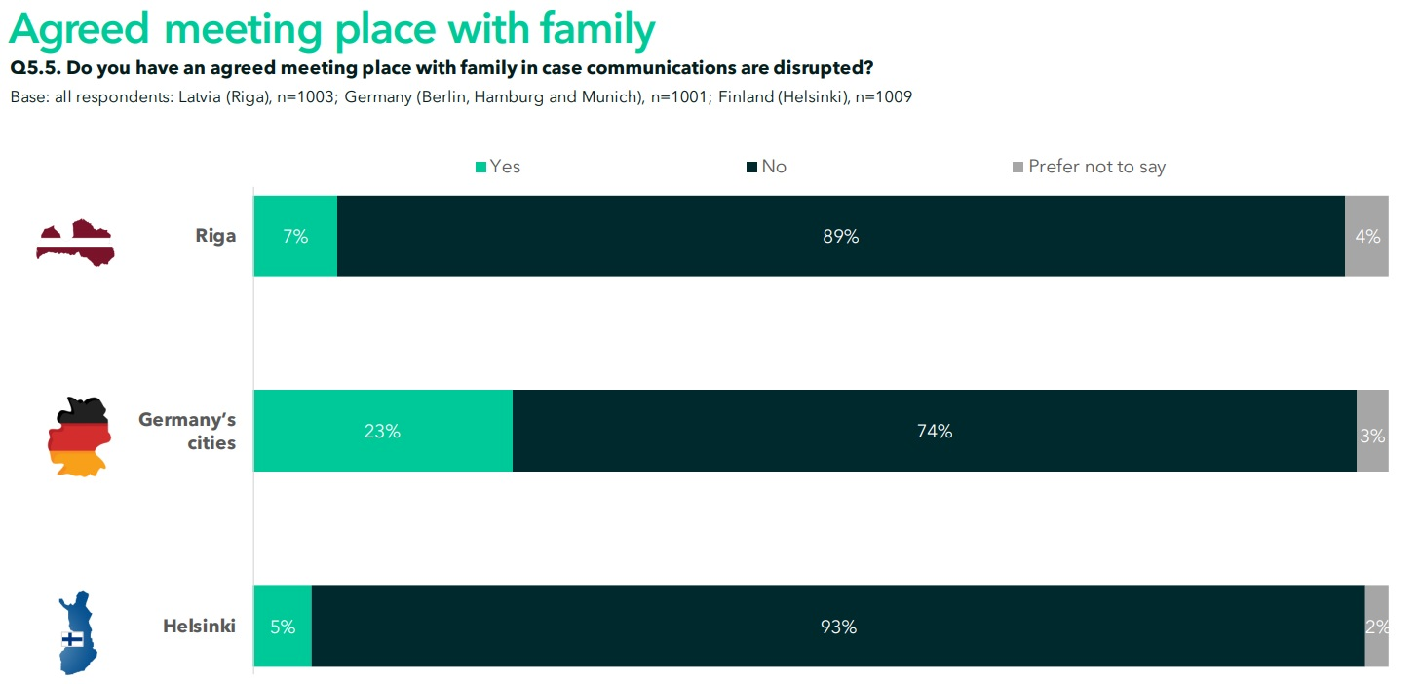
Meeting Place
Notes:
Urban populations from all three countries seldom have an agreed upon meeting place with family in case of emergency and communication disruption.

Slide 14
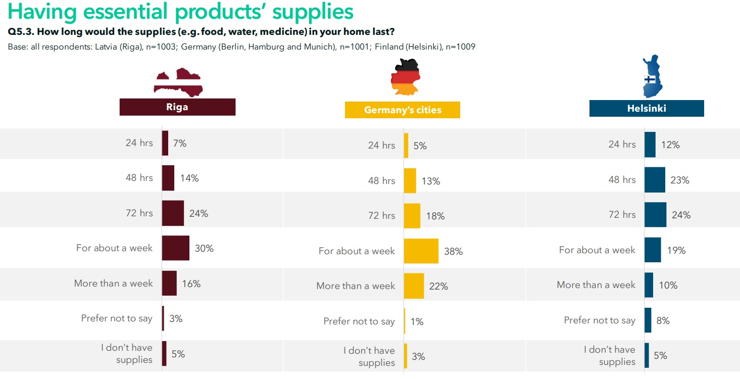
Supplies
Notes:
72 hour supplies are critical, but there are potential disasters/emergencies that may require remaining indoors for much longer.

Slide 15
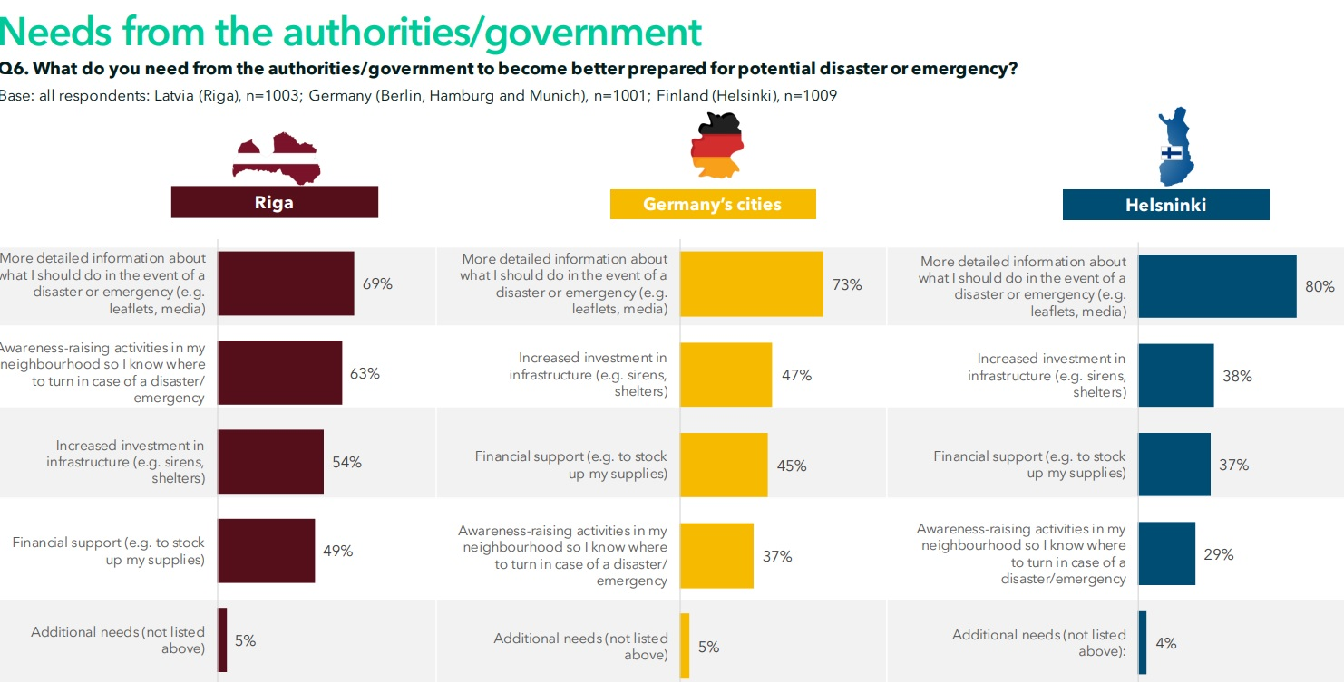
Needs
Notes:
Finally, in the survey we asked what the needs would be from the authorities. Here we see that all urban residents are keen on more detailed information. But in Riga, urban residents are also keen for neighborhood awarness raising, increased investment in infrastructure, and financial support for stocking up on supplies. Our aim is to write opinion pieces using this data, and getting the entire report into the hands of the competent authorities to help them see the gaps, where disaster preparedness work is necessary.

Slide 16
Crisis preparedness as part of the Total Defence Approach
Surveyed residents nowhere near the level of readiness necessary to respond to disasters/emergency situations and do not have sufficient knowledge about necessary actions. Majority need more detailed information about what to do in the event of a disaster or emergency (e.g. leaflets, media) - 69% of inhabitants of Riga, 73% of inhabitants of Germany’s cities and 80% of inhabitants Helsinki.

Slide 17
Thank you!

