Slide 1
DEMOGRAPHIC AGING AND ITS IMPLICATIONS ON THE QUALITY OF LIFE AND HEALTH SERVICES IN ROMANIA
Dr. Violeta Francu,
University Lucian Blaga - Faculty of Medicine Sibiu, Romania
Second Annual FORTHEM conference
FORTHEM – Connecting Worlds of Science and Society
January 29-31, 2025

Slide 2
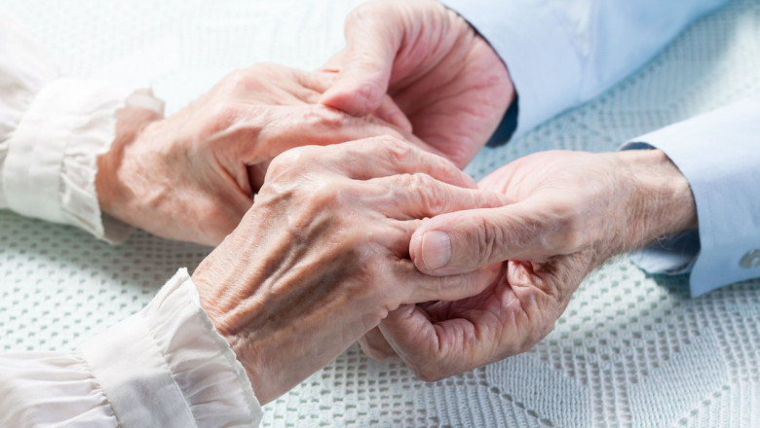
AGING POPULATION - A PUBLIC HEALTH PROBLEM
The ageing of Europe, also known as the greying of Europe, is a demographic phenomenon characterised by a decrease in fertility, a decrease in mortality rate, and a higher life expectancy among European population.
In Romania we also have an important increase in emigration and a decrease in natality.
Romania is among the top 20 countries in the world in the ranking of countries with the highest emigration, with over 4 million Romanians living outside the country, according to the Global Migration Report, 2022.
Second Annual FORTHEM conference
FORTHEM – Connecting Worlds of Science and Society
January 29-31, 2025

Slide 3
The consequence is the increase in the proportion of elderly people in the total population.
This trend has major implications for the economies, health systems and social structures of European countries:
Impact on the economy
Labor force decline: an aging population leads to a decrease in the available labor force, which can reduce economic productivity
Declining consumption: older people tend to consume less than the younger population, which can negatively affect certain economic sectors.
The need to adapt the labor market and the economy: increased demand for services and products for the elderly (home care, adapted housing, etc.).

Slide 4
Impact on health systems
Older people require more health services, including treatments for chronic diseases, long-term care, and disability support. This leads to increased government spending on health and the need to expand medical infrastructure.
Pressure on pension and social assistance systems
The number of active taxpayers (young population) decreases in relation to that of pension beneficiaries.
Social assistance systems are becoming more expensive, requiring additional funding to support the care of the elderly.
Governments are forced to reform pension systems, encourage birth rates, or attract immigrants to counterbalance the decline in the working population.

Slide 5
In 2019, people aged 55 years or more accounted for just over one third (33.6 %) of the total EU-27 population (Figure 1).
This share was higher than one third, in 10 of the EU Member States and peaked at 36.5 % in Italy.
At the other end of the range, people aged 55 years or more accounted for one quarter (25.0 %) of the population in Ireland (the youngest pop. in Europe).
The share of this age group (55 years or more) in the EU-27 population is projected to reach 40.6 % by 2050;
45.9 % of the population in Italy, and
for more than 45 % in Lithuania, Portugal, Greece and Latvia.
Second Annual FORTHEM conference
FORTHEM – Connecting Worlds of Science and Society
January 29-31, 2025

Slide 6
The influence of population aging on quality of life
Increased risk of social isolation
older people may become more vulnerable to loneliness and depression due to loss of loved ones, reduced mobility or reduced participation in active life. Improving the quality of life depends on the integration of the elderly into the community, through social and cultural initiatives.
Financial barriers
Many retirees face insufficient pensions, which affects their access to services, medicines and other essential goods.
Increased care needs
Increased support is needed for older people, especially those with chronic illnesses or disabilities. Maintaining and caring for the elderly can put pressure on families and public systems
Managing this phenomenon requires collaboration between governments, communities and families to create a more age-friendly and supportive environment for older people.
Second Annual FORTHEM conference
FORTHEM – Connecting Worlds of Science and Society
January 29-31, 2025

Slide 7
The impact of population aging on health systems
Increased demand for health services
Elderly people frequently use health services, including consultations, hospitalizations and treatments for chronic diseases such as diabetes, cardiovascular diseases,cancer, Alzheimer’s etc.
Accessibility barriers
Not all older people have equal access to care services, which can negatively affect quality of life.
Insufficiency of human resources
The lack of doctors, nurses and staff specialized in geriatrics affects the quality of the care provided.
High costs of health services and care
Treatments for age-related conditions, such as cancer or degenerative diseases, involve substantial expenditure, with the pressure being felt by both the public budget and patients.
Need for long-term care services
Nursing homes, day care centers and home care services are underdeveloped to meet the demand.
Second Annual FORTHEM conference
FORTHEM – Connecting Worlds of Science and Society
January 29-31, 2025

Slide 8
Challenges and solutions
Development of community services: access to support services and home care can help reduce isolation and improve the lives of older people.
A sustainable pension system: a reform of the pension system could support the elderly to maintain a decent quality of life
Investments in health infrastructure: building and modernizing hospitals, as well as developing geriatric centers, are essential.
Training of medical personnel: it is necessary to increase the number of geriatric specialists and their training to respond to the specific requirements of the elderly.
Prevention programs: promoting a healthy lifestyle and implementing prevention programs can help reduce the incidence of chronic diseases.
Second Annual FORTHEM conference
FORTHEM – Connecting Worlds of Science and Society
January 29-31, 2025

Slide 9
Demographic aging is an inevitable process, but through appropriate public policies and an integrated approach, the negative impact on quality of life and health services can be minimized.
Thank you!
Second Annual FORTHEM conference
FORTHEM – Connecting Worlds of Science and Society
January 29-31, 2025

