Slide 1


Comparative analysis of the regional identities formation through minority organizations:
cross-border features and belonging
Khrystyna Shelvakh, PhD Candidate
Opole University
Second Annual FORTHEM conference
FORTHEM – Connecting Worlds of Science and Society
January 29-31, 2025

Slide 2

Border and Regional Studies Network
Opole University
Second Annual FORTHEM conference
FORTHEM – Connecting Worlds of Science and Society
January 29-31, 2025

Slide 3
Overview
  Introduction
  Focus Area
  Research Relevance
  Research Problem and Questions
  Hypothesis
  Methodology
  Summary
  References
Second Annual FORTHEM conference
FORTHEM – Connecting Worlds of Science and Society
January 29-31, 2025

Slide 4
“In fact, identity in all its various manifestations is above all the willingness to be something determined.”
(Maffesoli, p. 67, 1996)
Second Annual FORTHEM conference
FORTHEM – Connecting Worlds of Science and Society
January 29-31, 2025

Slide 5
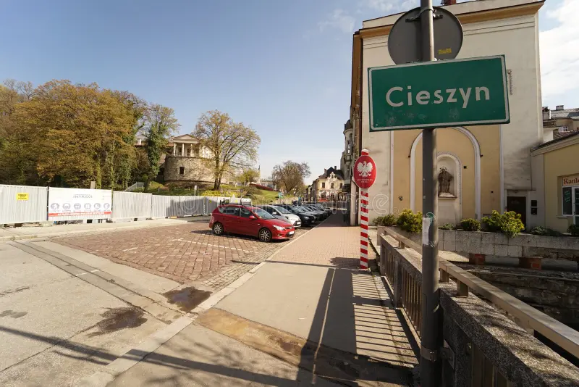
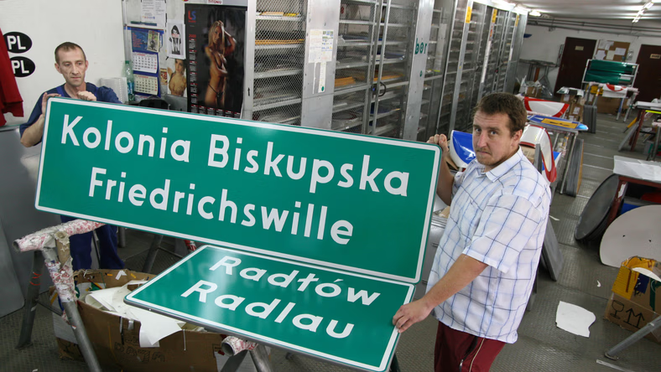
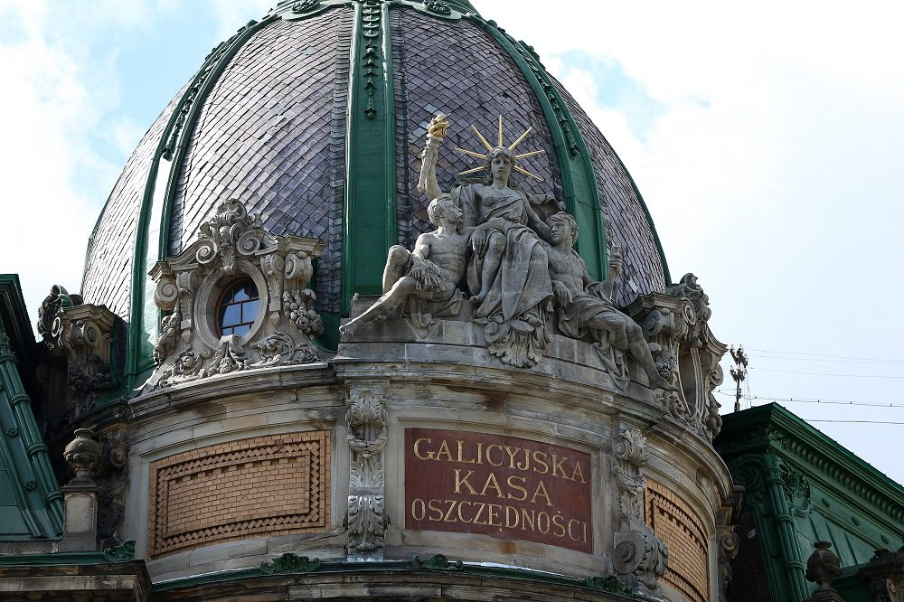
Introduction
D. Newman says it is noticeable when a border separates a historically linked cultural region, since people often experience a deeper connection with those across the border rather than to the majority of their own country, with whom they lack a common history (2012).
Image source: State border between CZ PL stock photo
https://www.dreamstime.com/
Image source: https://wiadomosci.onet.pl/opole/opolskie-dwujezyczne-tablice-w-16-gminach/kxfpxrl
Image source: https://mylviv.city/galyczka-oshhadova-kasa-yak-bank-stav-muzeyem

Slide 6



Focus Area
The ongoing research focuses on differences between three ethnically diversified regions, specifically minority organizations of the German minority in Opole Voivodeship, as well as the Polish minority in Cieszyn Silesia (Czechia), and Lviv Oblast, accordingly.
SKGD - Deutsche Minderheit In Oppeln
Kongres Poláků v České republice
Związek Polaków «Orzeł Biały»
Image Source:
https://skgd.pl
Image Source:
https://www.polonica.cz
Image Source:
http://orzelbialy.org.ua
Second Annual FORTHEM conference
FORTHEM – Connecting Worlds of Science and Society
January 29-31, 2025

Slide 7
Therefore, borders are complex social structures that obtain meaning and value from numerous geographical dimensions and social behaviors, perceived as “meeting points” (Paasi, 2012).
Second Annual FORTHEM conference
FORTHEM – Connecting Worlds of Science and Society
January 29-31, 2025

Slide 8
Focus Area
Historically the territory of Opole Silesia after the Potsdam Conference (1945) was under Polish Jurisdiction.
Around the same time, due to the forced resettlements, the German population first became a minority.
After the strict ideological rule of the communist regime in Poland that did not recognize minority rights, only in 1989 the first minority organizations could start to function properly .
SKGD - Deutsche Minderheit In Oppeln
  The biggest German minority Organization, not only in Opole but the whole country;
  Officially established on 16th January 1990;
Image Source:
https://skgd.pl
Second Annual FORTHEM conference
FORTHEM – Connecting Worlds of Science and Society
January 29-31, 2025

Slide 9
Focus Area
The only organization permitted by the Communist Party of Czechoslovakia (KSČ) was the Polish Cultural and Educational Union (Polski Związek Kulturalno-Oświatowy, PZKO),
After the fall of the communist regime during the Velvet Revolution (1989) old and new organizations started being established. 3 March 1990 was the beginning of Council of Poles that was later transformed to the Congress of Poles in the Czech Republic.
Kongres Poláků v České republice
  An umbrella organization in which all renewed and newly established associations were associated;
  Officially established in 1993;
Image Source:
https://www.polonica.cz
Second Annual FORTHEM conference
FORTHEM – Connecting Worlds of Science and Society
January 29-31, 2025

Slide 10
Focus Area
Similarly to the previous examples, minorities in Ukraine could openly admit their belonging to civic organizations after the return of democratic government and the country’s independence in 1991.
The civic organization was established in Lviv and it actively participates in the Polish environment, enhancing cooperation with Poland for creating various activities for people belonging to a minority and those only willing to learn Polish language for personal use.
Związek Polaków «Orzeł Biały»
Image Source:
http://orzelbialy.org.ua
  Popularizes Polish cultures and traditions in Western Ukraine and support ethnic Poles in its territory;
  Officially established on 2011;
Second Annual FORTHEM conference
FORTHEM – Connecting Worlds of Science and Society
January 29-31, 2025

Slide 11
Relevance
By examining and comparing the organizational activities of these civic groups it would be possible to fill the research gap on the importance of cross-border cooperation features of the Polish civic organizations in Lviv.
Second Annual FORTHEM conference
FORTHEM – Connecting Worlds of Science and Society
January 29-31, 2025

Slide 12
Research Problem
Understanding how much cross-border features and/or belonging impact the complexity of regional identities.
Second Annual FORTHEM conference
FORTHEM – Connecting Worlds of Science and Society
January 29-31, 2025

Slide 13
Research Questions
-How do people in the minority organizations identify themselves?
-What impacts it according to the narratives?
Second Annual FORTHEM conference
FORTHEM – Connecting Worlds of Science and Society
January 29-31, 2025

Slide 14
Hypothesis
It is expected that despite having presented regions within the EU (Polish minority in Czech Republic and German minority in Poland) and their cross-border cooperation strategies, the importance of general cross-border features for the people in minority organizations as well as belongingness will still be more visible within Polish minority in Ukraine.
Second Annual FORTHEM conference
FORTHEM – Connecting Worlds of Science and Society
January 29-31, 2025

Slide 15
Methodology
 | Type of research | Qualitative research
 | Research Instruments | Case Studies/ Semi-structured interviwes
 | Samping technique | Non-probability purposive sampling / snowball sampling
 | Data Analysis | ATLAS.TI licensed tool for qualitative data analysis through coding
Second Annual FORTHEM conference
FORTHEM – Connecting Worlds of Science and Society
January 29-31, 2025

Slide 16
Methodology
representatives of minority organizations and their narratives
Participants/Respondents:
Organizational activity of chosen minorities and employed cooperation strategies - an independent variable
Research Variables
The sense of belongingness and cross-border features’ importance - dependent variable
Second Annual FORTHEM conference
FORTHEM – Connecting Worlds of Science and Society
January 29-31, 2025

Slide 17
Summary
Due to minority organizations being a societal group of contributors to the diverse societies inhabiting the space, their ways of living should then also influence its production and, therefore, must be deliberately researched.
Second Annual FORTHEM conference
FORTHEM – Connecting Worlds of Science and Society
January 29-31, 2025

Slide 18
References
Bauman, Z. (1992). Soil, blood and identity. The Sociological Review, 40(4), 675–701. https://doi.org/10.1111/j.1467-954x.1992.tb00407.x
Czok. M (2023) Śląsk Opolski I Jego Tożsamość: Dyskursy- aspekty społeczno-polityczne – prasa regionalna. Centrum Badań Mniejszości Niemieckiej, Opole.
Home - SKGD | Mniejszość niemiecka. (Last accessed: 2025, January 27). SKGD | Mniejszość Niemiecka. https://skgd.pl/
Maffesoli, M. (1996). The time of the tribes: The Decline of Individualism in Mass Society. SAGE.
Orzeł Biały Lwów. (LAst accessed: 2025, January 27). Союз Поляків «Білий Орел». http://orzelbialy.org.ua/pl/
Szymeczek, J. – Baron, R., Kongres Poláků v České republice. In: Akademická encyklopedie českých dějin, Svazek VII, K/2-L, vědecký redaktor Jaroslav Pánek, Praha: Historický ústav 2021, s. 144-148, ISBN 978-80-7286-392-1.
Wastl-Walter, D. (2012). The Ashgate Research companion to Border Studies. http://ci.nii.ac.jp/ncid/BB07368029

Slide 19
Thank you!
Second Annual FORTHEM conference
FORTHEM – Connecting Worlds of Science and Society
January 29-31, 2025

