Slide 1
EVOLUTION AND FUTURE PERSPECTIVES OF THE RIGA METROPOLITAN AREA GOVERNANCE
Rūdolfs Cimdiņš
University of Latvia
Sub-section „Spatial Development and Planning” March 6, 2025, Riga

Slide 2
More than 2 decades of shaping an understanding of Riga's functional space Various visions on possible governance solutions – from voluntary cooperation to normatively regulated approaches

Slide 3
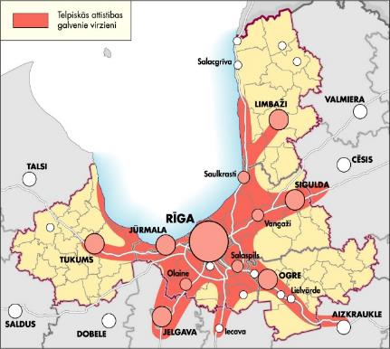
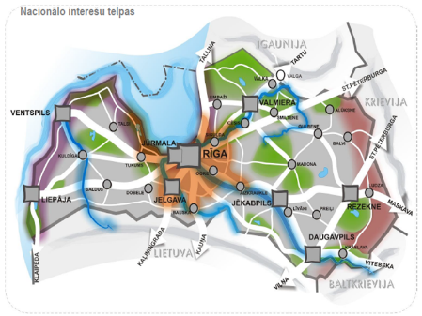
Defining the significance of the Riga metropolitan area (RMA)
The first Riga Region strategy
The Riga region was formed in 1996, through the cooperation of the cities of Riga and Jurmala and the Riga district
The public organization “Riga Region Development Council” registered in 1998 by voluntarily joining 8 local governments of the Riga district
2000 - the first Riga Region Development Strategy is approved
2006 - Riga Planning Region is established
2000
„Riga Region Development Strategy 2000-2020”
Riga metropolitan area in the state strategy
With the development and approval of Latvia's sustainable development strategy "Latvia 2030" in 2010, the Riga metropolitan area is being defined as a space of national interest
“Latvia 2030” is the hierarchically highest long-term development planning document in Latvia, which includes the development vision and spatial perspective of the Riga metropolitan area
2010
„LATVIA 2030”

Slide 4
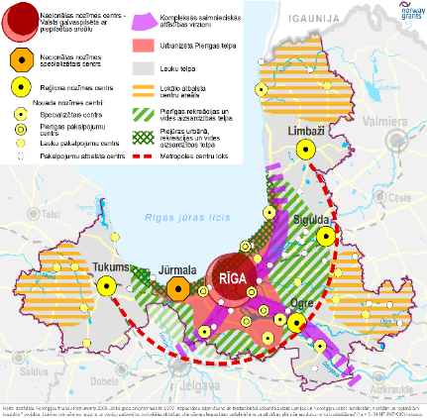
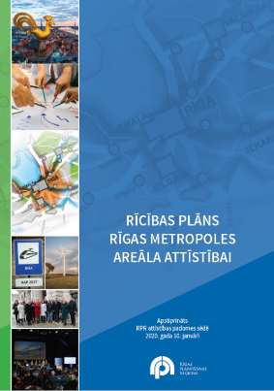
Formation and strengthening the idea of ​​RMA cooperation
Riga metropolitan area in the regional strategy
The Riga Planning Region Sustainable Development Strategy 2030 has been approved, which includes the development vision and spatial perspective of the Riga metropolitan area
Cooperation in the Riga metropolitan area is set as one of the basic elements of the strategy
2015
„RPR Sustainable Development Strategy 2030”
Action plan for the development of the Riga metropolitan area
The aim is to achieve a coordinated development of the RMA by integrated approach and complex solutions to harmonize the interests of the state, the city of Riga, the municipalities within the Riga metropolitan area and the inhabitants
Creating a dialogue between metropolitan development stakeholders
2020
„RMA Development Action Plan”

Slide 5
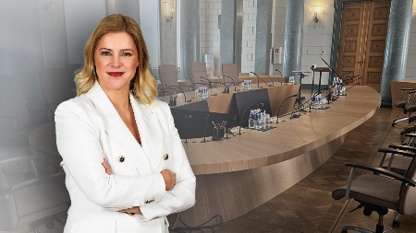
Expanding local cooperation and national level actions
Association of local governments “Rīgas Metropole”
Establishment of Riga and Pieriga Municipalities Association
The organization's goal is to promote mutual cooperation between Riga and Pieriga municipalities, promoting economic and social development
Consists of 9 municipalities
2021
Action planned by the Cabinet of Ministers
Declaration on the intended activities of the Cabinet of Ministers led by prime minister Evika Siliņa on September 15, 2023
Statement - increase of Riga's competitiveness in Northern Europe by ensuring opportunities to invest in Riga's infrastructure and creating a unified model for the development and governance of the Riga metropolis
2023

Slide 6
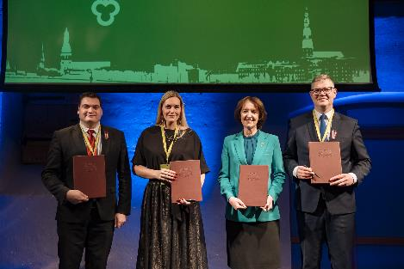
Actions for elaboration of a governance model
Riga Metropolitan Area Forum
December 1, 2023, Riga, Spīķeri Concert Hall - event "Competitiveness of the Riga Metropolitan Area in Modern Conditions"
Goal to strengthen cooperation initiatives within the Riga metropolitan area and begin developing solutions for creating a metropolitan governance model
The signing of the Memorandum of Understanding – vol.2
2023
Working group on Riga metropolitan development issues
The key areas in the context of RMA cooperation being defined - COMPETITIVENESS, MOBILITY and QUALITY OF LIFE
Proposal for a governance framework and the initiation of the elaboration of the Riga Metropolitan Area Law
Diversity of opinions on the governance model and the next steps
2023
-
2025

Slide 7
Existing RMA coordination platforms
LATVIA
INTERNATIONAL

Slide 8
Timeline – evolution of RMA governance "thinking"
Riga metropolitan area in the regional strategy
The first Riga Region strategy
Association of local governments “Rīgas Metropole”
Riga Metropolitan Area Forum
2023 - 2025
2010
2020
2023
2000
2015
2021
2023
Riga metropolitan area in the state strategy
Action plan for the development of the Riga metropolitan area
Action planned by the Cabinet of Ministers
Working group on Riga metropolitan development issues

Slide 9
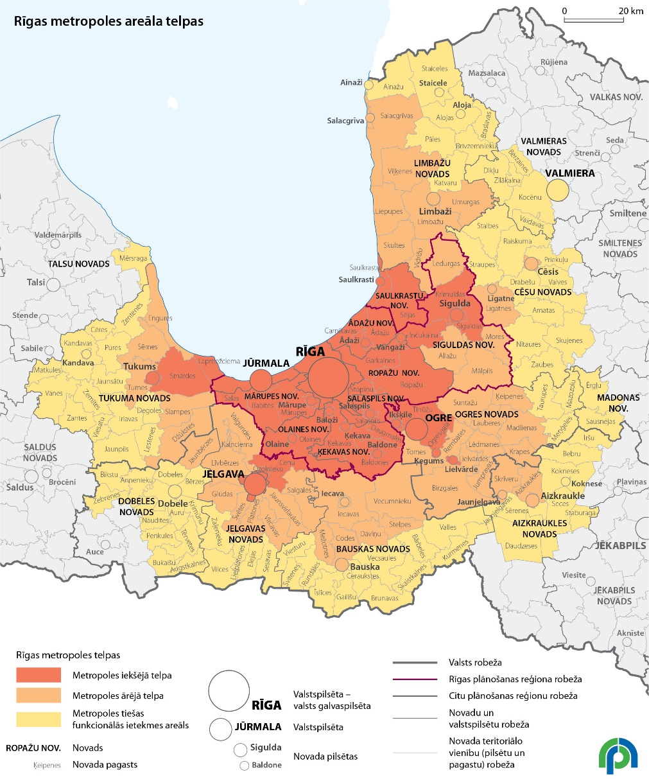
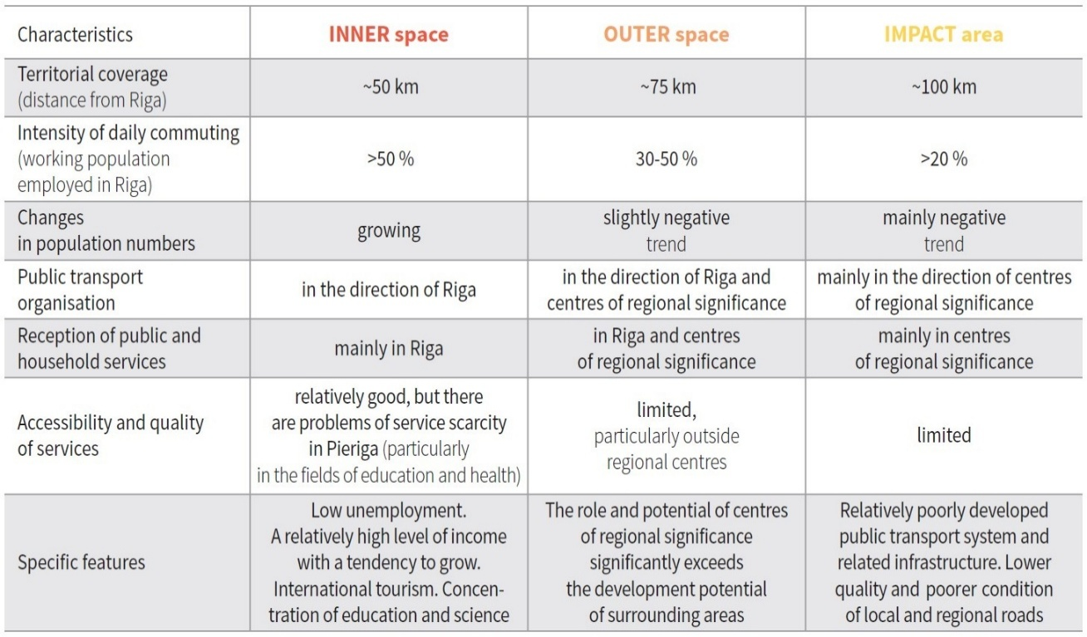
Understanding of the territorial scale of RMA
Metropolitan spaces
Definition of metropolitan spaces in „Action plan for the development of the Riga metropolitan area” (approved 2020)
Focus on inner space or „core” metropolitan area
Administrative borders vs. functional space
„RMA Development Action Plan”

Slide 10
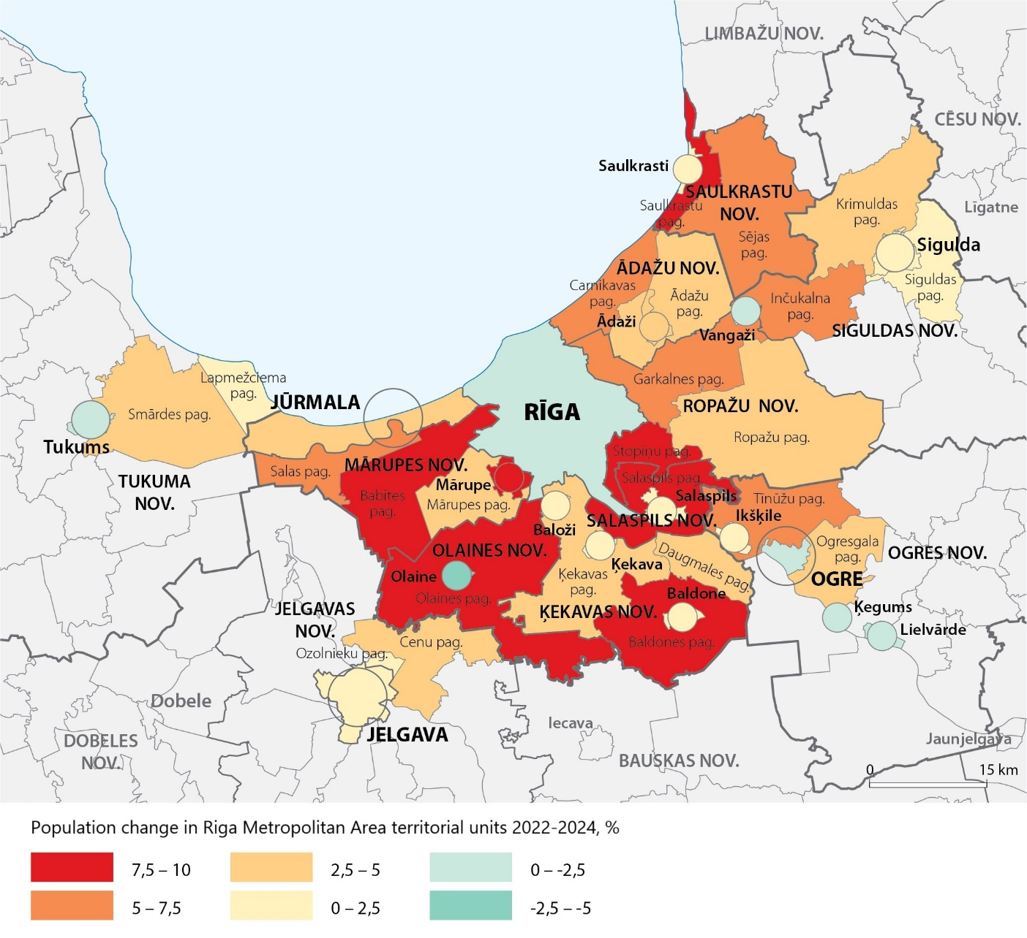
Situation and tendencies - population change in RMA 2022-2024
Situation
The number of inhabitants in the inner space or ‘core’ of the Riga metropolitan area in 2024 – almost 1 million (991 781)
Riga 605 273 inhabitants
Rest of the RMA 386 508
Share of RMA from total population of Latvia – 53 %
Every year the total number of RMA inhabitants increases by 0.5 % or approximately 5,000 (i.e. the size of Ķekava city or Saulkrasti parish)
Tendencies
2022-2024 population changes in Riga stabilizes, 0,1 % decrease
The fastest growing RMA city is Jūrmala +3%
In the remaining RMA cities (except Mārupe +7.6 % and Ādaži +4.7 %), the population is actually unchanged or even decreasing!
In the areas around the RMA cities (Olaine, Salaspils, Stopiņi parishes +9 %) the growth is much faster – forming local ‘urban sprawl’
Source: CSB data, territorial units after ATR

Slide 11
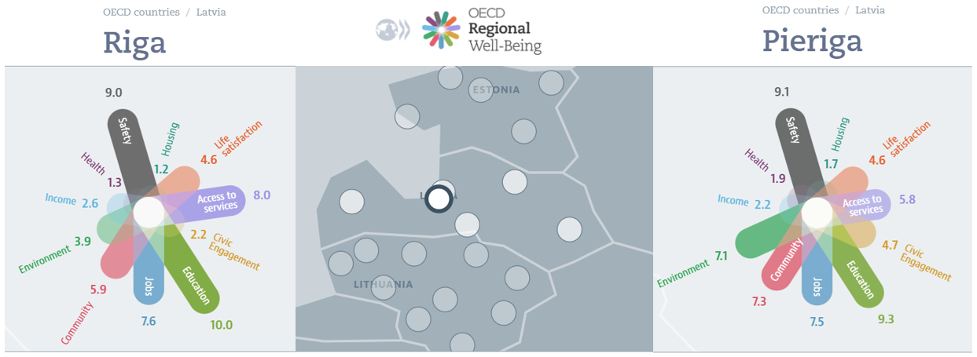
Quality of life indicators
Education, safety, jobs, access to services and community activity indicators in Riga and the surrounding area are generally at a sufficiently high level
Housing, health, income level and civic engagement indicators are at a relatively low or even critical level
Source: OECD Regional Well-Being (accessed January 2025)

Slide 12
Perspectives - identified issues to be addressed at the RMA scale
Competitiveness
Elaboration and coordination of the competitiveness and productivity strategy
RMA identity and marketing activities
Development of a unified RMA scale tourism product
Linking higher education and vocational education with labor market requirements, attracting talents in accordance with the areas of excellence and specialization determined by the RMA
Mobility
Elaboration and coordination of the Sustainable Urban Mobility Plan (SUMP)
Establishment and coordination of the operation of a unified public transport authority
Planning and coordination of the development of a network of micromobility infrastructure and mobility hubs
Quality of life
Elaboration and coordination of the settlement management and housing development strategy, including unified guidelines for settlement planning and principles for the development of building regulations
Sustainable urban planning - coordination of the improvement of the quality of public space and the development of public infrastructure facilities
Improvement of the public services quality and location planning according to actual population and needs
Source: Working group on Riga metropolitan development issues (VARAM, February, 2025)

Slide 13
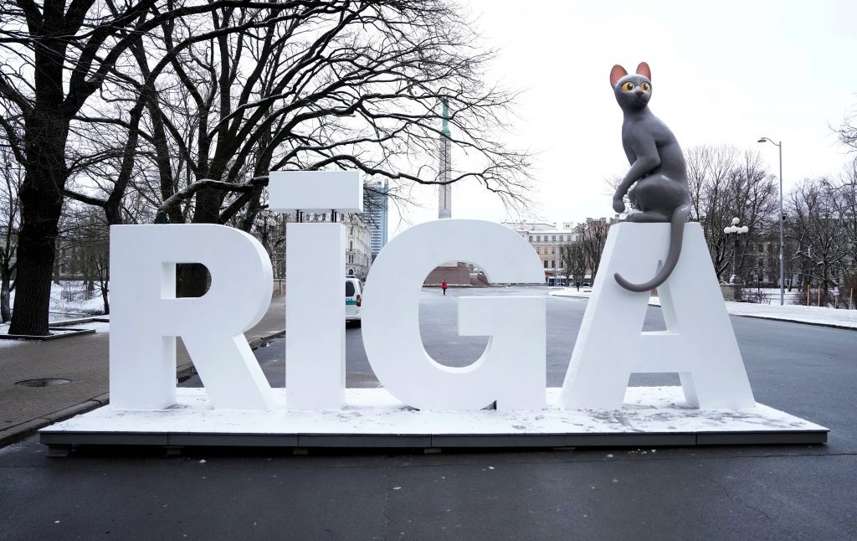
Thank you! Paldies!

