Slide 1
Metropolitan governance in Europe:
A classification of existing institutional models
Donato Casavola, Giancarlo Cotella, Umberto Janin Rivolin, Elisabetta Vitale Brovarone
Politecnico di Torino, Turin, Italy

Slide 2
Context and objective
Context: Given the increasing relevance of metropolitan phenomena, their delimitation are subject to debate, and metropolitan areas have become a site of institutional experimentation (Salet et al., 2003; Albrechts et al., 2017; Zimmermann et al., 2020).
Aim: To compare and classify existing national metropolitan governance models in Europe.

Slide 3
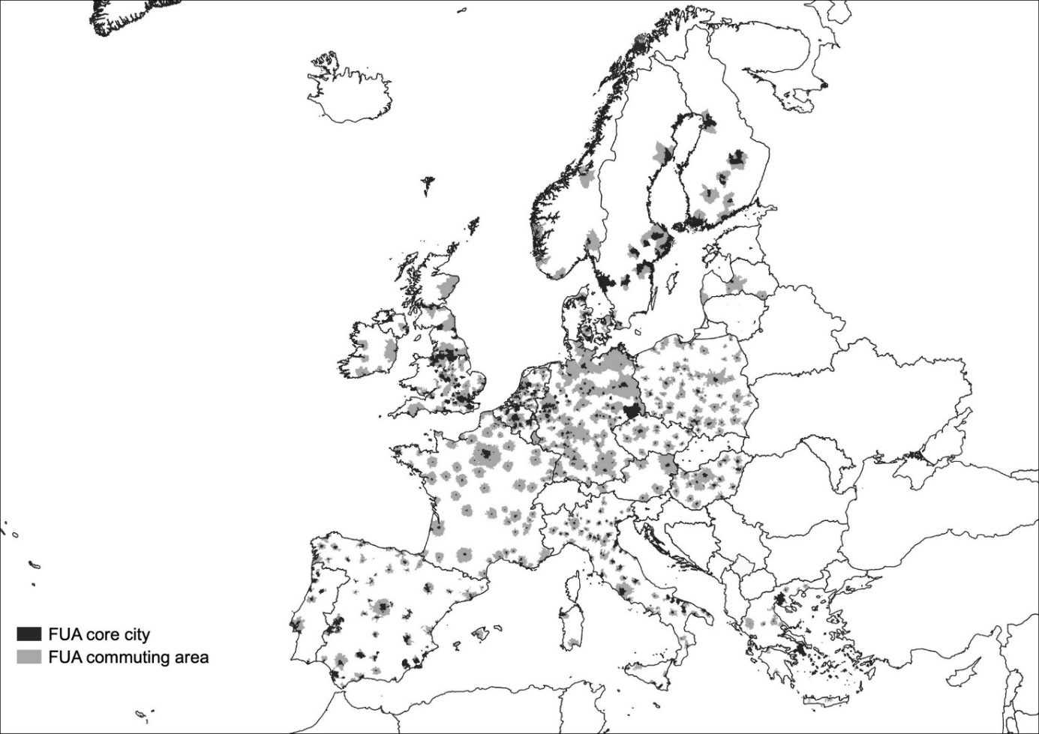
To understand and govern metropolitan phenomena
The role of metropolitan areas as engines of global development has grown over time, following complex processes of socio-economic reorganisation and downsizing (Bassand, 1993; Brenner, 2003).
To date, there is no unambiguous definition of the metropolitan dimension. Over time, numerous attempts have emerged to consistently define and delimit Functional Urban Areas (FUAs).

Slide 4
To understand and govern metropolitan phenomena
FUAs can inspire public action in spatial governance and planning. While this often occurs through informal inter-municipal cooperation, some countries have introduced formal administrative bodies dedicated to metropolitan governance.
This prompts reflection on the relationships between the institutional and the functional dimensions (Albrechts et al., 2017), with the rigidity of traditional administrative units often coming into conflict with phenomena characterised by ‘soft geographies with fuzzy boundaries’ (Allmendinger et al., 2015).

Slide 5
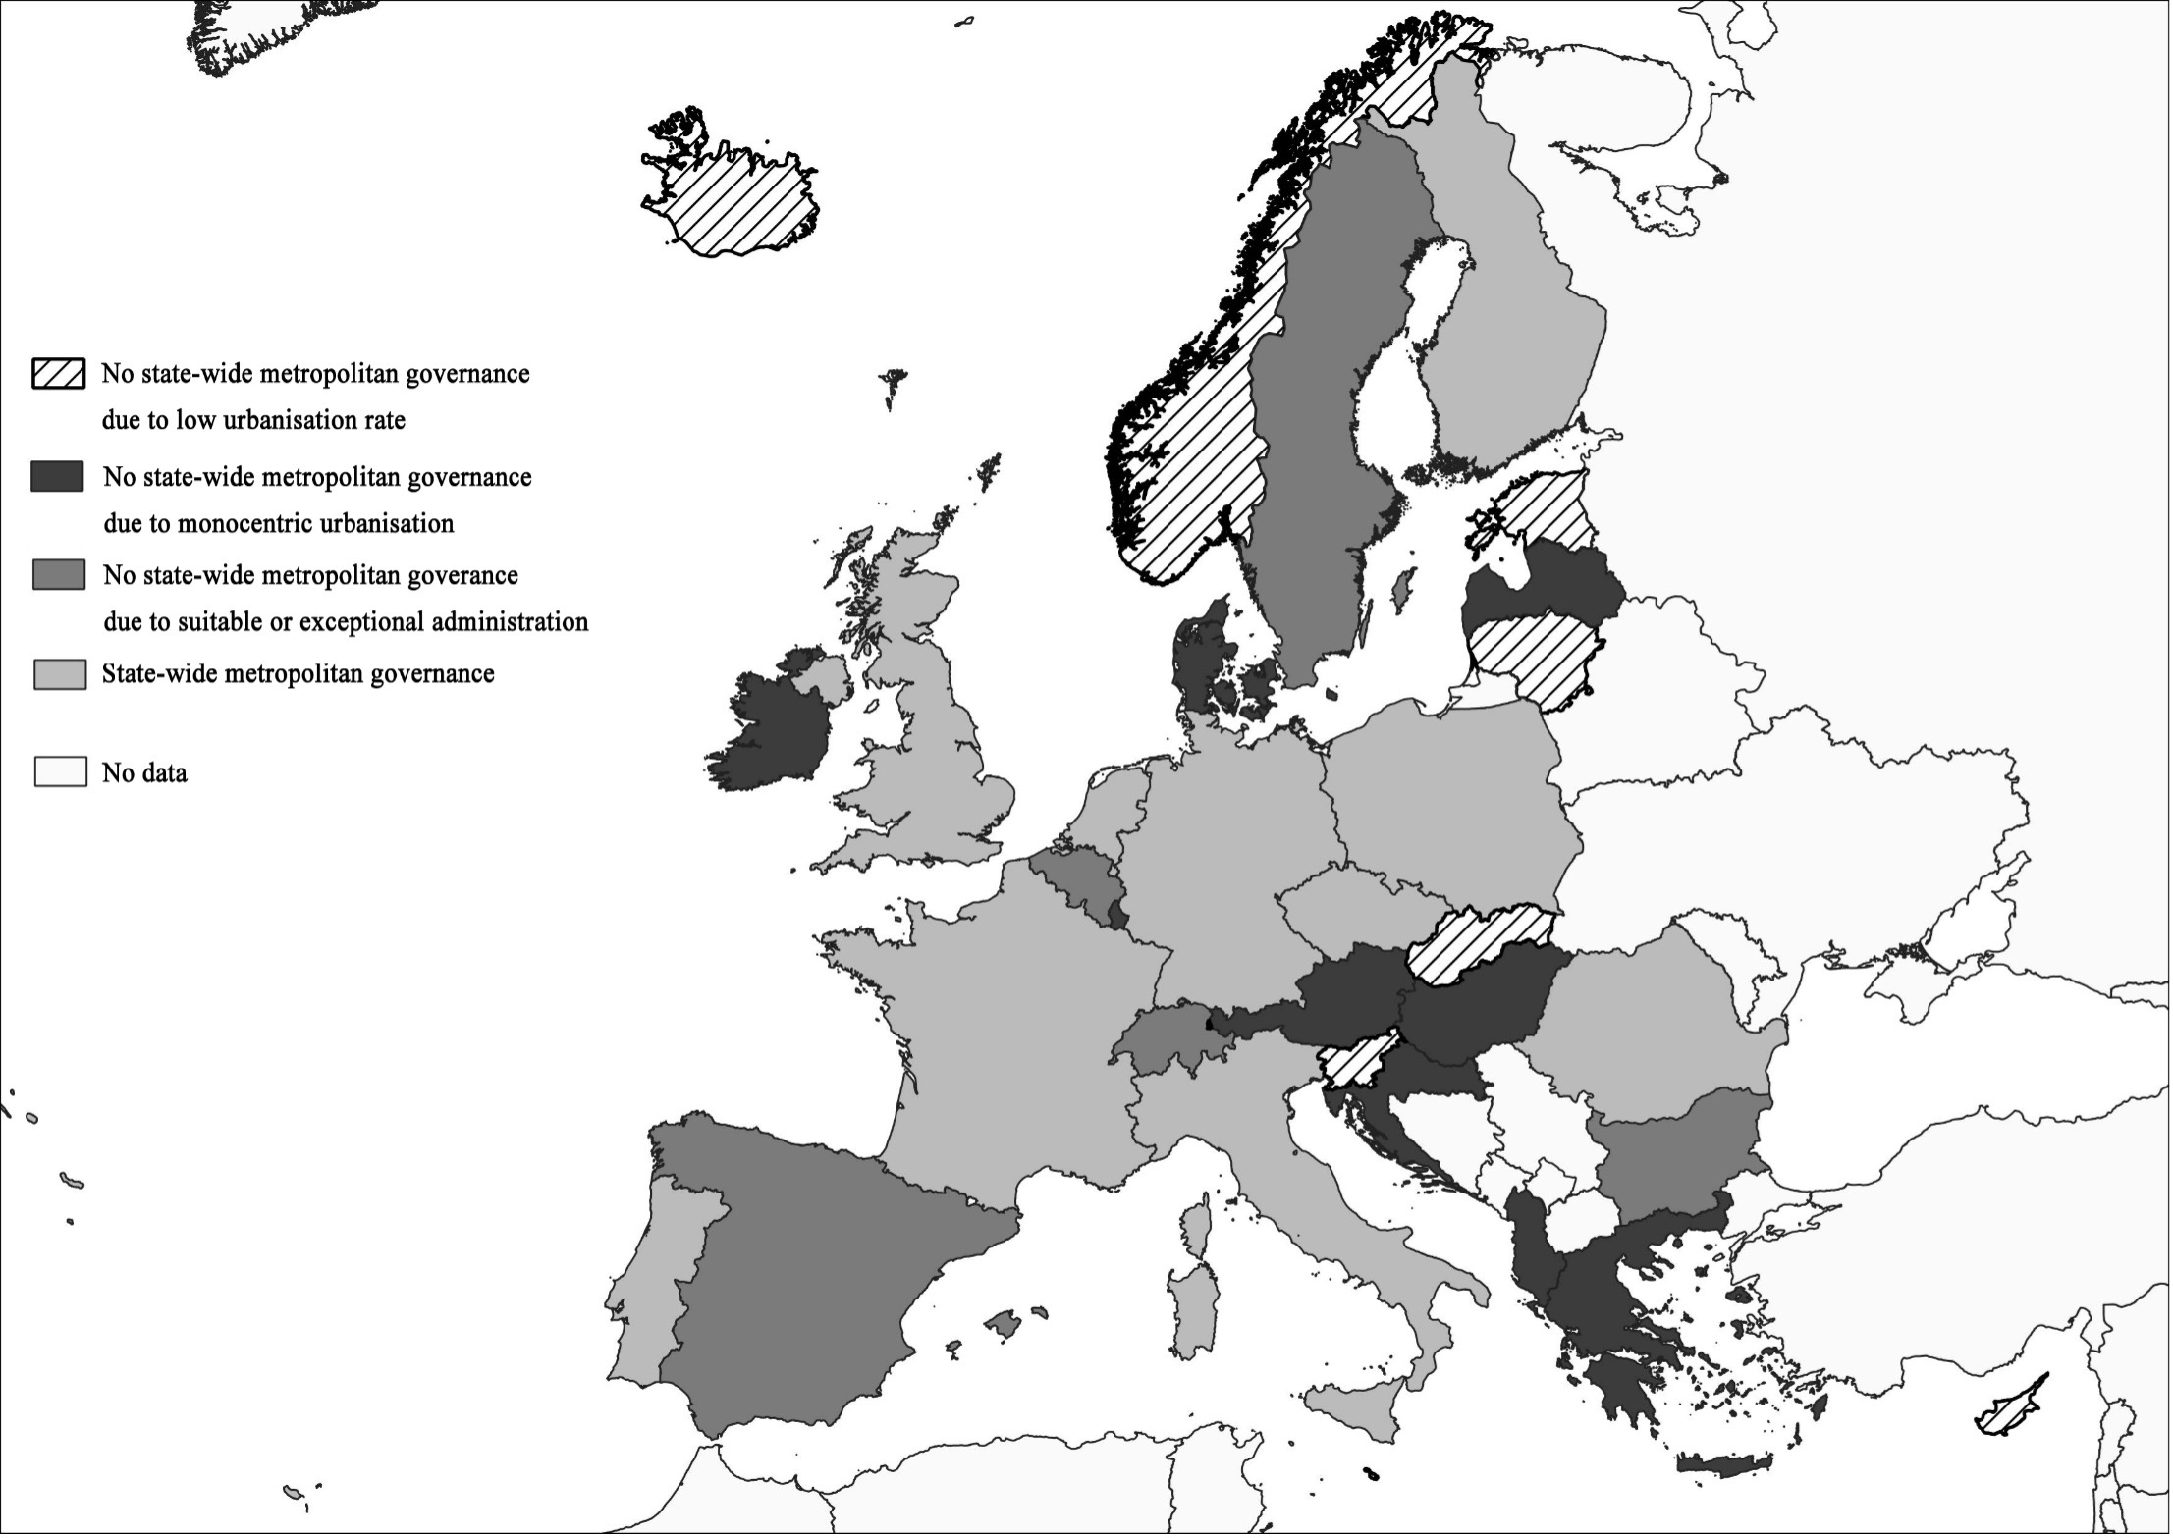
European countries and metropolitan governance
Some states do not need a structured approach to metropolitan governance.
Some states are dominated by the presence of a single metropolitan region, for which establishing metropolitan governance at the state level does not seem relevant.
A third group includes those states whose administrative system allows metropolitan dynamics to be addressed through local units.
Finally, some states have addressed metropolisation processes more systematically by introducing dedicated governance models.

Slide 6
Towards a classification
Four variables to organise the comparison:
The institutionalisation paths of metropolitan governance
The nature and characteristics of the governance model
The relevance functional logics of in the perimeter of metropolitan action
The competences and instruments
Materials: ESPON COMPASS country reports (32 countries) + ARL International; ESPON METRO research reports (8 countries) and interviews with metropolitan stakeholders.

Slide 7
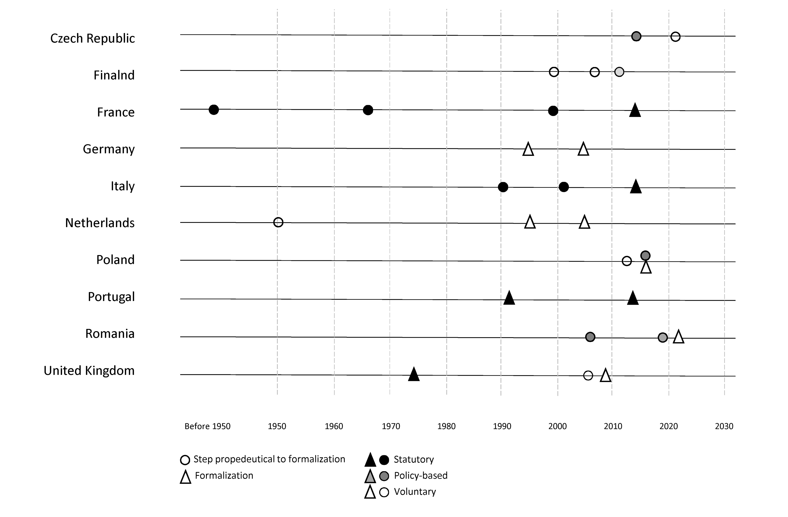
The path towards institutionalisation

Slide 8
The governance model
New formal authority. It concerns those states that have established metropolitan authorities with formal legal status, provided with power and competences (IT, FR, PT).
Policy-based. Concerns those states that have introduced one or more policies administered at the metropolitan level (often concerning the management of EU funds and instruments), but without conferring formal administrative status or legal powers (CZ, RO, PL).
Soft space. Concerns those states that have opted for more flexible metropolitan cooperation solutions (DE, FI, NL, UK).

Slide 9
The role of functional logics
Low relevance. Countries where the institutional processes that led to the formal institutionalisation of metropolitan governance were not directly driven by functional logic (IT, FR, UK).
Decisive role. Countries in which the units of metropolitan governance have been delimited following functional logics (albeit mediated with other logics). (CZ, RO, PL, FI, PT).
Uncertain role. Countries where the role of functional logics in the perimeter of metropolitan action is variable or unclear (DE, NL).

Slide 10
The competences and instruments
State | Metropolitan body | Competences | Instruments
CZ | ITI Office | ITI implementation as Intermediary body | ITI Strategy
DE | Metropolregionen | No predefined competences, each metropolitan region defines its competences and instruments | From more comprehensive strategies and frameworks to flagship projects
FI | MAL Agreement* | Spatial planning, housing and transport | MAL agreement
FR | Métropole | Spatial planning, economic development, innovation, housing, energy, tourism, culture, etc. | Schéma de cohérence territoriale – SCOT) Plan local d’urbanisme – PLU Other environmental plans
IT | Città Metropolitana | Strategic, spatial and mobility planning, organisation of coordinated systems for the management of public services, mobility and transport, promotion and coordination of digitalisation and economic and social development, etc. | Metropolitan Strategic Plan Metropolitan General Territorial Plan Sustainable Urban Mobility Plan
NL | Metropoolregio | Transport, economic development | n.a.
PL | ITI Unit | ITI implementation as Intermediary body | ITI Strategy
PT | Área Metropolitana | Public transport, spatial planning and strategic planning, but also waste, health, education, natural conservation, security and civil protection, tourism and cultural heritage, etc. | Mobility and strategic planning
RO | Zona Metropolitane | Management of EU resources under the Regional Operational Programs | Peri-urban/Metropolitan Territorial Development Strategy (SDTZP/M) Sustainable Urban Mobility Plan
UK | Combined Authorities | Varied, pooled by the districts or decentralised by the government; often involve urban transport, strategic planning, economic development, urban planning, housing and police. | Varied, depending on the respective competences

Slide 11
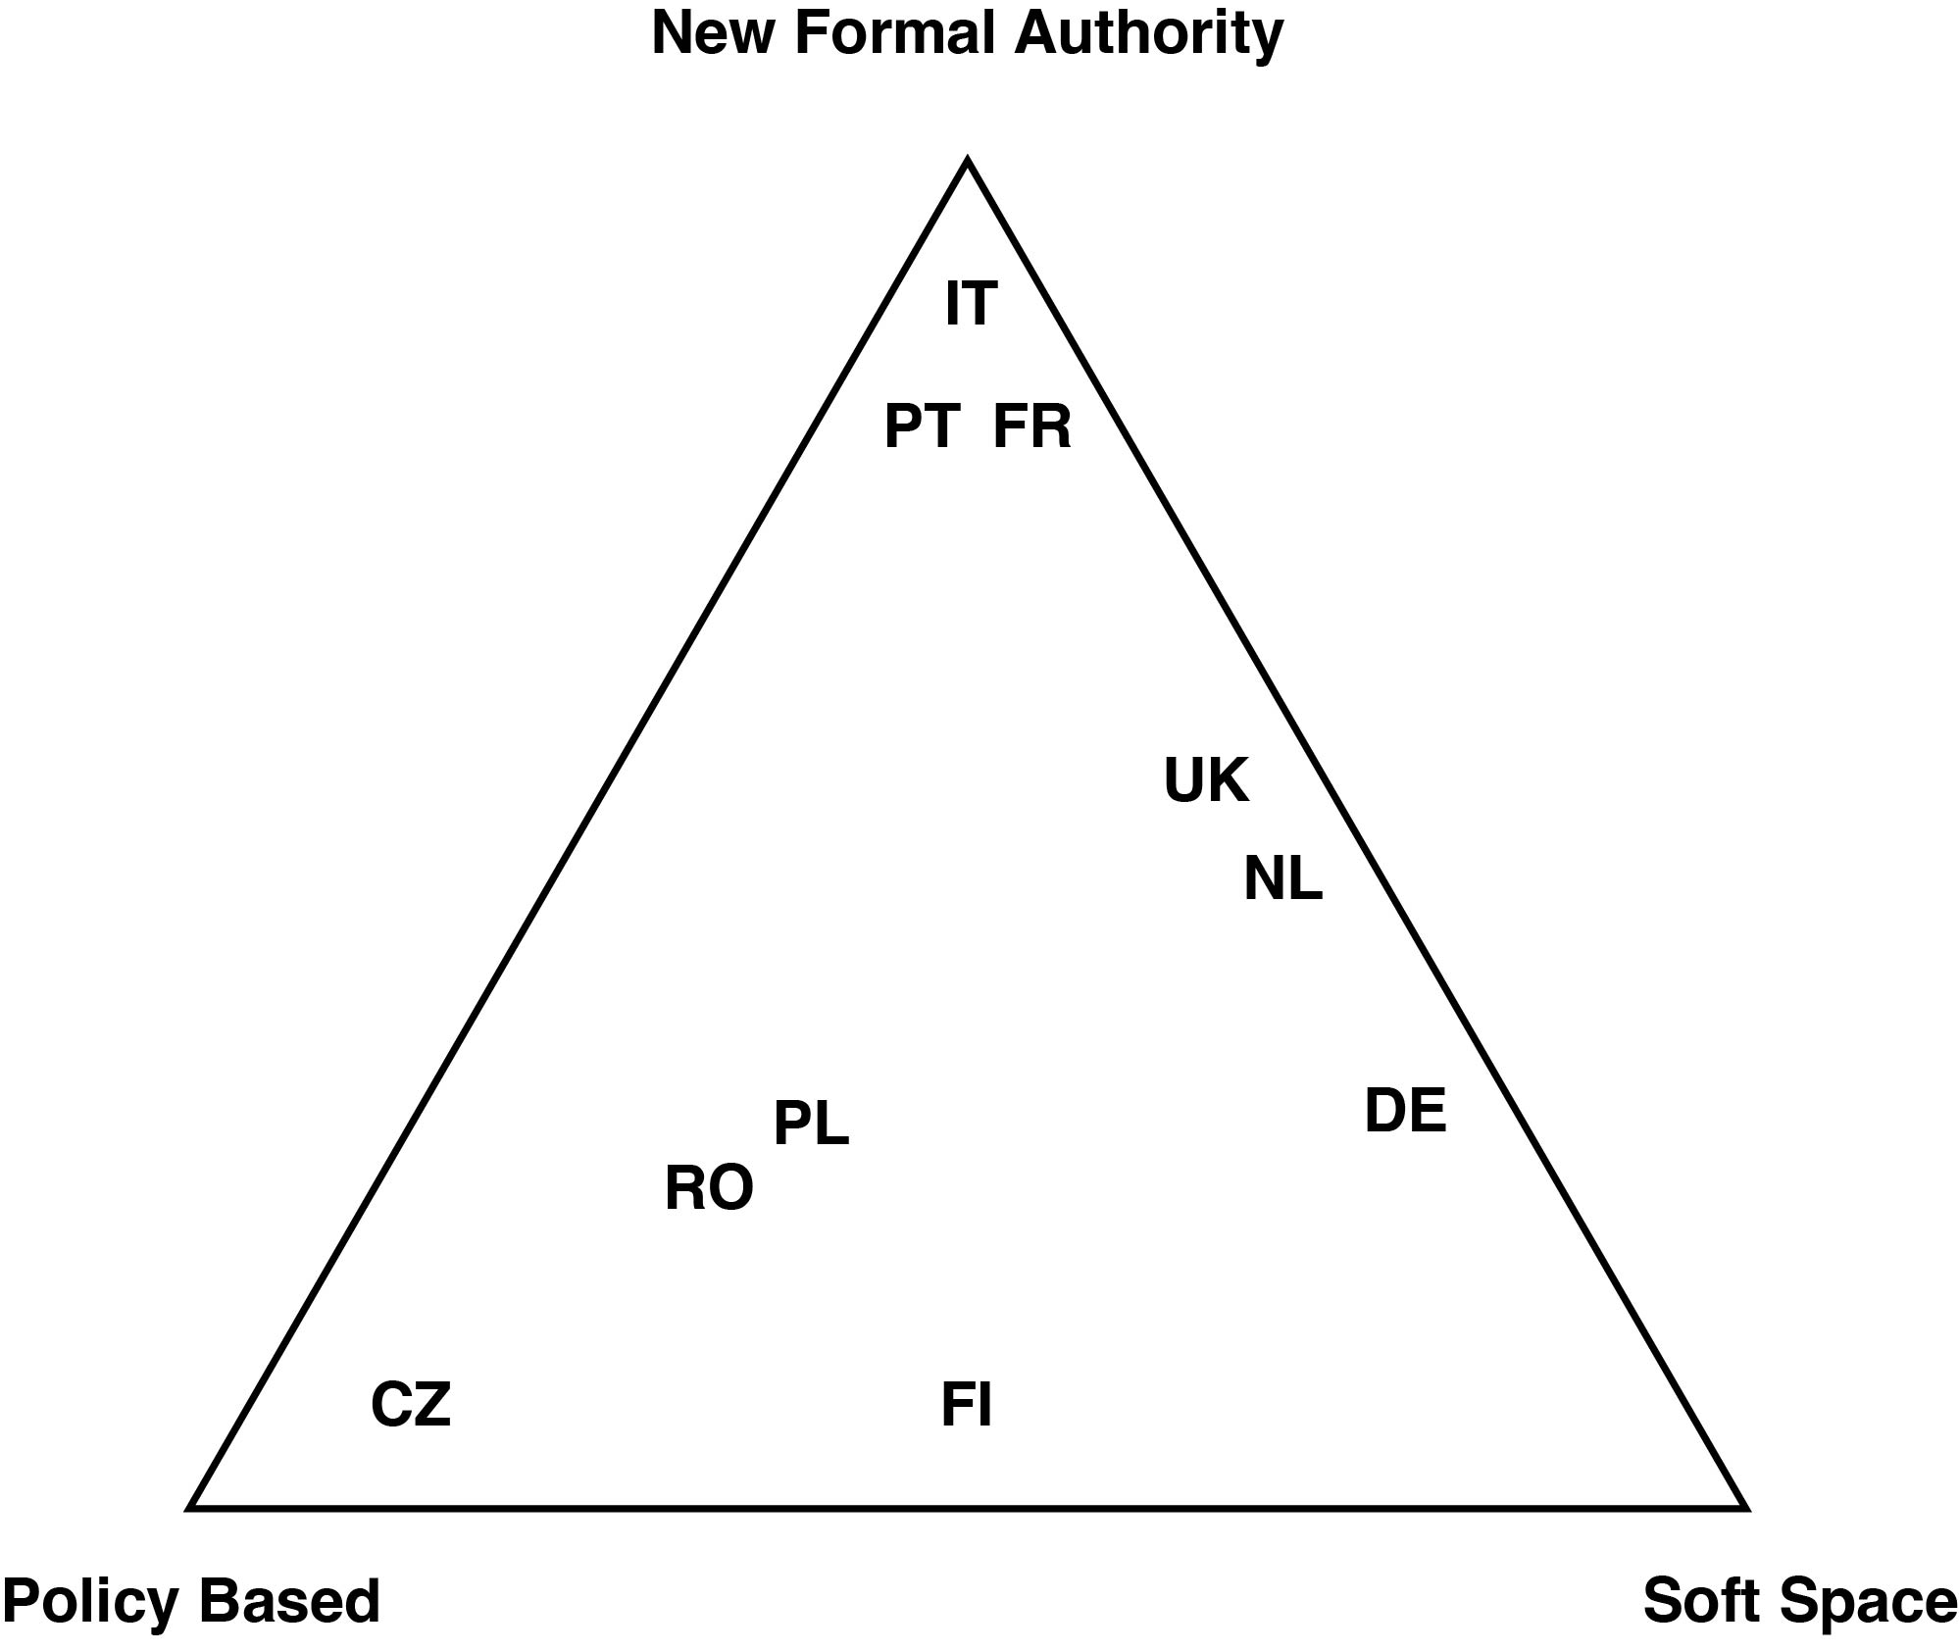
The path towards institutionalisation

Slide 12
Concluding remarks and perspectives
Results
The study allowed for classifying the models of metropolitan governance that characterise the 10 European states that approached the issue from a national perspective.
Despite the variable duration of the institutionalisation process, only France, Italy and Portugal have adopted a formal metropolitan governance model.
In the Czech Republic, Poland and Romania, the introduction of policy-based metropolitan governance models has been triggered by EU funds, and shaped by the instruments used to implement them.
In Poland and Romania, this process has facilitated the introduction of framework legislations in this regard, and a similar reform is under discussion in the Czech Republic.
Finally, metropolitan governance follows models that are softer and generally open to local choices in Germany, the Netherlands, the United Kingdom and (partly) Finland.

Slide 13
Concluding remarks and perspectives
Research perspectives
To complement the proposed classification through the analysis of the various ad hoc models of metropolitan governance introduced in relation to individual realities (e.g. capital cities or exceptional cases such as the Capital Region of Brussels, Barcelona, GMZ Metropolis in Poland, etc.)
To delve into the discourses that, over time, have accompanied the establishment of metropolitan governance in the various countries, in order to reflect more in depth on the logics and instances of the various actors that have led to the consolidation of the existing institutional models and the delimitation of the territorial scope of their action.
To monitor whether and to what extent the identified governance models are capable of incorporating and adapting to the changing functional dynamics that characterise the processes of metropolisation, through a readjustment of their thematic and geographical scope of action, but also of the metropolitan governance model itself.

Slide 14


Thank you!

