Slide 1
Ira Sibelius Senior Advisor Union of the Baltic Cities Sustainable Cities Commission c/o City of Turku
Marcin Wołek Associate Professor Department of Transport Market, University of Gdańsk
6.3.2025

Slide 2
CHANGING LANDSCAPE OF SUSTAINABLE URBAN MOBILITY PLANNING
EXPERIENCES FROM THE SUMPS FOR BSR PROJECT

Slide 3
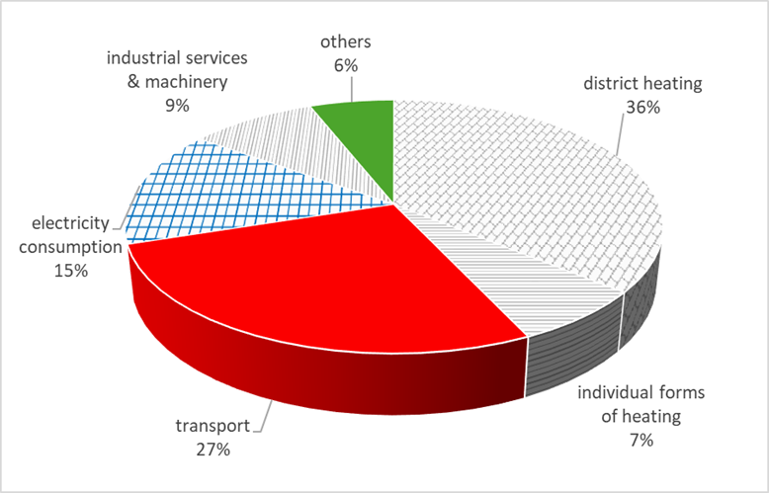
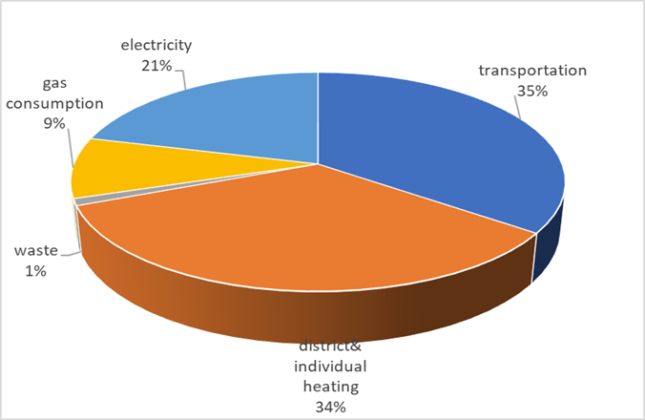
Transport and emissions
Structure of the CO2 equivalent emissions in Turku (Finland) in 2019
The transport sector is responsible for about 25% of global emissions.
Transport is the primary or one of the most important sources of emissions at the urban /metropolitan level.
The growth of cities means that the negative environmental impacts are concentrated in small areas, affecting an increasing number of residents.
The carbon footprint in Gdynia (Poland) in 2020
Notes:
challenge

Slide 4
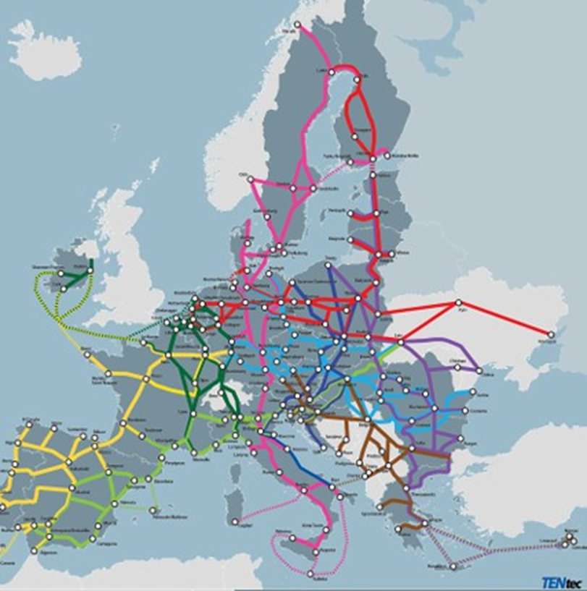
SUMP as a cornerstone of local & regional mobility policies
Sustainable urban mobility planning is seen as a solution enabling the decrease of emissions and achieving ambitious climate-related goals.
In 2013, the EU Urban Mobility Package outlined procedures and support mechanisms for developing sustainable urban mobility plans (SUMPs).
Since then, the European Commission has promoted SUMPs as an effective & strategic tool for planning and implementing transport policies in cities.
In 2024, the revised Regulation on the trans-European transport network (TEN-T) set a requirement for the 431 urban nodes along the TEN-T network to adopt and monitor SUMPs by 2027, covering the entire Functional Urban Area (FUA).
Notes:
as a short introduction, stressing out new requirements of the EC for the TEN-T nodes

Slide 5
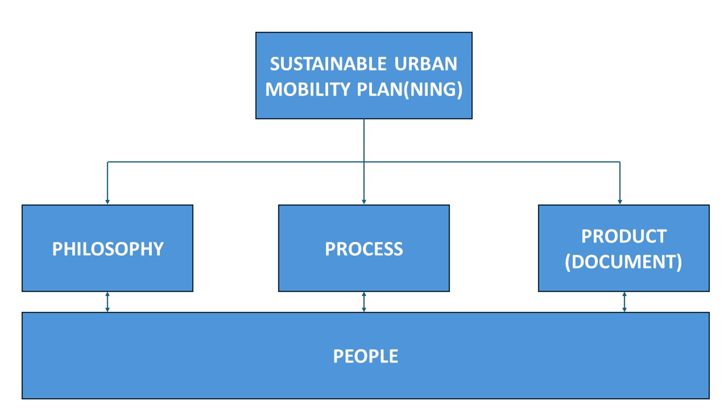
The essence, goals and benefits of the SUMP approach
SUMP is a strategic and integrated approach to urban transport contributing to improved accessibility and quality of life through a shift towards sustainable mobility – helps cities & regions to reduce their climate impact from transport.
It supports fact-based decision-making guided by a long-term vision.
It requires a thorough assessment of the status quo and future trends, a shared vision with strategic objectives, and an integrated set of measures from different policy areas.
SUMP emphasizes the involvement of citizens and stakeholders and cooperation across institutional boundaries.
Planning for the functional urban area & arranging the monitoring and evaluation – stressed by the revised TEN-T regulation.
Source: Rupprecht Consult (editor), Guidelines for Developing and Implementing a Sustainable Urban Mobility Plan, 2nd Edition, 2019
Notes:
as a short introduction, stressing out new requirements of the EC for the TEN-T nodes

Slide 6
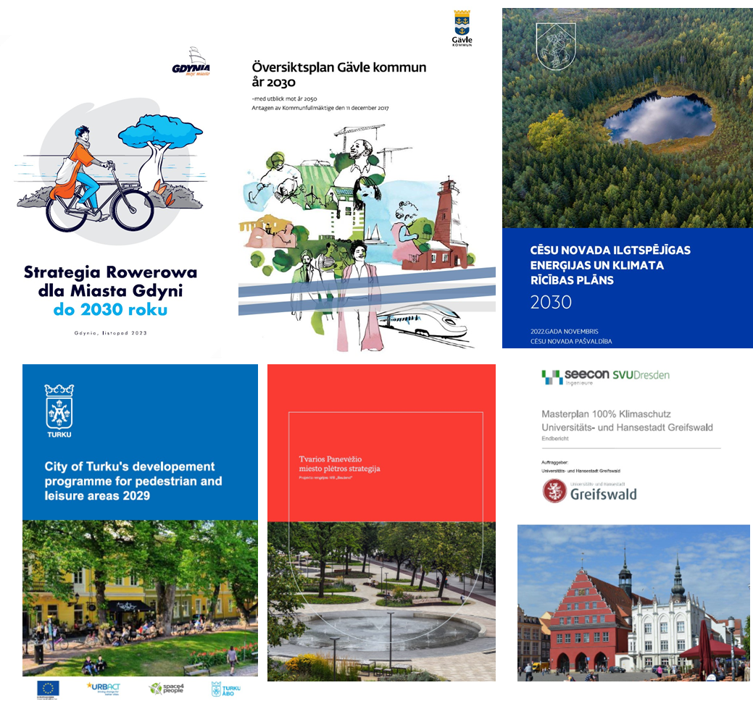
SUMP in the Baltic Sea Region
The Baltic Sea Region is characterised by a small number of large metropolises of European or global importance.
The urban landscape is shaped by medium and small cities, whose areas of influence are not extensive. However, they are key in developing spatial and social cohesion.
There are 135 Functional Urban Areas (FUAs) in the Baltic Sea Region, representing nearly 2/3rd of its total population.
They are different in size and impact area.
Many cities in the BSR have adopted SUMPs or SUMP-related documents. Still, the TEN-T regulation poses new questions and challenges regarding FUA governance, establishing monitoring and evaluation on the FUA level, etc.
Notes:
The context and specifics of the Baltic Sea Region, examples of SUMP planning (experience and lessons learned from the project "SUMPs for BSR")

Slide 7
SUMPs for BSR responding to the challenge
The SUMPs for BSR project, co-funded by the Interreg BSR programme, is supporting small and medium sized cities in the BSR transition to sustainable urban mobility planning.
Partnership: UBC Sustainable Cities Commission (leader), 6 BSR cities and expert partners University of Gdansk and the Institute of Baltic Studies
The project aims to increase the uptake of SUMPs as a strategic tool for local authorities.
It develops a common framework on monitoring and evaluation that supports cities in setting up sound local processes.
Focuses strongly on promoting active mobility - one of the most effective and investment-efficient measures linking sustainable mobility, health improvement and the wellbeing of urban society.

Slide 8
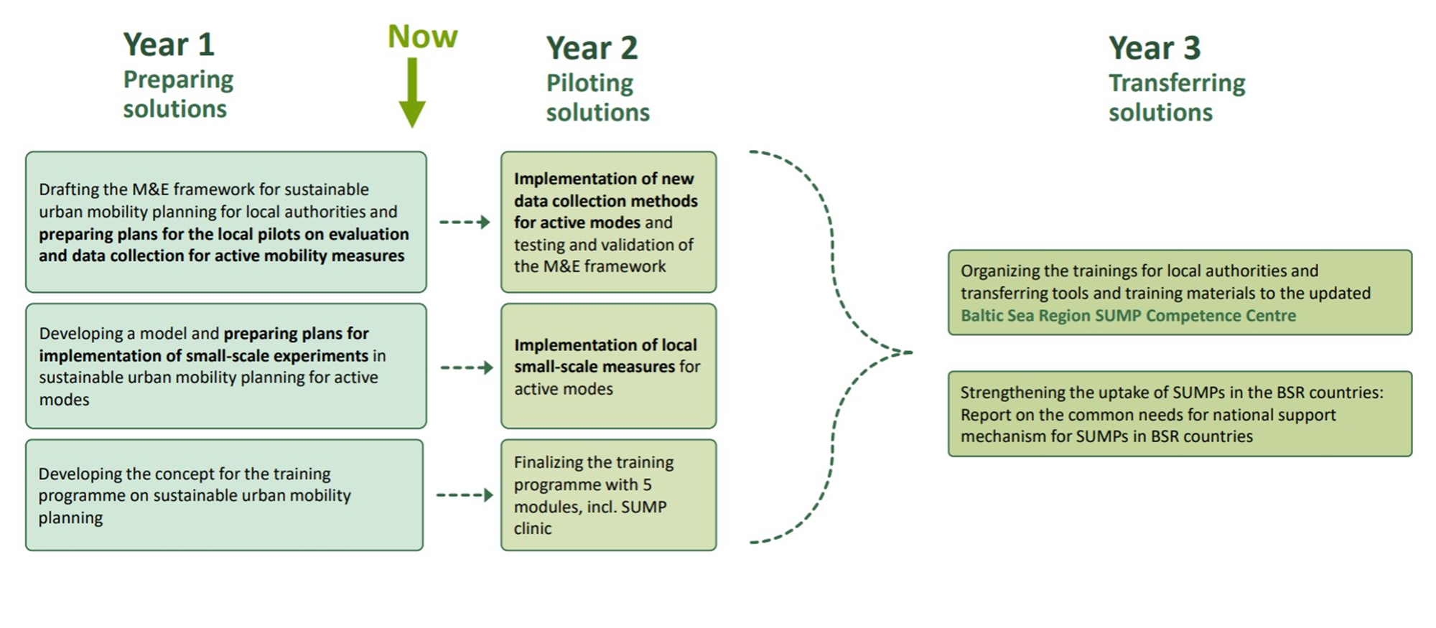
Experiences from SUMPs for BSR – two case studies
Project activities enabled the assessment of the changing landscape of sustainable urban mobility planning from the perspective of small and medium-sized cities in the Baltic Sea Region;
Based on baseline analysis, incl. in-depth interviews, surveys, data audits, and workshops;
Focus on experiences from Turku (Finland) and Gdansk-Gdynia-Sopot (Poland) metropolitan areas;
In both cities, sustainable urban mobility planning occurs at multiple levels.
The FUA level planning is crucial to capture mobility activity (pedestrian and cycling traffic) accurately.
Notes:
Linking the city of Turku and the region/metropolitan area in planning processes, mobility planning and management in the functional area of the city

Slide 9
Mobility planning in Turku metropolitan area
National Transport System Plan for 2021–2032
Agreement on land use, housing and transport 2020-2024 (between the region and the State)
Regional Transport System Plan 2020-2024
(FUA SUMP)
Turku SUMP 2025-2029
(City-level SUMP)
In Finland, SUMP will be integrated into the regional transport system work.
SUMP principles applied.
Update planned in 2025.
Complements and gives input to the regional SUMP.
SUMP principles applied (excluding regional coverage and wide cooperation with other institutions)
Update planned in 2028.
Notes:
County level: Transport System Plan of the Southwest Finland (2020)
FUA level: Transport System Plan of the Turku Urban Region (2020)
Consisting of 13 municipalities that make up one the 7 Finnish city-regions that have a MAL agreement with the state regulating land-use, transport and housing in the municipalities.
City level: City of Turku finalized its own SUMP in late 2024
Bringing together the main elements of previous city-level policies, strategies, & programmes on or related to transport, forming one logical and integrated entity.
Four sets of measures – safe, healthy, equal and carbon-neutral - consisting 66 actions under them
Why Turku then needed own SUMP?
Turku had over 500 decided measures for transport and mobility – implementation cannot be sufficiently monitored.​
Turku is the only large city in the region. ​
Turku has more ambitious climate goal than other region (2029/ 2035).​
Better chance to reach the joint regional goal for the modal share (66 % by 2029).​

Slide 10
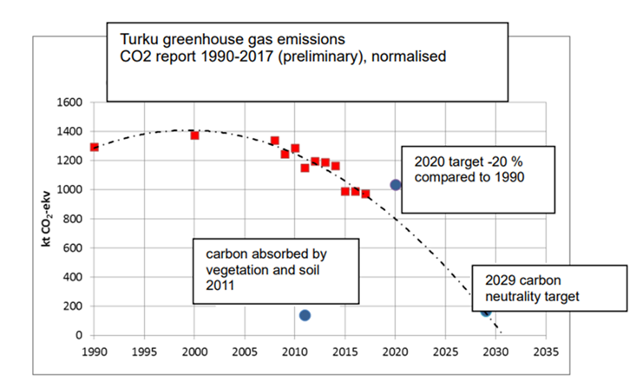
Specificities of Turku region
Turku is the only large city in the region – and growing fast.
Turku had over 500 decided measures for transport and mobility – their implementation couldn’t be sufficiently monitored.​
The City of Turku has a more ambitious climate goal than the rest of the region: to be climate-neutral by 2029 (vs. region: 2035).​
​Still necessary to enhance the monitoring and evaluation practices to follow progress – support from SUMPs for BSR project.
Source: Turku Climate Plan 2029. The City of Turku Sustainable
Energy and Climate Action Plan 2029. Turku City Council, June 2018, p. 30

Slide 11
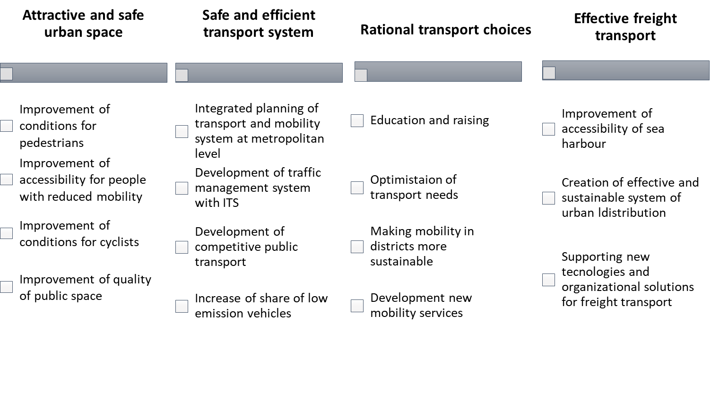
Mobility planning in Gdansk-Gdynia-Sopot
Strategic and operational goals of Gdynia’s SUMP (2016)
First Sustainable Urban Transport Plan in Gdynia elaborated in 2009 (never officially adopted);
SUMP for Gdynia adopted by the City Council in 2016, followed by Gdansk (2018) and Sopot SUMPs;
The plans focused on particular cities, considering active modes, public transport, car traffic, freight and urban logistics, parking policy and mobility management;
In addition to mobility plans, many other strategic documents have addressed issues such as emissions, motorised traffic, and public transport.
It resulted in less precise monitoring & evaluation processes and less precise allocation of responsibilities.
Source: Sustainable Urban Mobility Plan for Gdynia, Gdynia 2016

Slide 12
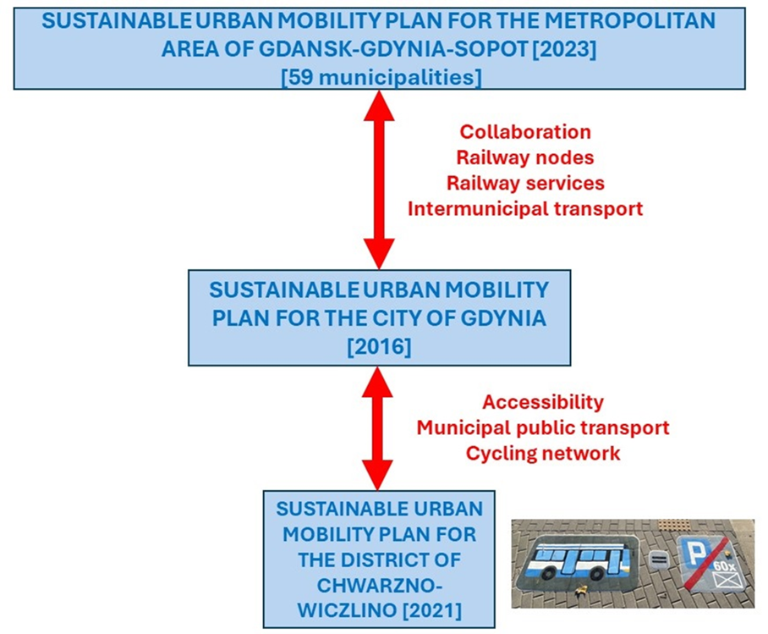
Mobility planning in Gdansk-Gdynia-Sopot
One of the most dynamic metropolitan areas of Poland;
The long process of integration of the Metropolitan Area of Gdansk-Gdynia-Sopot was formalised in 2014;
One of the most essential challenges addressed on this level is transport and mobility with a focus on spatial planning and development;
SUMP for the Metropolitan Area was adopted in 2023/2024 by all municipalities;
The main objectives of the Sustainable Mobility Plan for OMMGS include improving public transport accessibility, increasing road traffic safety for all participants, enhancing air quality and increasing the share of sustainable transport modes in overall travel;
An interesting aspect of the local approach to mobility planning is the development of district-level urban mobility plans. Gdynia has created a document for one of its districts, focusing on local issues.

Slide 13
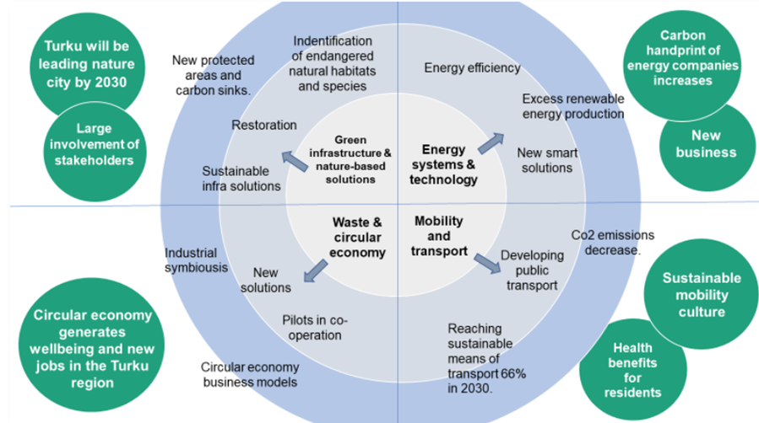
Summary
The importance of the Functional Urban Areas is growing. Therefore, the planning level for sustainable mobility includes at least city and metropolitan/functional urban areas.
Although small and mid-sized cities dominate the BSR area, many have formulated ambitious goals to reduce emissions.
Ambitious climate goals align with the development of sustainable urban mobility plans, as the transport sector is among the most important sources of emissions.
Transport and mobility are among the most critical pathways to carbon neutrality in the cities.
The European Commission supports this approach. The revision of the regulation of the TEN-T network extends the number of urban nodes in the EU (from 135 to 431) and sets an obligation to develop a sustainable urban mobility plan up to 2027.
Transport & mobility among other pathways
in Turku’s way to carbon neutrality
Source: Climate City Contract. 2030 Climate Neutrality Action Plan.
2030 Climate Neutrality Action Plan of the City of Turku.
NetZero Cities, https://netzerocities.app/resource-4223

Slide 14
Event coming up on TEN-T requirements
The changing landscape of Sustainable Urban Mobility Planning
Tue 18 March 2025 at 09:00 - 12:30 CET
Join in Gävle (SE) or online
The hybrid event will include inspiring presentations and an engaging workshop. You will hear about guidance and recommendations from the European Commission and learn about the revised TEN-T regulation, and dive into the experiences from Sweden on sustainable urban mobility planning. Welcome!

Slide 15
Thank you!
Ira Sibelius Senior Advisor Union of the Baltic Cities Sustainable Cities
Commission c/o City of Turku
ira.sibelius@turku.fi
Marcin Wołek Associate Professor Faculty of Economics
University of Gdańsk
marcin.wolek@ug.edu.pl

