Slide 1
Green infrastructure and green spaces as a spatial planning instrument
Maciej Nowak
West Pomeranian University of Technology in Szczecin
This presentation is the result of a research project entitled Assessment of the status and significance of green infrastructure as a natural and social resource of small and medium-sized cities in Poland, no. 2019/35/B/HS4/04221, funded by the by the National Science Centre.

Slide 2
Research question
Key challenges
Protection of existing green spaces;
Shaping of new land for green space purposes;
Inclusion of green roofs, a certain number of trees, plants, etc. in spatial planning;
What is the role of legal and institutional solutions/tools in shaping and protecting green infrastructure and green spaces?

Slide 3
Key terms
Green areas/ green spaces
Green infrastructure
Urban greening

Slide 4
Key tools (in spatial planning system)
Legal tools
Strategic tools
Legal regulations;
Spatial plans/ land use plans/ zoning plans;
Strategies (with spatial dimension);

Slide 5
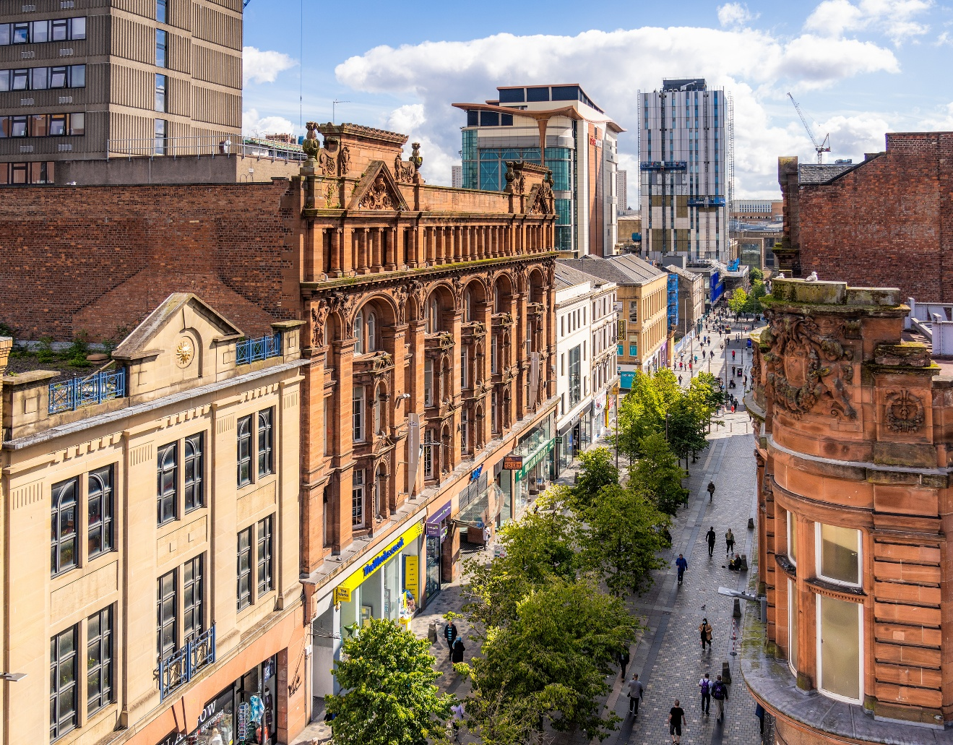
Possible lines of action for public policies
Zoning green spaces (in local/urban spatial plans) - this applies both to areas developed for green space and to areas only designated for these purposes;

Slide 6
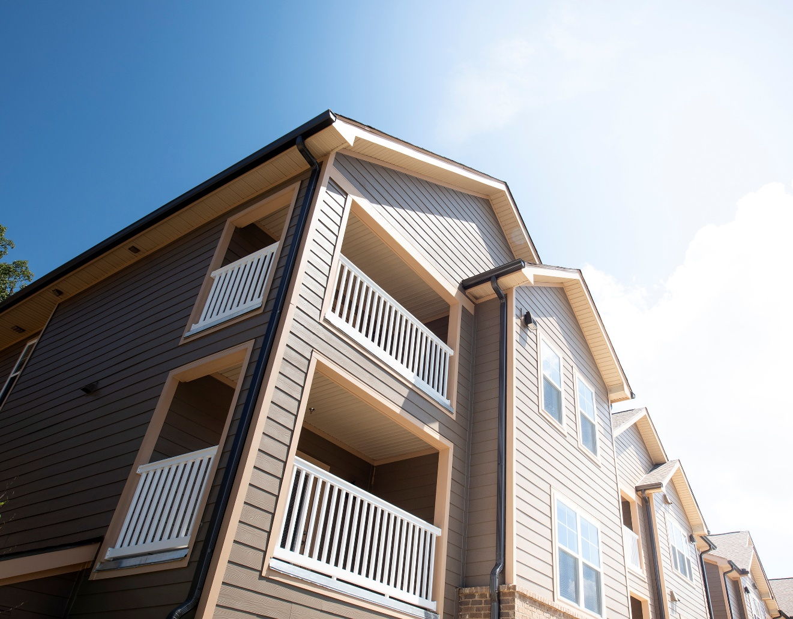
Possible lines of action for public policies
Determining the minimum required access of new residential developments in relation to green spaces;

Slide 7
Possible lines of action for public policies
Imposing (on a city-wide basis) the need to maintain a certain amount of green space;

Slide 8
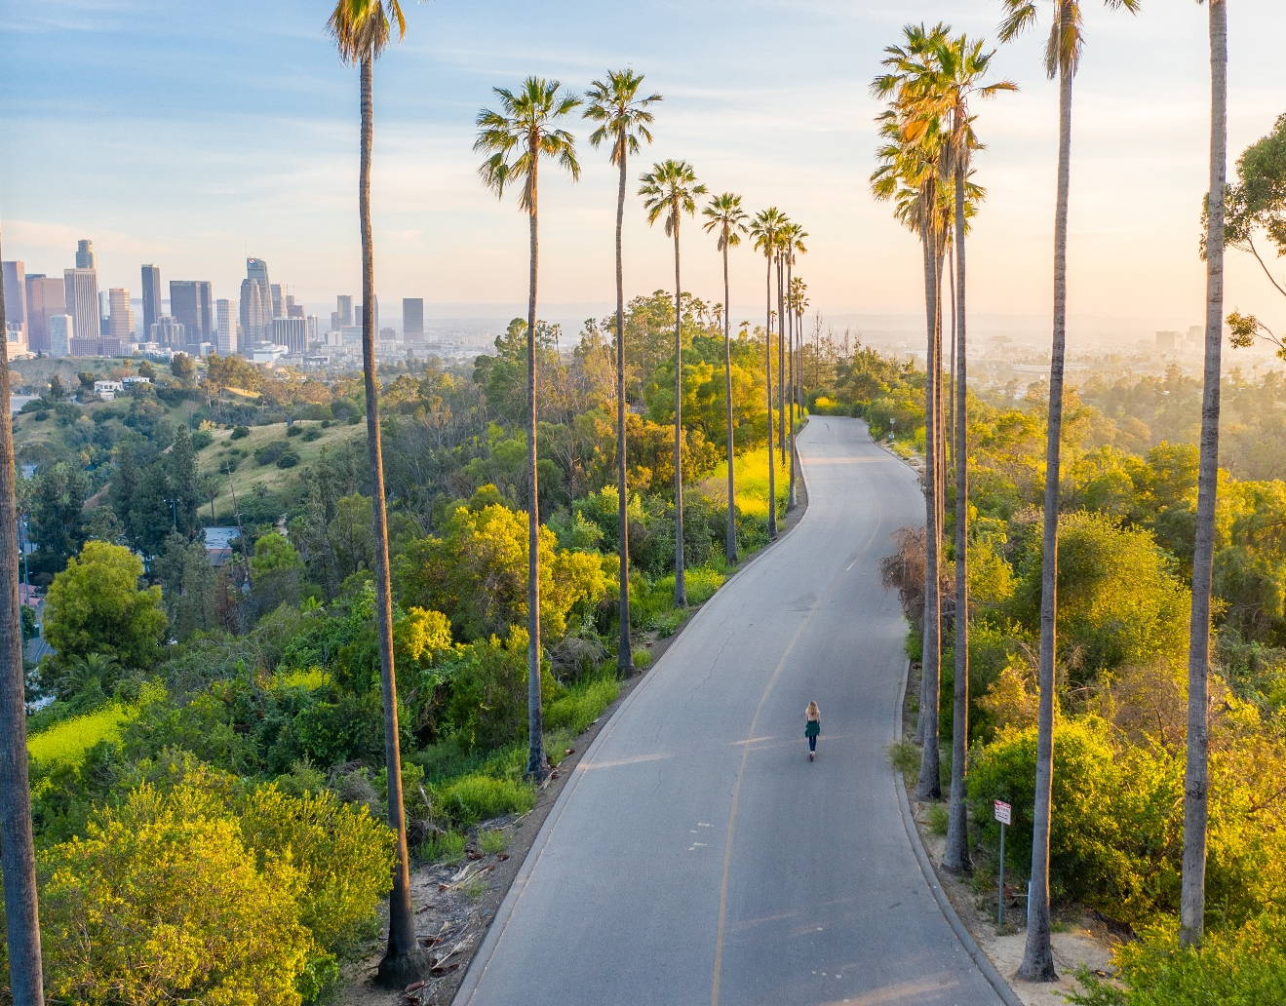
Possible lines of action for public policies
Imposing green roof bonding requirements for the erection of buildings;
Specifying a minimum number of trees per area;

Slide 9
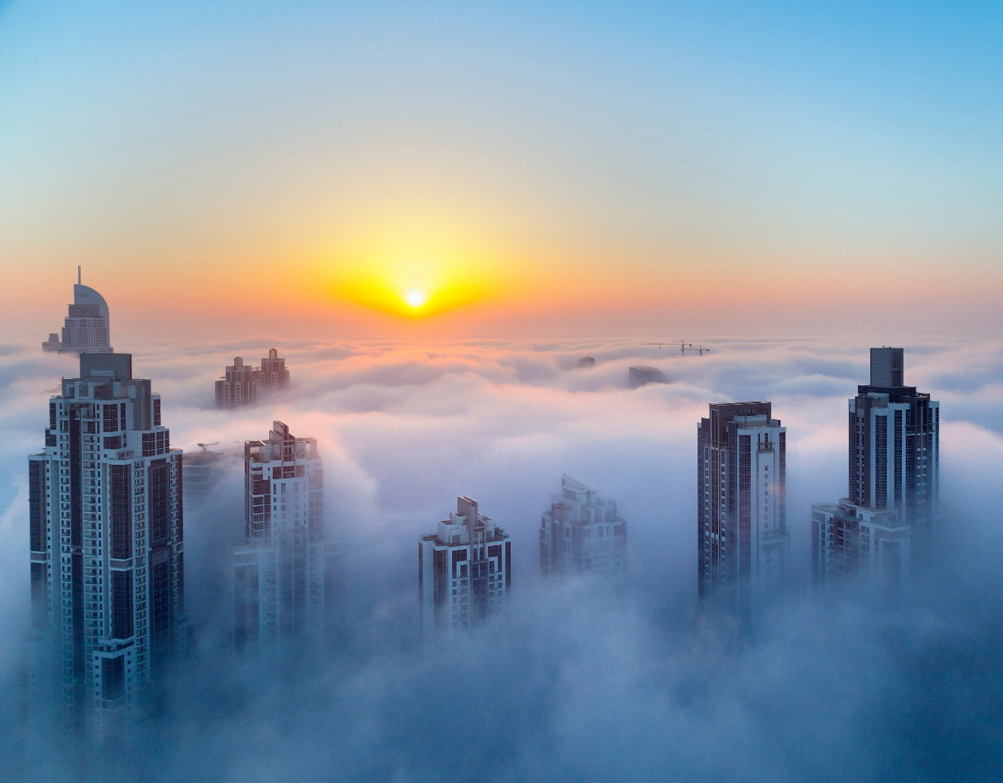
Main social barriers
Spatial conflicts (some stakeholders, especially investors, may plan spatial development differently);

Slide 10
Main technical barriers
Terminological problems (lack of consistency between different documents, especially between strategic and regulatory acts);
Implementation problems - some provisions (even regulatory ones) may be difficult to enforce;
Long time to amend/update the content of specific planning acts;

Slide 11
Case study – Ghana (Kumasi)
The city of Kumasi has a great deal of green space (‘the green garden of Ghana’);
ownership of many properties belongs to the tribal leaders. They are not interested in maintaining the green space and are trying to make commercial developments;
spatial planners oppose this;

Slide 12
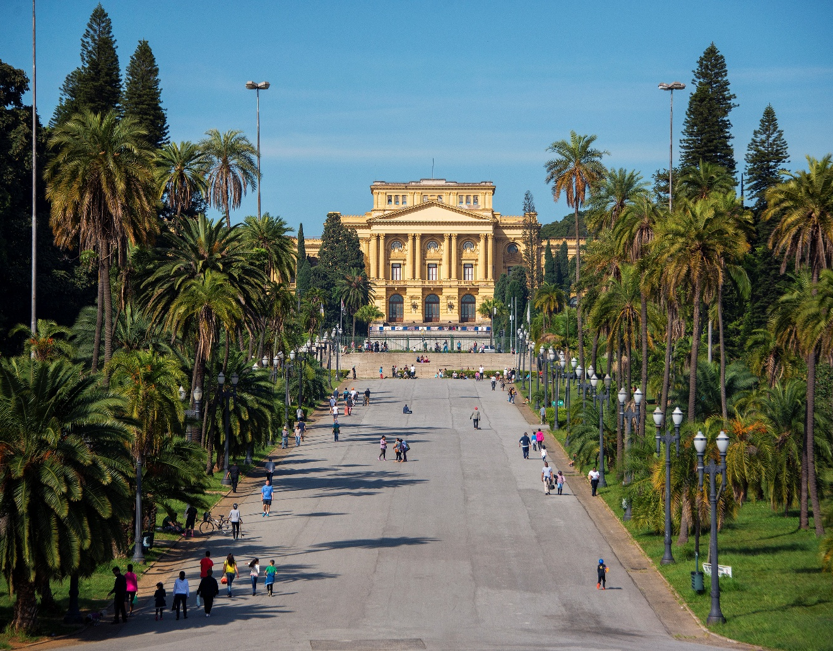
Case study Brasil (Sao Paulo)
the direction related to the expansion of green spaces is not in doubt;
however, there are opinions in the public discourse according to which the city prefers areas inhabited by wealthier residents. Poorer neighbourhoods have far fewer green spaces;

Slide 13
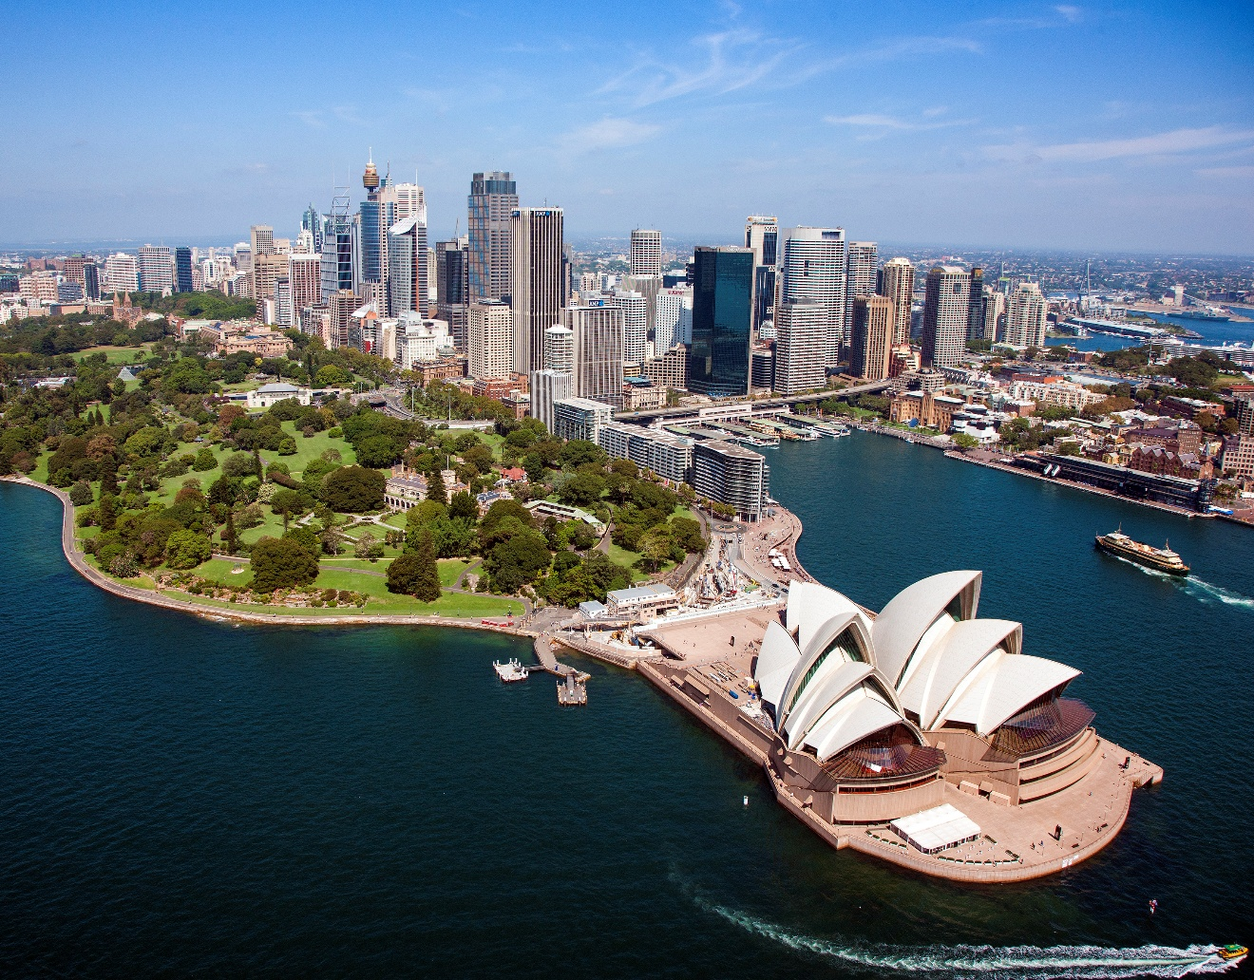
Case study Australia (Sydney)
record warm temperatures in the Sydney suburbs;
an order has been made for new buildings to be constructed only with green roofs;
this change was opposed by some investors - the municipal authorities have withdrawn this regulation;

Slide 14
Poland
there is a lack of more ambitious institutional action to link spatial and climate challenges;
‘biologically active area’ must be included in spatial plans for the project area). This is often bypassed or even ignored;
there are general demands in the law for ‘urban greening’;

Slide 15
Conclusions
the shaping of green spaces must be based on a strategic view. In a significant number of countries, however, legal support is needed;
1
city/municipality zoning, taking into account existing and new green spaces, is crucial in this context. However, there is a risk of spatial conflicts here;
2
goals for ‘greening’ the space can also be shaped in other ways. The risks, however, are ‘technical-legal’ problems and attempts to circumvent regulations;
3

Slide 16
Thank you!

