Slide 1
ESTONIA’S DISSONANT HERITAGE: SPATIAL PLANNING AND SOVIET MILITARY SITES
Ann-Leena MILLER & Joanna Tamar STORIE
Estonian University of Life Sciences, Chair of Landscape Architecture
annleena.miller@student.emu.ee; joannatamar.storie@emu.ee

Slide 2
Historical Context
Soviet occupation (1944-1991) > Estonia was a strategic Soviet military outpost with a significant military presence
Iron Curtain/outer border of Soviet Union > large-scale construction of artillery and defensive positions along the coast (border zone)
Number of Soviet military sites unclear >
Raukas (1999) – 800 sites, 1,565 objects
Estonian Heritage Society (2018) – 349 sites, 3,386 objects
Issues with classification and documentation
Lack of interest - symbols of division and foreign control

Slide 3
Current State of Military Heritage
Older military heritage valuable due to its age > under protection
Soviet military heritage > large numbers > limited architectural value > utilitarian design and poor construction quality > unprotected
Limited government interest in repurposing > private property
Lack of infrastructure, lack of resources, low population density > limited redevelopment potential > no immediate pressure
Abandoned, left to decay > part of a post-Soviet landscape > blending with the natural environment, overtaken by vegetation
Two legacies > military restrictions led to conservation of wildlife

Slide 4
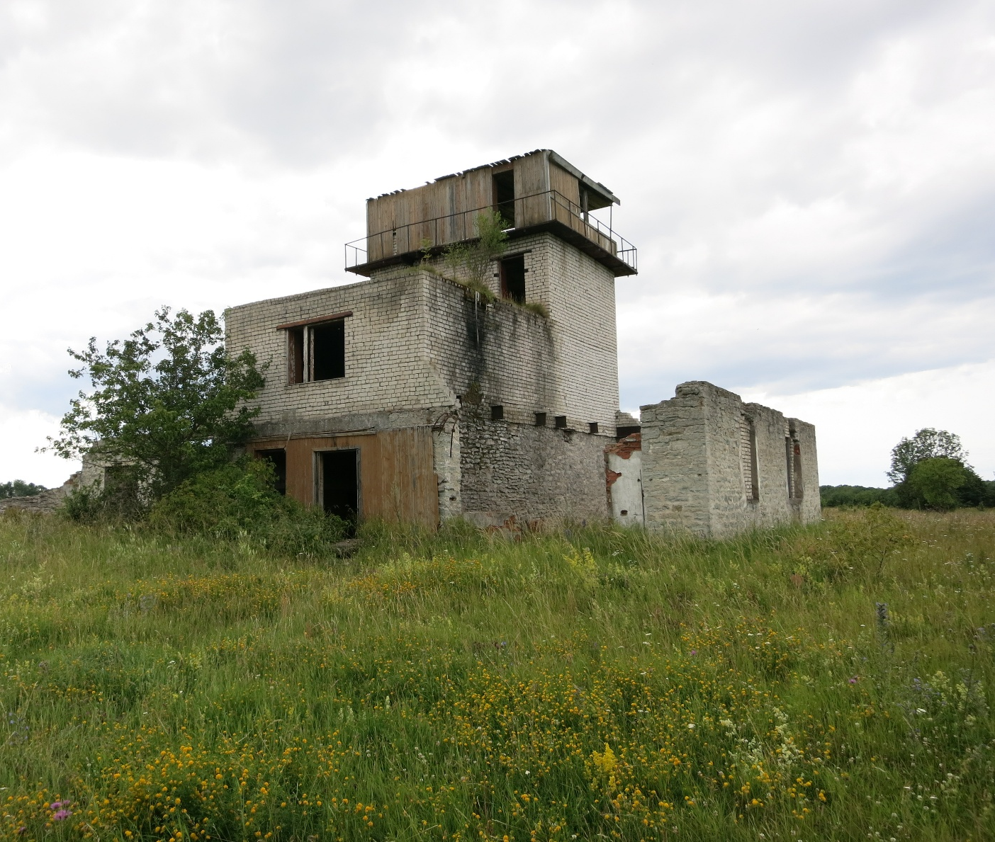
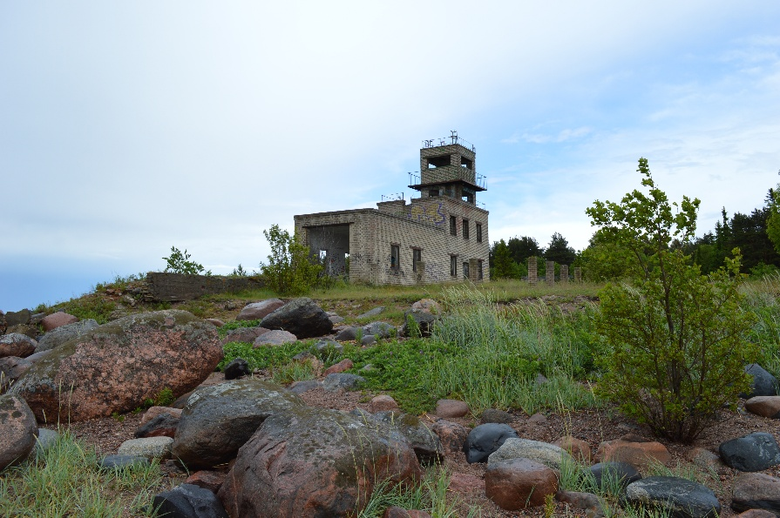
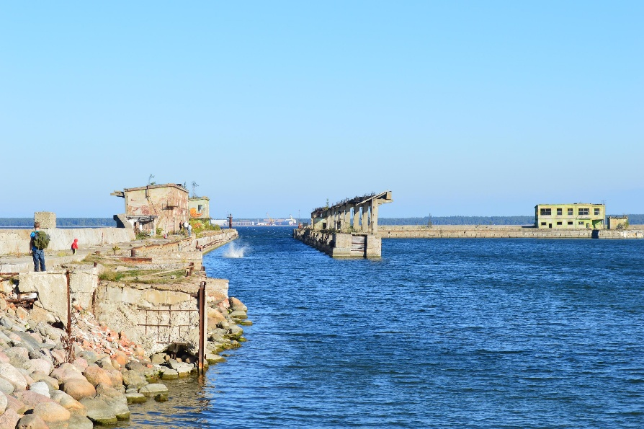
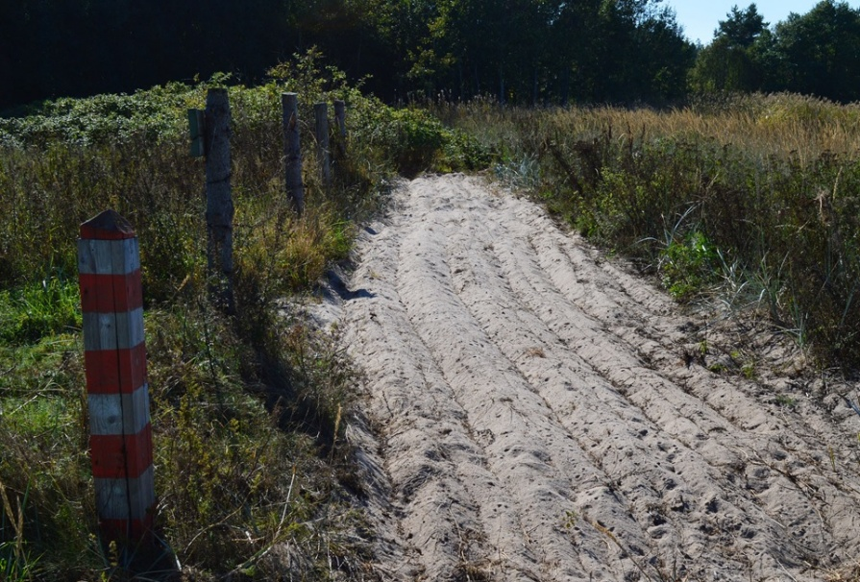
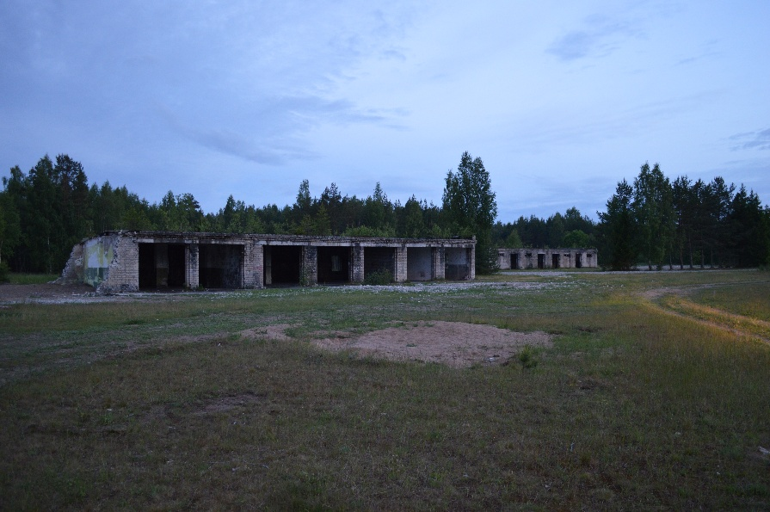

Slide 5
Heritage Challenges
Landscape layers can hold emotional and historical significance shaped by collective memory > influences how people perceive and interact with those spaces
A number of (older) Estonian cultural landmarks are of foreign origin > castles, manor houses > appreciated
Soviet heritage > a representation of foreign power and influence
“Dissonant heritage” > controversial or uncomfortable past that is difficult to integrate into national narratives
He who does not remember the past, lives without a future.“ (J.Liiv)

Slide 6
Heritage Challenges
History becomes heritage when defined in the context of landscape and interpreted through collective memory
Mental pollution > doesn’t fade over time or by removing physical symbols > shifting the mental framework and collective memory
Public attitudes polarized > generations > planning more difficult
Through thoughtful planning Soviet military landscape can be reimagined not as a forgotten relic, but as an opportunity for understanding, education, and sustainable development in a post-Soviet context
A way of coming to terms with a painful past rather than ignoring it

Slide 7
Protection and Preservation
State protection > cultural monument
Heritage protection is currently regulated at the state level by the Heritage Conservation Act, the Nature Conservation Act and the Planning Act
Only the most significant objects meet the criteria
Local Protection (Planning Act) > culturally significant area/individual object
Documentation (digital display) > not possible to preserve or protect
Mapping and presentation > rising public awareness

Slide 8
Protection and Preservation
Protection cannot be organized and regulated by laws alone > laws only provide important structure and guidelines for safeguarding cultural assets
Broader approach > community engagement, public education, sustainable management practices, and the involvement of various stakeholders

Slide 9
Protection and Preservation
Dual focus > integrating the historical and ecological value into national planning frameworks
Built heritage under state protection > the good condition of heritage must be preserved or ensured > frozen in time
Sustainable way to preserve both the built and natural environments without compromising the safety, accessibility and long-term viability > at the same time maintaining the historical narrative
Selective preservation strategies > stabilizing key elements, allowing aesthetic decay > reduce costs while preserving cultural significance

Slide 10
Protection and Preservation
Community involvement and public education > dialogue about Estonia’s Soviet past > a way of reconciliation
Educating planners > no regulations (not protected) > a lot depends on the knowledge, awareness, and desires of the planner and the client
Result > Soviet heritage not only preserved legally but also respected, valued, and maintained in a way that resonates with future generations

Slide 11
Planning
Planning > preserve existing values while establishing the necessary conditions for a user-friendly and safe living environment, a spatial framework that reflects the community's values, and the development of aesthetically pleasing surroundings
Develop integrated planning documents that treat military zones as multi-faceted areas requiring environmental and heritage preservation
Incorporate these sites into regional and national heritage strategies and planning documents (general plans of local governments)
Implement zoning laws and ecological remediation techniques to stabilize or repurpose contaminated or degraded sites safely

Slide 12
Future Directions
Explore opportunities for ecological restoration while selectively preserving historical elements, emphasizing the co-existence of nature and history
Promote the adaptive reuse of military sites through community-driven designs and inclusive policymaking
Reframe Soviet military heritage as a tool for understanding and education, addressing ecological recovery, sustainable development, and collective memory
On site > Making it more visible in the landscape > basic maintenance and neutralising immediate dangers > site marking and access

Slide 13
Thank you!

