Slide 1
Inovācijas ārtelpas plānojumu praksē vēsturiskā pilsētas ainavā
Indra Purs

Slide 2
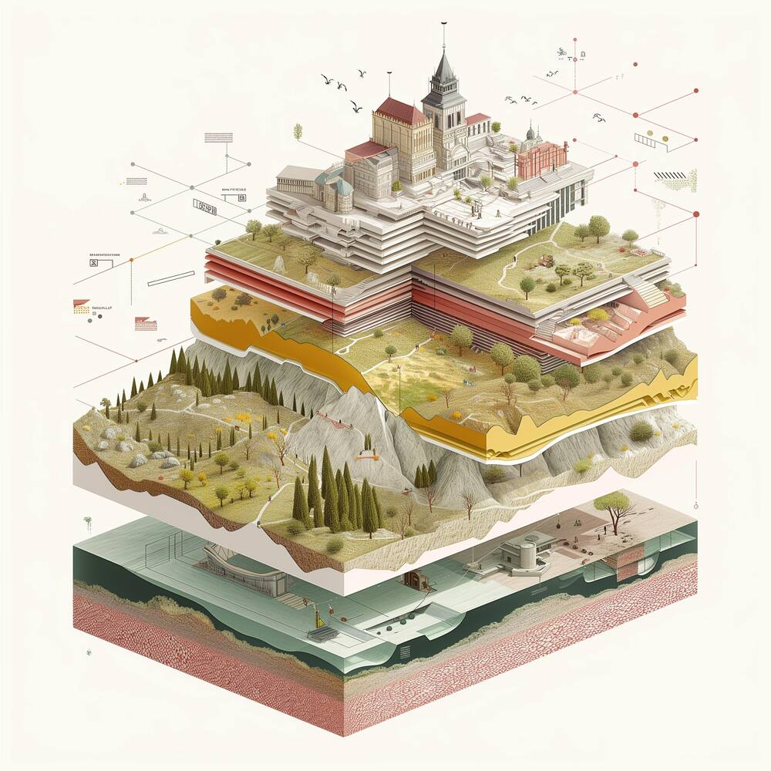
Milestones of commitments for recognition of landscapes in the UNESCO
Recommendation concerning the Safeguarding of the Beauty and Character of Landscapes and Sites, 1962
Convention concerning the Protection of the World Cultural and Natural Heritage, 1972
Operational Guidelines for the Implementation of the World Heritage Convention, 1992
Convention on Biological Diversity, 1992
European Landscape Convention, Council of Europe, 2000
Recommendation on the Historic Urban Landscape, 2011
United Nations Framework Convention on Climate Change, 1992
Convention on the Protection of the Underwater Cultural Heritage, 2001
Until 1992, no World Heritage cultural landscapes existed
Convention for the Safeguarding of the Intangible Cultural Heritage , 2003

Slide 3
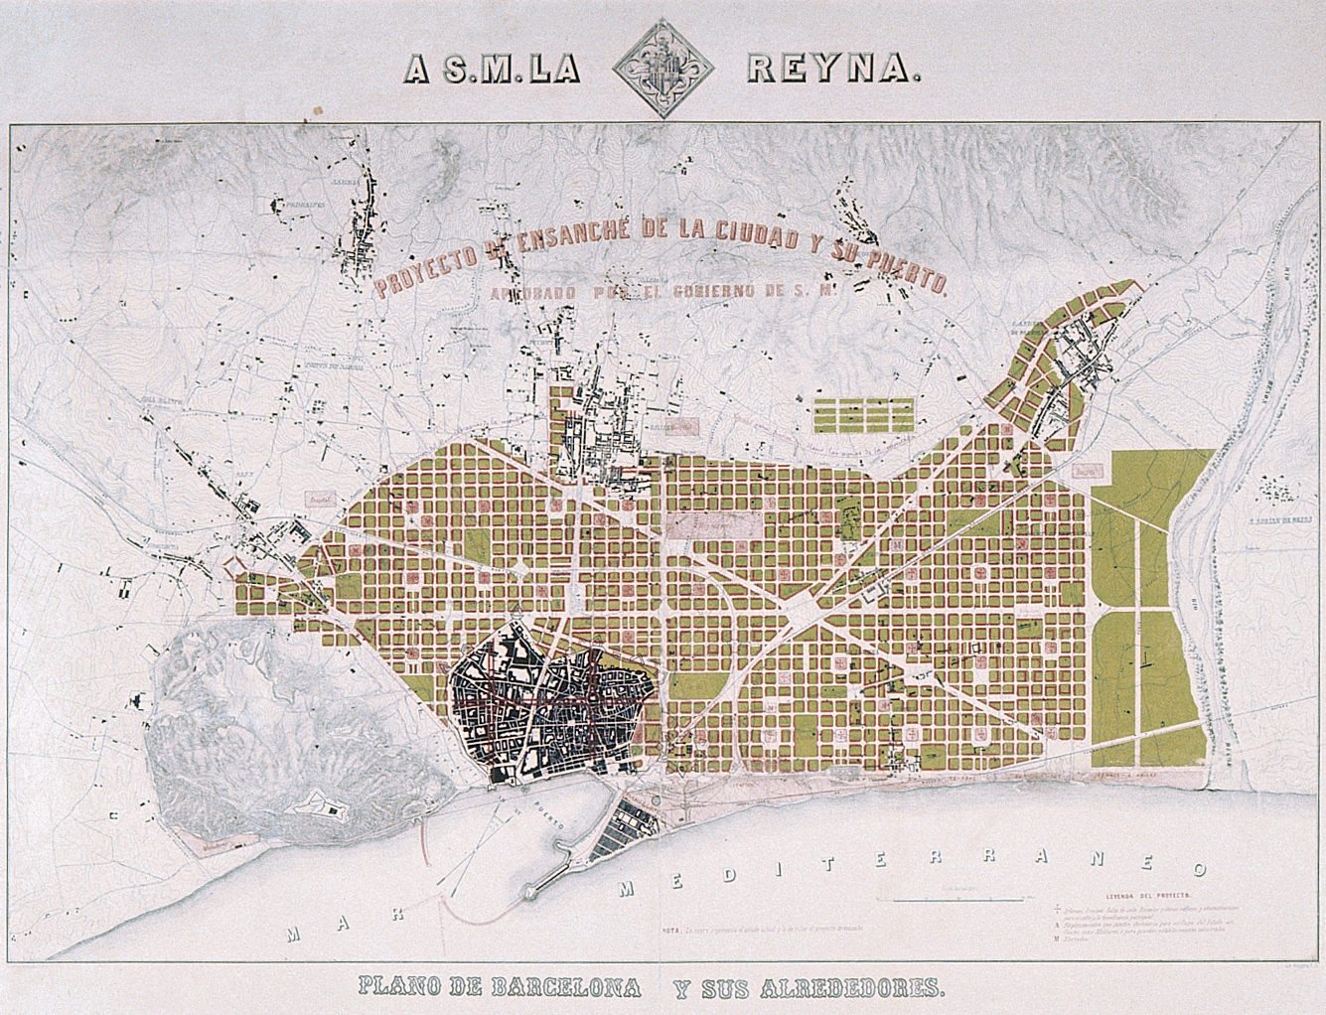
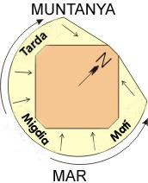
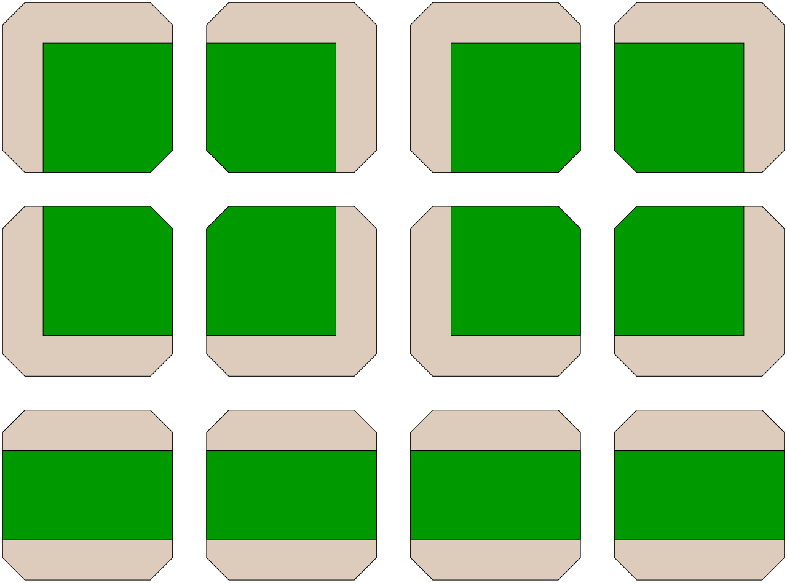
Cerdà plāns. 1859.
http://www.ub.edu/visitavirtual/visitavirtualEH/index.php/en/get-to-know-the-university-of-barcelona/the-city-in-the-nineteenth-century/the-eixample-and-the-historic-building/399-the-cerda-plan

Slide 4
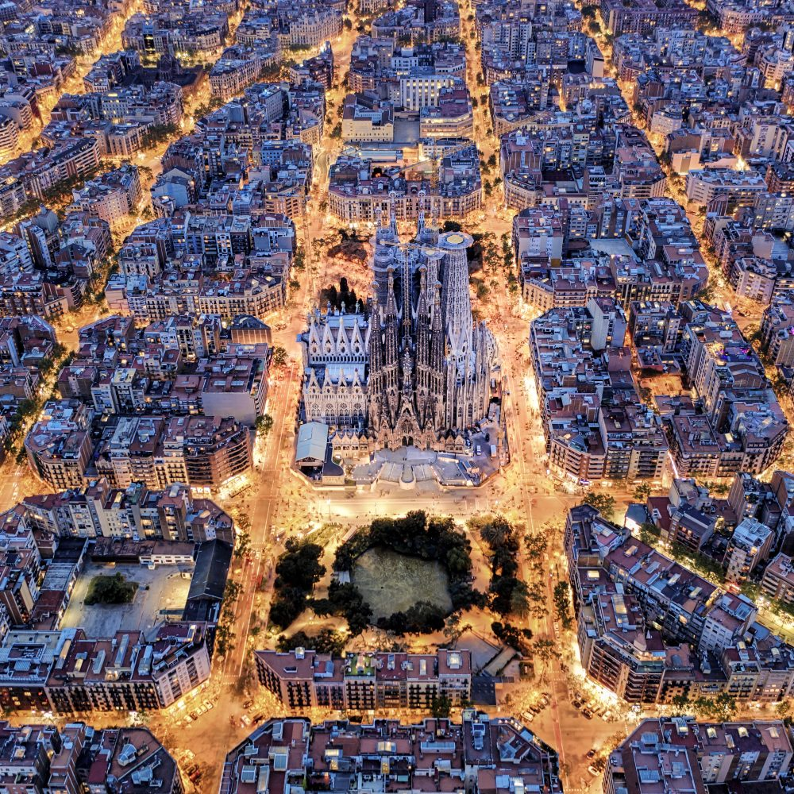
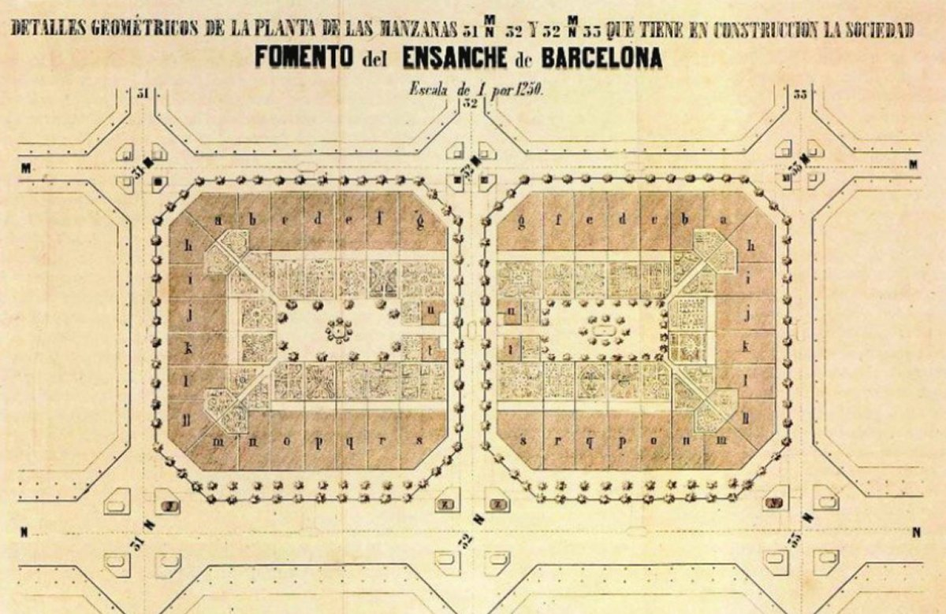
https://es.wikipedia.org/wiki/Plan_Cerd%C3%A1
https://www.ebrdgreencities.com/policy-tool/urban-planning-with-superblocks-barcelona-spain-2/

Slide 5
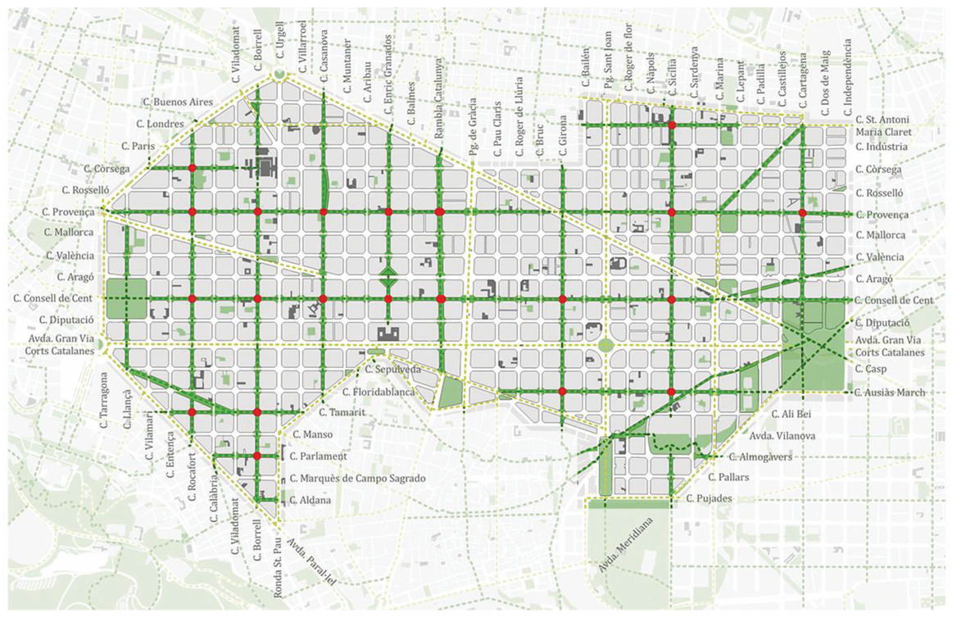
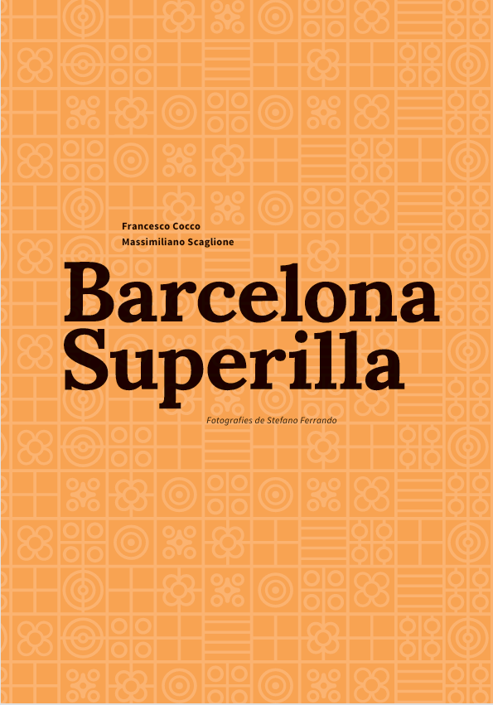
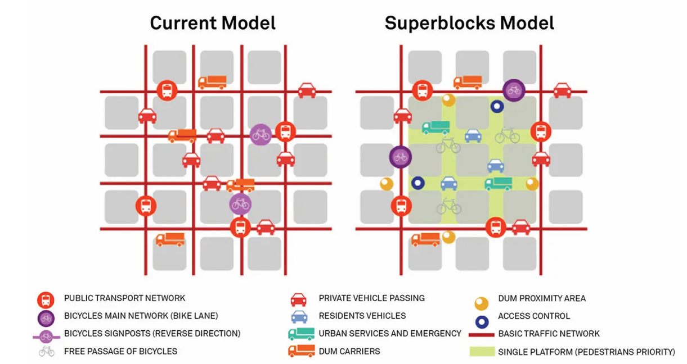

Slide 6
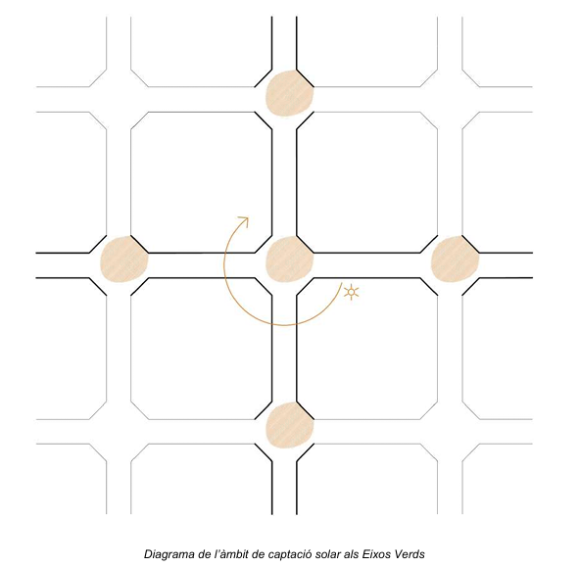
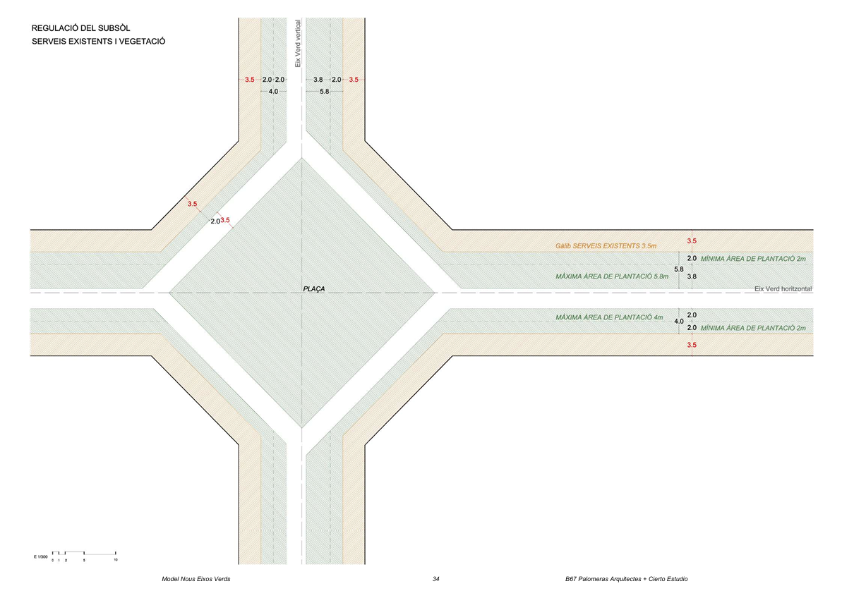
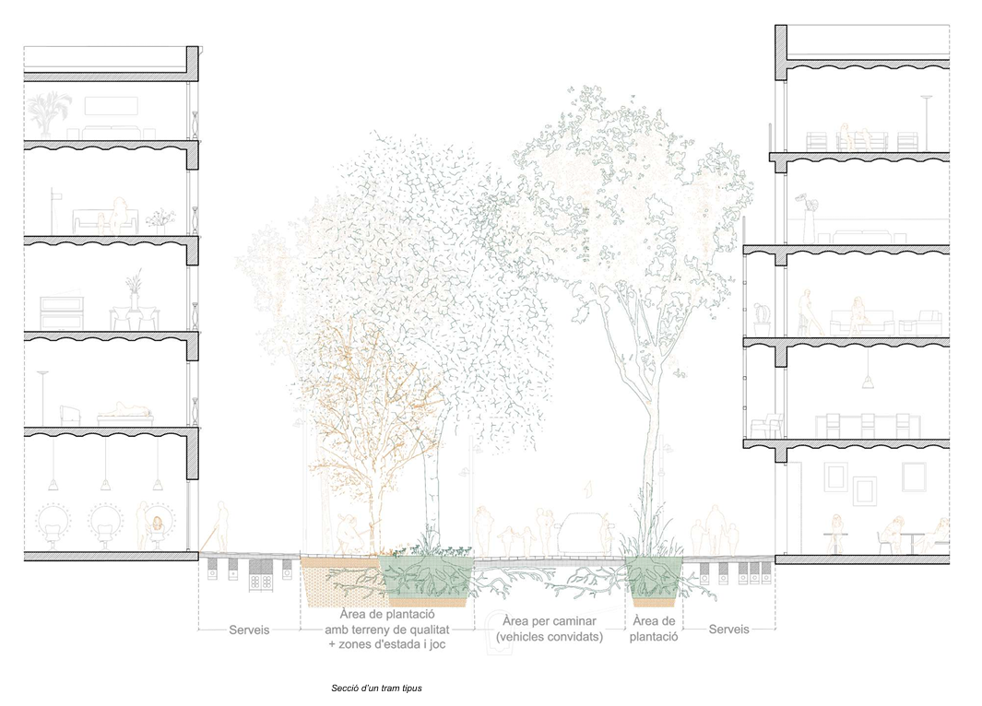
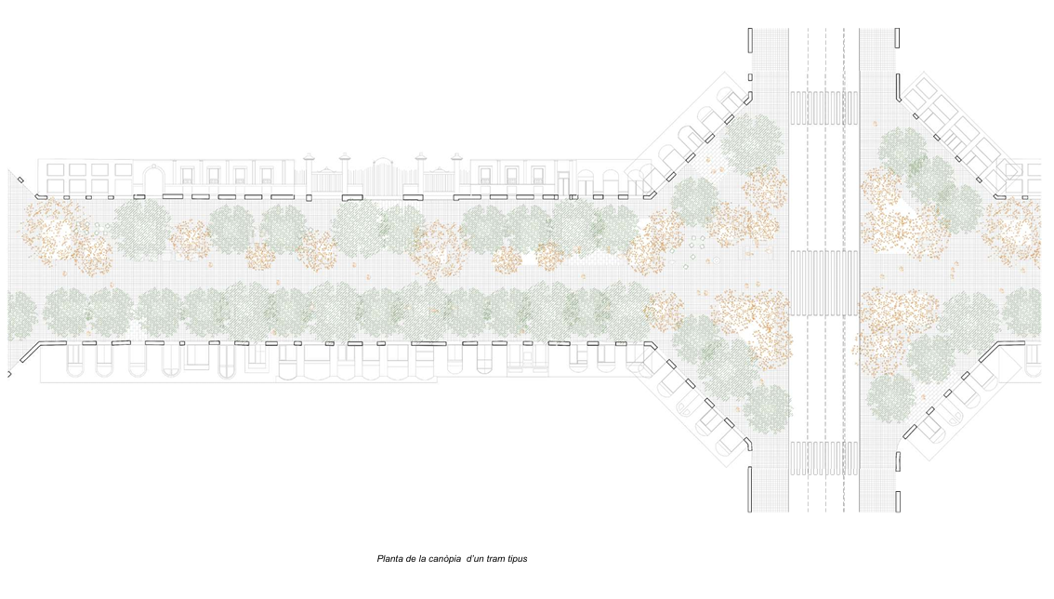

Slide 7
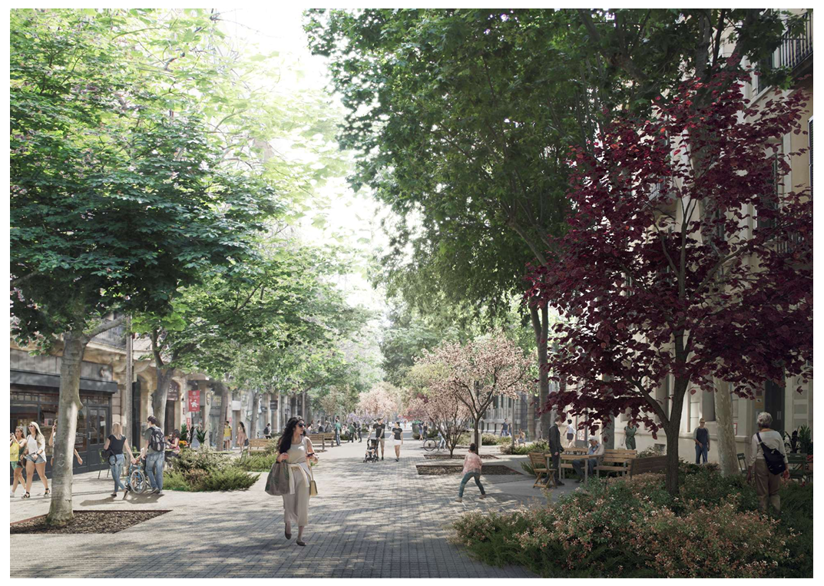

Slide 8
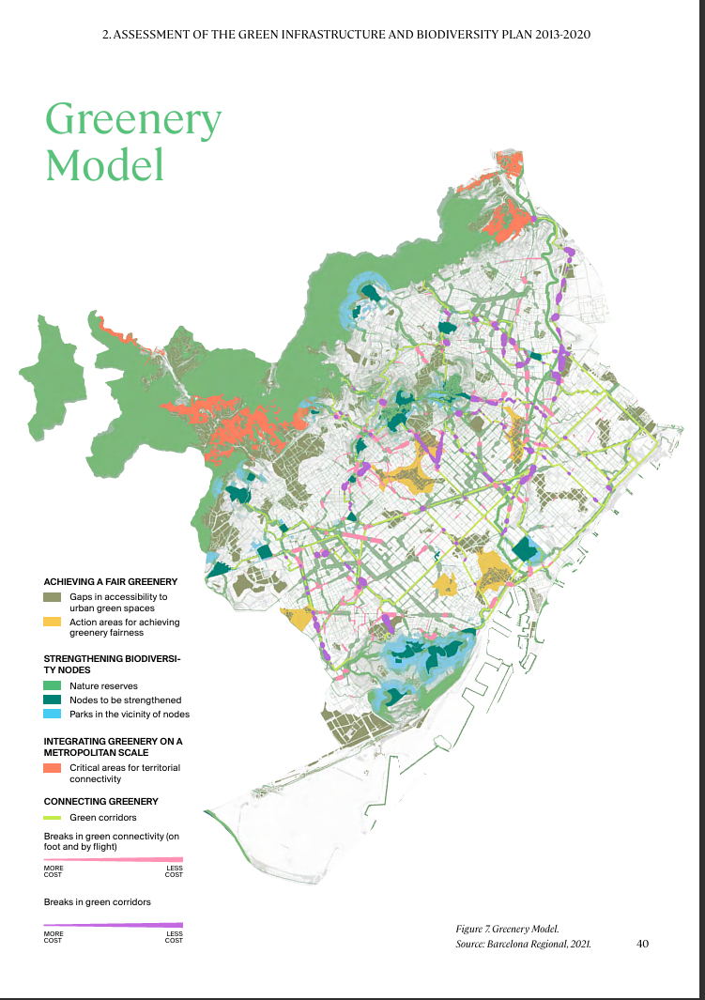
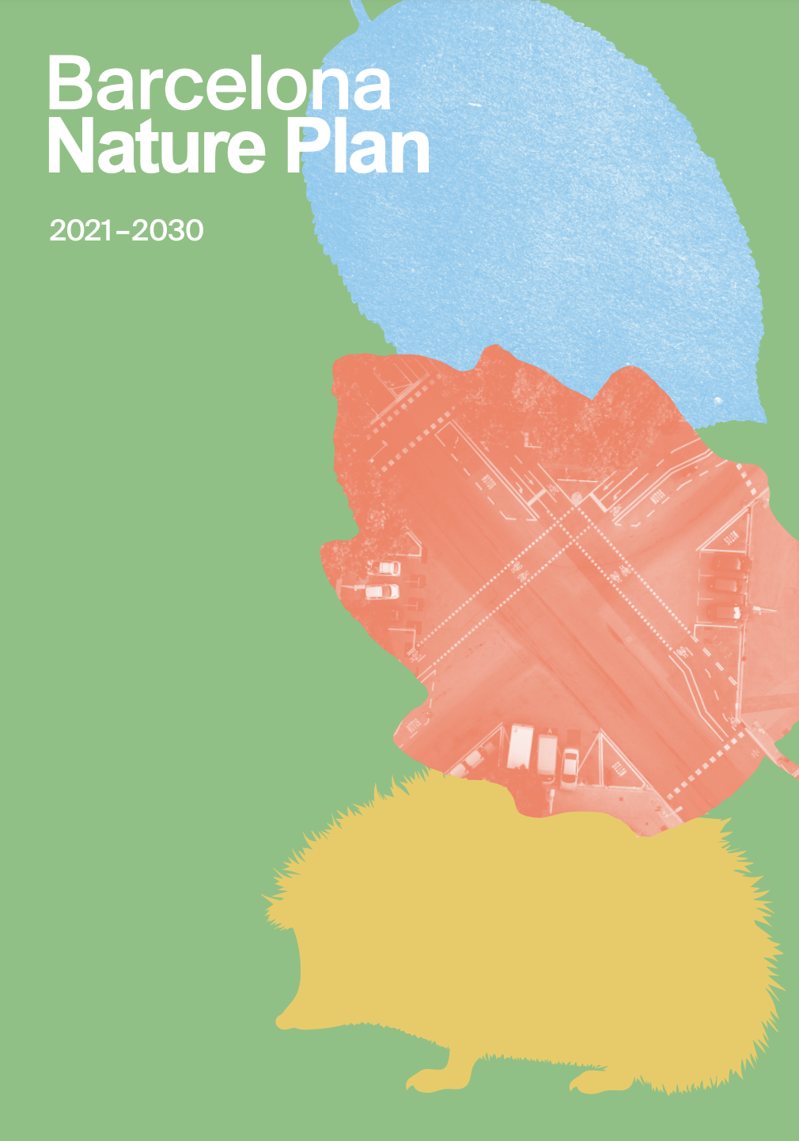
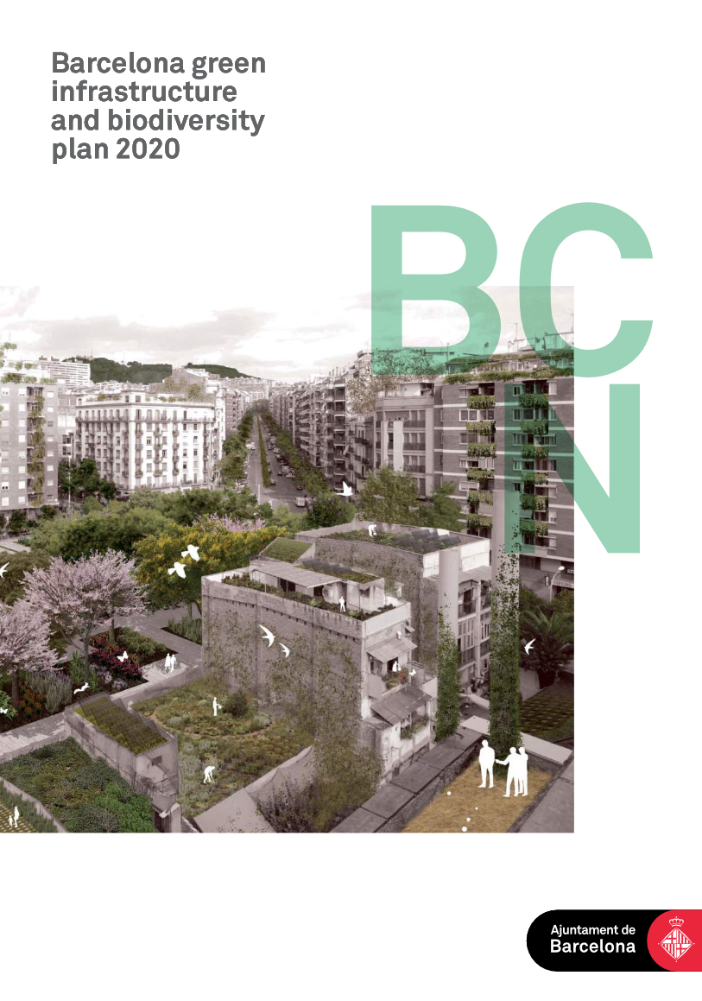

Slide 9
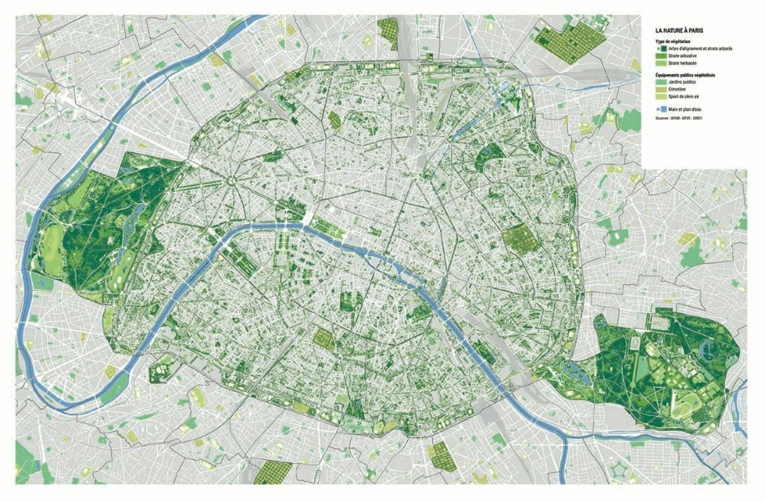

Slide 10
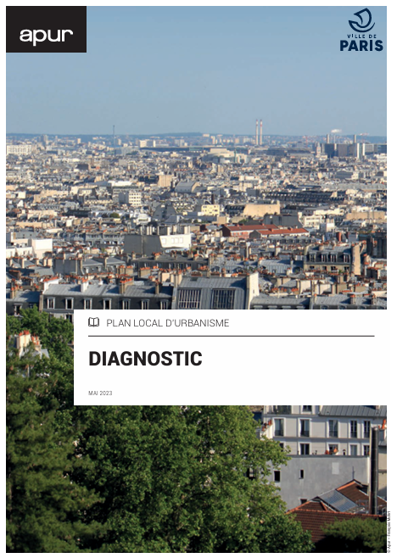
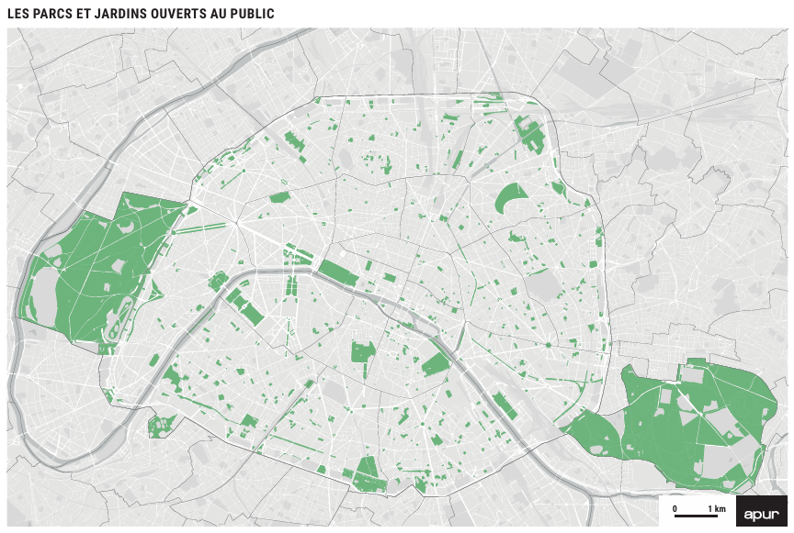

Slide 11
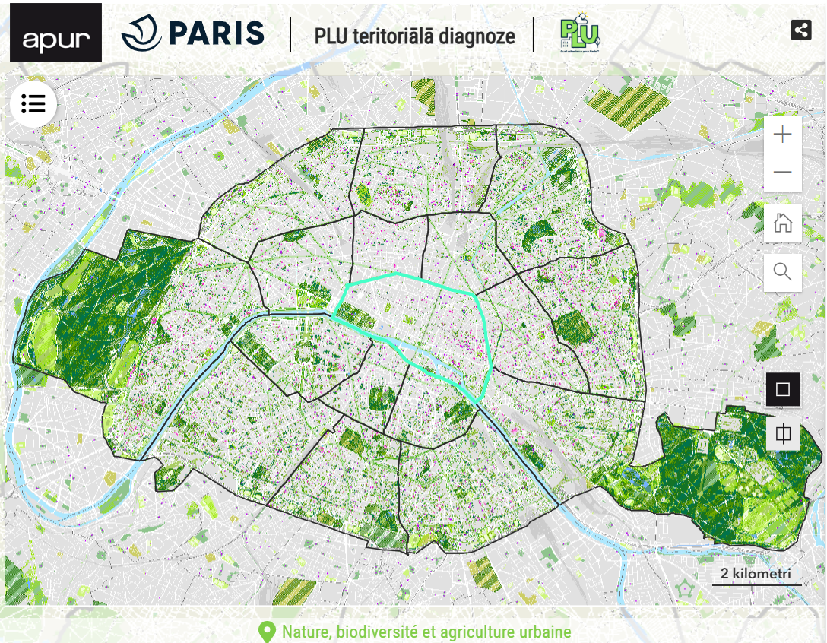
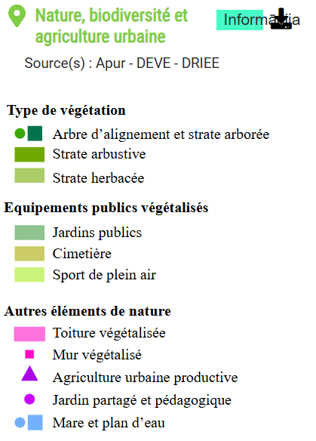
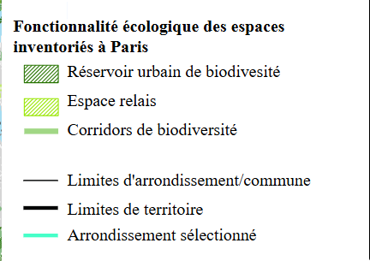

Slide 12
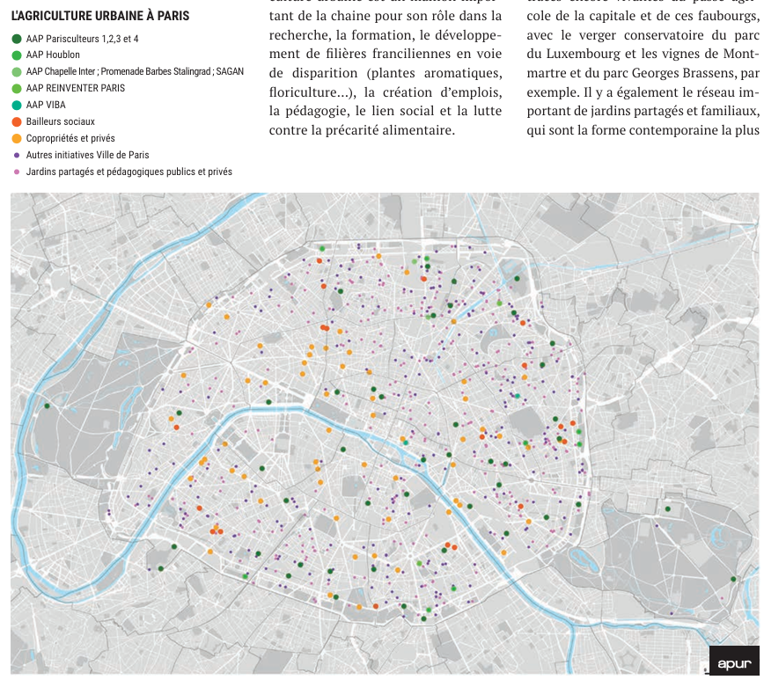
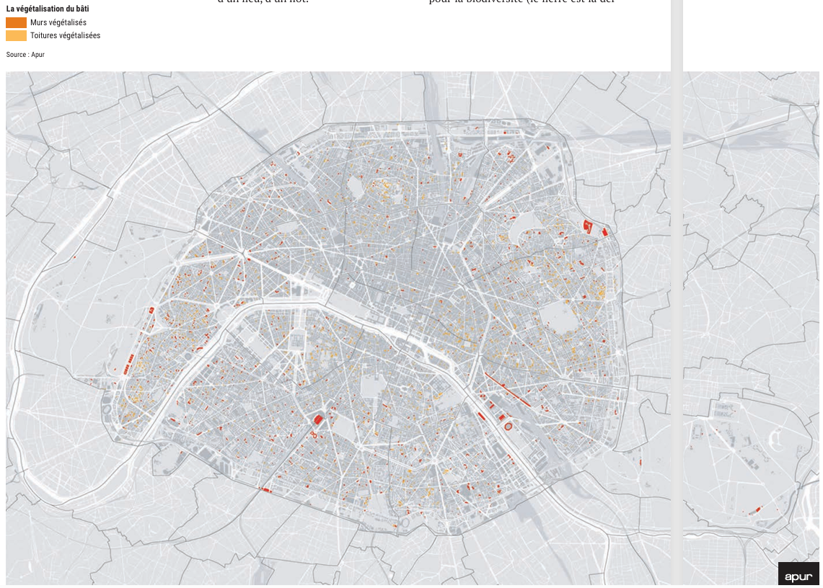

Slide 13
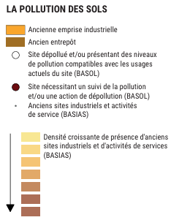
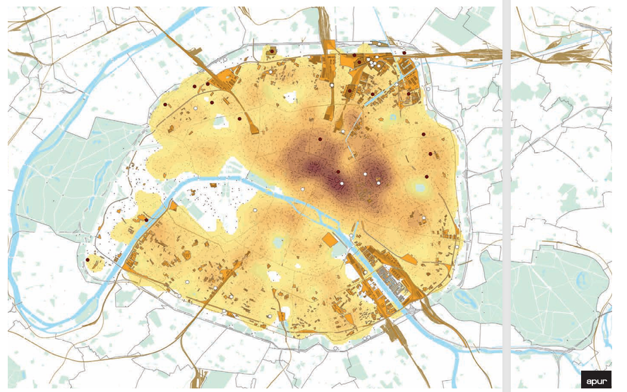
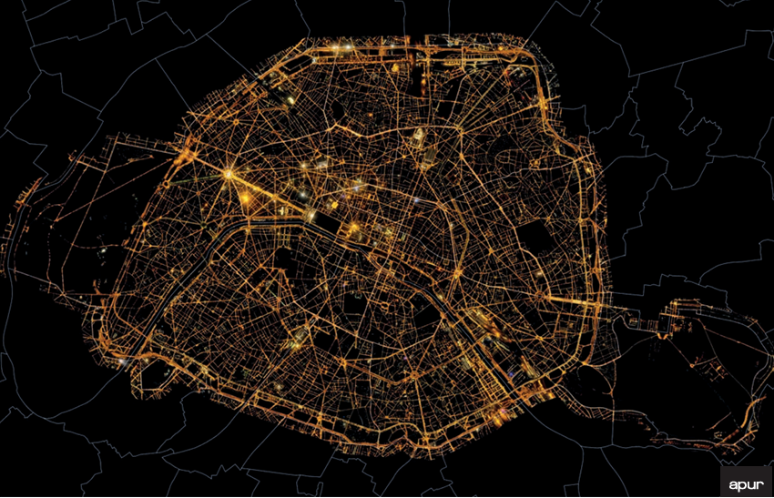

Slide 14
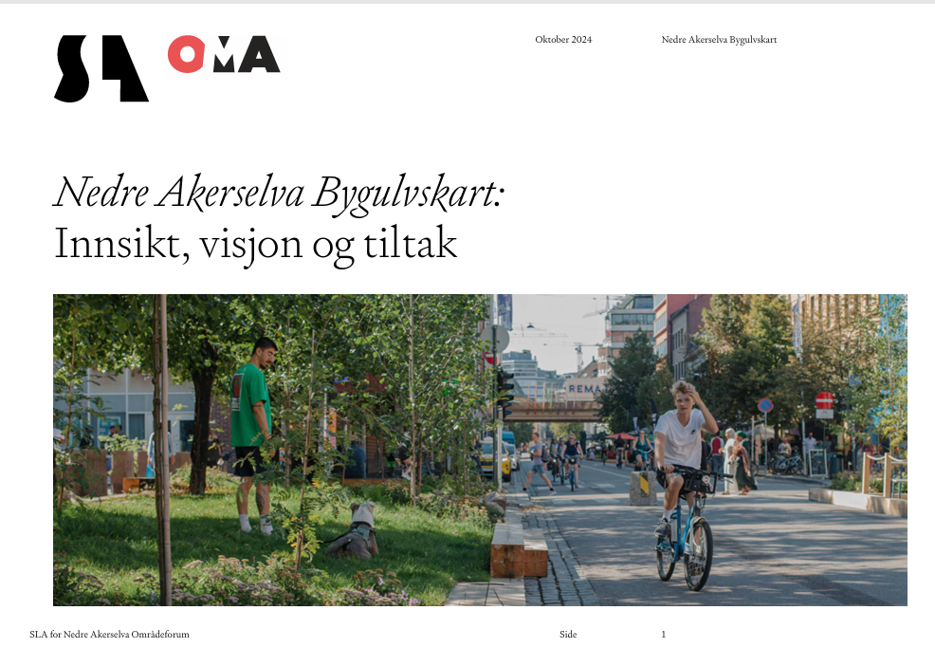
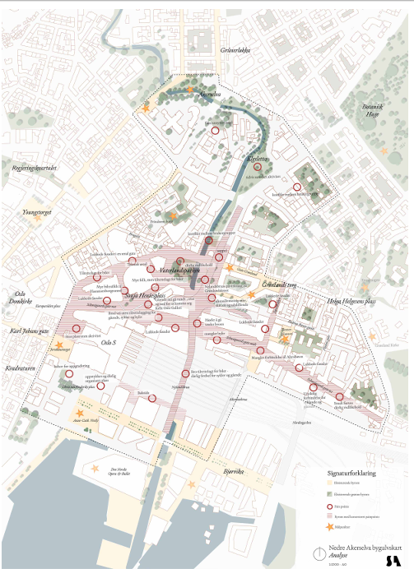
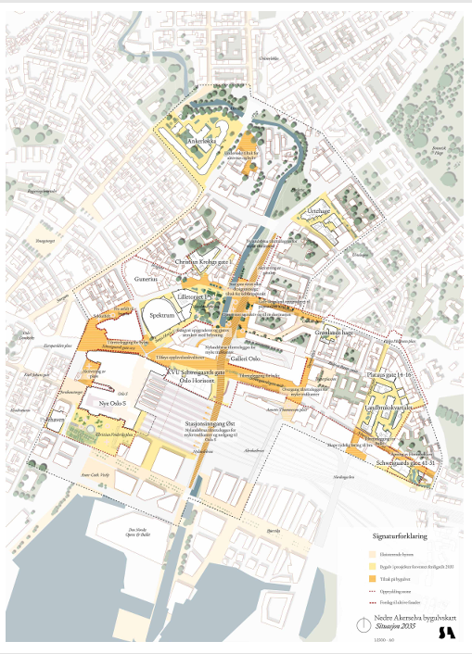
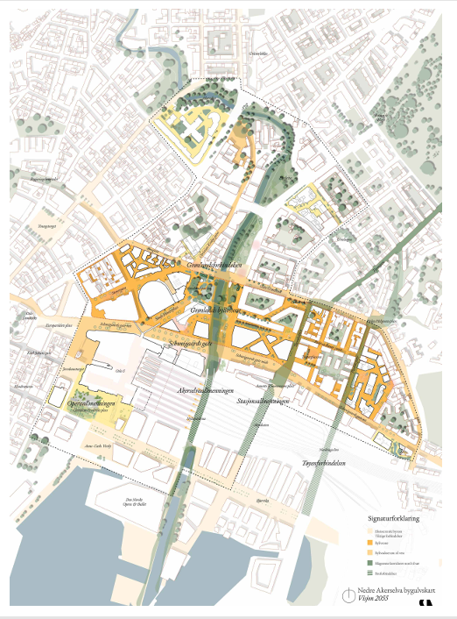
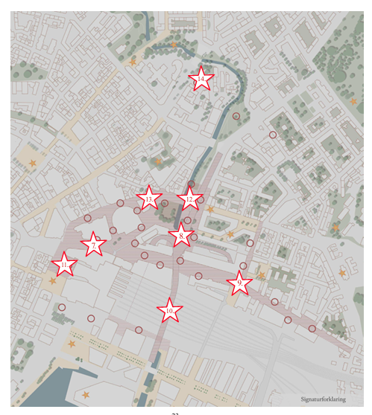
sāpju punkti
tūlītējas rīcības
2035
2050
Nedre Akerselva, Oslo

Slide 15
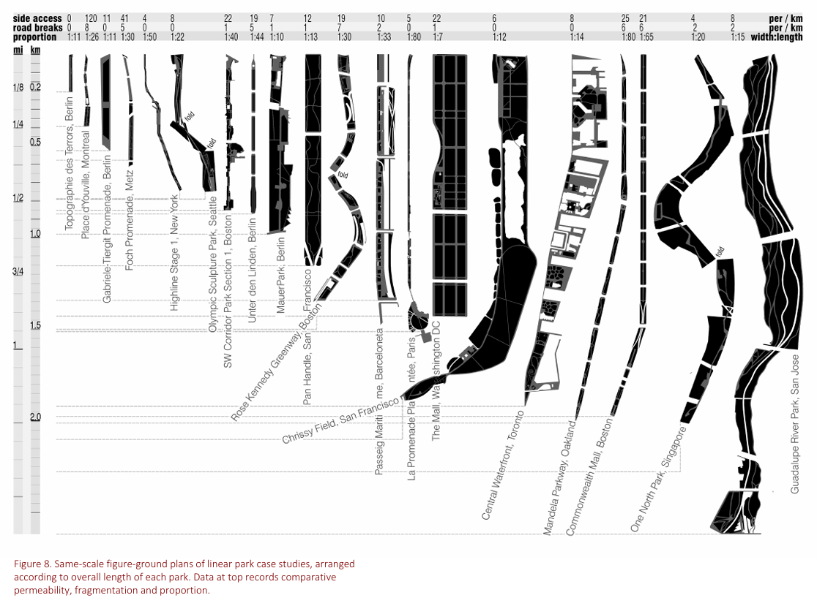
Kullmann, K. (2011). Thin parks / thick edges: towards a linear park typology for (post)infrastructural sites. Journal of Landscape Architecture, 6(2), 70–81. https://doi.org/10.1080/18626033.2011.9723456

Slide 16
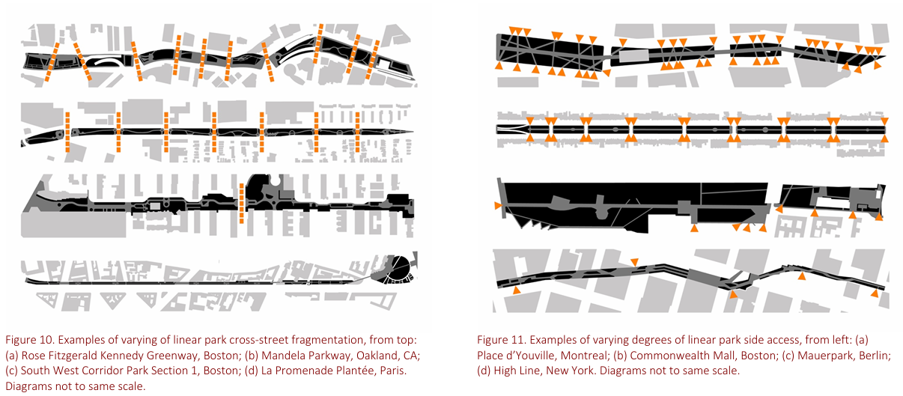
Kullmann, K. (2011). Thin parks / thick edges: towards a linear park typology for (post)infrastructural sites. Journal of Landscape Architecture, 6(2), 70–81. https://doi.org/10.1080/18626033.2011.9723456

Slide 17
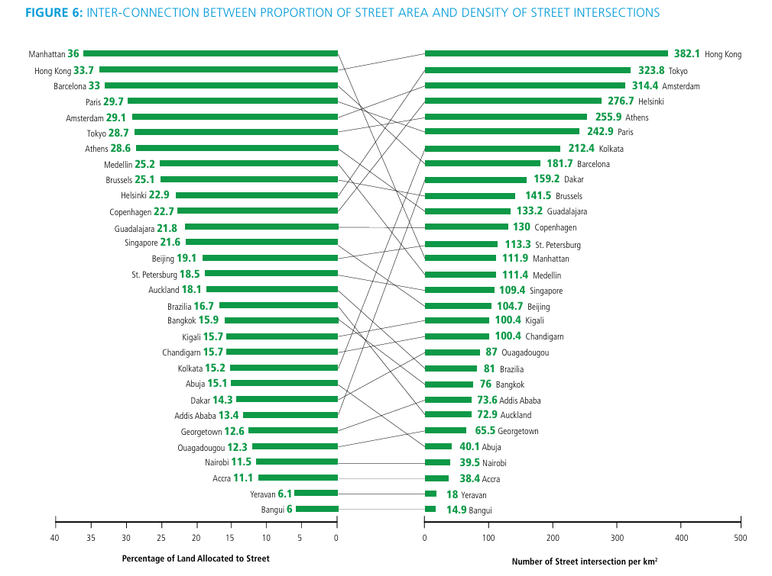
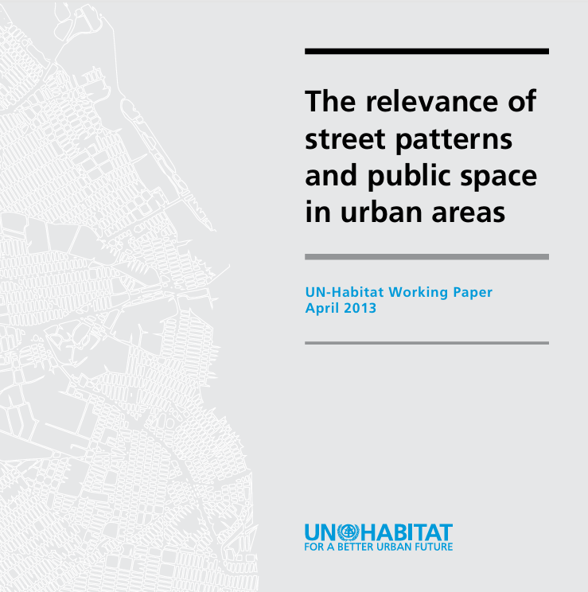

Slide 18
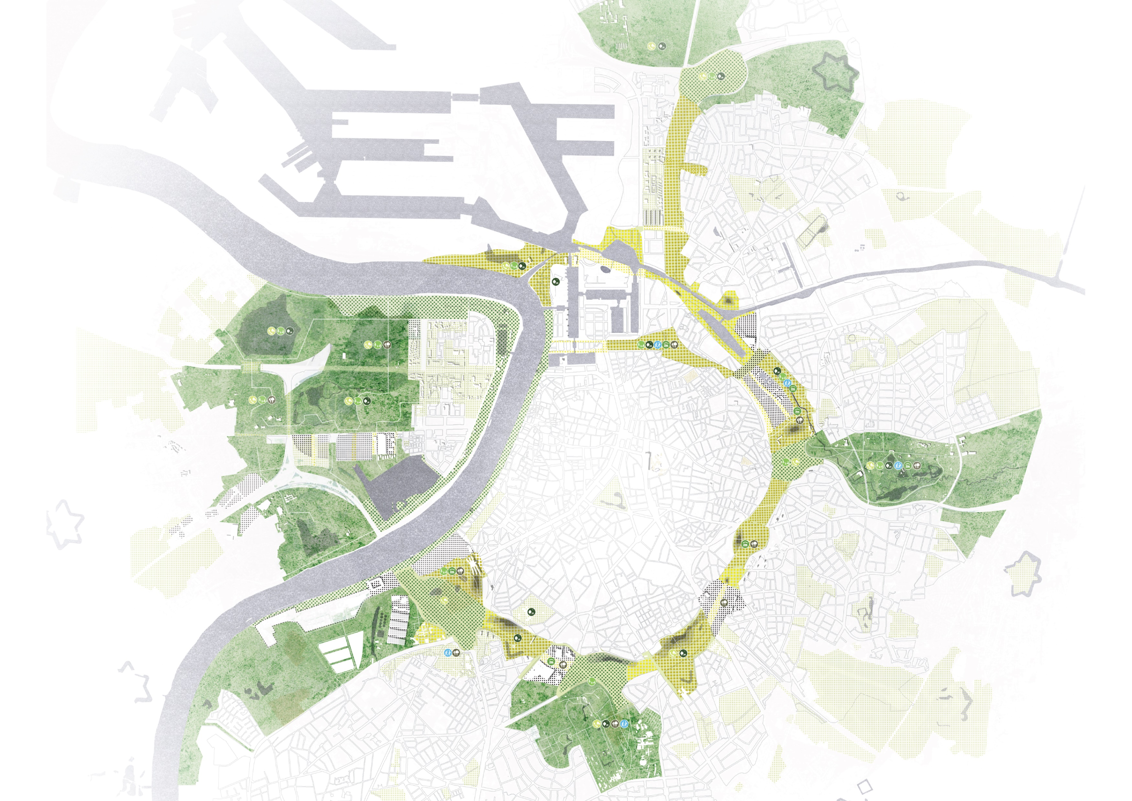
https://bauland.lt/Antwerp-XXIc-Green-Ring

Slide 19
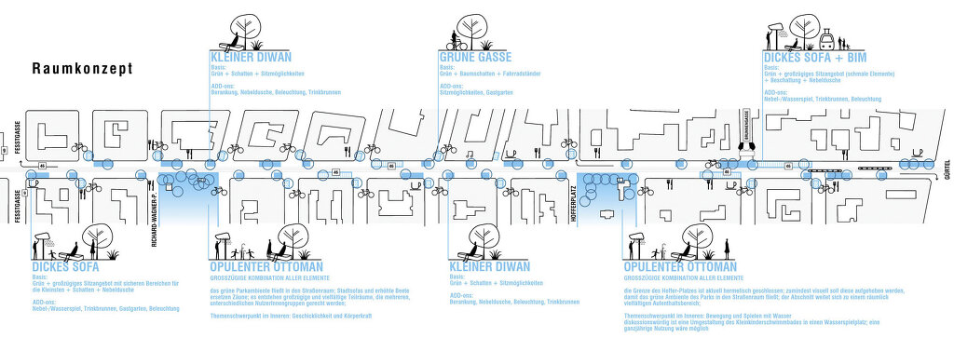
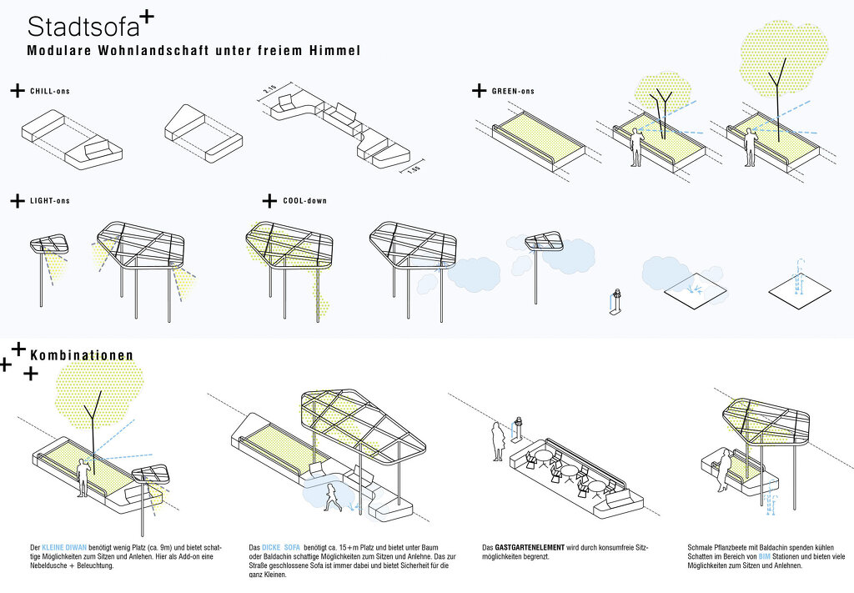
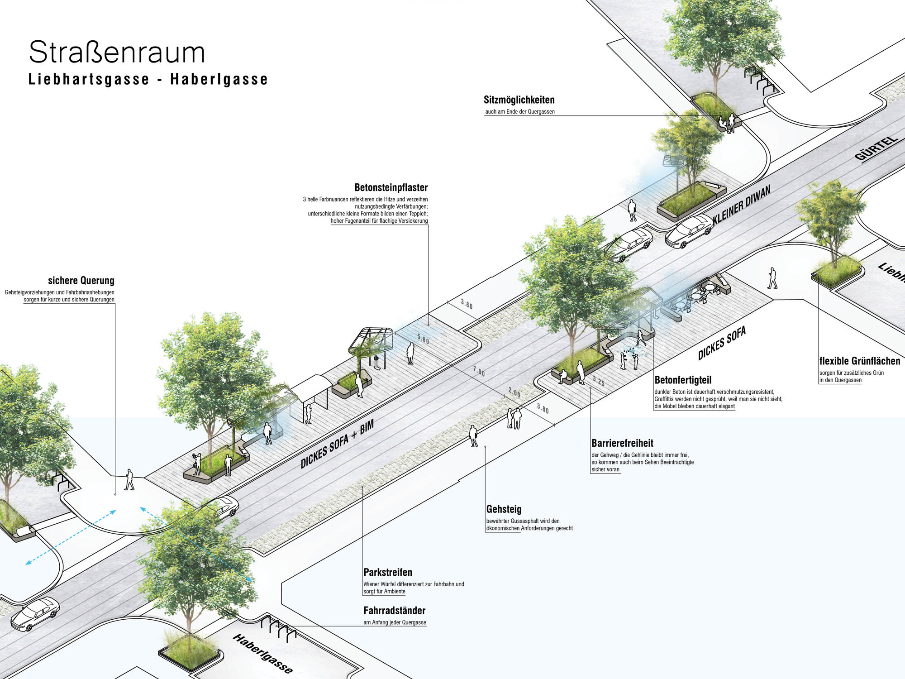
Street Redesign Thaliastraße
Authors DnD Landschaftsplanung
Service Temporary urban space, 600 trees Location Vienna, Austria https://www.dnd.at/index.php?inc=projectSelection&id=192:3430

Slide 20
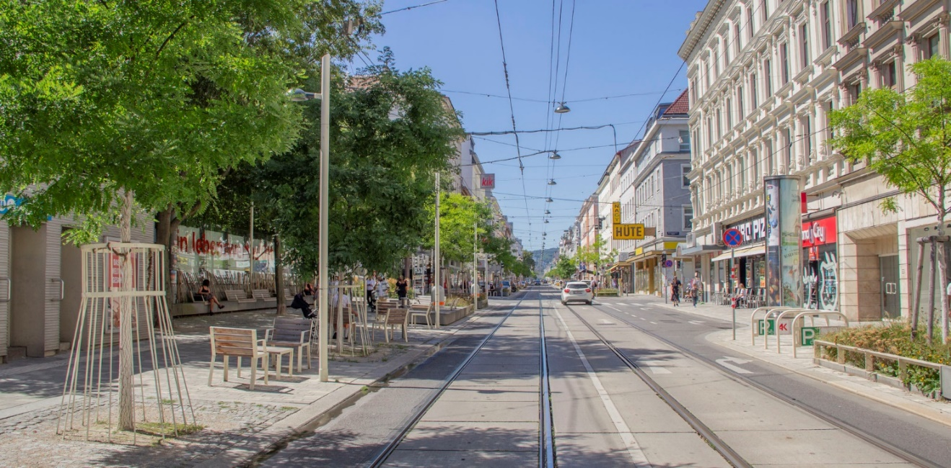
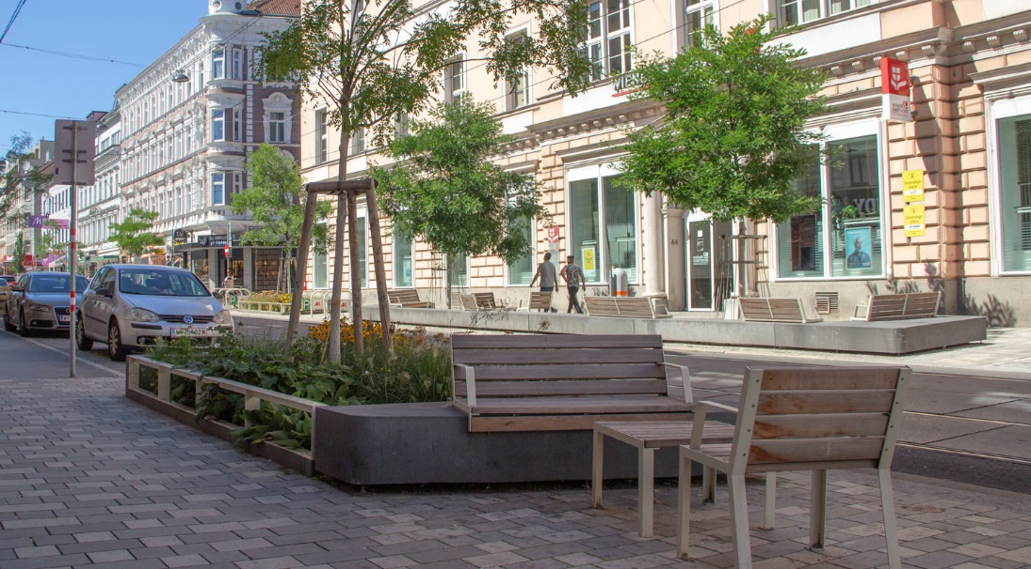
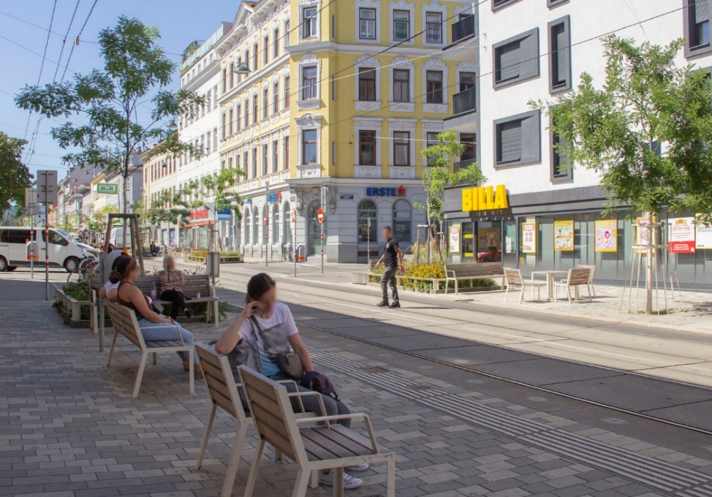
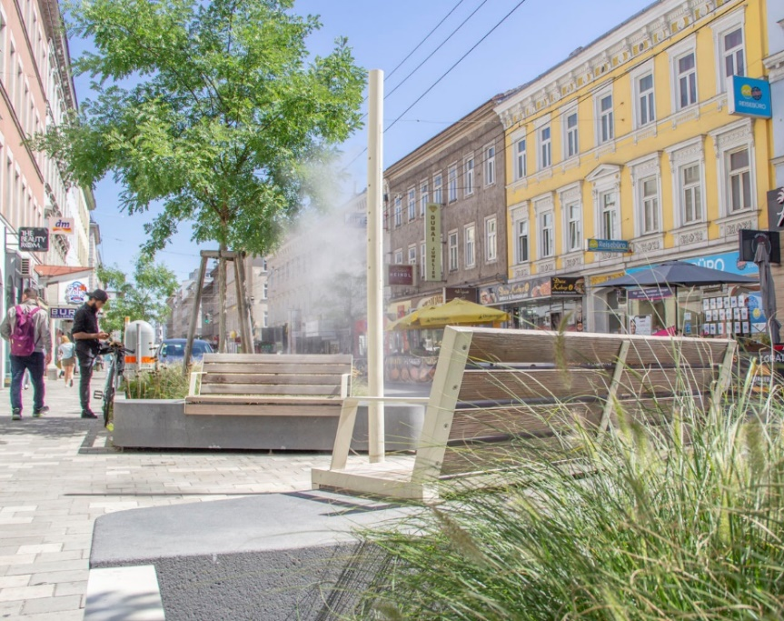
2,5 km length
20 meter width
3 construction phases,
to be finised 2024
223 trees
48 fog steles and water features
25 drinking fountains
Photo: DnD

Slide 21
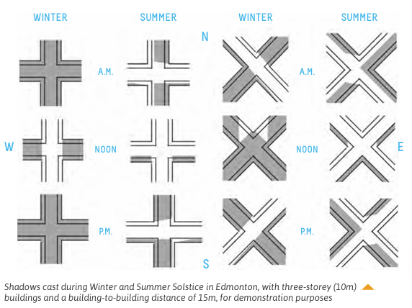
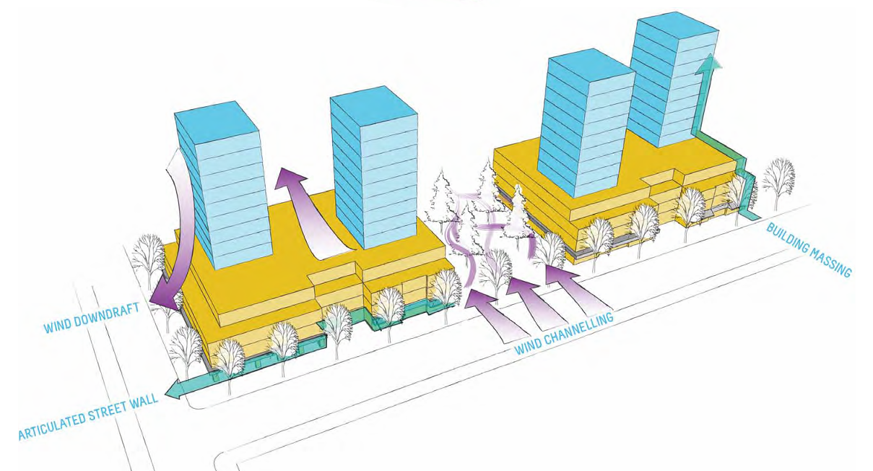
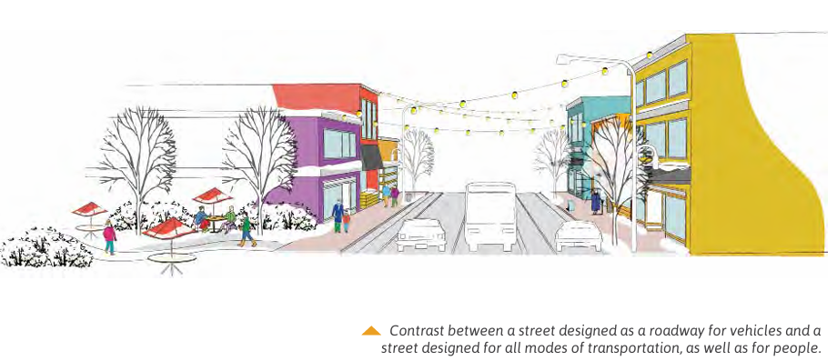

Slide 22
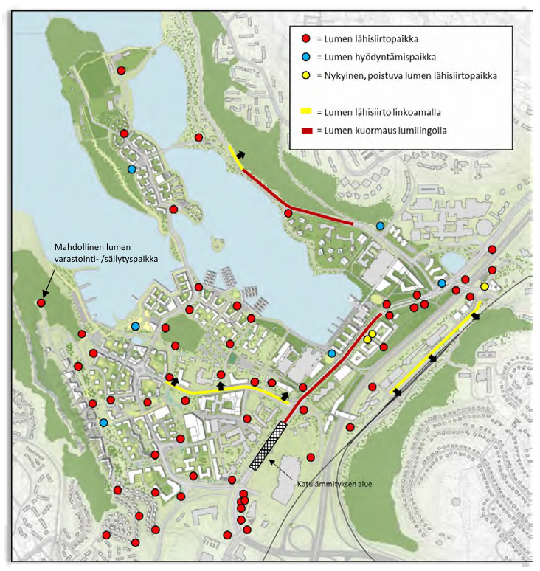
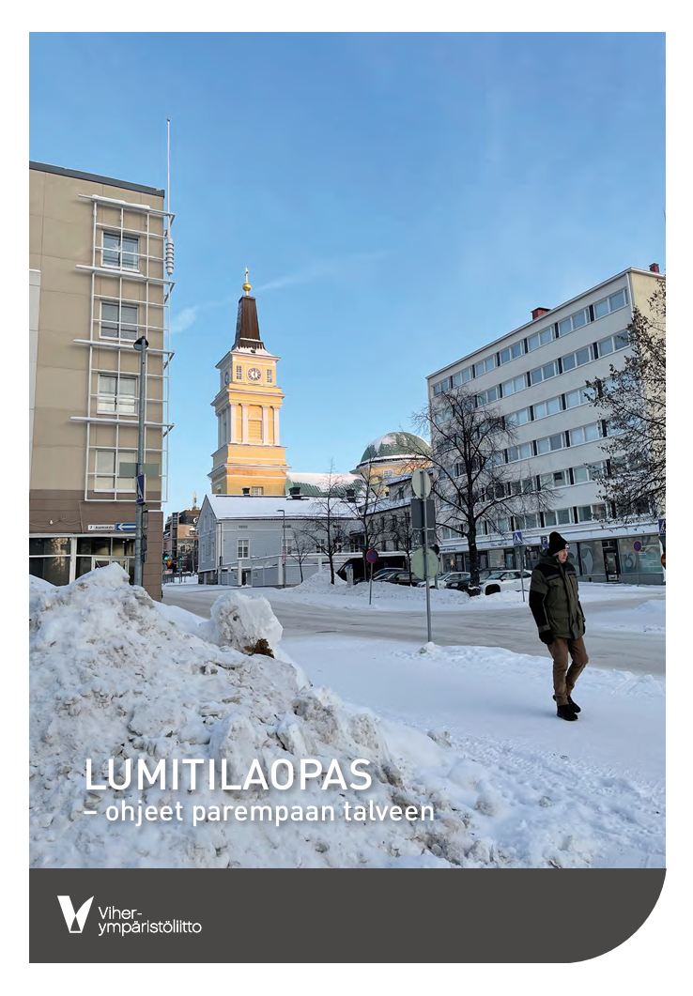

Slide 23
koncepti un idejas
vārdam var būt ķermenis
vārds var būt pļāpas

Slide 24
di Marino, Mina & Tiitu, Maija & Saglie, Inger-Lise & Lapintie, Kimmo. (2023). Conceptualizing ‘green’ in urban and regional planning – the cases of Oslo and Helsinki. European Planning Studies. 32. 1-23. 10.1080/09654313.2023.2285811.

Slide 25
di Marino, Mina & Tiitu, Maija & Saglie, Inger-Lise & Lapintie, Kimmo. (2023). Conceptualizing ‘green’ in urban and regional planning – the cases of Oslo and Helsinki. European Planning Studies. 32. 1-23. 10.1080/09654313.2023.2285811.

Slide 26
Negotiating wilder nature: developing a views-of-nature typology
Lisbet Christoffersen∗ and Thomas B Randrup
Published 20 December 2024 • © 2024 The Author(s). Published by IOP Publishing Ltd
Environmental Research Communications, Volume 6, Number 12

Slide 30
paldies!

