Slide 1





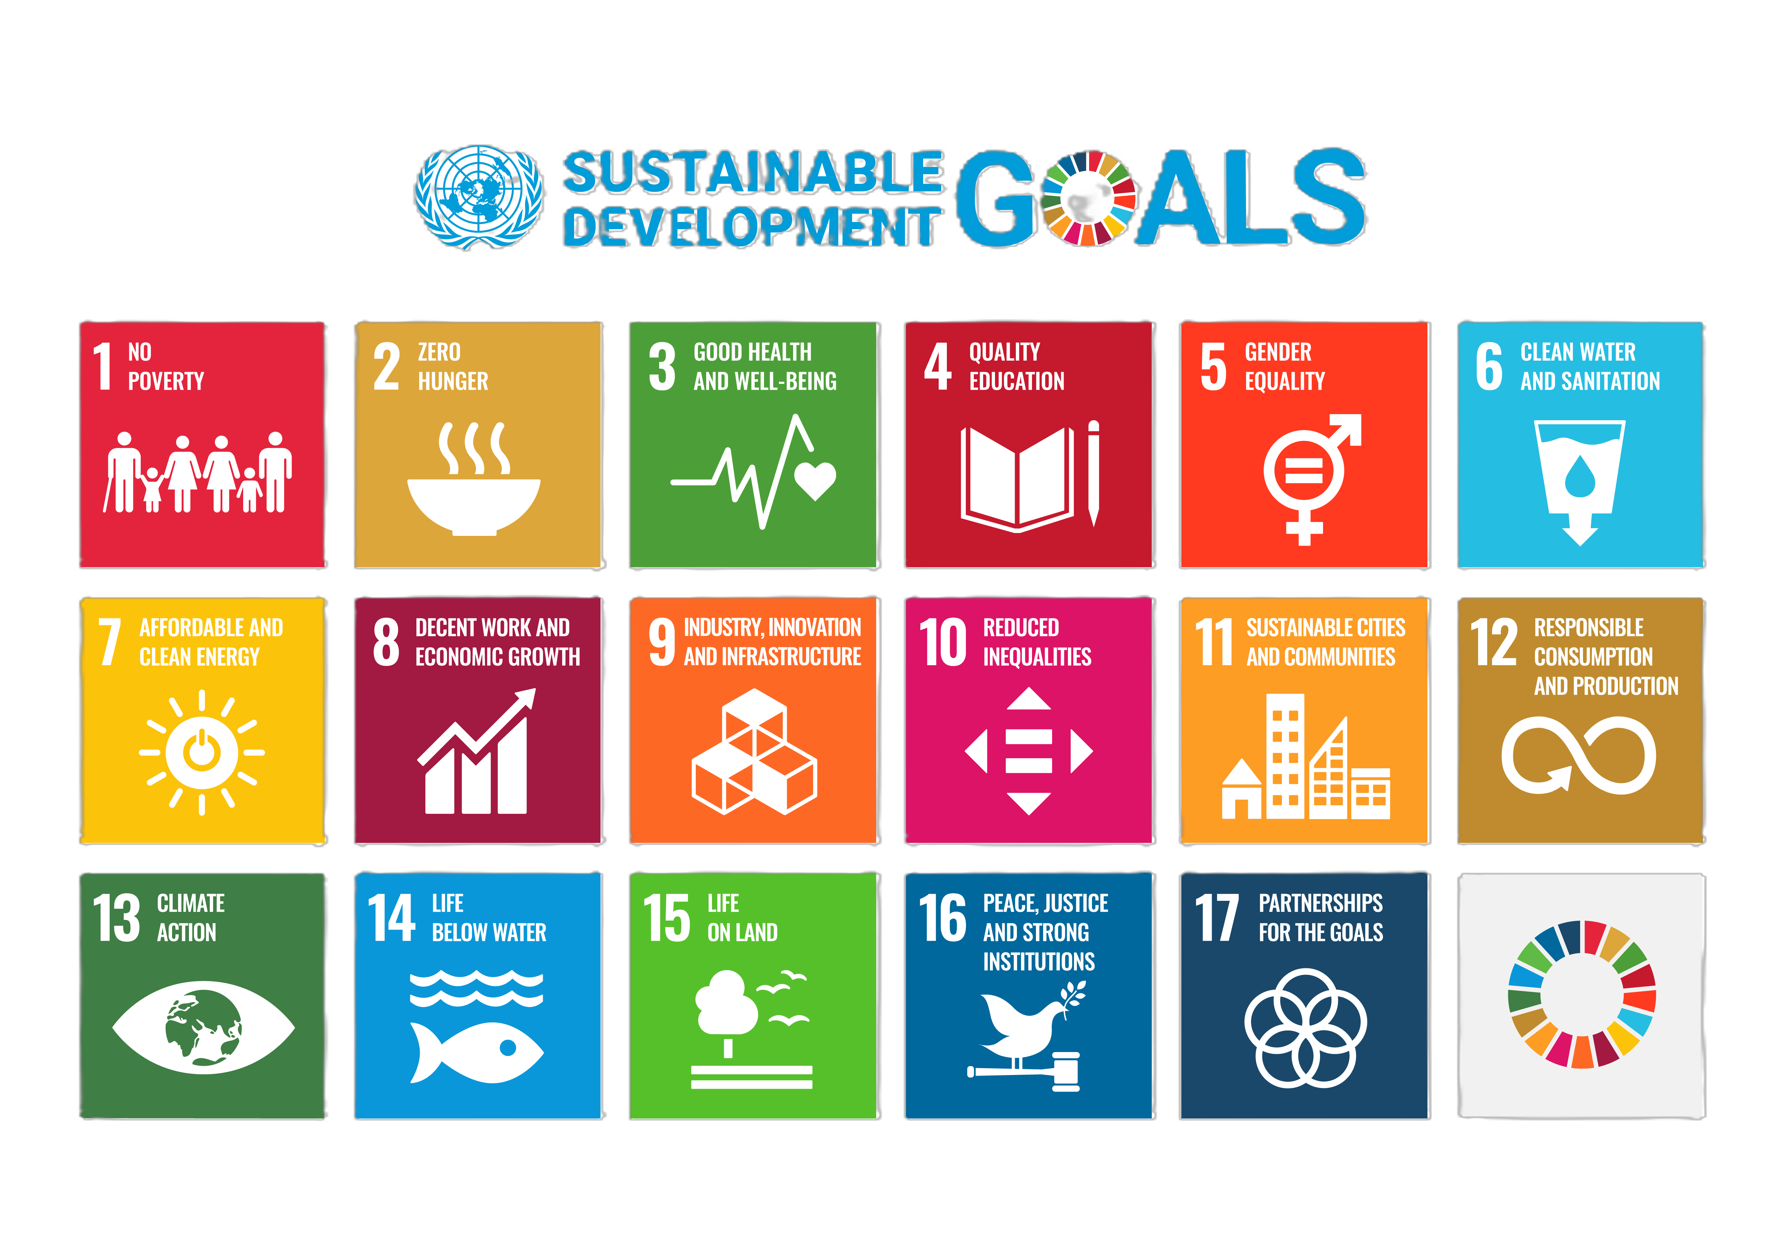
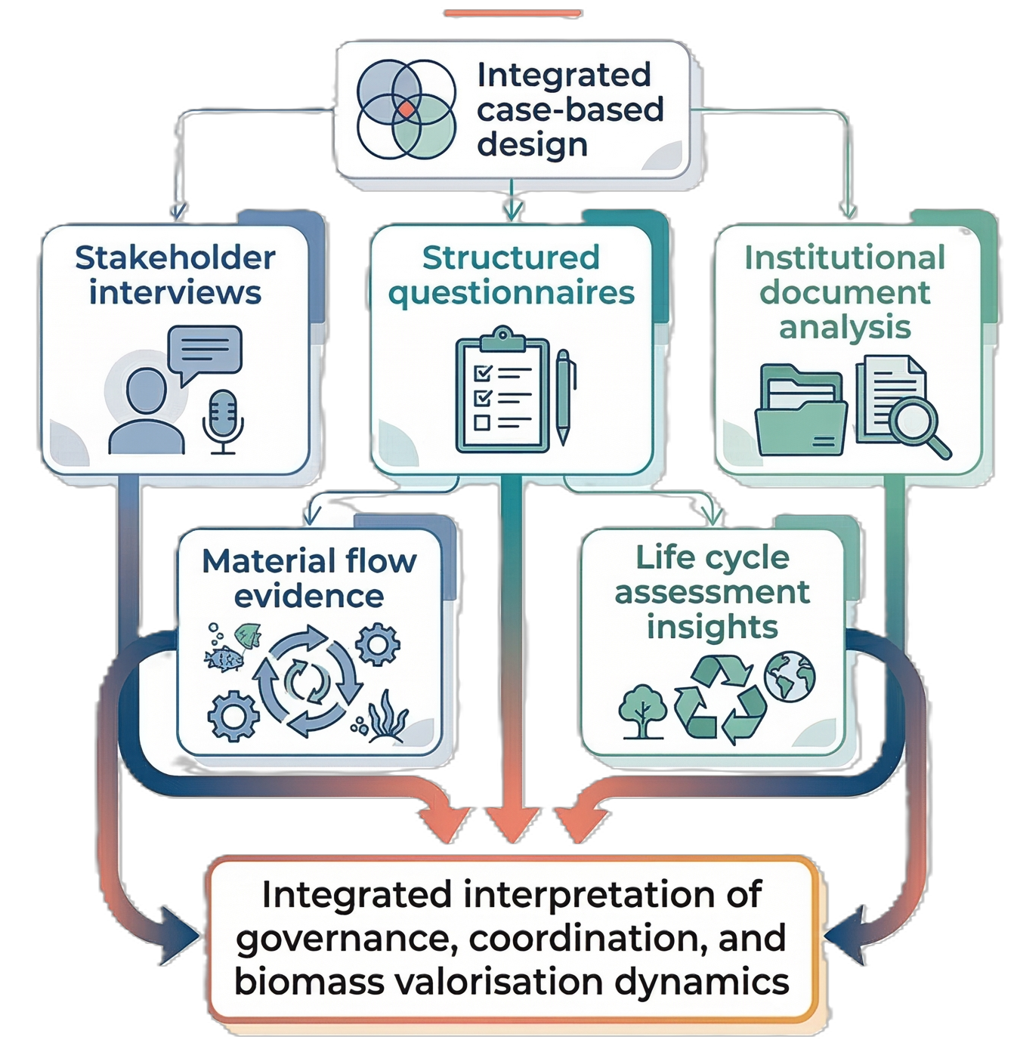
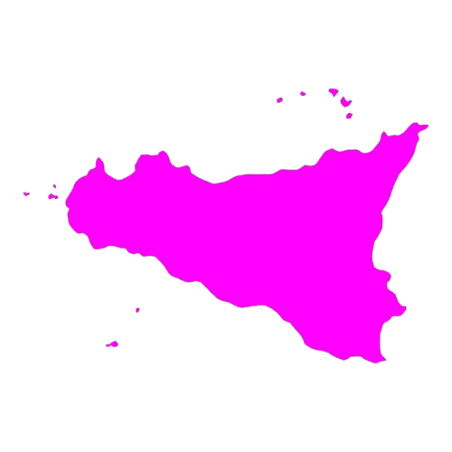


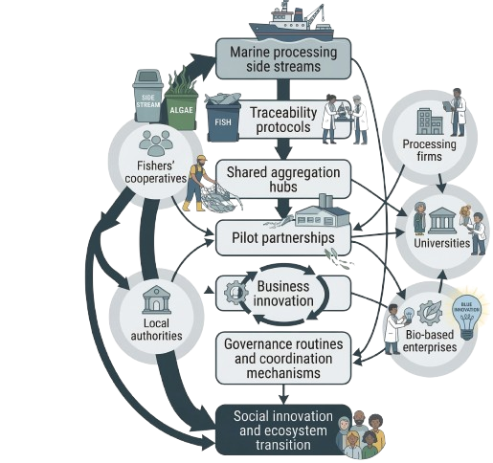
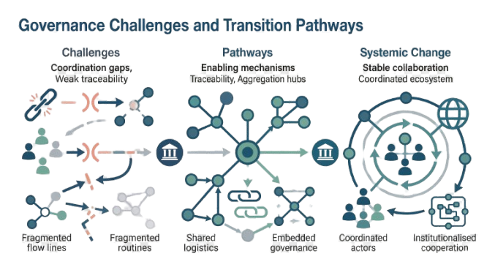

From circular economy to social innovation: ecosystem governance and marine by-products valorisation in Sicily
MARCHAN GONZALEZ, Michelle Magriet¹; PERGOLIZZI, Valerio¹; OTTAVIANI AALMO, Giovanna² ; MANUGUERRA, Simona¹; CURCURACI, Eleonora¹
¹ University of Palermo, Palermo, Italy
² Department of Economics and Society, Norwegian Institute of Bioeconomy Research (NIBIO), NO-1433 Ås, Norway
Introduction
In Sicily, circular economy and social innovation are developing in the
Marine by-products represent a valuable secondary biomass stream within blue circular economy strategies.
same territorial context but remain only partially integrated.
Methodological Approach
How can business innovation in marine by-product valorisation scale into social innovation within blue bioeconomy ecosystem?
Results and discussion
Processing systems show marked variability and limited quantification of at-sea biomass. As a result, circular transition is constrained more by traceability and coordination gaps than by technological barriers.
Conclusions
In Sicily, the transition from marine by-product valorisation to broader social innovation depends on stabilising coordination across the ecosystem. Circular change becomes durable only when traceability, governance routines, and collaborative structures are institutionally embedded.
FORTHEM international conference
Democratic and Responsible Bio Innovation
March 11-13, 2026

