Slide 1
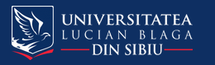

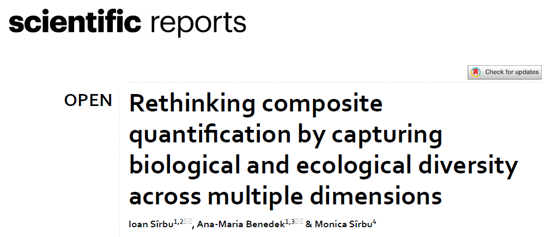
Contribution to the development of a multifaceted diversity framework in the context of the
Biology–Ecology–Environmental Sciences–Environmental Engineering–and–(Human) Society
(BEES) System.
Ioan Sîrbu, Ana-Maria Benedek, Monica Sîrbu
Sîrbu, I., Benedek, A.M., Sîrbu, M. (2025). Rethinking composite quantification by capturing biological and ecological diversity across multiple dimensions. Scientific Reports 15, 27822. https://doi.org/10.1038/s41598-025-13161-6

Slide 2
Overview of our contribution to the development of a multifaceted diversity framework in the context of the Biology - Ecology - Environmental Sciences - Environmental Engineering - and - (Human) Society (BEES) System. The figure summarizes multiple dimensions of diversity, including (1) traditional metrics: TD—taxonomic diversity, FD—functional diversity, ND—niche-based diversity, PD—phylogenetic (or genetic-based) diversity, α—alpha diversity, γ—gamma diversity, ε—epsilon diversity (overall diversity within large biogeographic areas), ζ—zeta diversity, β—beta diversity, δ—delta diversity (change between large biogeographic areas), and (2) newly introduced metrics: λ—lambda diversity, γρ— relative sequential cumulative gamma diversity, ξ— xi ecological diversities (ξ1—environment-life diversity, ξ2—life-space diversity, ξ3—integrative ecological diversity), OD'—overall diversities (ODP'—product-based, ODS'—sum-based expressions), SADDI—Standardized Average Diversity Distinctness Index. For clarity, only the primary relationship—through SADDI—is illustrated; other interrelations between diversity measures and the BEES System components are not shown.

Slide 3
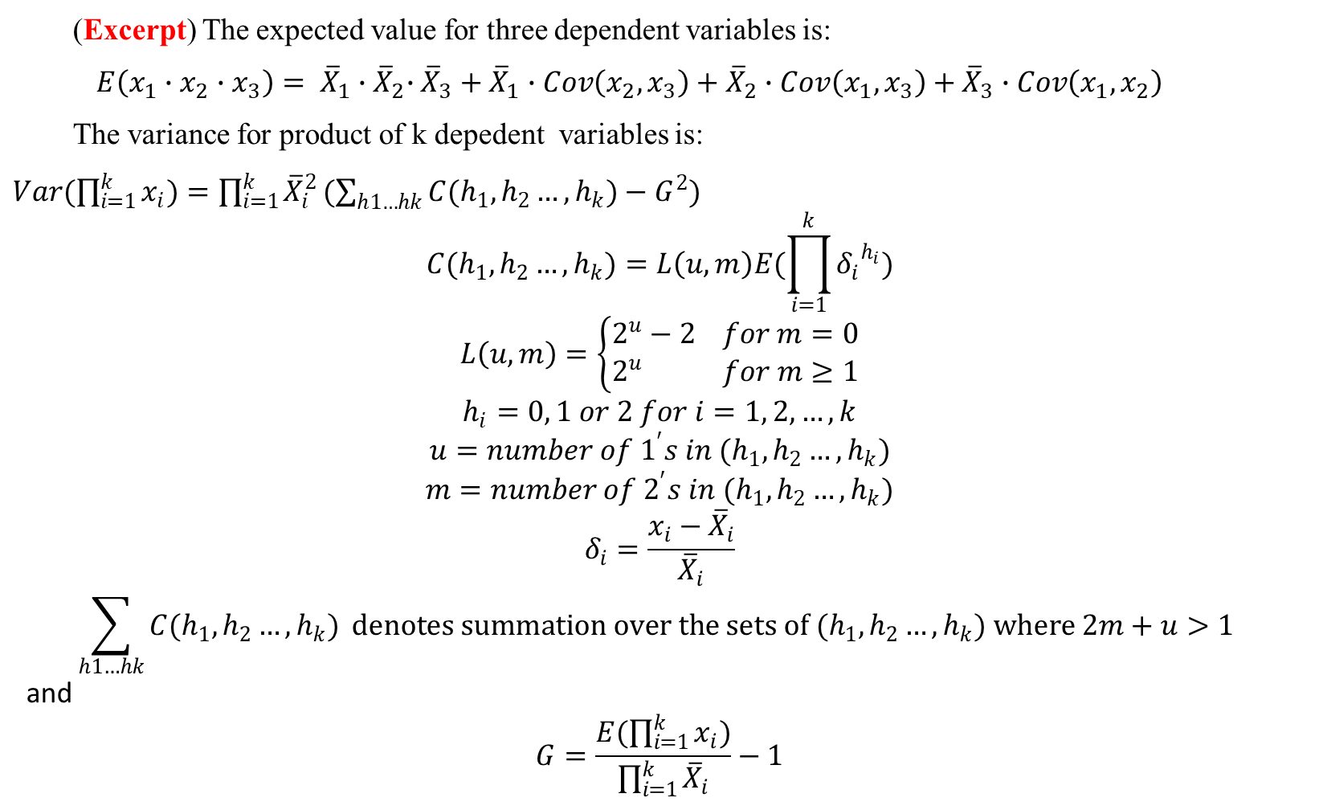
1. Expected value and variance for the additive and multiplicative combination of k correlated variables
(Excerpt) The expected value for three dependent variables is:
$$E\left(x_{1}∙x_{2}{∙x}_{3}\right)= {\overline{X}}_{1}{∙\overline{X}}_{2}∙{\overline{X}}_{3}+{\overline{X}}_{1}∙Cov\left(x_{2},x_{3}\right)+{\overline{X}}_{2}∙Cov\left(x_{1},x_{3}\right)+{\overline{X}}_{3}∙Cov\left(x_{1},x_{2}\right)$$
The variance for product of k depedent variables is:
$Var(\prod_{i=1}^{k}{x_{i})=\prod_{i=1}^{k}{{\overline{X}}_{i}^{2}}(\sum_{h1…hk}{C(h_{1},h_{2}…,h_{k})}−G^{2})}$
$$C(h_{1},h_{2}…,h_{k})=L\left(u,m\right)E(\prod_{i=1}^{k}{{δ_{i}}^{h_{i}}})$$
$$L\left(u,m\right)=\left\{\begin{aligned}2^{u}−2 for m=0 \\ 2^{u} for m≥1\end{aligned}\right.$$
$$h_{i}=0, 1 or 2 for i=1, 2,…,k$$
$$u=number of 1^{′}s in (h_{1},h_{2}…,h_{k})$$
$$m=number of 2^{′}s in (h_{1},h_{2}…,h_{k})$$
$$δ_{i}=\frac{x_{i}−{\overline{X}}_{i}}{{\overline{X}}_{i}}$$
$$\sum_{h1…hk}{C(h_{1},h_{2}…,h_{k})} denotes summation over the sets of (h_{1},h_{2}…,h_{k}) where 2m+u>1$$
and
$$G=\frac{E(\prod_{i=1}^{k}{x_{i}})}{\prod_{i=1}^{k}{{\overline{X}}_{i}}}−1$$
These and other formulas
were used for computing
standard errors and
confidence intervals for
sums and products of
independent and related
variables, used further in
synthetic biodiversity measures.
An R script was developed
and is also freely available.

Slide 4
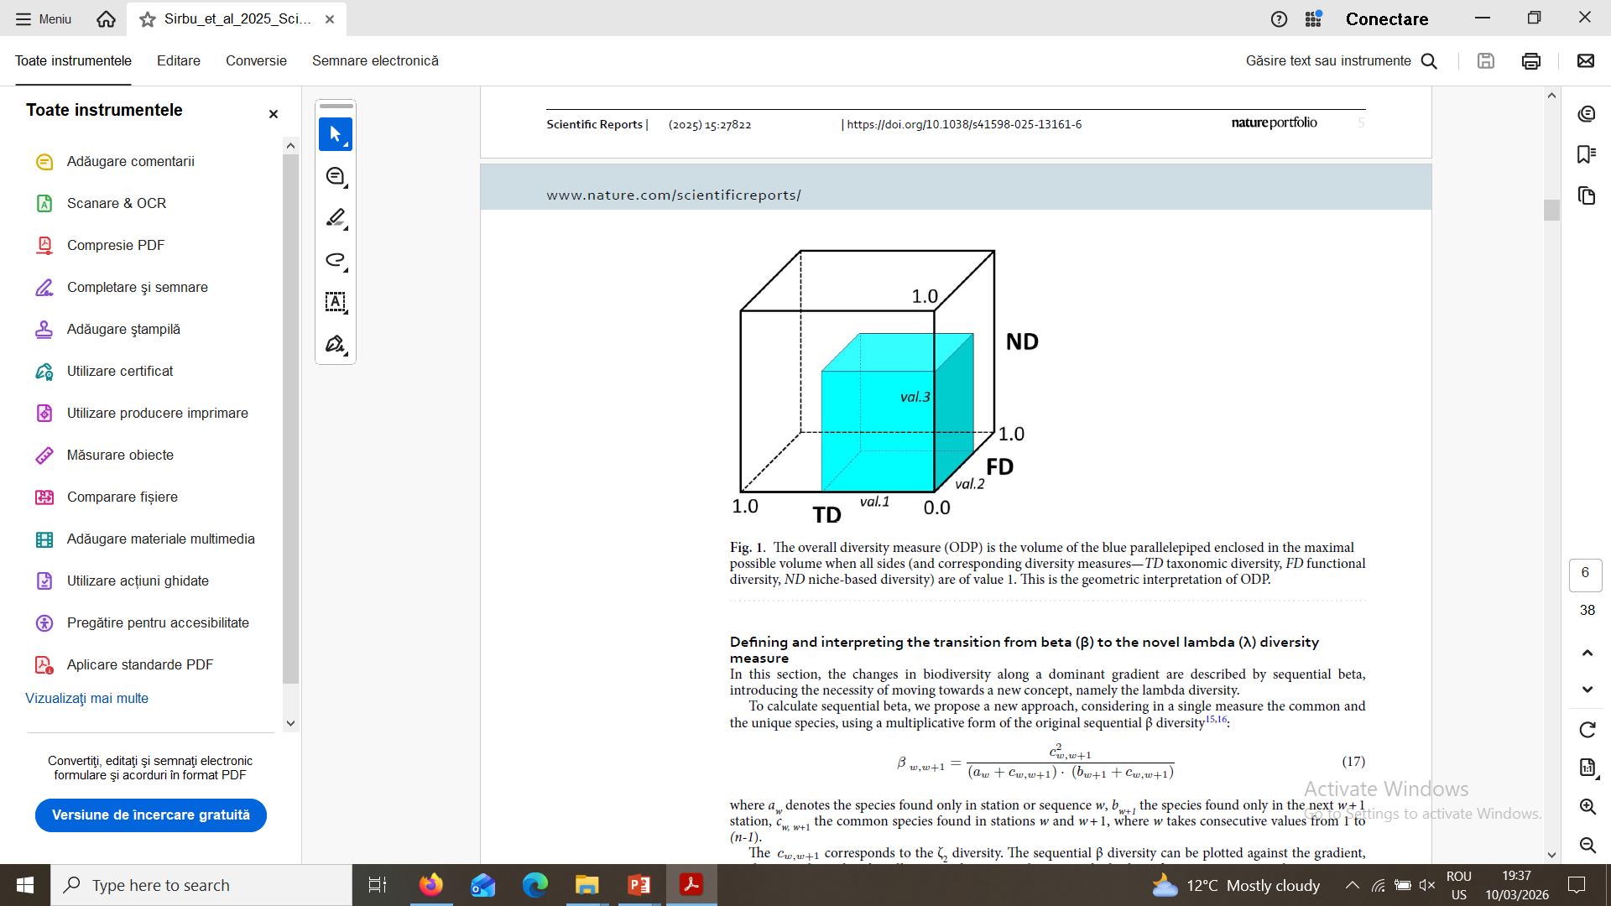
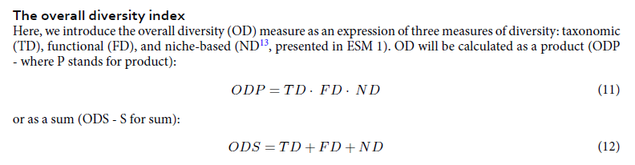
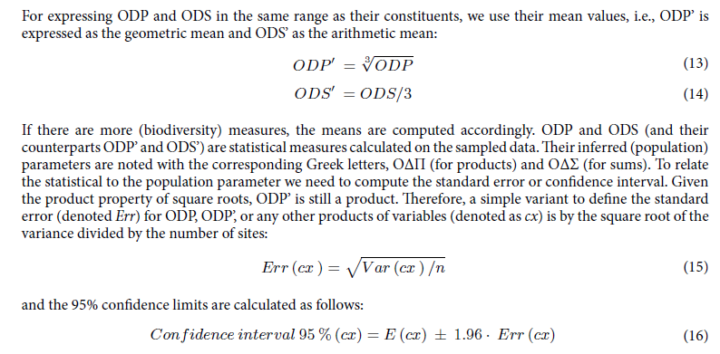
2. Combining community diversity measures and geometric meaning.

Slide 5
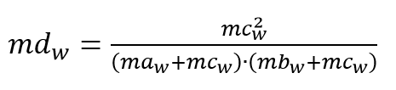
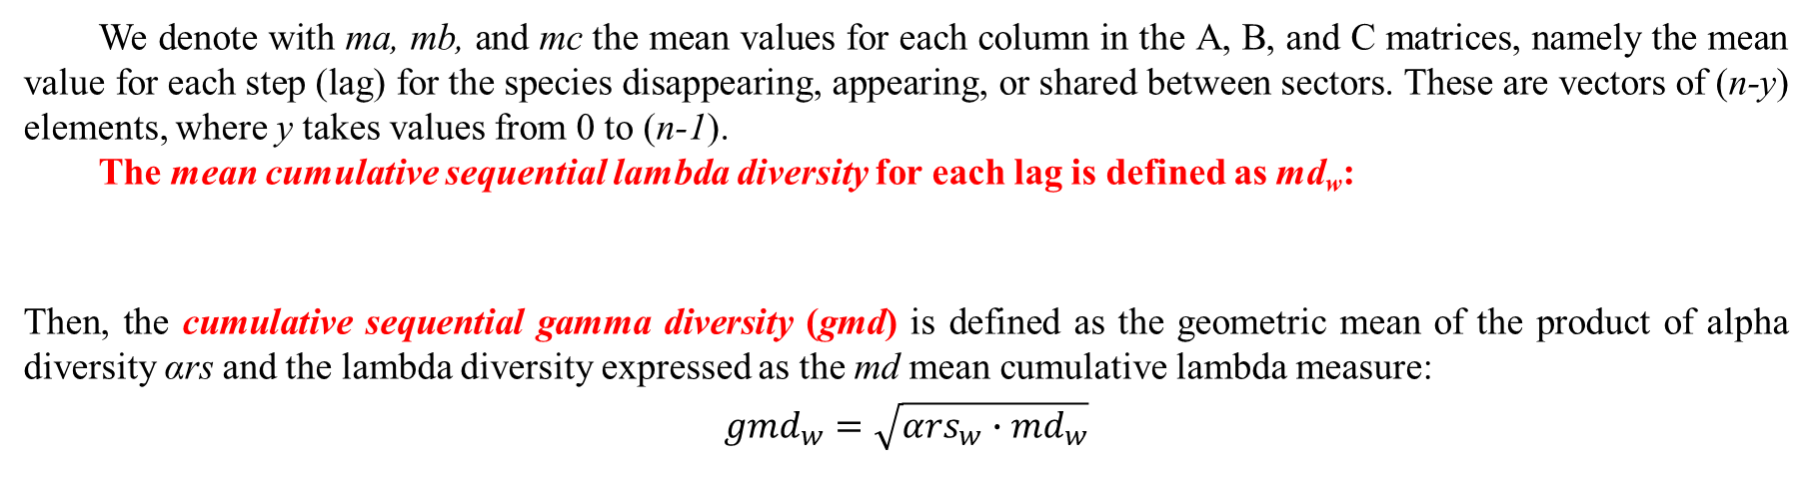
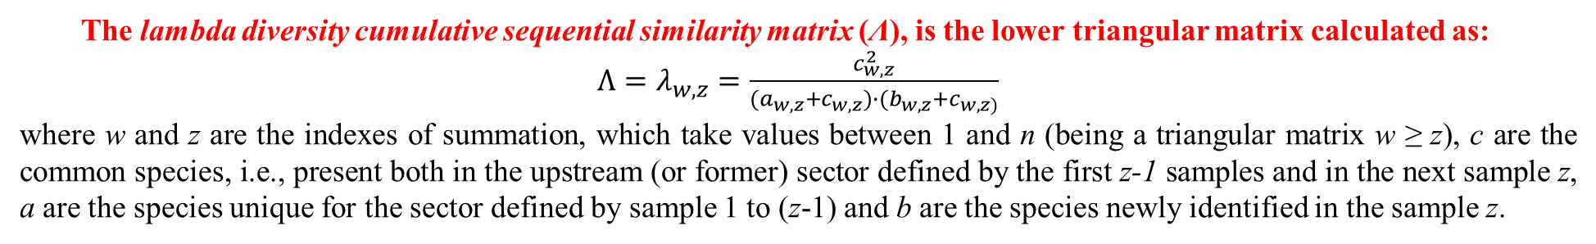

3. Defining the cumulative sequential lambda (λ) and gamma (γ) diversity measures
The lambda diversity cumulative sequential similarity matrix (Λ), is the lower triangular matrix calculated as:
$Λ=λ_{w,z}=\frac{c_{w,z}^{2}}{(a_{w,z}+c_{w,z})∙(b_{w,z}+c_{w,z)}}$
where w and z are the indexes of summation, which take values between 1 and n (being a triangular matrix w ≥ z), c are the common species, i.e., present both in the upstream (or former) sector defined by the first z-1 samples and in the next sample z, a are the species unique for the sector defined by sample 1 to (z-1) and b are the species newly identified in the sample z.
Three triangular matrices, namely A—including the species unique for the upstream sector (group of samples), B—species appearing in each downstream sample, and C—common species, are summarized in the matrix Λ.
We denote with ma, mb, and mc the mean values for each column in the A, B, and C matrices, namely the mean value for each step (lag) for the species disappearing, appearing, or shared between sectors. These are vectors of (n-y) elements, where y takes values from 0 to (n-1).
The mean cumulative sequential lambda diversity for each lag is defined as md_{w}:
Then, the cumulative sequential gamma diversity (gmd) is defined as the geometric mean of the product of alpha diversity αrs and the lambda diversity expressed as the md mean cumulative lambda measure:
${gmd}_{w}=\sqrt{α{rs}_{w}{∙md}_{w}}$
where αrs_{w} is a relative measure of the alpha diversity, s_{w} is the number of species in the sample, and S is the number of species identified along the gradient.
$${αrs}_{w}=\frac{s_{w}}{S}$$

Slide 6
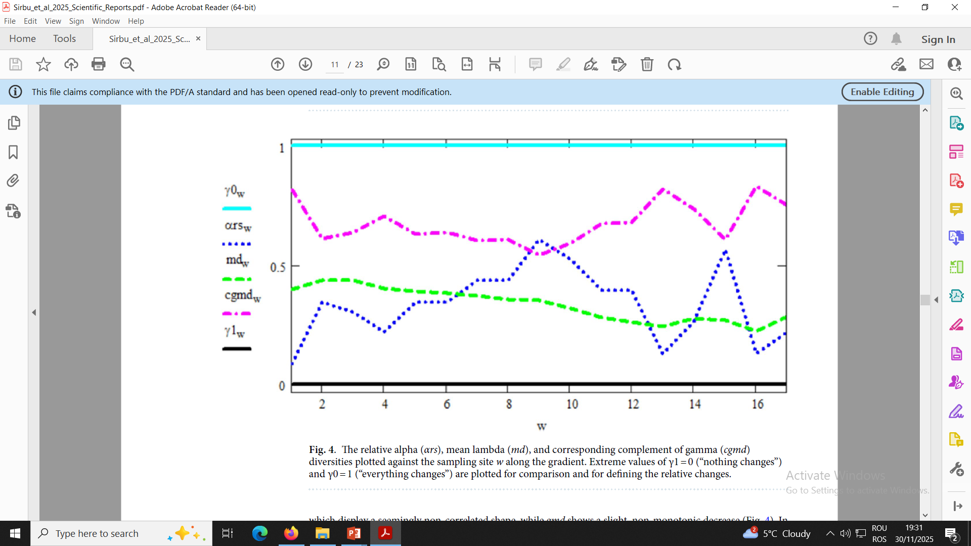
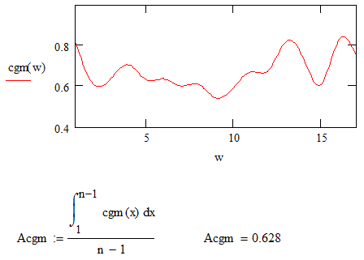
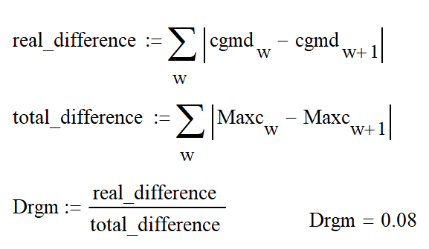
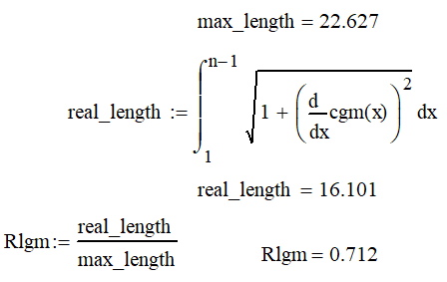

The complement on gamma diversity is
cgmd_{w} = (1-gmd_{w})
We defined several measures of diversity changes:
Acgm = relative geometrical gamma change,
Rlgm = relative length ratio between the graphical
display of the gamma complement and the
total possible length of change
Drgm = difference in relative changes in successive
gamma diversity measure
γρ = relative sequential cumulative gamma
diversity change along a gradient
The relative alpha (αrs), mean lambda (md), and corresponding complement of gamma (cgmd) diversities plotted against the sample w along the gradient. Extreme values of γ1 = 0 ("nothing changes") and γ0 = 1 ("everything changes") are plotted for comparison and for defining the relative changes.
Excerpts
from Mathcad
templates

Slide 7
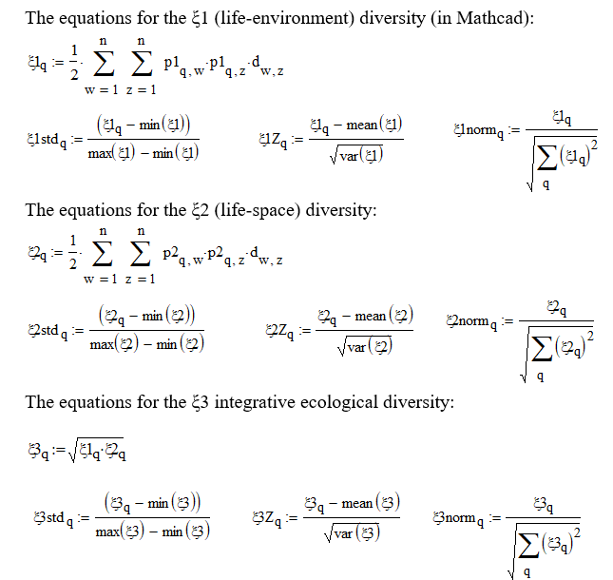
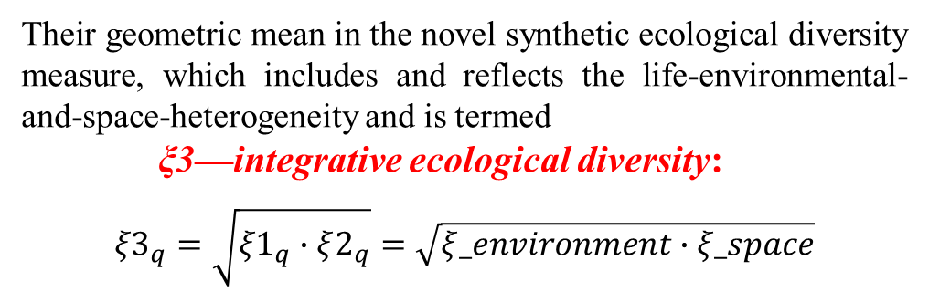
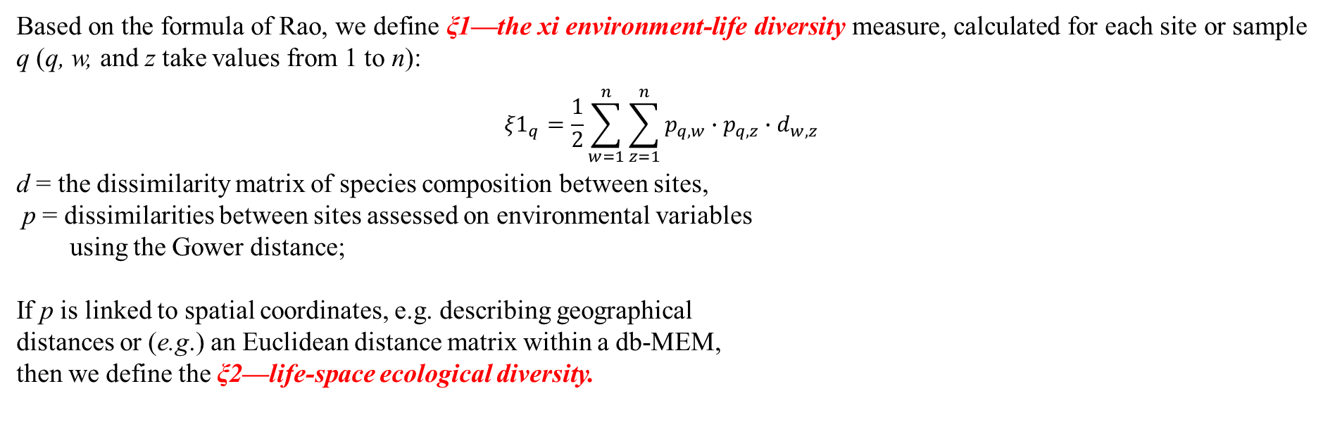
4. Defining and computing the xi (ξ) integrative ecological diversity
Based on the formula of Rao, we define ξ1—the xi environment-life diversity measure, calculated for each site or sample q (q, w, and z take values from 1 to n):
$${ξ1}_{q}=\frac{1}{2}\sum_{w=1}^{n}{\sum_{z=1}^{n}{p_{q,w}∙p_{q,z}{∙d}_{w,z}}}$$
d = the dissimilarity matrix of species composition between sites,
p = dissimilarities between sites assessed on environmental variables
using the Gower distance;
If p is linked to spatial coordinates, e.g. describing geographical
distances or (e.g.) an Euclidean distance matrix within a db-MEM,
then we define the ξ2—life-space ecological diversity.
Their geometric mean in the novel synthetic ecological diversity measure, which includes and reflects the life-environmental-and-space-heterogeneity and is termed
ξ3—integrative ecological diversity:
$${ξ3}_{q}=\sqrt{ξ1_{q}∙ξ2_{q}}=\sqrt{ξ_environment∙ξ_space}$$

Slide 8
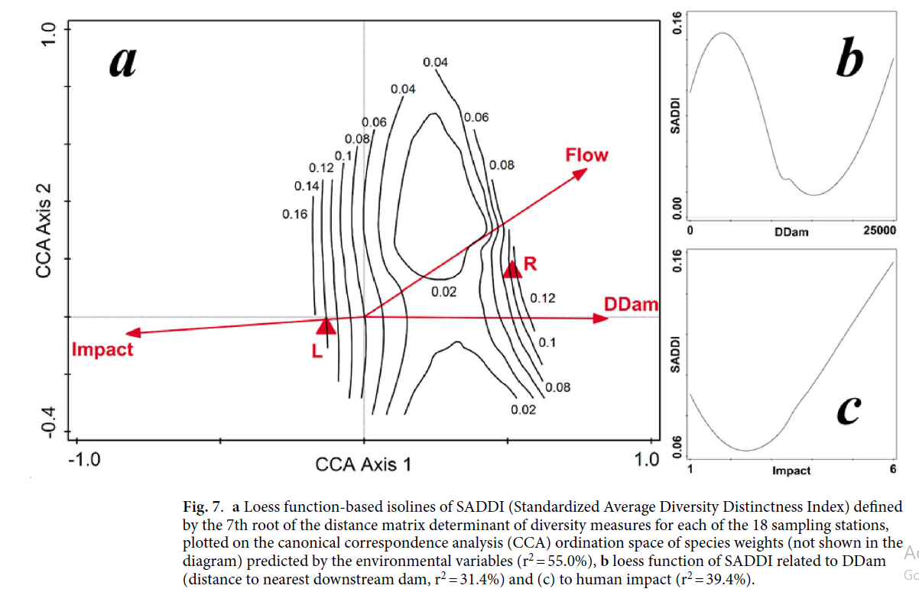
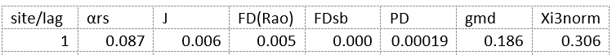
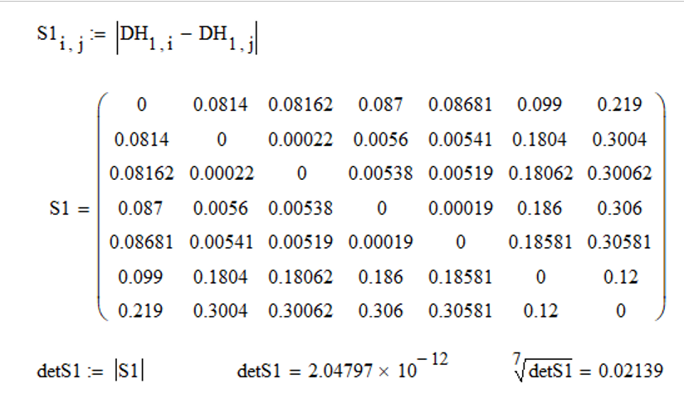
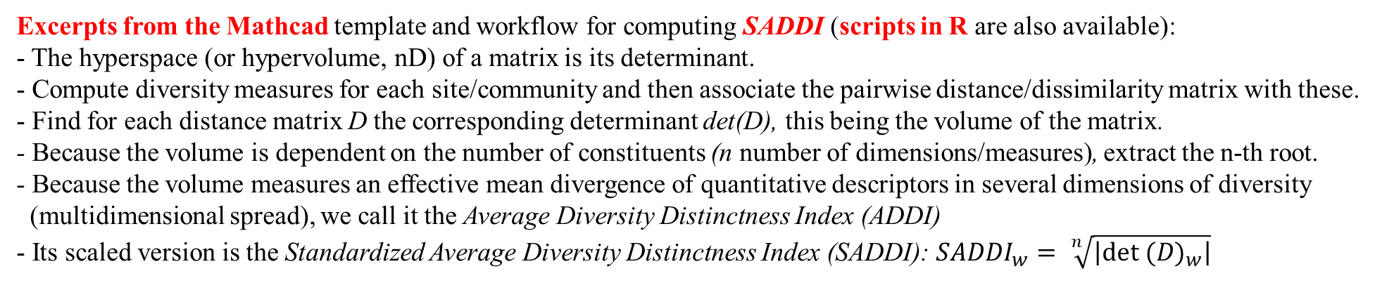
5. Introducing the Standardized Average Diversity Distinctness Index (SADDI).
Excerpts from the Mathcad template and workflow for computing SADDI (scripts in R are also available):
- The hyperspace (or hypervolume, nD) of a matrix is its determinant.
- Compute diversity measures for each site/community and then associate the pairwise distance/dissimilarity matrix with these.
- Find for each distance matrix D the corresponding determinant det(D), this being the volume of the matrix.
- Because the volume is dependent on the number of constituents (n number of dimensions/measures), extract the n-th root.
- Because the volume measures an effective mean divergence of quantitative descriptors in several dimensions of diversity
(multidimensional spread), we call it the Average Diversity Distinctness Index (ADDI)
- Its scaled version is the Standardized Average Diversity Distinctness Index (SADDI): ${SADDI}_{w}= \sqrt[n]{\left|{det (D)}_{w}\right|}$
(e.g. computing SADDI measure for one site/community and
an example of its use on a real data set)

Slide 9
Some of the meanings and goals of these introduced synthetic diversity measures:
- expanding the conceptual and methodological framework of life–environment diversity,
- combining the variability in community structure with species' traits, ecological niches, and genetic distances
to measure the overall diversity of life,
- relating the heterogeneity in ecological communities' structure with that in their environment and their spatial patterns,
- proposing some geometrical ways of illustration, which could preserve both the synthetic value and the individual
contributions of each implied measure,
- synthesizing different diversity measures into a few or one index, which might be a useful tool in assessing conservation
effectiveness, ecological monitoring, and management.
- developing an inclusive approach and harmonizing different models and frameworks as a necessity and a step forward
in future diversity research.
- searching for integrative approaches and theories that combine various facets and fields of science,
- detecting dependence and relations between components and hidden structural features that are not covered
by univariate measures.
- not replacing, but rather adding our perspective to those already defined and commonly agreed upon,
- mitigating the 'identification crisis', meaning the decrease in the number of experts in species identification
and the decline of species-based biodiversity research,
- sustaining trans-, meta-, and interdisciplinary research and communication, linking people and their different interests
and knowledge of nature and its values, establishing a stage for a common understanding and cooperation,
- motivating students to train within environmental and ecological sciences while also considering mathematics and IT,
- enhancing the general intellectual and cultural heritage, with benefits for society, environment, and life.

Slide 10
Expanding the framework (to be done ...)
- exporting ideas, measures, and interpretations to other fields of knowledge,
- applying to other real data sets, environments, and contexts,
- including more dimensions and sources of information,
- developing a unified R package and other software applications,
- refining and improving the mathematical background,
- elaborating on ecological meanings and significance,
- ... and many others.

Slide 11
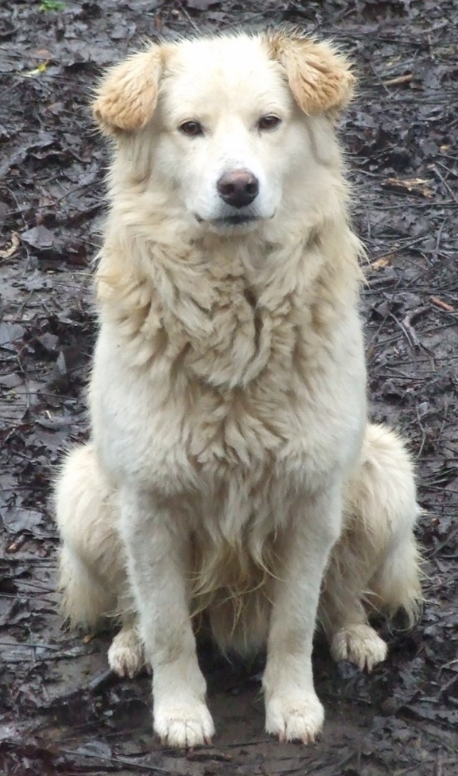
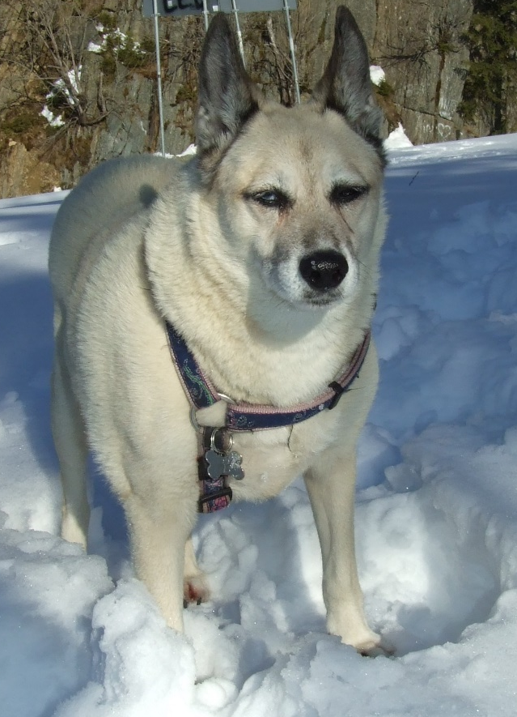
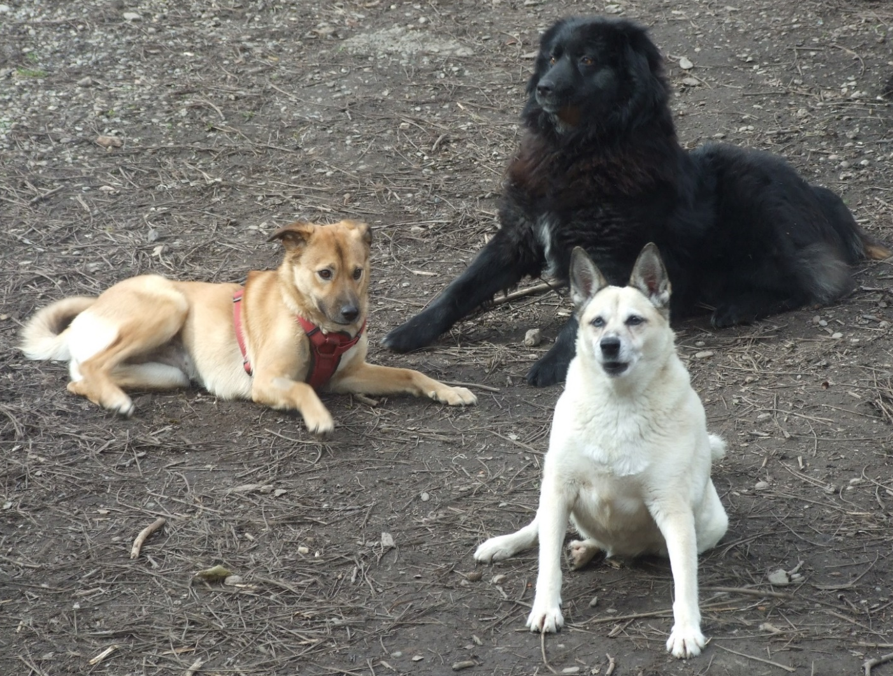
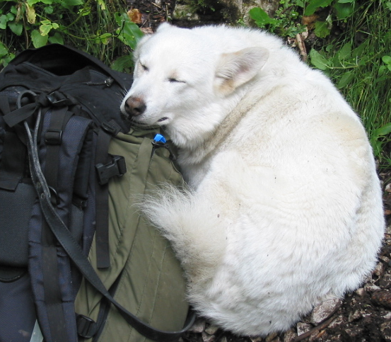
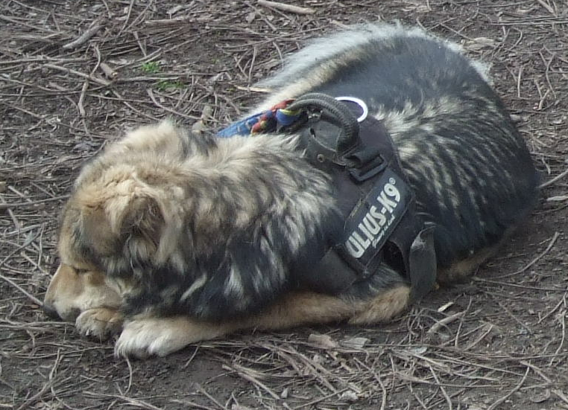
Thank you for listening to us!

