Slide 1

Tools for the theory of change in developing green bioeconomy strategy
Maria-Mihaela Antofie, Iulian Bratu
Lucian Blaga University of Sibiu
Teodor Vintilă
Life Sciences University of Timișoara

Slide 2


Ribes project
GA 101134911
20 partners
14 countries
36 months [2024-2027]
Budget 4.99 M euros
Leader Central European
Initiative
Horizon, governance call

Slide 3
Lead CENTRAL EUROPEAN INITIATIVE – EXECUTIVE SECRETARIAT (IT)
UNIVERSITY OF MAASTRICHT (NL)
CENTRE FOR RESEARCH AND TECHNOLOGY HELLAS – CERTH (EL)
BIOCOM INTERRELATIONS GMBH (DE)
WHITE RESEARCH SRL – WHITE (BE)
UNIVERSITY OF HOHENHEIM – UHOH (DE)
TECHNOLOGY CENTRE - CIRCE (ES)
Q-PLAN INTERNATIONAL ADVISORS PC - QPL (EL)
ARX NET MOBILE INNOVATIONS (EL)
EUROPEAN RURAL DEVELOPMENT NETWORK - ERDN (PL)
AGRICULTURAL UNIVERSITY – PLOVDIV - AUP (BG)
MEDITERRANEAN INSTITUTE FOR NATURE AND ANTHROPOS - MedINA (EL)
ENERGY INSTITUTE HRVOJE POZAR – EIHP (HR)
SPRING SUSTAINABLE PROCESSES AND RESOURCES FOR INNOVATION AND NATIONAL GROWTH – SPRING (IT)
BALKAN RURAL DEVELOPMENT NETWORK SKOPJE – BRDN (MK)
RZESZÓW REGIONAL DEVELOPMENT AGENCY S.A. – RARR (PL)
THE “LUCIAN BLAGA” UNIVERSITY OF SIBIU – ULBS (RO)
FACULTY OF TECHNICAL SCIENCES UNIVERSITY OF NOVI SAD– FTN (RS)
BIOECONOMY CLUSTER – BEC (SK)
FORZA AGENCY FOR SUSTAINABLE DEVELOPMENT OF THE CARPATHIAN REGION NONPROFIT ORGANIZATION – FORZA (UA)

Slide 4
Ribes objective
RIBES will address the need to enhance the uptake of biobased innovations through pioneering governance and business models developed at the convergence of social entrepreneurship and rural development. It will also contribute to the shift from a linear to a circular economy in 9 regions that lag in innovation.
Activities will focus on 9 case study regions, which were selected based on a variety of socio-economic indicators and data on the role and characteristics of the agricultural and biobased sectors, demographics, innovation capacity, etc.
Ribes foresees dedicated dissemination at the EU level, particularly in central, east and see countries.
Notes:
The RIBES project is co-financed by the European Union's Horizon 2020 research and innovation programme. It aims to increase the adoption of biobased innovations by introducing new governance and business models that integrate the circular bioeconomy, social innovation, and rural development. This initiative targets 9 European regions that currently lack innovation in this area, focusing on sub-national levels while ensuring dissemination and replication at the national level.
The Central European Initiative – Executive Secretariat (CEI-ES) coordinates the RIBES project. This involves managing activities, facilitating partner collaboration, ensuring compliance, and promoting results dissemination. RIBES will also establish 9 local Multi-actor Transformative Forums (MTFs) to foster stakeholder participation and deliberation processes.
RIBES will deliver a comprehensive assessment of regional bioeconomy ecosystems and develop innovative governance solutions. Tailored business models will support circular bioeconomy value chains, promoting sustainable biobased entrepreneurship. The 9 MTFs will co-create customized business and governance models, addressing societal challenges and driving transformative change.

Slide 5
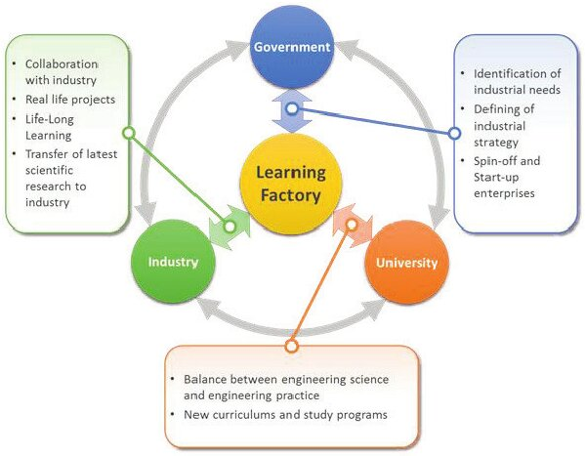
Ribes objective
RIBES will shed light on social entrepreneurship that combines public interest with a commercial logic.
The ambition is to come to new innovative kinds of organisations (business and governance models) that operate as alternatives or hybrids between – community, market and government.
Ribes looks beyond the ´triple helix` governance of public-private partnership between governments, knowledge institutions and companies that has long been seen as the main driver of innovation in a region. T
O accelerate and guide a fair and transition towards a CBE that revitalizes local communities, the MTFs will explore new forms of cooperation
https://www.researchgate.net/publication/279070672_Lean_learning_factory_at_FESB_-_University_of_Split/figures?lo=1

Slide 6
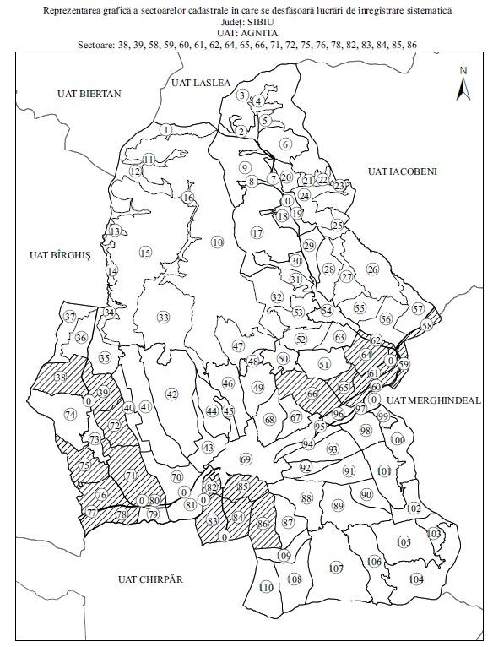
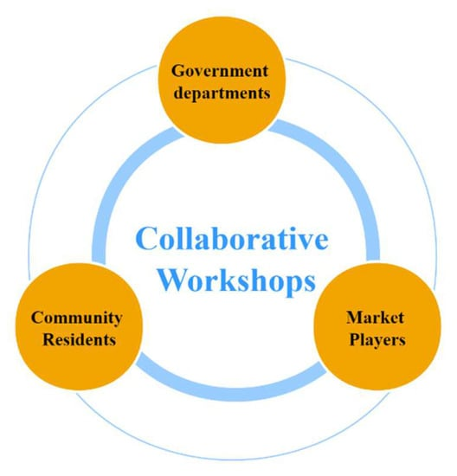
https://lege5.ro/Gratuit/gmydkojyg4yq/uat-agnita-ordin-1066-2018?dp=gi3tcnzvgq3tsni

Slide 7
Need 1
Rural and peri-urban communities need support to drive and accelerate the CBE in an inclusive and sustainable manner
Need 2
Enhance decision-making and increase the absorptive capacity of rural actors and bridge research to practice, empowering them to realise their innovative bio-based business models
Need 3
Need to create innovative governance models and structures to support enhanced and more meaningful engagement of regional/local bioeconomy actors
Need 4
Tools and good practices are needed for improved governance and better support social engagement and social innovation

Slide 8
Expected Outcome 1:
Higher impact of bio-based innovation to accelerate the transition from a linear fossil-based economy, which leads to overuse and depletion of natural resources, into a resource-efficient and circular bio-based systems operating within safe planetary boundaries
Facilitate innovation, co-development and upscaling through the development of 9 multi-actor transformative forums (MTFs)
Stimulate the transition towards more sustainable bio-based systems with enhanced circularity
Prevent environmental degradation and reduce social inequality
Expected Outcome 2:
Improved and informed public awareness, governance and social innovation contributing to reduced resource consumption and increased innovation capacity of all CBE actors, reduced risk of leaving anyone behind, particularly in the areas and communities in need of revitalization
Enhance innovation capacity and understanding of social innovation
Address the need for public engagement
Revitalise communities by promoting social sustainability and inclusion
Foster circularity in the bio-based sector
Boost sustainable consumption patterns in the general public
Expected Outcome 3:
Higher level of innovation at local scale and inclusive engagement of all actors (especially focusing on the ‘social enterprise’ model relevant for vulnerable populations).
Setting up an encouraging ecosystem for innovation (scientific, societal
Unlocking social innovation and social entrepreneurship
Empowerment and engagement of actors in the decision-making process by framing the governance dimension of social innovation

Slide 9
Wider Impact 1:
Innovative governance models enabling sustainability and resilience notably to achieve better informed decision-making processes, societal engagement and innovation
Empowering actors’ capacity in the decision-making processes (technical, economic, societal, environmental
Mainstreaming societal engagement and innovation (research, societal)
Wider Impact 2:
Areas related to the European Green Deal benefit from further deployment and exploitation of environmental observation data, products and “green” solutions.
Rural economies revitalisation and limiting local resistance (societal, economic)
Facilitating the knowledge exchange to support the wider adoption of bio-based innovation in other areas of EU (scientific, technological)
Wider Impact 3:
Sustainability performance and competitiveness in the areas covered by Cluster 6 are improved through further deployment of digital and data technologies as key enablers
Contributing towards transparency and knowledge sharing across the entire value chain (scientific, societal, economic)
Wider Impact 4:
Stakeholders and end users including primary producers and consumers are better informed and engaged thanks to effective platforms such as AKIS
Boosting open innovation, inclusive structures and knowledge flows across European local communities:
Breaking geographical barriers of knowledge transfer (societal, economic)
Wider Impact 5:
Strengthened EU and international science-policy interfaces to achieve the Sustainable Development Goals
Promote policy conditions for innovation and circular bio-based systems with safe planetary conditions

Slide 10
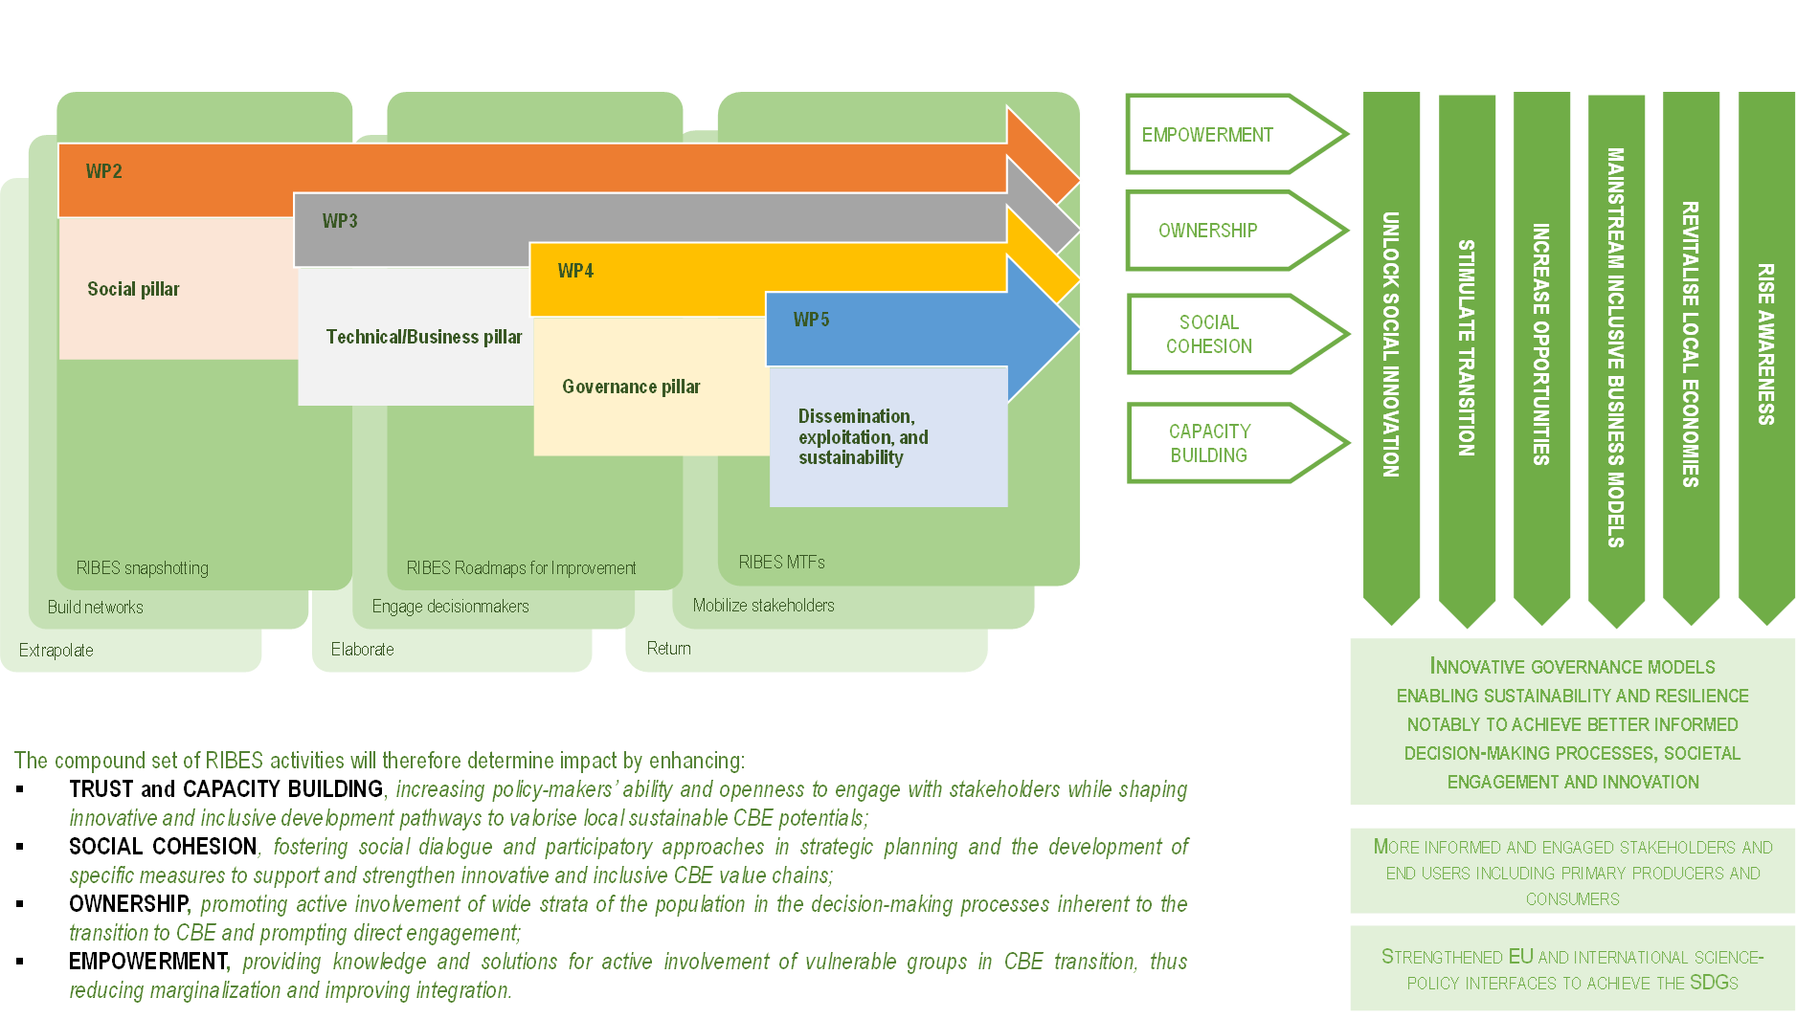

Slide 11
Biomass from agriculture Iuliana Antonie
Cultura | 2018 | 2019 | 2020 | 2021 | 2022 | 2023 | 2024 | Medie (t/ha)
Grâu comun | 3.77 | 3.37 | 3.31 | 3.81 | 3.78 | 3.71 | 3.46 | 3.61
Porumb boabe | 6.26 | 5.45 | 5.27 | 5.56 | 4.58 | 4.61 | 4.02 | 5.07
Floarea soarelui | 2.53 | 2.38 | 2.24 | 2.09 | 2.27 | 2.48 | 2.43 | 2.32
Soia boabe | 2.01 | 1.47 | 1.29 | 2.31 | 1.59 | 2.08 | 2.15 | 1.81
Cartofi – total | 18.26 | 15.24 | 19.56 | 16.35 | 14.15 | 15.38 | 12.59 | 16.57
Legume – total | 13.50 | 13.13 | 15.94 | 18.84 | 12.78 | 11.45 | 9.26 | 13.85
Lucerna | 19.31 | 17.04 | 16.11 | 16.50 | 14.53 | 13.26 | 11.70 | 15.45
Porumb verde furajer | 31.55 | 27.21 | 22.81 | 29.17 | 24.33 | 24.45 | 19.69 | 25.20
Total productivitate/an |  |  |  |  |  |  |  | =468
Biomasă estimată 1:1 (raport dintre producție și masa vegetală ne – utilizată ) |  |  |  |  |  |  |  | =468
Disponibilitate minima estimate pentru 10% masă vegetală |  |  |  |  |  |  |  | 46,8 t/ha

Slide 12
Biomass from husbandry Mirela Stanciu
Specia/categoria (Efectiv la nivel de județ) | Capete | Cantitatea de dejecții+așternut /cap/zi | Cantitatea de dejecții+ așternut / efectiv | Cantitatea de dejecții+așternut/efectiv/an (kg) | Cantitatea de dejecții/efectiv/an (t)
Vaci și juninci | 42851 | 40 | 1714040 | 625624600 | 625624.6
Tauri | 507 | 35 | 17745 | 6476925 | 6476.925
Viței 0-6 luni | 7655 | 8 | 61240 | 22352600 | 22352.6
Iepe | 1431 | 30 | 42930 | 15669450 | 15669.45
Armăsari | 37 | 30 | 1110 | 405150 | 405.15
Asini | 65 | 20 | 1300 | 474500 | 474.5
Oi+mioare | 420267 | 2.8 | 1176748 | 429512874 | 429512.874
Berbeci | 16425 | 2.8 | 45990 | 16786350 | 16786.35
Caprine | 14170 | 2.8 | 39676 | 14481740 | 14481.74
Scroafe | 1037 | 14 | 14518 | 5299070 | 5299.07
Vieri | 30 | 12 | 360 | 131400 | 131.4
Găini | 956349 | 0.12 | 114761.9 | 41888086.2 | 41888.0862
Total dejecții / an (t) |  |  |  |  | 1.220.991

Slide 13
Biomass from forestry – Sibiu County, Iulian Bratu
Forestry areas
Land use | Anul 2018 | Anul 2019 | Anul 2020 | Anul 2021 | Anul 2022 | Anul 2023 | Anul 2024
Total | 201.6 | 201.9 | 202 | 202.5 | 202.7 | 202.8 | 203.5
Forestry area | 199.1 | 199.5 | 199.6 | 200 | 200.2 | 200.2 | 201.1
Softwood | 74.5 | 74.7 | 74.3 | 74.3 | 74.5 | 74.3 | 74.7
Decideous | 124.6 | 124.8 | 125.3 | 125.7 | 125.6 | 125.9 | 126.4
Other uses | 2.5 | 2.4 | 2.4 | 2.5 | 2.6 | 2.6 | 2.4
Crt. | Indicators | TOTAL | Softwood | Beech | Oak | Other hard species | Other soft species
1 | Wood collected- TOTAL | 461.3 | 218.1 | 115.4 | 63.8 | 58.5 | 5.5
2 | public forests of state | 177.2 | 84.1 | 47.7 | 21.9 | 22.3 | 1.2
3 | public forests of UAT | 248.2 | 117.7 | 58.2 | 39.5 | 30.3 | 2.5
4 | private forests | 24.2 | 13.4 | 5.7 | 1.8 | 3.2 | 0.1
5 | out-side forest area – with forest vegetation | 11.7 | 2.9 | 3.8 | 0.6 | 2.7 | 1.7

Slide 14
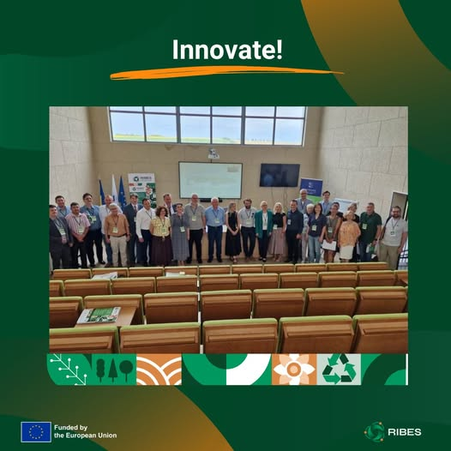
Change Theory in action to transf
General public
Education/ information /
Agriculture - crops, Hubandry, Forestry
Biomass for bio-based solutions l
Food chain
Affairs plus bio-based solutions
Bio-based inovation
Effects of communication needs, implementing and functioning

Slide 15
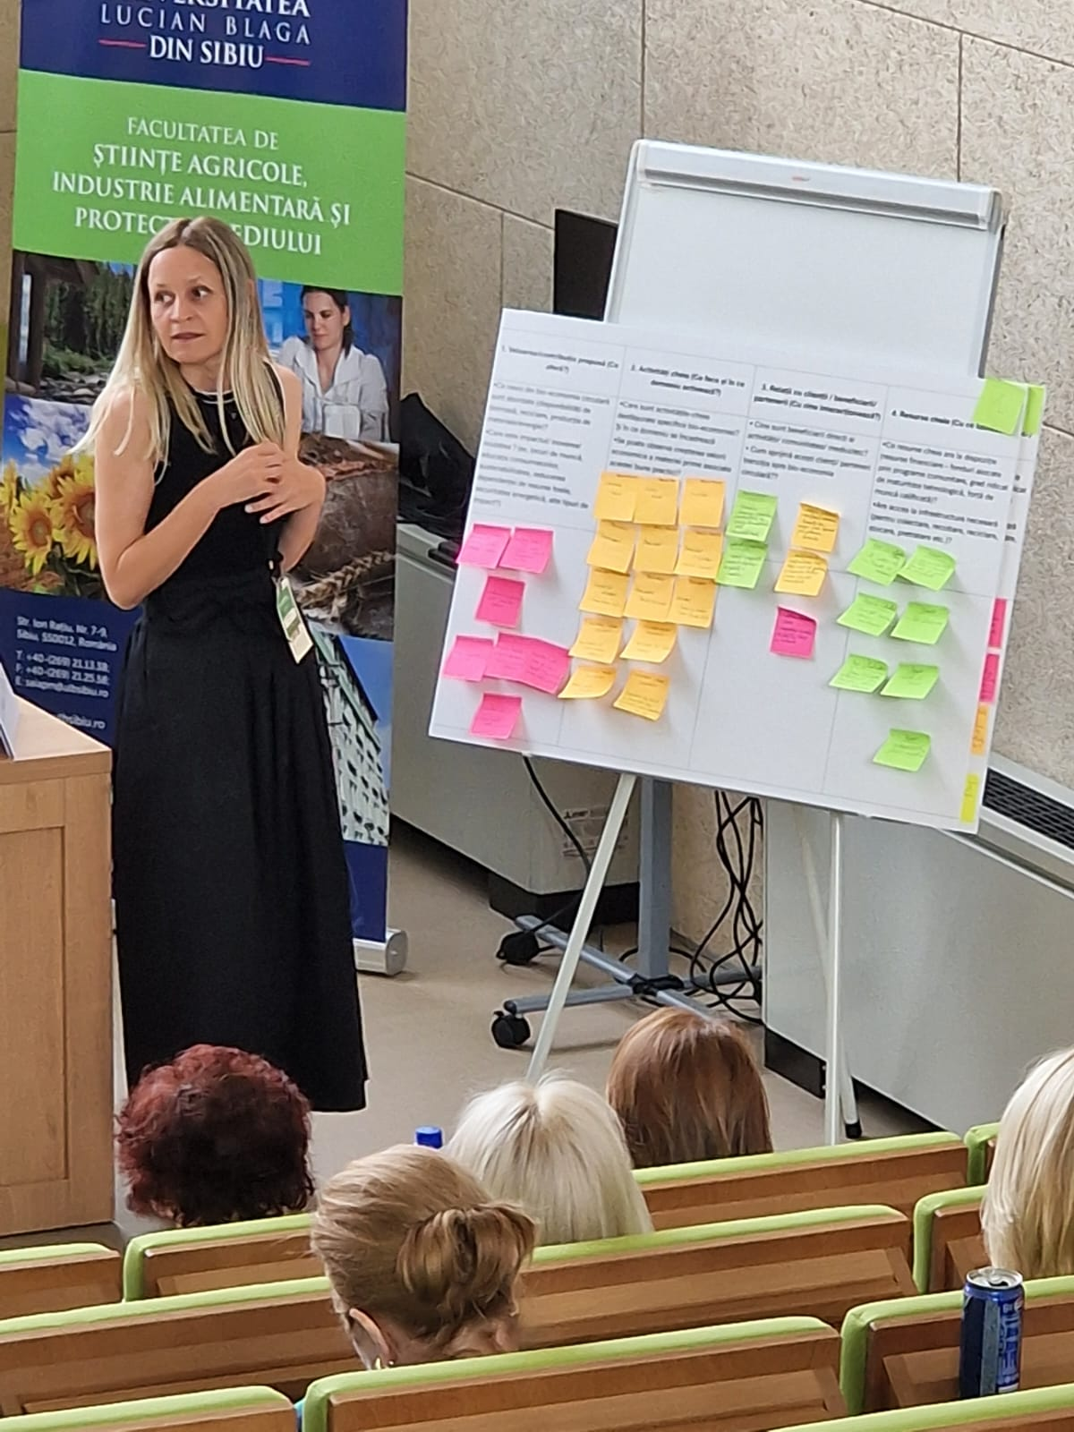
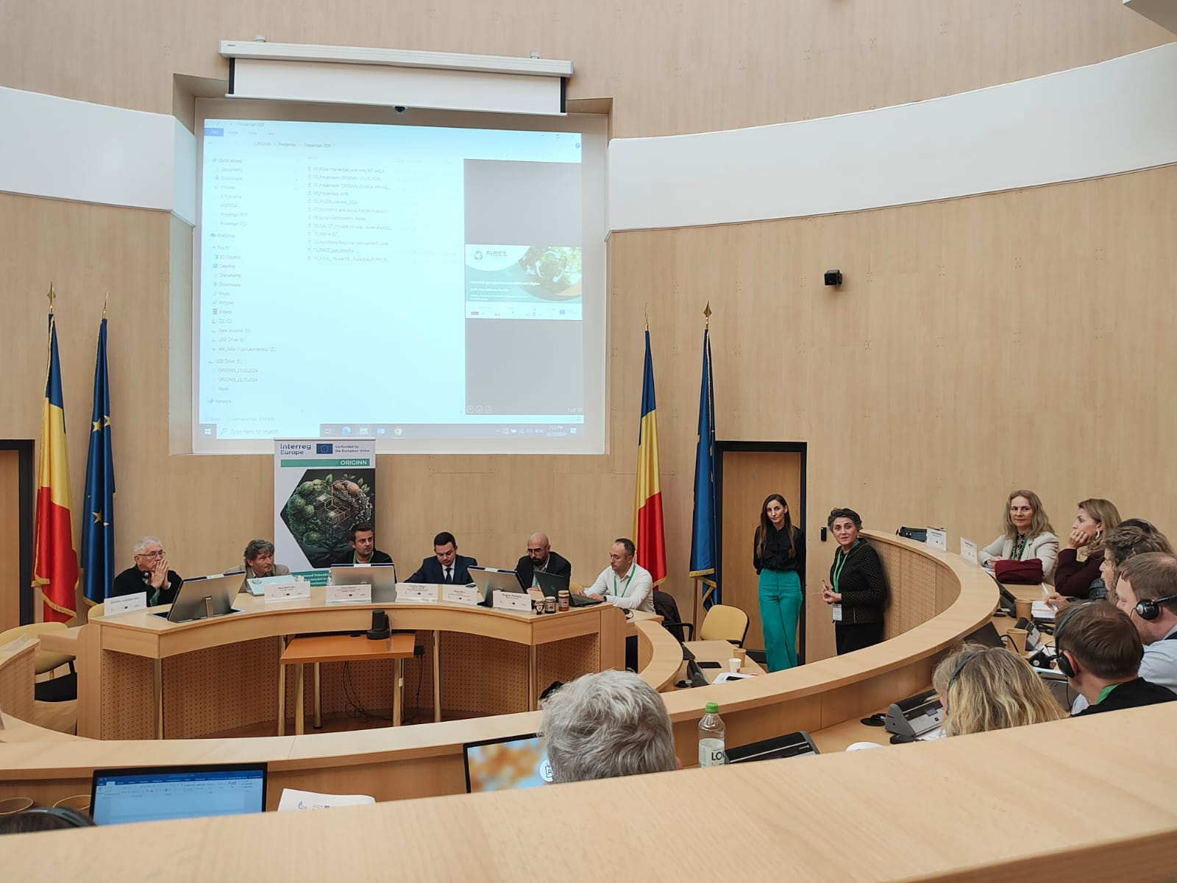
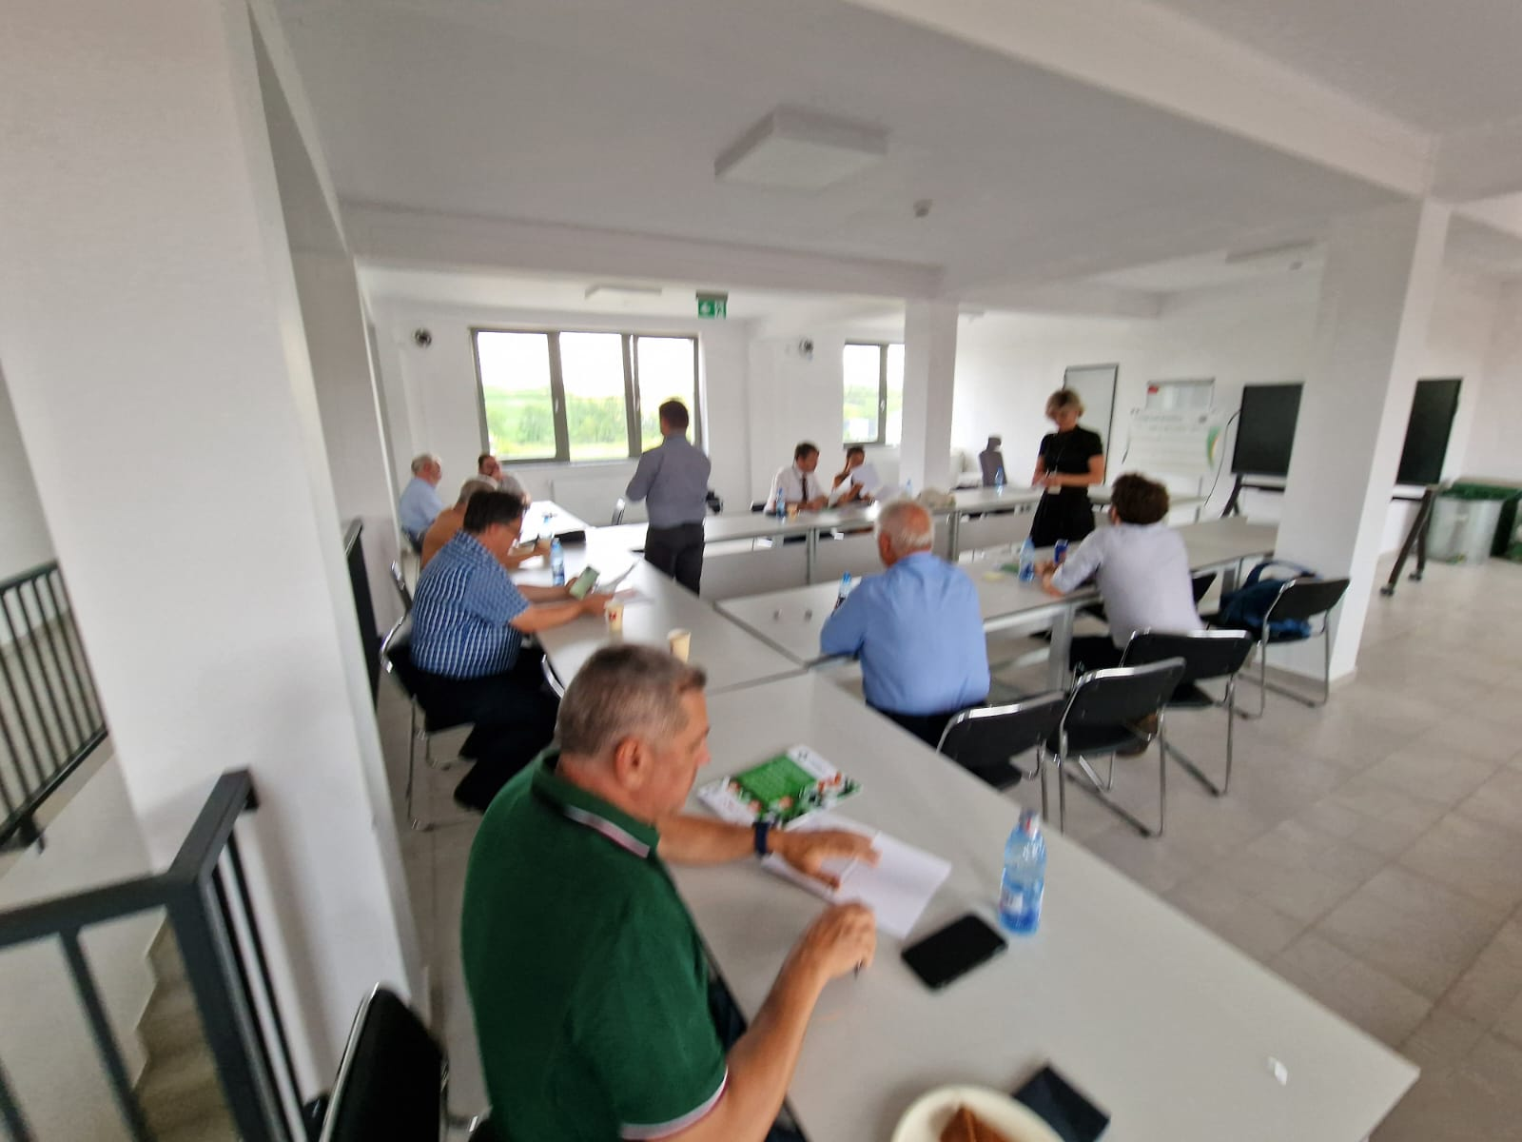
In action
Value chains assessment for agriculture and forestry
Bio-based solutions – potential assessment for different industries
Food industry
Wood
Energy
Others

Slide 16
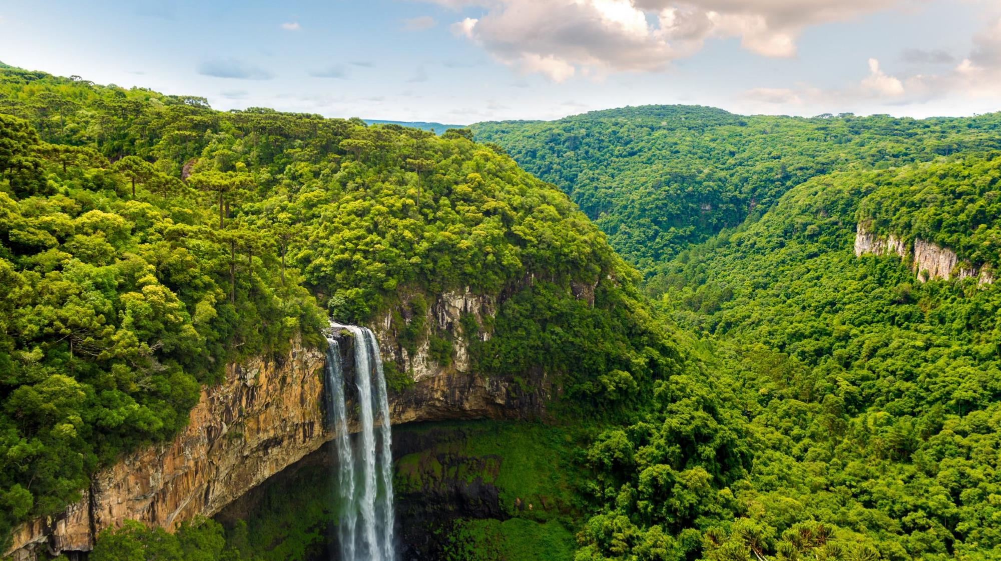
Contents:
Why?
What is a theory of change?
What are the steps?
Definitions
What does it look like?
Design for Impact
UNEP-WCMC

Slide 17

Objectives
By the end of this session you should have a clear understanding of:
Importance of being able to explain the 'why' of their projects
Concept of Theory of Change including definitions
Know what an outcome is!
Overview of the steps of theory of change
Understand what applying a theory of change approach means for an organisation
Notes:
ToC is a narrative of change, a hypothetical projection of the future. It is full of assumptions and based on values, political choices, and on what we know at this moment. It is our best guess about how change will happen and a road map to help us deliver our intended outcomes.
TOC does not offer any guarantees. Rather it acknowledges that change processes are uncertain, complex and involving interacting dynamics of multiple forces at multiple levels.

Slide 18
Many organisations are better at describing what they do rather than the difference they make to people’s lives
Workshops
Collating spatial data
Attending COPs
Doing surveys
Teaching on Masters Courses
WHY are we doing these activities?
What impact do these actions lead to?
Writing policy briefs
Modelling
Fundraising
Creating Maps
Doing analysis
Capacity Building
Reviewing contracts
Notes:
Put simply impact not just about how may workshops you do but the learning from those workshops

Slide 19
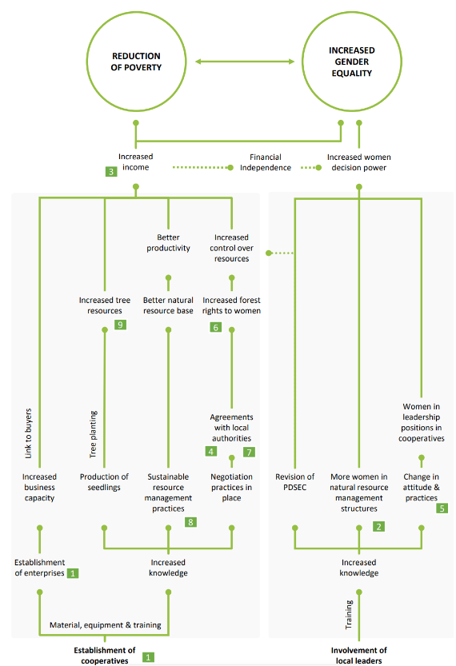
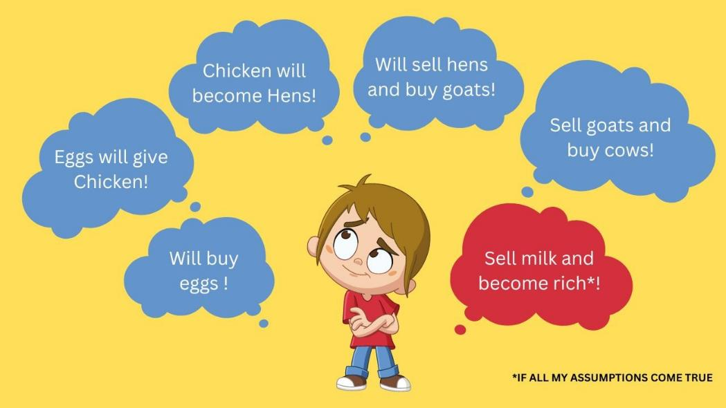
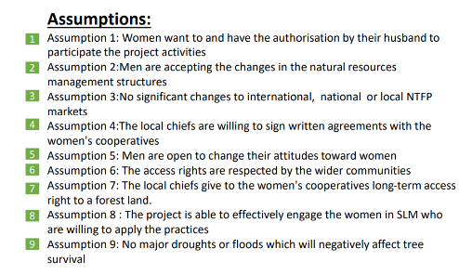
What is a Theory of Change?
Theory of how the world works: A description of how you think the world functions, and how change can happen, in your specific area of work
Theory of how the project will cause positive change: Visualise how your work will contribute to addressing the problem in question
A list of assumptions that you are accepting. If these assumptions turn out to be wrong, they will jeopardise your impact.
Notes:
Why do we care?

Slide 20
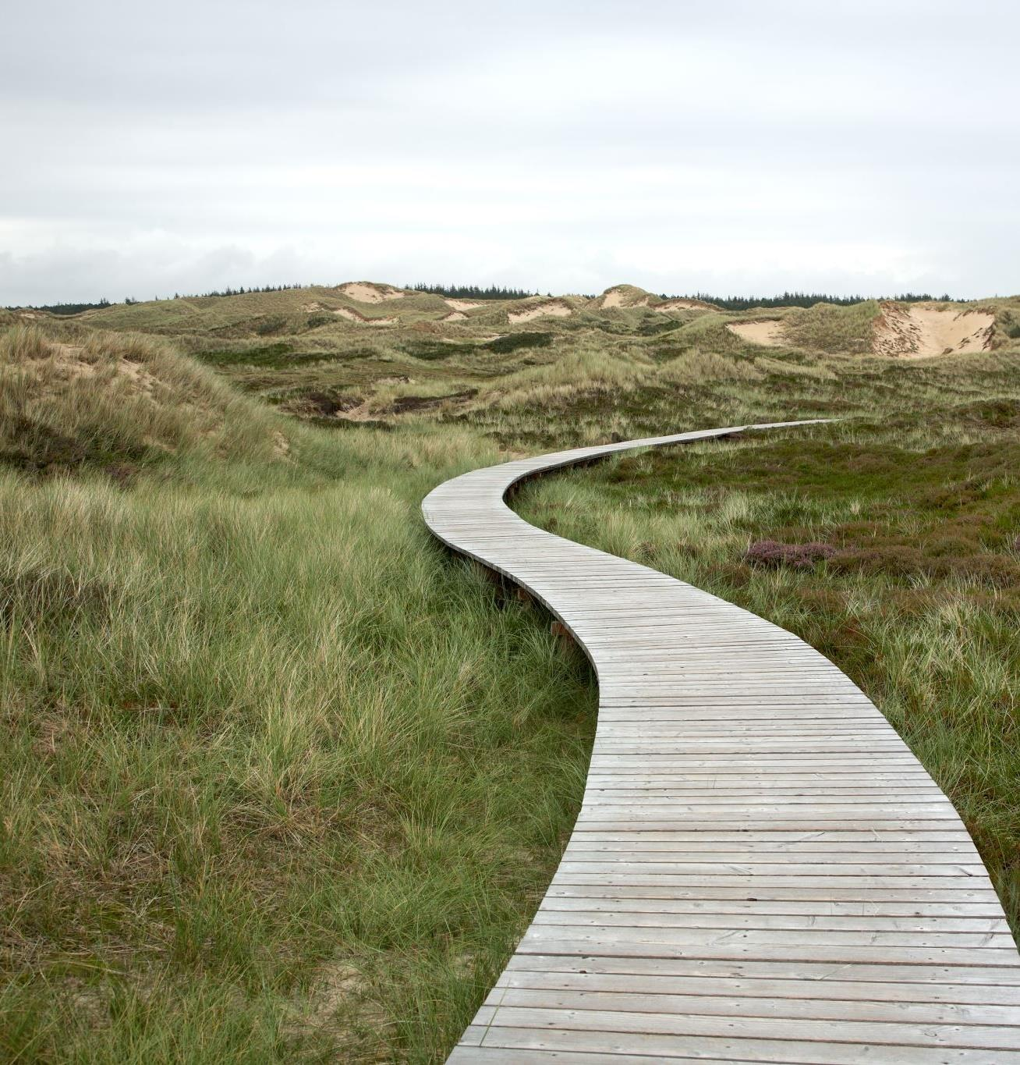
Why use a Theory of Change?
To scrutinise the relationships between problems and solutions
To identify logical pathways from input to impact (via activities, outputs, outcomes)
Important for understanding WHY we are doing work
To describe how the project delivers support the County of Sibiu
Notes:
Why do we care?

Slide 21
Process of creating a theory of change
1 Situation / System
Objectives
Problem definitions
Target Audience & Stakeholders
2 Intervention logic
Impact and Outcomes
Outputs and Activities
Assumptions / Risks
Barriers and Enablers
3 Refine / Revise
Evaluate plausibility
Set up Monitoring Evaluation and Learning

Slide 22
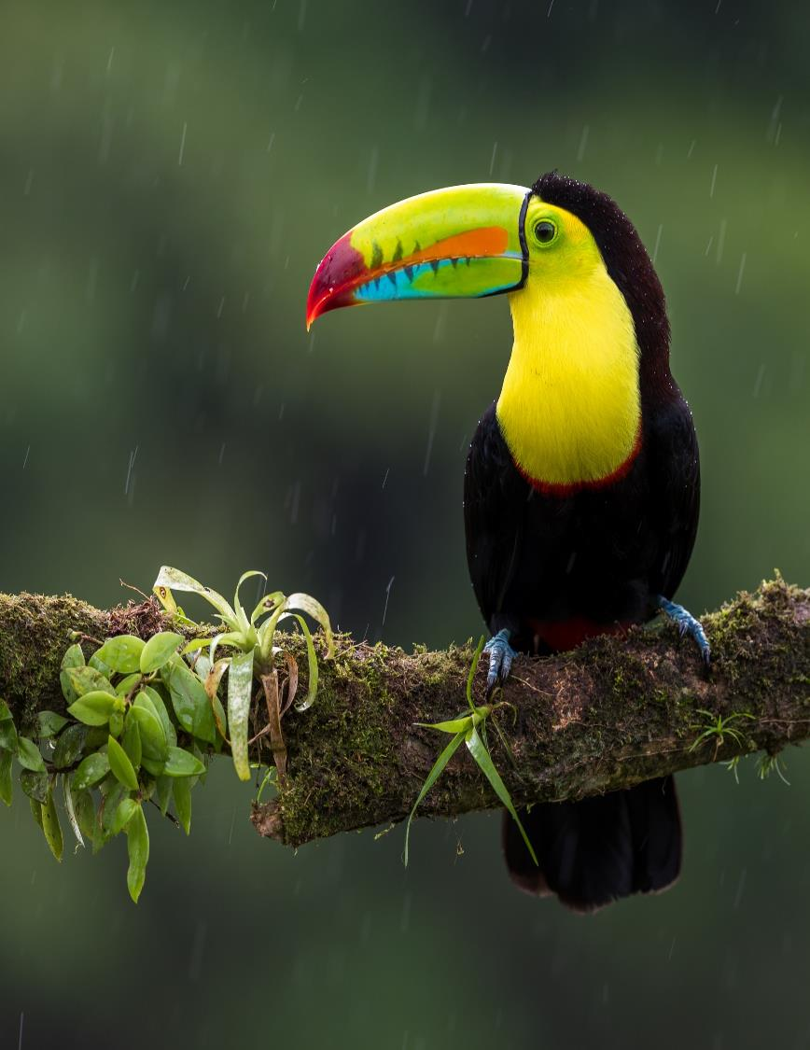
Definitions
Activities
Outputs
Outcomes
Intermediate State
Impacts

Slide 23
Nested process
Can do Theory of Change at different scales
Activities
Outputs
Outcomes
Intermediate State
Impacts
Impact Pathway
Smaller projects may not need a Theory of Change
It is important that all projects understand how their outputs are expecting to achieve change

Slide 24
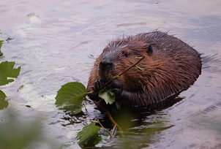
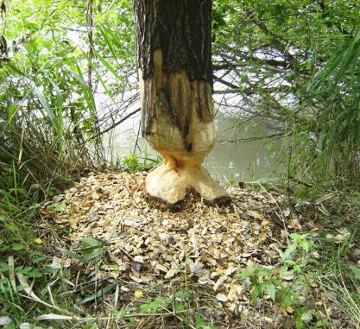
Activities
Activity: Actions taken or work performed through which inputs, such as funds, technical assistance and other types of resources, are mobilized to produce specific outputs
E.g. Analysis, map design, workshop planning, interview
Image credit: Lindsey Krause
Image credit: Theo Crazzolara
Notes:
Practical, time bound actions carried out to deliver the desired project outputs.
Image beaver: https://www.flickr.com/photos/lindseysphotos/3899028812/in/photolist-6WxxqG-9pR7GH-6UMhAM-LpBn-5cqAMH-8F419s-fo4Fq-8MmHwC-4WgDGS-5epVj1-29qt5V7-a4pHLj-6ffPdM-5utHdR-28phpGo-5epVph-wUfmFF-4zdGH-a4mRtZ-f7EEfU-gkLhX-rWk4QQ-eZwHz-83Dkw9-6h39yR-2MNeAR-feM8-4Dv5XV-4o29N-rYuQnb-52e8L-rs6jfz-5dPru-5gMc2Z-8vYNmH-FadL7S-29qsZgm-5quHX5-4r285P-26W78Gf-29qt2cW-7fVCSR-5fSF6t-29qt3DU-pud7r-cxEZyo-pudhc-4KZ8G1-rwQeN-7iQLCE
Image tree: https://www.flickr.com/photos/theocrazzolara/32240960204/in/photolist-R82mdd-tpoQV-2hittdW-a3WZMo-9oiDbb-22LTRhm-4qM4pP-p1usyK-BP2J1-pETAjh-69LeCG-pEQzP3-5BPnNW-pXmTbL-pX48Sp-p1usSk-pV8mtq-dDV6RY-2eEmzZ-5Cb2Mj-9ofBoa-mZYJSn-pXdX4e-pXdWP6-pERS3x-2eEmzP-8cAuGx-7sSwfu-aZKCfZ-pEQANs-pALsZ-6tMaoM-p1rxwN-7feos8-pENgaV-9oiDCY-fpv3iJ-p1rxgY-pENgmX-7k8u8q-yfD9f-C9Dwk-djPyE5-42xAve-8HUZnv-6cKTsW-7DC3J-4i5q8f-8HY6BS-4ccTBp

Slide 25
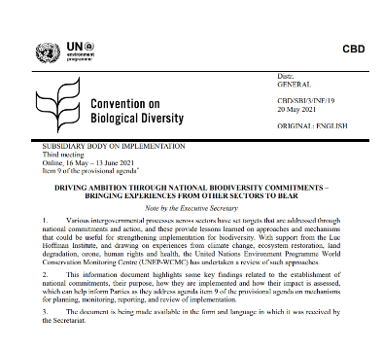
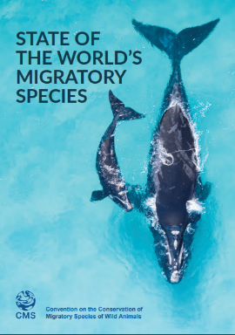
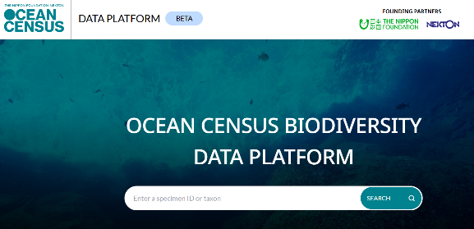




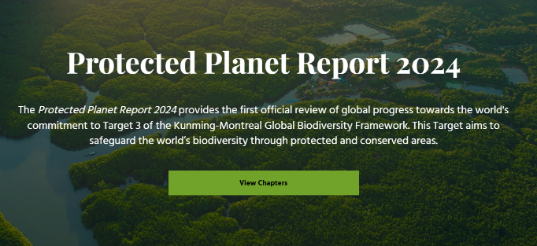
Outputs
Project Outputs: Tangible products or services delivered by the project
e.g. Report / map / training / website
Outputs are the availability (for intended beneficiaries/users) of new products and services that result from the completion of activities and/or gains in knowledge, abilities and awareness of individuals or within institutions.
Notes:
The products and services which result from the completion of activities within a project leading towards achievement of the project outcomes. These are lower level results.

Slide 26





Outcomes
Behaviour or
Institution
Outcomes: Changes you want to see in the users of the outputs
Action /
Attitude
Outcomes are the use (i.e. uptake, adoption, application) of a product or service by the intended beneficiary observed as changes in …
(BACKS)
Condition
Knowledge
Outcomes are change in behaviour of stakeholders, while impact is change in state or condition of beneficiaries.
Skill
Notes:
The intended or achieved short-term and medium term effects of project outputs, usually requiring the collective effort of partners. Outcomes represent changes in Behaviour, Action/Attitude, Condition, Knowledge, Skills (BACKS) that occur (even if only in part) due to the project’s activities.

Slide 27



Outcome examples
Institution / behaviour
Condition
Memorandum of Understanding signed between institutions
Law drafted
Resources mobilized for biodiversity conservation
Increased population of target species
Reduction in plastic pollution found in beach survey
Increase in protected area coverage
Action / Attitude
Trust built between partners
Biodiversity considered as relevant to policy creation (e.g. economic policies)
Difference between outcomes and impacts can be a difference of scale

Slide 28
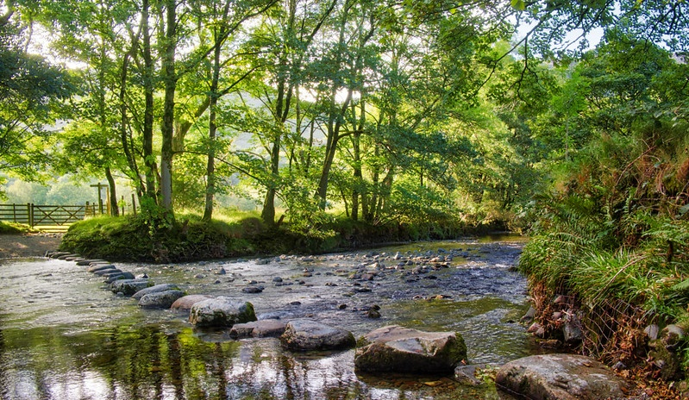
Intermediate state
Intermediate states are changes beyond the project's (direct) outcome(s) and required to achieve the intended impact of the project.
Stepping-stones to impact
Image credit: Helen M Bushe
Notes:
Expressed as changes resulting from project outcomes, needed for the achievement of the intended impacts. They are often also behavioral changes, but not directly linked to project outputs
https://www.flickr.com/photos/mistyblue17/48789781091/in/photolist-2hkoo7g-a8qLNk-c8vXMU-929Bgv-XLvsHc-Y3jAgW-83qibi-2g1Q9dE-2fGShJ6-21d8Xyv-6Jyj49-Hv7oKy-7QUJw6-cZeuk-5o7sxr-DRPGvz-fgT3vk-Gu9CGL-6KqVo5-256GMwY-HDnEiB-8FqeNA-p29QDz-2iKzrz4-fD2KAx-bG7bxn-2hBEeXx-rjNeyf-2iS5ow7-bxbJ84-Sn9DPN-H6avSu-9YeCQt-dRNHjN-2bdvgVZ-HPKHpy-67KsEt-2fS4EmQ-nNFkqJ-7zbfUr-bJCCcz-4qHpgc-2hqbEXr-fyDji-6KmHGV-8GAiQM-7aDJVQ-boyuij-pzK65V-ks2wdP/

Slide 29

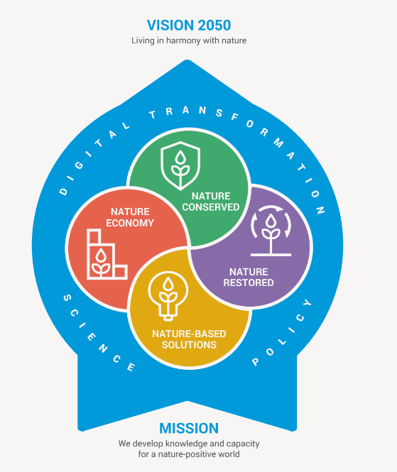
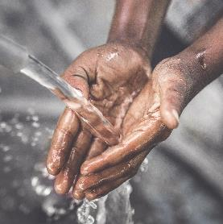
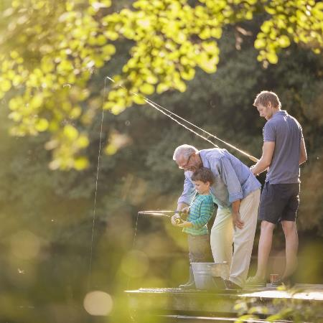
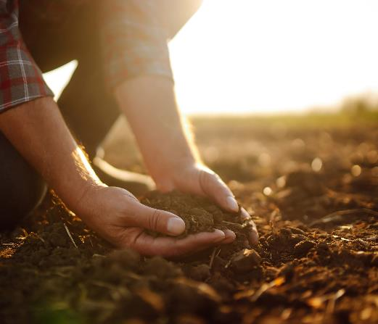
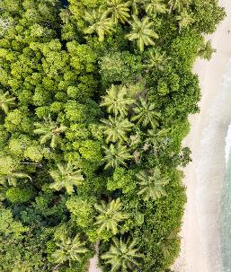
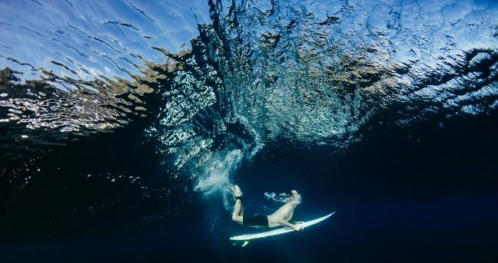
Impact
Impact: Positive and negative long-term effects contributed to by an intervention.
For UNEP-WCMC these effects will usually concern the natural environment and how it affects human life

Slide 30
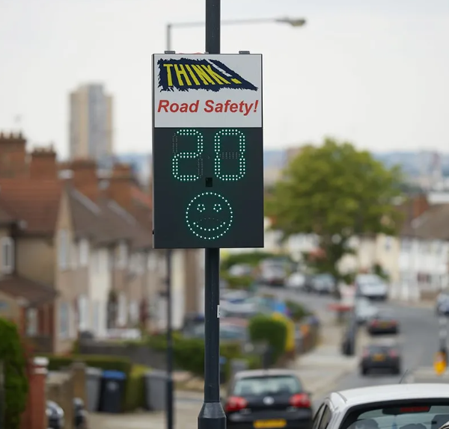

Activity
Location, design and installation of road sign
Output
Road sign
Outcome
Intermediate
state
Safer pedestrians
Fewer accidents
Traffic slows
Impact
Improved health and quality of life

Slide 31





Outcomes
There are several stages of outcomes, including intermediate states
Outcomes are changes in behaviour of stakeholders
Impact is change in state or condition of beneficiaries
Outcomes
Intermediate state
Impact
Activities
Outputs
Analysis
Map design
Workshop planning
Interview
Report
Map
Training
Website
Trust built
Outputs used or cited
Decision made
Policy debates initiated
Changes at policy or legal level
Adoption of new practices
Restored ecosystem
New protected areas established
New laws or policies implemented
Increased species populations
Poverty reduction
Functioning ecosystem
Sustainable Livelihoods
Agricultural output up
Sustained or increased delivery of ecosystem services or ecosystem resilience

Slide 32
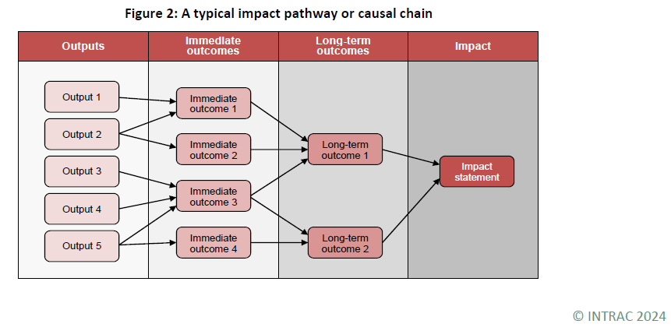
A recommended reource
Notes:
AGENDA SLIDE
1. Insert photo by right clicking on slide and selecting Format Background.
2. Select Picture or Texture Fill and click Insert.
3. Choose a scenic/natural background photo that is not too busy with darker tones.

Slide 33


Assumptions
Risks
External factors that can influence the success of the project but are beyond its direct control. These are the conditions that need to be in place for the project to succeed.
When understood can help steer project design to mitigate risks
May be influenceable but not guaranteed
Examples
Good internet available for use of online tool
Stakeholders sufficiently incentivised to engage
National legislation is enforced
Project able to access appropriate data from providers (and the data exists)
Some can be influenced, some not
To be mitigated as far as possible/reasonable
Risk registers are tools to identify risks, plan to mitigate them, assign responsibilities, and follow up regularly
Examples
Covid-19
Economic crisis leads governments to de-prioritise non-urgent activities
Companies choose not to engage with Proteus
Key contacts/decision makers change jobs

Slide 34
What concerns me?
We are responsible for designing activities and outputs in our sphere of control so that they have the best possible chance of making a difference in our sphere of influence, and interest
Responsibility Wedge
Budget for sharing your outputs, not just completing them
Consider how the outputs will be used.
Do the longer-term relationship building, that increases the likelihood of outputs being used
Activities
Outcomes
Impacts
Intermediate State
Outputs
Interest
Influence
Control
40% of World Bank reports had zero downloads between 2008 and 2012 . The complexity and jargon in these PDFs contribute to low readership
Notes:
Add – we can influence the next steps
We shouldn't put all our time in outputs
We should consider how the outputs are used. We can influence the way outputs are used by designing outreach / engagement / use of outputs etc.

Slide 35

Situation / System
Objectives
Problem definitions
Target Audience & Stakeholders

Slide 36

“When Einstein was asked how he would save the world in one hour, he said he’d spend 55 minutes defining the problem and five minutes solving it”

Slide 37
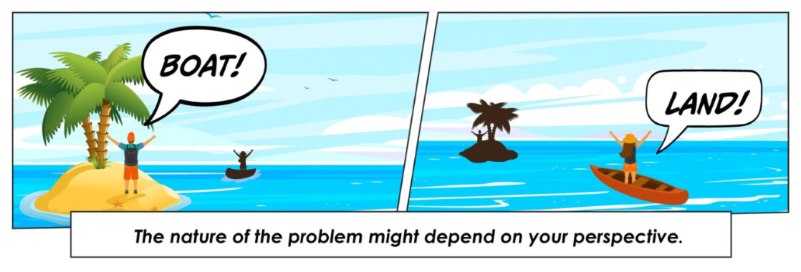
​
https://humber.ca/innovativelearning/wp-content/uploads/systems-thinking/03/sec03-02.html
Notes:
We can be biased to our own perspective. Especially once we've started a project. We might not be clear.
https://humber.ca/innovativelearning/wp-content/uploads/systems-thinking/03/sec03-02.html

Slide 38
Situation or context analysis
What is the desired situation for people and the environment?
What is the political, social, economic and environmental landscape for this issue? How is this changing?
What is known about the causes of the issue of concern?
Who are the stakeholders in this issue, and what is their power to influence it?
What is the existing capacity to address this issue?

Slide 39

Intervention logic
Impact and Outcomes Outputs and Activities Assumptions / Risks Barriers and Enablers

Slide 40
Design your project
Activity
Outcome
Intermediate State
Output
Impact
Implement your project

Slide 41

What does a Theory of Change look like?

Slide 42
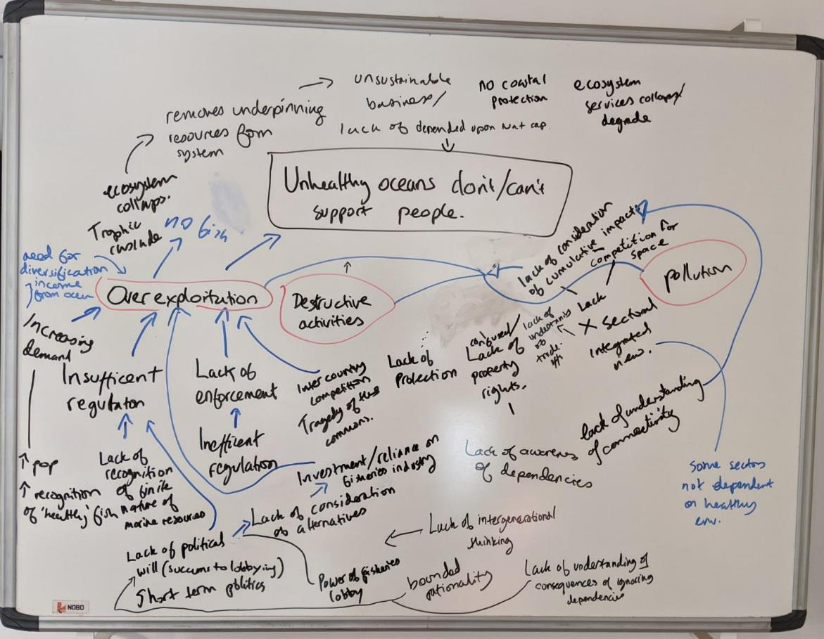
Messy first drafts
Example Problem Analysis
Notes:
This can be and should messy and iterative

Slide 43
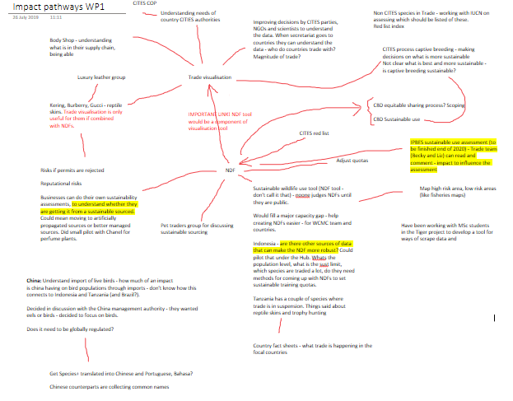
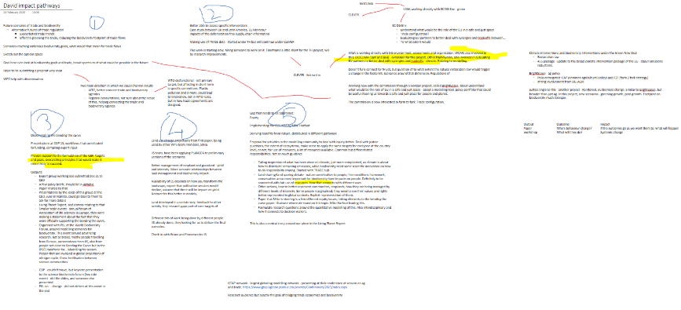
Notes:
These are first drafts of impact pathways for a couple of small teams under the TRADE hub – we had dozens of teams, and their priorities, and impact pathways all changed over the five years of the project.
Important thing is to get it down on paper. Then refine, write up, clarify, and turn into a plan.

Slide 44
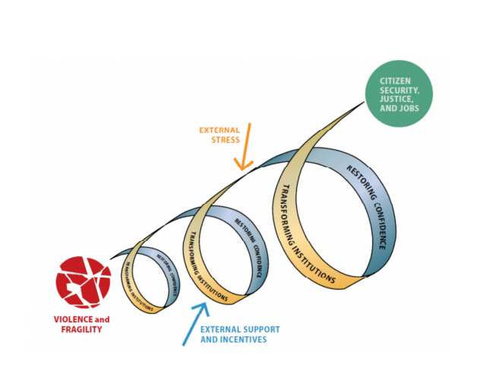
Example Theory of Change Diagrams
How are you going to visualise your project's impact pathways?
Notes:
https://assets.publishing.service.gov.uk/media/57a08a66ed915d622c000703/Appendix_3_ToC_Examples.pdf
You are not meant to be able to read these. They just show that ToC diagrams can be all shapes and sizes. They tend to have colour to differentiate the different parts. And will all have some sort of flow from Activity to Impact. One suggestion I heard recently was that you had a professional designer to pull together the diagram itself for large projects. I think this sounds very sensible.
Google theory of change in google images and you will get lots of interesting results.

Slide 45
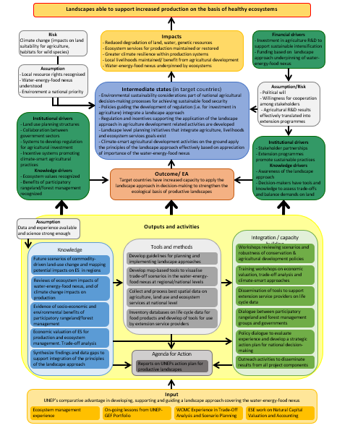
Example Theory of Change Diagrams
How are you going to visualise your project's impact pathways?
Notes:
https://assets.publishing.service.gov.uk/media/57a08a66ed915d622c000703/Appendix_3_ToC_Examples.pdf
You are not meant to be able to read these. They just show that ToC diagrams can be all shapes and sizes. They tend to have colour to differentiate the different parts. And will all have some sort of flow from Activity to Impact. One suggestion I heard recently was that you had a professional designer to pull together the diagram itself for large projects. I think this sounds very sensible.
Google theory of change in google images and you will get lots of interesting results.

Slide 46
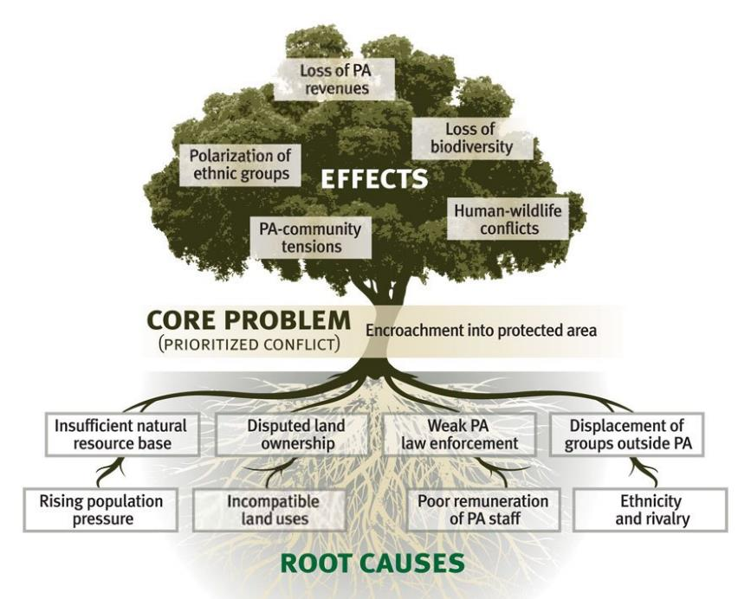
Problem Tree
Poor integration of traditional ecological knowledge and indigenous perspectives into conservation policies and management plans, undermining their effectiveness and cultural relevance.
It can be hard to produce this brainstorming statement
Question your assumptions.
“Is this really a problem?” “Do we have any evidence?”
Notes:
Brainstorming the problem is hard. That is why Einstein spent 55 minutes of the hour talking about the problem. You can move the 'problem' causes into the centre of the trunk during this process.
https://conservationbydesign.org/our-approach/identify-challenges-and-goals/conduct-a-situation-analysis/
Move slide 8 examples into this slide

Slide 47
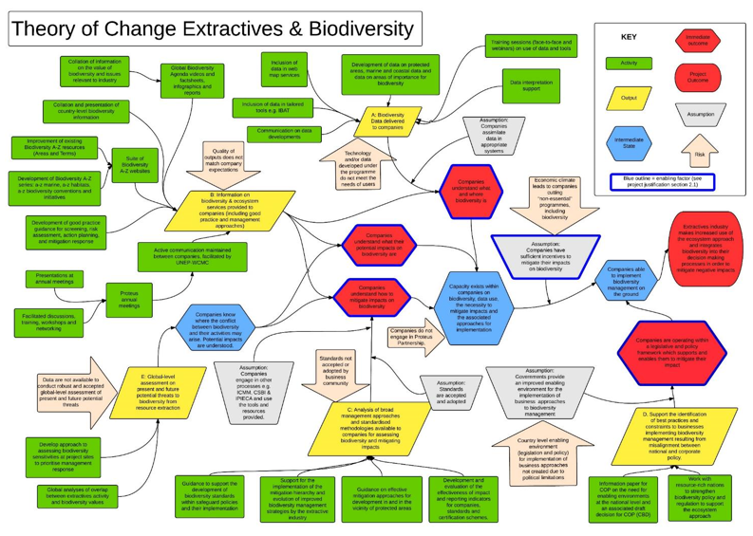
Example Theory of Change Diagrams (2/4)
How are you going to visualise your project's impact pathways?
Notes:
https://assets.publishing.service.gov.uk/media/57a08a66ed915d622c000703/Appendix_3_ToC_Examples.pdf
You are not meant to be able to read these. They just show that ToC diagrams can be all shapes and sizes. They tend to have colour to differentiate the different parts. And will all have some sort of flow from Activity to Impact. One suggestion I heard recently was that you had a professional designer to pull together the diagram itself for large projects. I think this sounds very sensible.
Google theory of change in google images and you will get lots of interesting results.

Slide 48
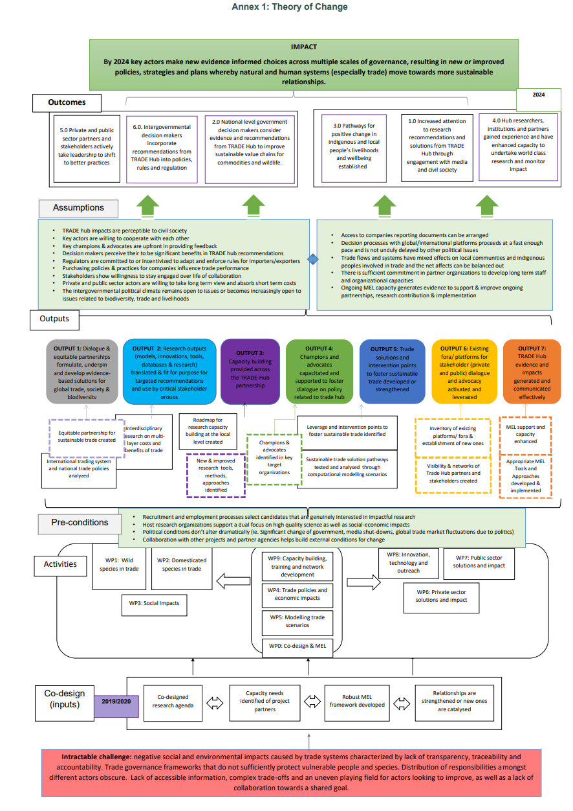
Example Theory of Change Diagrams (4/4)

Slide 49
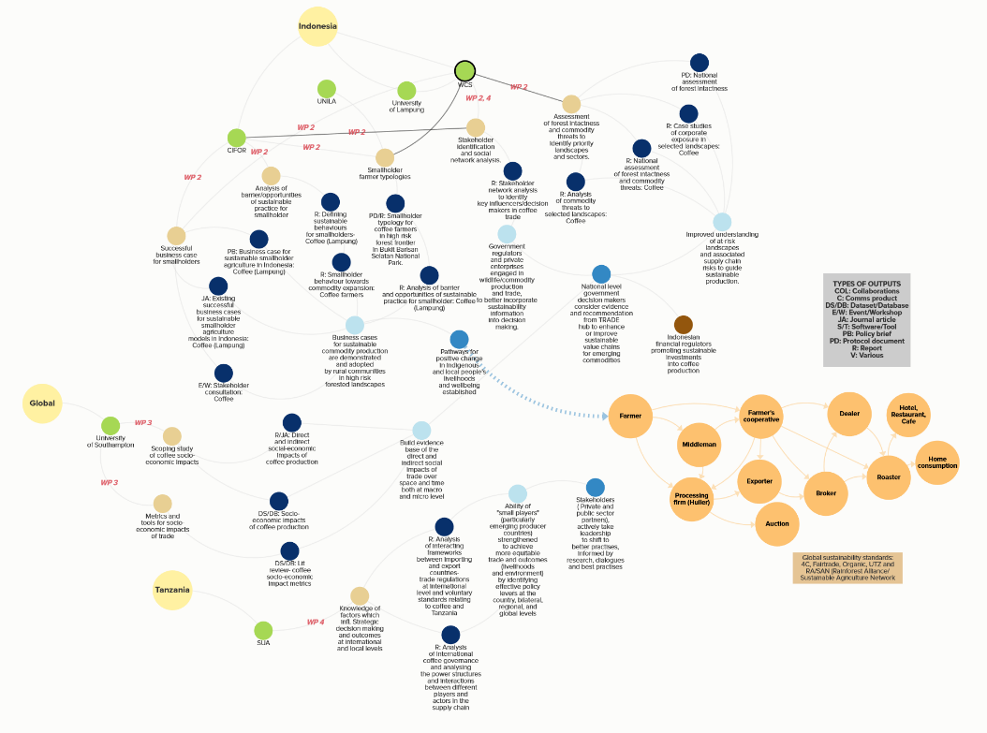

Impact Pathways: Example from TRADE Hub
Overarching research questions
Specific research questions
Outputs
Intended outcomes (behavioural changes)
Intended impact (systemic changes)
Mapping against network diagram of trade actors
KUMU online tool

Slide 50
Tools
First collaborative draft
Final version
In person, small group
Post-its and flipcharts
Pen and paper
Physical whiteboard
Remotely, small group
OneNote
MS Whiteboard
Miro
Theory of Change
Powerpoint
Miro / MS Whiteboard
Any graphical software you like and have long-term access to
Impact pathways
Kumu.io
Miro/MS Whiteboard
In person, large group
Post-its and flipcharts
Remotely, large group
Miro
Remember that others may need to be able to edit it later, so don’t use a software only you have access to, or something too complicated
Notes:
White board
Miro
Ppt
Post its
Kumu.io
What works best in different situations

Slide 51
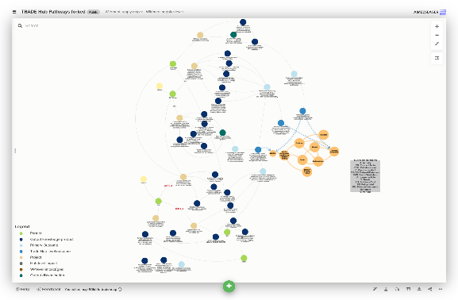
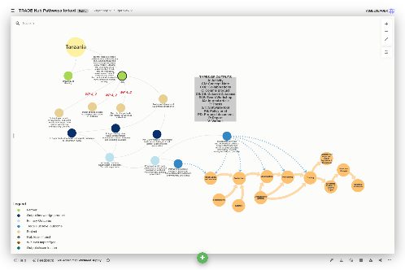
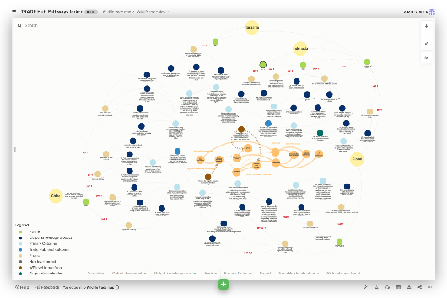
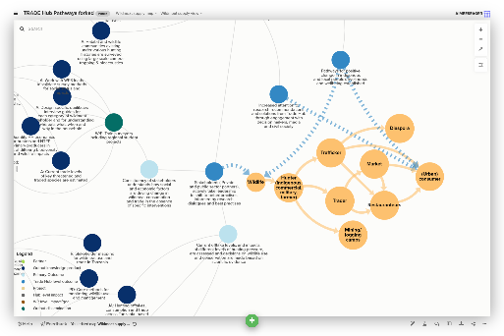
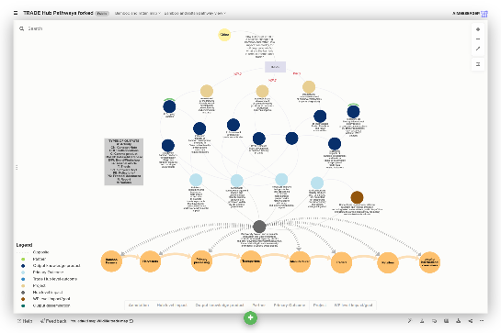
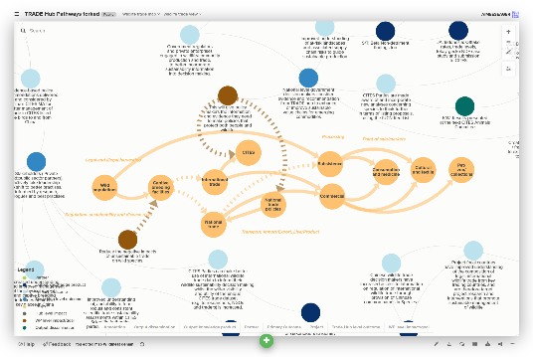
Impact Pathways

Slide 52

Refine / Revise / Track changes
Evaluate plausibility
Set up Monitoring Evaluation and Learning

Slide 53
Drivers for monitoring impact
Organisational governance
Performance management
External Partnerships
Communication
Funding
Change

Slide 54
Defining what and how to monitor
Activities
Outputs
Outcomes
Intermediate State
Impacts
Did you do it as and when you planned to?
Was the product, event, etc. available
as and when you planned?
Was there the desired change in beneficiaries behaviour, skills, etc.?
Was there the desired change in beneficiaries behaviour, skills, etc., or condition of something?
Was there the desired change in the condition of beneficiaries and/or the environment?
Determine how to answer these questions:

Slide 55
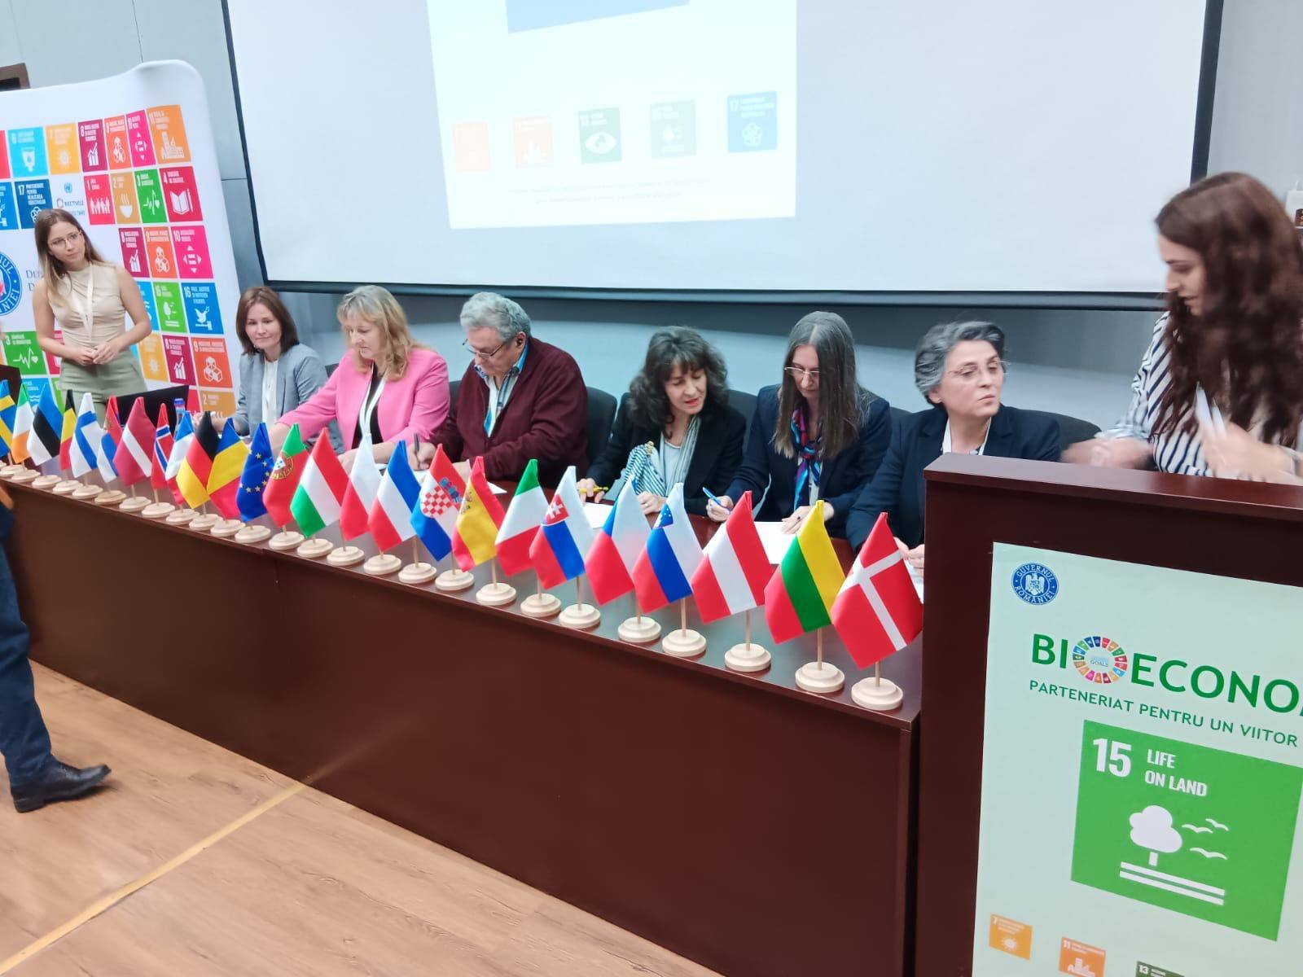
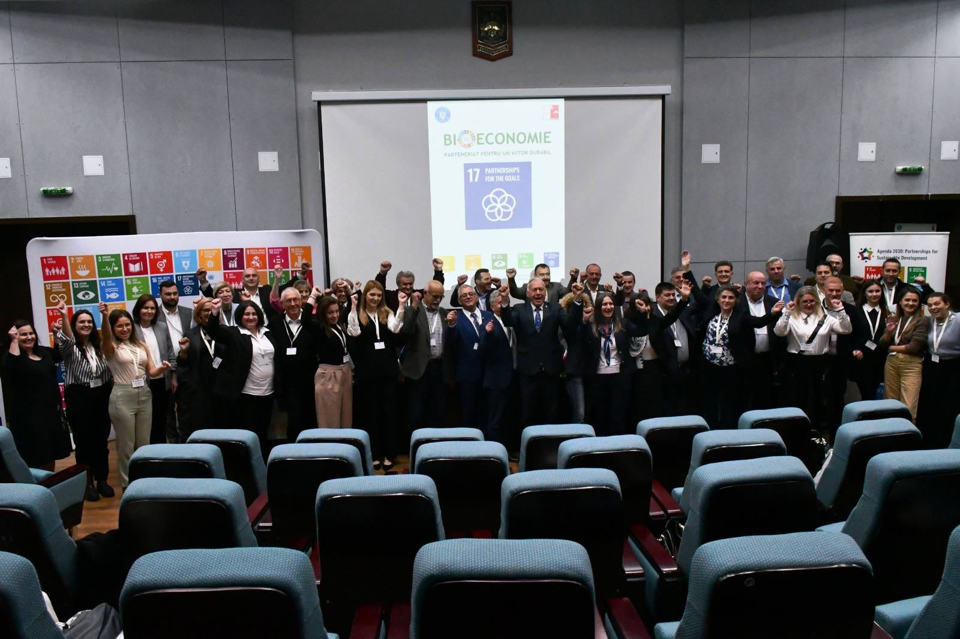
BioEconomy Cluster Central Region First in Romania 15 oct 2025, USAMV Bucharest Road map for developing a bioeconomy strategy and action plan – synergically with SDG, Climate Change, Biodiversity, Circular Economy

Slide 56
Policies
Strategies
Action plans
Funding programs
Projects
Social innovation

Slide 57
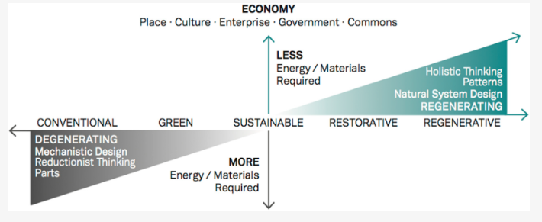
Catalytic ideas for conceptualization

Slide 58
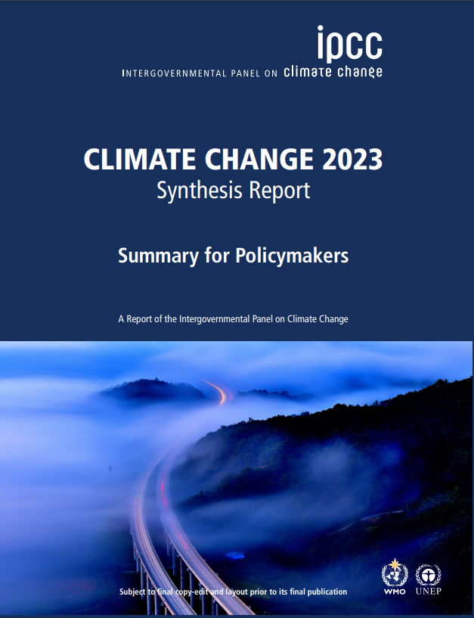
Main Triggers: IPCC reports
Paris Agreement (December 2015) 197 countries agreed to reduce global warming to “well below 2 °C above pre-industrial levels” [21], and an aspiration at 1.5 °C.
The Intergovernmental Panel on Climate Change (IPCC) report of 2024 as well as of 2018, stressed the importance to achieve consistent pathways toward global CO2 mitigation [22].
It is well established that humans are at the center of global climate change: their actions cause anthropogenic climate change, and social change is key to effectively respond to climate change [23,24,25].
Sonetti, G., Brown, M., & Naboni, E. (2019). About the triggering of UN sustainable development goals and regenerative sustainability in higher education. Sustainability, 11(1), 254.

Slide 59
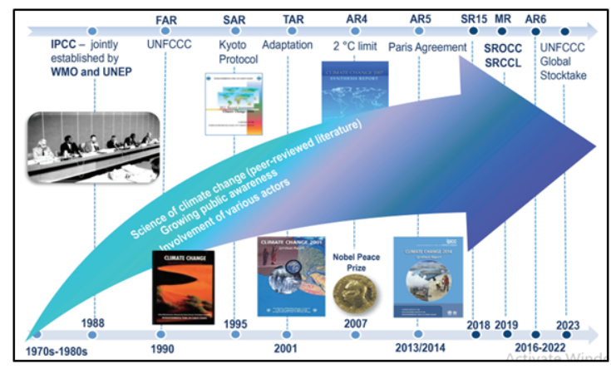
IPCC timeline
https://vajiramandravi.com/current-affairs/ipcc-reports/

Slide 60

Main triggers: IPBES reports
The Report provides a critical evaluation of evidence on the interlinkages between biodiversity loss, water availability and quality, food insecurity, health risks and climate change - the five elements of the Nexus. It puts forward a “nexus approach” whereby the different crises should not be addressed in isolation, since challenges within each element are interconnected with other elements across multiple spatial and temporal scales. A better understanding of these interconnections enables the identification of opportunities for collaboration across sectors and scales and contributes to synergistic and holistic management and governance.
https://knowledge4policy.ec.europa.eu/publication/ipbes-thematic-assessment-report-interlinkages-among-biodiversity-water-food-health_en

Slide 61

International Panel on Chemical Pollution 2025
The goal of the IPCP is to collect scientific knowledge about issues of chemical pollution and to provide summaries and interpretations of the available knowledge for decision makers and the public.
In total, there are several tens of thousands of chemicals on the market worldwide. Chemicals are released from many sources, enter the environment, reach our food and drinking water, and cause many types of adverse effects in both humans and wildlife.

Slide 62
Synergies among scientific platforms
IPBES has been operational since 2012, making it nearly twenty-five years younger than the IPCC. Inspired by the IPCC's success in raising awareness about climate change, IPBES aims to achieve the same for biodiversity.
However, their approaches have diverged, particularly around incorporation of diverse knowledge systems, engagement with stakeholders, and coordination across science-policy platforms.
These practices can create new audiences and a stronger foundation for action, all valuable lessons for the IPCC's upcoming Seventh Assessment Report (AR7) cycle.
McElwee, P. (2025). A tale of two panels: learning and coordinating across IPCC, IPBES, and other science-policy interfaces. Climatic Change, 178(3), 1-20.

Slide 63

Social innovation of today
Industry with Global players for global market for America, Europe, Asia Pacific,

Slide 64

Social innovation when reporting for 2025

Slide 65


Players on the global market

Slide 66




Bioeconomy and plant tissue culture at the global level
https://www.openpr.com/news/2686760/plant-tissue-culture-market-demand-volume-growth-ratio

Slide 67

News

Slide 68


News
https://www.britishecologicalsociety.org/content/a-beginners-guide-to-biodiversity-credits/
https://www.biodiversitycreditalliance.org/

Slide 69

We still need to consider long term policies
Policies to real support - PPP – public private partnership
Policies to support long life learning / education
Policies to support public engagement in improving education up to university level
Policies to real develop - IPO - Initial Public Oferring
Policies to support social innovation – as temporary or permanent structures and ensure communication exists
https://jelvix.com/blog/protect-intellectual-property

Slide 70

Final houghts
One way of defining biotech is as a source of new research tools for probing biology and providing new insights into the workings of living cells and organisms (Azvolinsky et al., 2016).
Living in harmony with nature should be completed when we will understand that we also need to share with nature
https://www.nasdaq.com/sites/acquia.prod/files/image/29525db076bcc42505a356e55dbe94f38b28530b_getty-stock-market-data.jpg?1930919888

