Slide 1




Capacity building for analysis of circular economy needs for master class curriculum development
Delia Ștefenel, Mihaela Antofie, Ionuț Tăușan, Radu Breaz
FORTHEM international conference
Democratic and Responsible Bio Innovation
^{March 11-13, 2026}

Slide 2
The main goal of this proposal is to transfer knowledge and training capacities, focusing on cultivating professionals in sustainability and circularity practices.
Producing training modules for professors in Asian Partner countries
Goal

Slide 3
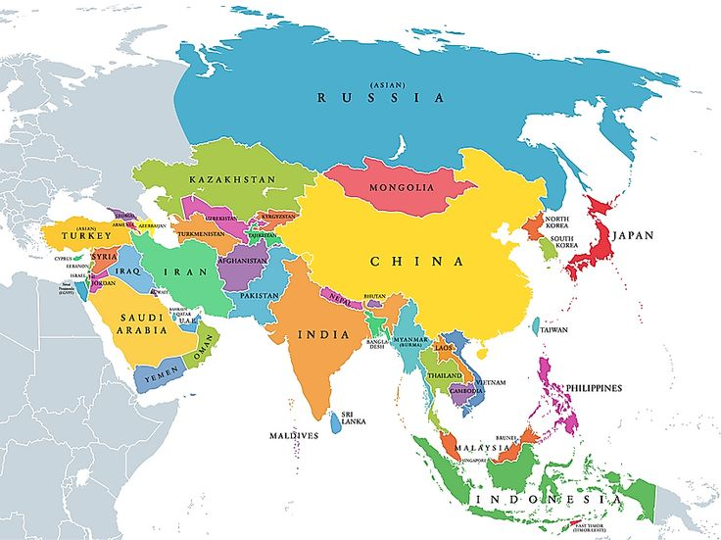



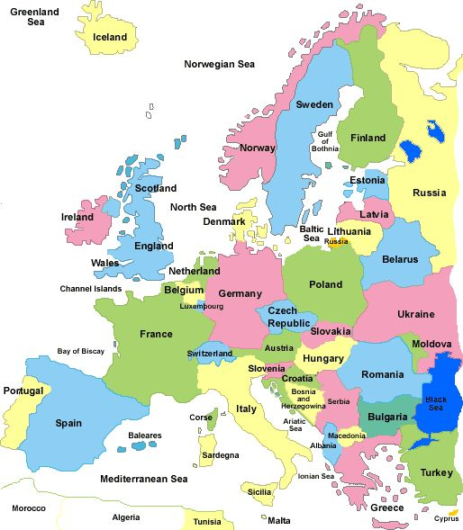




Romania
Lao Rep
Luxembourg
Viet Nam
Greece
Indonesia
Spain

Slide 4










Partners
Vietnam National University of Agriculture (VNUA)
Hanoi University of Science and Technology (HUST)
University of Santiago de Compostela - coordinator
Universitas Sebelas Maret (UNS)
University of Thessaly
Bogor Agricultural University (IPB)
University Lucian Blaga of Sibiu
National University of Laos (NUoL)
Novel Group LX
Savannakhet University (SKU)

Slide 5
WP
Work Package 1: Management & Coordination
Work Package 2: Preparation and needs analysis
Work Package 3: Curricula and Vocational Course development
Work Package 4: Syllabus Design, Research Units and Capacity Building Course
Work Package 5: Accreditation of Master’s Course
Work Package 6: Delivery of the Master Program
Work Package 7: Dissemination/ Exploitation & Impact

Slide 6
Work Package 3: Curricula and Vocational Course development
ULBS, 26 Feb 2025, Santiago de Compostela, Spain
ULBS, 22 sept. 2025, Vientiane, Laos

Slide 7
Starting points: abstract wording
This proposal aligns with the European Green Deal, extending its impact to address sustainability and circular economy challenges in Asian economies. The project aims to transfer knowledge through a postgraduate course, targeting recent graduates and professionals in various specializations. It offers a holistic understanding of key environmental issues, measurement tools, and focuses on energy transition within the circular economy framework, particularly in the automotive sector and alternative energies. The program accepts diverse professional profiles, promoting circularity across industries, economic sectors, and journalism. Participants gain insights into circular economy proposals, sustainability measures, and methods for project implementation within their domains. Emphasizing the imperative for cooperation, the proposal recognizes sustainability challenges in the target region and leverages EU leadership in circularity measures. European Higher Education Institutions play a crucial role in training staff from beneficiary institutions, ensuring essential skills for driving circularity practices.A sustainable training course, tailored for each beneficiary institution, will use an accessible digital platform for long-term viability. Mobility activities are planned, enabling staff, students, and professionals to train in countries implementing notable sustainability and circularity practices. In summary, the project extends the Green Deal's impact, promoting best practices in education and digital transformation. The postgraduate course aims to cultivate professionals trained in sustainability and circular economy practices, enhancing their competitiveness and employability in line with the Green Deal's broader goals.
Keywords:
Natural environment
Circular economy
Sustainability
Green Technology
Energy transition
Innovation
Environment protection

Slide 8
WP 3 Curricula and vocational course development
Develop the outline and teaching methodology of the master's program (WP3) based on WP2 results in collaboration with focus groups (p. 47 Document PROPOSAL_101179061-CEBCAT-ERASMUS-EDU-2024-CBHE). The program, open to various specializations, will span 2 academic years, divided into 4 semesters (120 ECTS, with flexibility in credit distribution). Part-time enrollment, not exceeding 3 years, will be permitted. Considering the diverse audience of graduate students and professionals, two alternatives will be designed: primarily face-to-face training with synchronous/asynchronous online components, and secondarily, fully asynchronous online training for flexibility.

Slide 9
Mandatory modules will include
Basics of sustainability and circular economy versus linear economic system (20 ECTS).
Air, soil and water pollution. Techniques and tools for measuring environmental impacts (10 ECTS).
Energy transition: reducing the dependence on fossil fuels (30 ECTS).
Closing the cycle in the automotive sector. From fossil fuels to green hydrogen (25 ECTS).
National and international regulatory framework on sustainability and circularity: main proposals and measures for a transition in energy and automotive (10 ECTS).
Techniques for reporting information: elaboration of reports and research papers (20 ECTS).
Practical task: environmental impact analysis and policy proposals (10 ECTS).

Slide 10
WP 3 Curricula and Vocational Course development
T.3.1. Examine current curricula & units with similar content.
T.3.2. Identification of Specific Training Needs through Focus Groups.
T.3.4. Preparation of State of the Art Report on Training Needs

Slide 11
T3.1 Examine current curricula and Units with similar content.
Conduct a comprehensive examination of existing curricula and academic units covering similar content, analyzing their structure, content, and methodologies to identify strengths, gaps, and areas for improvement, ensuring alignment with current educational standards and incorporation of best practices for the enhancement, effectiveness, and relevance of our educational programs

Slide 12
T3.2 Identification of Specific Training Needs through Focus Groups
Identify specific training needs by facilitating focus groups, engaging participants to gather insights, preferences, and requirements, aiming for a comprehensive understanding of unique training needs within the targeted audience to tailor subsequent initiatives for skill development and knowledge enhancement based on collaborative discussions

Slide 13
T3.3 Preparation of State of the Art Report on Training Needs.
Compile a comprehensive State of the Art Report on training needs assessment, analyzing current requirements and emerging trends, synthesizing key findings, identifying priority areas, and presenting a detailed overview to inform decision-making and strategically develop targeted training programs

Slide 14

T.3.1. Examine current curricula & units with similar content.
Starting M1
M1, Jan 2025
Progress
M2-M5
Ending M6
M6
Jun, 2025
P 47. Document PROPOSAL_101179061-CEBCAT-ERASMUS-EDU-2024-CBHE-PART_B_Section_1

Slide 15

Agreed instructions WP3/T3.1./D3.1
Questionnaire applied to all partners
ULBS will prepare a report on the existing curriculum content in the Asian universities participating in the project. For this purpose, ULBS can request the cooperation of the Asian partners. This will result in WP3-MS1. Regarding this milestone, ULBS and UTH should stay in touch for the further development of deliverable 3.2.

Slide 16
Questionaire
Keywords:
Natural environment
Circular economy
Sustainability
Green Technology
Energy transition
Innovation
Environment protection
 | Country
 | City
 | University/ Institution
 | Faculty
 | Department
Crt No | Master programs (title of Master in EN and native language) | Higher Education Domain (ISCED) https://isced.uis.unesco.org/ and your national standards | Choose the most suitable keyword (select a keyword bellow) | Calculate a % for the programe covering the selected keyword | The main objective of the master programme | No of semesters | ECTS | List the main 7 courses supporting the master programme and supporting the selected keyword | Methods of teaching and tools supporting innovation and digital transformation | No of students in the past year | Describe min 5 competencies to be achieved | Is it possible a duplication of the Master with the contents of the CEBCAT project?

Slide 17
7 modules
How to share the credentials among the 7 modules
Basics of sustainability and circular economy versus linear economic system (20 ECTS).
Air, soil and water pollution. Techniques and tools for measuring environmental impacts (10 ECTS).
Energy transition: reducing the dependence on fossil fuels (30 ECTS).
Closing the cycle in the automotive sector. From fossil fuels to green hydrogen (25 ECTS).
National and international regulatory framework on sustainability and circularity: main proposals and measures for a transition in energy and automotive (10 ECTS).
Techniques for reporting information: elaboration of reports and research papers (20 ECTS).
Practical task: environmental impact analysis and policy proposals (10 ECTS).

Slide 18
Conclusions of the report
This postgraduate program on sustainability and circular economy is recognized for its high relevance and potential impact.
This curricula will follow a transdisciplinary and interdisciplinary approach between Economics and Business, Environmental Sciences, and Agricultural/Food Systems, followed by Engineering and Social Sciences.
A transdisciplinary framework will be built up, that can integrate systems thinking with applied skills, is considered essential to prepare graduates for the complexities of real-world sustainability challenges.

Slide 19
Conclusions of the report
More structured and diverse learning materials a well as a balanced integration of resources, including practical toolkits, digital simulations for engagement, and extensive libraries of case studies and handbooks for contextual and applied learning will be looking for (the lack of practical training emerged as a critical gap, with field visits, internships, and collaborative projects)
In terms of skills/ competencies development, it is a clear call for the curriculum to cultivate advanced technological and analytical capabilities.

Slide 20
Conclusions of the report
Skills associated with sustainability metrics, environmental data analysis, and visualization tools, commercial and business aspects are considered a priority
Feedback on the draft syllabi reinforced the importance of applied and interactive teaching methods
Case studies, simulations, and expert insights were consistently favored
However, a common concern was the technical complexity of some subjects (making content more accessible).

Slide 21
Conclusions of the report
Our project teams findings support the case for a dynamic, integrated curriculum that combines rigorous academic training with real-world application by prioritizing interdisciplinary collaboration, hands-on learning, and adaptive implementation methods, the program can equip graduates with the skills and knowledge to drive meaningful sustainability transitions across sectors.
Future improvements should be focused to refine content balance, regional relevance, and instructional diversity to ensure broad engagement and long-term impact.

Slide 22
Courses development
Principles
  Apply results of the reports related to the identified needs
  Apply general information and according to the Green Deal agenda
  Develop general subjects and frame case studies relevant for Asian partners
  Ask for feedback after the training session to improve further the

Slide 23
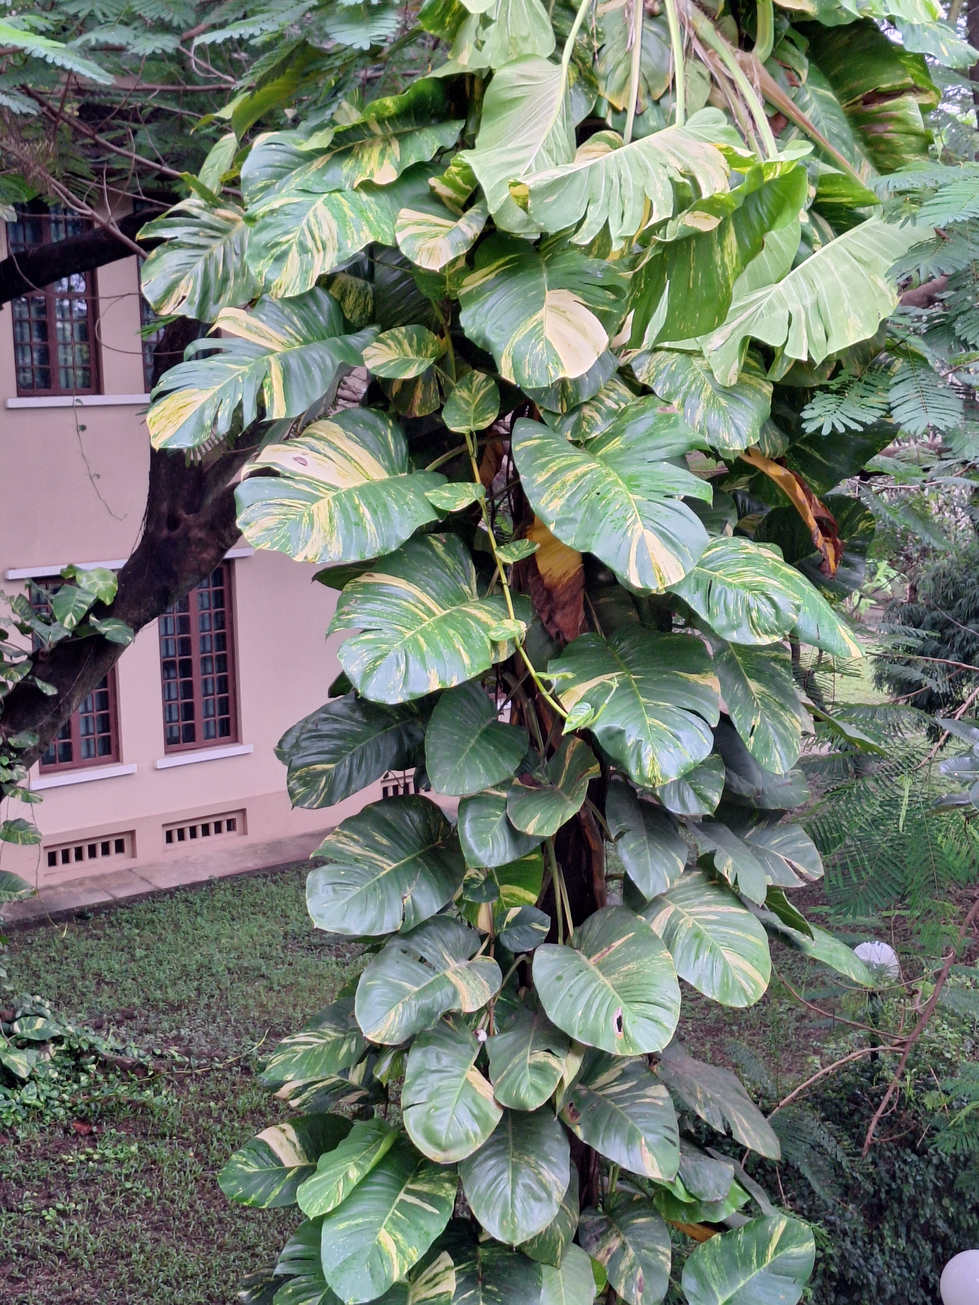
Preparing the training
10 participants per institution/ it is 60 persons in total minimum
Vietnam | HUST | 13
Laos | SKU | 10
Vietnam | VNUA | 11
Inodnesia | IPB | 11
Inodnesia | UNS | 10
Laos | NUoL | 10
Total | 60 | 45

Slide 24
Calendar - ended
Sep. 2025
Module 1
Oct. 2025
Module 2
Nov. 2025
Module 3
Dec. 2025
Module 4
Jan. 2026
Module 5
Jan. 2026
Module 6

Slide 25
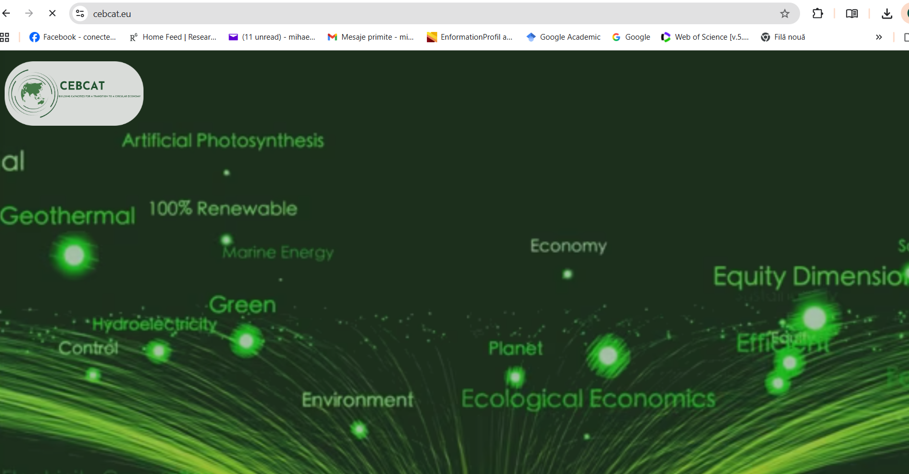
CEBCAT platform gp to https://e-learning.cebcat.eu/

Slide 26
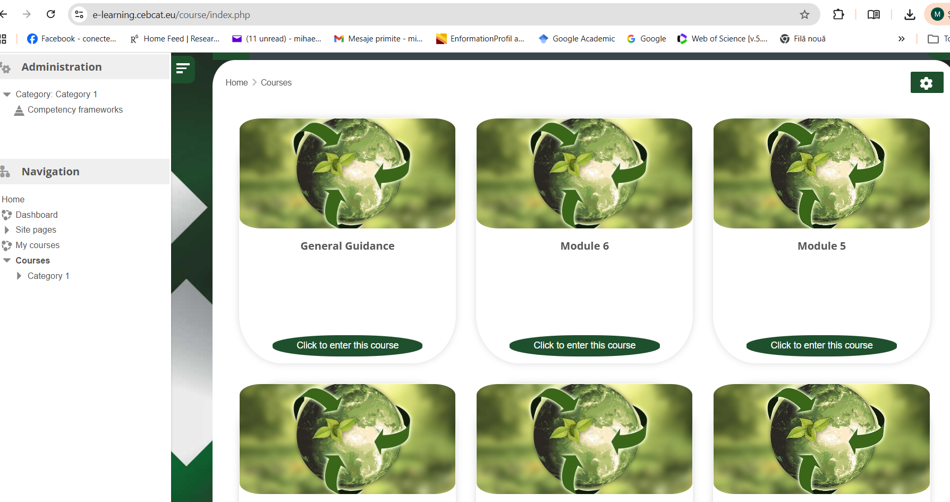

Slide 27
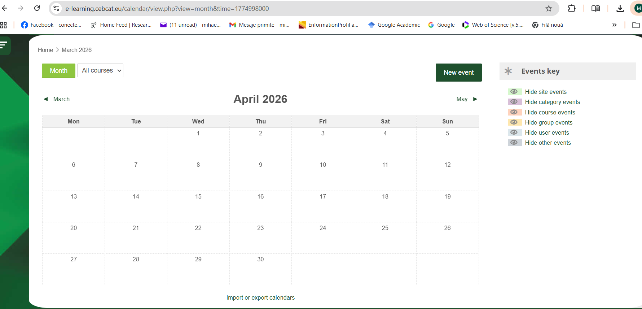

Slide 28
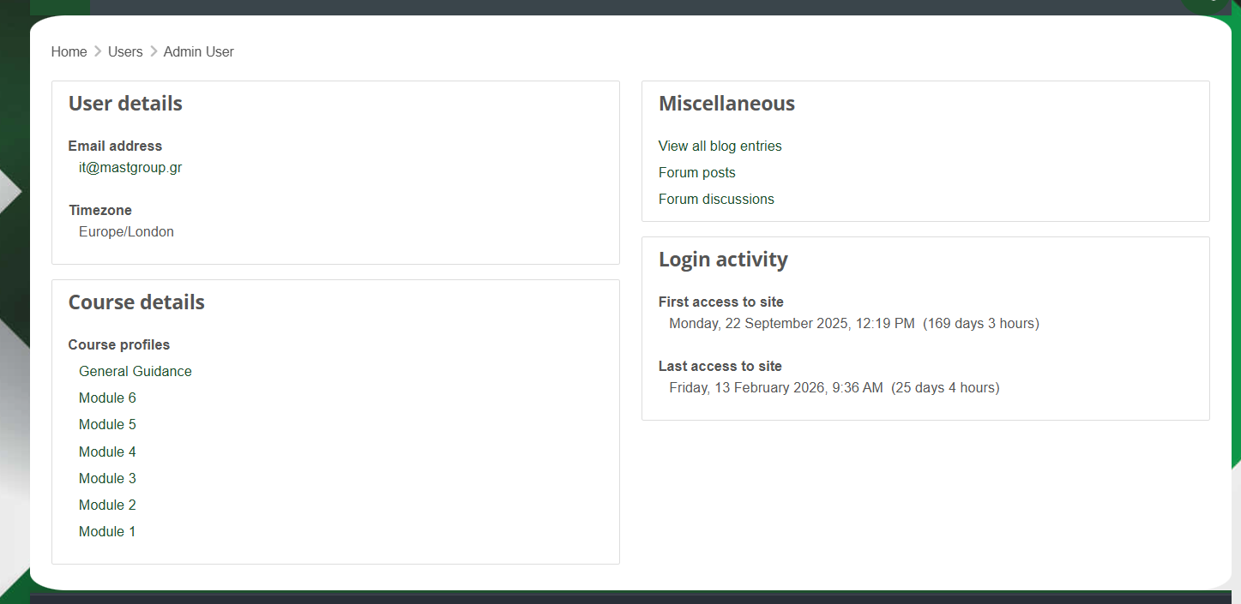
Reporting

Slide 29
Thank you

