Slide 1







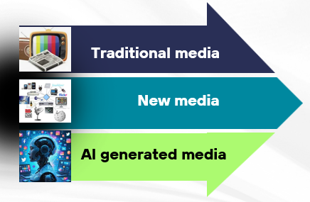
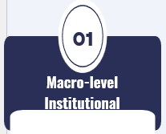
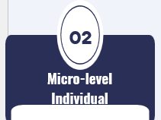


Countering Hybrid Warfare Campaigns
FORTHEM International Conference
European Universities 2030: Building Knowledge Ecosystems for Europe’s Strategic Capacity in an Age of Polycrisis
^{June 3-5, 2026}

