Slide 1



4th FORTHEM Annual Conference
03.06.2026
Transforming Higher Education: Governance, Values & Alliances as Strategic Systems –
The Emerging Research Dimension of European University Alliances

Slide 2
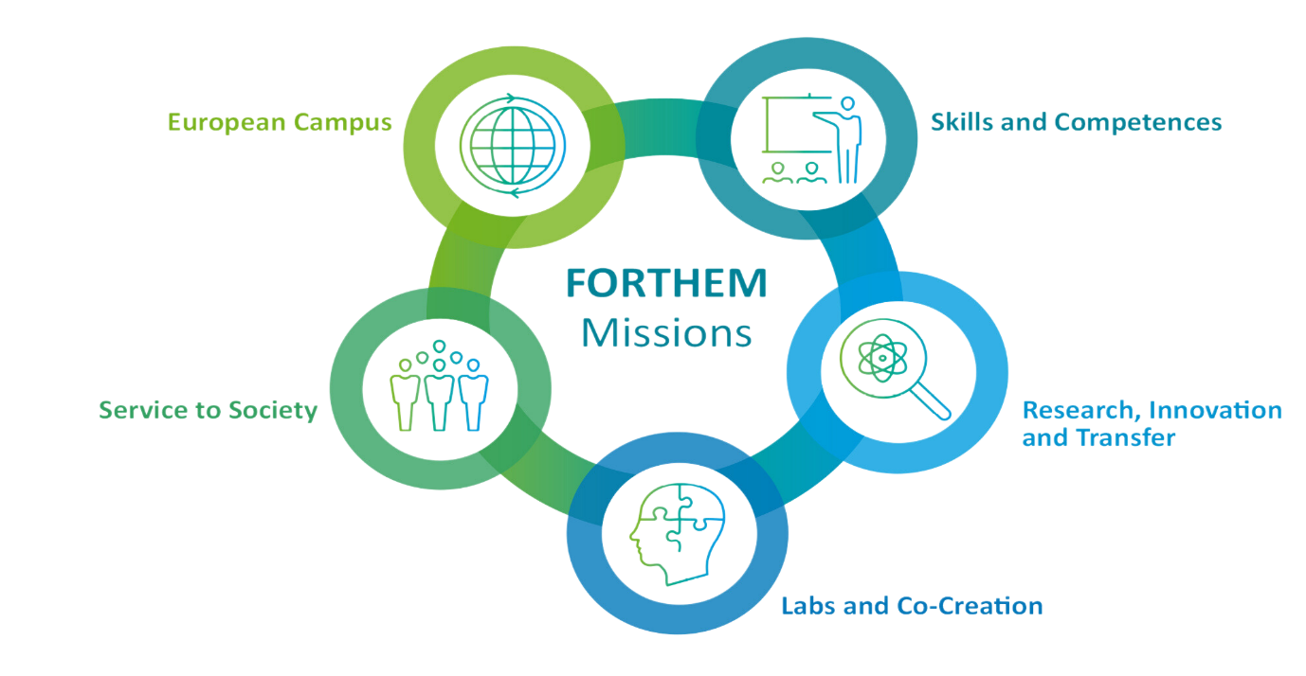
The European Universities Initiative and the FORTHEM Alliance
European Universities Initiative (EUI)
proposed by French President Emmanuel Macron in his 2017 Sorbonne speech on a comptetitive Higher Education Sector in Europe
launched by the European Commission in 2018
currently 74 alliances involving more than 650 higher education institutions
aims to strengthen long-term European cooperation in higher education
Increasly also about international collaboration
FORTHEM Alliance
founded in 2019
9 partner universities across Europe
around 230,000 students and 36,000 staff
mission-based alliance structure:

Slide 3
The Evolution of the European Universities Initiative
Early pilot phase (2019) | Current consolidation phase (2026)
“Bottom-up networks” testing “innovative and structural models” | Long-term institutional cooperation building on achieved integration
Focus on mobility, joint education & European student experience | Integrated strategies connecting education, research, innovation & societal engagement
Experimental cooperation formats | Upscaling, mainstreaming & embedding alliance activities
Mainly educational cooperation logic | Alliances increasingly framed as European knowledge ecosystems
The initiative evolved from experimenting with cooperation models → toward institutional transformation and long-term European capacity building.
Sources: European Commission Erasmus+ Programme Guide (2021); European Universities calls; Charret & Chankseliani (2023)

Slide 4
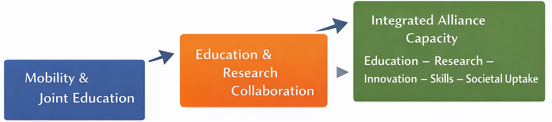
The Transformation Process
From mobility networks to integrated knowledge ecosystems
Alliances are evolving beyond mobility and joint education
Research increasingly connects education, innovation, skills and societal engagement
The research dimension is becoming central for institutional transformation, competitiveness and resilience
FORTHEM as an illustrative case
governance & operational mechanisms
talent ecosystems & research cultures
structural challenges for deeper integration

Slide 5
How Selected Alliances Describe their Research Dimension
4EU+
“One Comprehensive Research-Intensive European University”
Arqus
“Research-driven European University”
Circle U.
Research-intensive alliance linking education, research & innovation for societal transformation
Ulysseus
Strengthening both the European Higher Education Area and the European Research Area
CIVICA
Cross-border cooperation in education, research, innovation & civic engagement
EUniWell
Research-based contribution to policy, pedagogy & well-being
CHARM-EU
Challenge-driven and research-based alliance model
FORTHEM
Dedicated Research, Innovation & Transfer Mission since 2022
Across the initiative, research is increasingly embedded in alliance self-descriptions as a core dimension of European cooperation.

Slide 6
Why the Research Dimension Matters ?
Why research moved to the center of alliance debates
European policy agendas increasingly expect universities to contribute to innovation uptake, resilience and strategic autonomy
Policy reports by Letta, Draghi, Heitor and the ERA Policy Agenda frame knowledge and research as key European capacities
Alliances are increasingly seen as bridges between the European Education Area (EEA) and the European Research Area (ERA)
The European Universities Initiative is shifting from networking instrument toward long-term institutional integration
This raises a key question: Can alliances become stable environments for cross-border cooperation beyond project cycles?

Slide 7
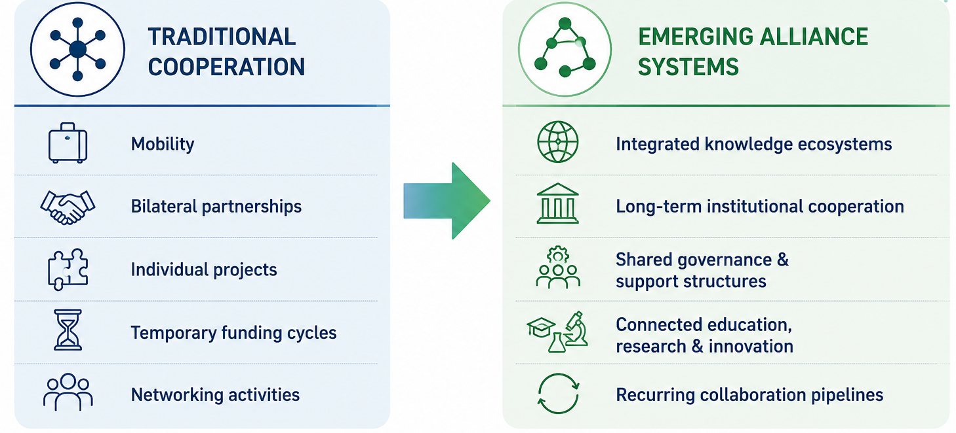
The Shift in Alliances‘ Logic

Slide 8
What Makes Research Integration Real?
From ambition to operational mechanisms
🏛 Governance & Structure
FORTHEM R&I&T mission alongside education and societal engagement
🧩 Thematic Integration Spaces
challenge-driven collaboration (9 FORTHEM Labs)
cross-border interaction (FORTHEM Matchmaking)
⚙️ Enabling Capacity
proposal support and RMA cooperation (FORTHEM Joint Virtual Office and expert groups)
policy intelligence (FORTHEM joins European Science Diplomacy Alliance)
Whom to take into account?
🎓 Talent Ecosystems (FORTHEM Academy for ESRs, FA4ESR)
ESR support & mentoring
mobility, training & skills development
🌍 Regional & Societal Integration (FORTHEM Regional Innovation Strategy)
RIS3 alignment & pathways from knowledge to uptake
stakeholder & innovation ecosystems
The goal is not isolated projects — but durable collaboration routines across the alliance also in the R&I Dimension.

Slide 9
Values, Research Culture & Assessment Reform
📖 Open Science & Collaboration – Equal/Democratic Access
recognition of teamwork, openness and knowledge sharing
alliances as spaces for cross-border learning and experimentation
📊 Research Assessment Reform (integrated in FA4ESR)
moving beyond narrow publication metrics
relevance of narrative CVs, societal impact & responsible metrics
👩‍🎓 Research Careers as a Policy Priority (integrated in FA4ESR)
more human-centered and connected career pathways
mobility, inclusion and transferable skills as part of research culture
🛡️ Values & Responsible Cooperation (FORTHEM Strategy 2030)
academic freedom
ethics by design
“secure openness” in international collaboration
🌍 Alliances as testing environments
pilot spaces for new practices before wider institutional implementation
Without incentive and culture change, alliance-based collaboration risks remaining an “extra activity” rather than normal academic practice.

Slide 10
Conceptual Perspective from Research Literature
Alliances as institutionalization processes
Recent research increasingly describes European University Alliances not simply as networks, but as new forms of transnational organizational cooperation (ref. Legal Entitiy).
Key arguments from the literature
Maassen, Stensaker & Rosso (2023)
alliances face coordination challenges without hierarchical authority
the key question is whether cooperation becomes durable and routinized
Charret & Chankseliani (2023)
alliance-building is non-linear and experimental
alliances emerge through negotiation, identity-building and organizational learning
Palmowski (2025)
alliances can be understood as emerging “communities of practice”
creating new forms of European collaboration and institutional identity
Research integration is therefore not only about projects — but about institutionalization, shared routines and organizational capacity.

Slide 11
Scientific Debates & Critical Perspectives
Emerging Debates across Alliances‘ Research Dimension
⚖️ Inclusion vs. Stratification
Lambrechts et al. (2024) and Rensimer & Brooks (2025)
alliances may unintentionally reproduce existing hierarchies
stronger institutions risk dominating research portfolios
🌍 Euro-internationalization
Frame & Curyło (2025)
alliances create a specifically European form of internationalization
based on long-term embedded cooperation rather than isolated mobility
🏛 Alliances as policy laboratories
Recent ERA and CoARA debates
alliances increasingly test new approaches to:
  research assessment
  research careers
  interoperability
  governance models
Alliances are not only implementation structures — they are becoming experimental environments for transforming higher education itself.

Slide 12
Structural Challenges & Possible Responses
From barriers to enabling conditions: Long-term institutional transformation requires long-term enabling conditions — not only ambitious projects.
⚠️ Structural Challenges Fragmented EEA / ERA governance Short-term project funding Legal & administrative diversity Unequal institutional capacities Dominance of narrow metrics Pressure toward high-TRL logics | ✅ Possible Responses Better alignment of European frameworks & instruments More sustainable long-term alliance support Shared services & interoperability mechanisms Inclusive participation & capacity building Research assessment reform & responsible metrics Flexible pipelines preserving research diversity
Long-term institutional transformation requires long-term enabling conditions — not only ambitious projects.

Slide 13


Our Vision:
We shape the next generation of creative minds and responsible citizens!
Forthem | Forthem Alliance

Slide 14

Contact
Nicole Birkle
FORTHEM General Secretary and Manager of the FORTHEM Academy for Early-Stage Researchers
A4ESR@forthem-alliance.eu
general.secretary@forthem-alliance.eu
https://www.forthem-alliance.eu/

