Slide 1
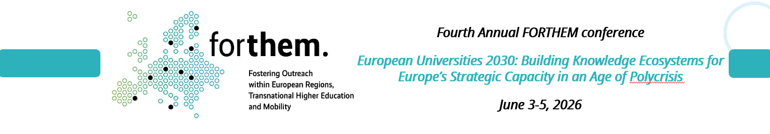

Traditional universities in European University Alliances -
from: Risk Management
to: Opportunity Management
A paradox of measurement
Dr.sc.admin. Agnese Rusakova
Expert, Council of Rectors’ of Latvia
Lead Researcher, University of Latvia (Policy Officer of the FORTHEM Alliance, member of FOREU4ALL Topical Group on Governance)

Slide 2
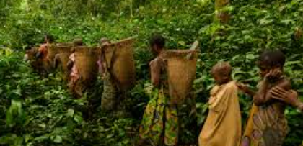


Slide 3
Universities are increasingly asked to demonstrate future readiness while accountability procedures still rely on indicators designed to validate past performance
Alliances is the place where this mismatch can be observed

Slide 4
Ecosystem actor | What they do well | Structural limitation | Innovation transfer
Projects | Introduce novelty; test ideas under uncertainty | Time-limited; scoped to deliverables | Innovation remains episodic and exits when funding ends
Individual boundary spanners | Translate, connect, unblock | Reliant on personal capacity; tacit knowledge | Innovation remains person-dependent and fragile
External partners (industry, NGOs, regions) | Pull relevance; create demand | No authority over university structures | Innovation pressure exists, but absorption capacity is missing
Policy frameworks (EU, national) | Set direction; define values and incentives | Abstract; unevenly implemented | Innovation is signalled, not operationalised
Internal university units | Ensure continuity and legitimacy | Optimised for stability, not change | Innovation is admitted as exception, not capability
Alliances | Compare systems; distribute risk; persist over time | Partial authority; coordination cost | Innovation transfer supported by alliance being a safe space combining reach, legitimacy, continuity, and comparison

Slide 5

Please cooperate with people outside the university
The world is changing rapidly.
Formal university is designed for a world that is stable.
It prioritizes predictability, internal logic, and internal values
UNIVERSITY
When innovation cannot yet be expressed through existing performance frameworks, the system lacks the channels to absorb it.
What cannot be measured inside the legacy system is treated as a risk.
Why should I? I can do everything at my university,in my language.....
-> the task is to increase the system’s permeability so that innovations can be absorbed organically
If value is only recognised when it fits existing indicators, the system will rationally prefer the past.

Slide 6
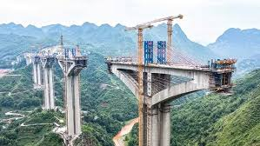

THE EUROPEAN POLICY SPACE
Vision, Potential Opportunities, and Real Constraints.
The second type of the employee is the boundary spanner - connects disciplines, cultures, and systems.
operates within a structure
operates through vectors and spheres of influence
UNIVERSITY
ECOSYSTEM
Boundary spanners are effective through relational intelligence - working with complexity to translate between domains governed by different logics and to open pathways where institutional alignment is still being built
ECOSYSTEM
violet = «value sharing».
Boundary spanners work within the evolving European policy space and help prepare the ground for future institutional opportunities
A dashed line, because the structure has not yet been formalized
Opportunity management is not more risk - it is more measurement capacity.We expand what can be institutionally recognised.
Aliance team
How to measure your performance?
We begin to measure not only what already exists, but also what can become possible.
The European policy landscape - its layout and terrain: the partnerships, indicators, and values defined, for example, by framework documents.
European frameworks provide direction; opportunity management determines whether that direction can be absorbed institutionally (permeability of innovation). Europe is already measuring direction, not only performance.

Slide 7


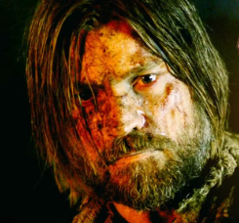
Modern university is governed by two co-existing institutional logics:
1) stability: secures legitimacy through continuity and process,
2) permeability: enables responsible action under uncertainty in fast-moving ecosystems.
Future readiness fails when timezones of legitimacy are misaligned
Those logics become visible in human form as ‘formal university employees’ and ‘project people’
formal university employee
project employee

Slide 8

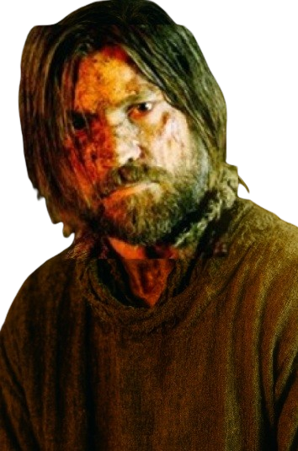


Slide 9

Project employee: “Winter is coming.”
Formal university employee: “Seasonal conditions may require an adaptive response.”

Slide 10
Translation
“Winter is coming.”
“Seasonal conditions may require an adaptive response.”
Both are saying the same thing - but they live in different time zones.
The project employee speak in urgency, outcomes, and accountability.
Their question is: “Did we act in time?”
They prove themselves through responsiveness, and visible progress.
The formal university employee speaks in continuity, process, and governance.
Their question is: “Was this done in a way the system can recognise?”
They prove themselves through compliance, and traceable decisions.
One is wired for speed and uncertainty; the other for stability and permanence. They are not opposites. They are co-dependent, optimised for different worlds
But in an alliance, those worlds collide - and suddenly we need people fluent in both languages: the language of structure, and the language of change.

Slide 11

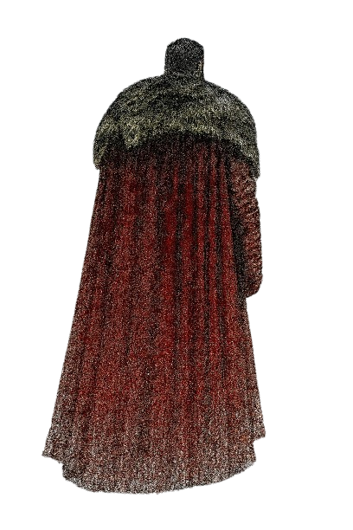
Project employee : “Apparently you did not understand. Winter is coming. Who will be responsible for finding wood?”
Formal university employee : “Before assigning responsibility, we should first define what constitutes ‘wood’ within our institutional framework. Rather than focusing on wood, perhaps we should develop a strategic vision for warmth. Let’s put it on the agenda for next semester’s resource planning meeting.”

Slide 12
Translation
“Apparently you did not understand. Winter is coming. Who will be responsible for finding wood?”
“Before assigning responsibility, we should first define what constitutes ‘wood’ within our institutional framework. Rather than focusing on wood, perhaps we should develop a strategic vision for warmth. Let’s put it on the agenda for next semester’s resource planning meeting.”
Formal university employee hears the same sentence that project people hear and reaches for the glossary. Wood isn’t just cellulose; it’s a procurement category, a sustainability metric, a line item in next year’s budget. Decision rule: Responsibility must be pre-allocated through policy, ratified by stakeholders, and insured against liability.
Outcome metric: A 47-page white paper, peer-reviewed, with footnotes that survive the next accreditation visit.
Their logic is airtight: if you assign the wrong person to gather the wrong kind of wood under the wrong policy, the entire system could splinter long before the first snowflake lands.
Project people hear “winter” and reach for the axe. To them, wood is whatever burns, responsibility is whoever’s closest to the forest. Decision rule: Proximity + competence (titles are irrelevant) + availability = responsibility.
Outcome metric: Fire crackling by dusk. Everything else is noise.
Their logic is brutally simple: if the fire isn’t lit by sundown, the meeting minutes won’t keep anyone warm.
Fire = real-world readiness

Slide 13

Project employee: “You clearly don’t get it. Ok, here’s what we’ll do. The colleague we know told me once she saw a forest nearby. And - I know guy in HR department who can chop the woods.”
Formal university employee : “We appreciate your enthusiasm, but any engagement with forests must follow institutional procurement and biodiversity protocols. Before proceeding, we’ll need to clarify whether the HR colleague’s job description includes lumber-related activities. We’ll need legal’s opinion before anyone enters the forest - and insurance confirmation from HR”

Slide 14
The project employees are in survival mode - agile, improvisational, certain that initiative will save the day. They operate on social capital and adrenaline: someone knows someone, we’ll make it happen. In their logic, a colleague with an axe is a resource, not a liability.
The formal university employee, follows due process. Every move must be sanctified by the trinity of policy, compliance, and liability. Forest? That’s not a place - that’s a jurisdiction. The HR guy? He’s not a woodsman; he’s a potential risk event.
Both sides, in truth, are protecting something sacred: the project people, momentum; the formal university employee, legitimacy. One trusts human ingenuity; the other trusts institutional order.
Our indicators are doing exactly what they were designed to do - just not for the world we are now entering.

Slide 15

.....and in that small clearing between them
- somewhere between the axe and the checklist -
the possibility of innovation quietly shivers in the cold.....

Slide 16
Two organizational logics within the system
Elements | Stability | Permeability (integration, porosity, reference nodes)
Priority | predictability, procedurality, repeatability | collaboration, open boundaries, experimentation
Governance | based on structures, regulations, and procedures | based on interaction, coordination, and adaptivity
Responsibility | chains are internal, boundaries are clear | is shared, boundaries are dynamic and permeable
Competence | skills in managing internal systems | skills in networking, contextualization, and configuration
Orientation | toward institutional resilience | toward participation in the ecosystem
Time horizon | long-term continuity, cyclical planning | short-to-medium term, opportunity windows
Authorisation | formal mandates, predefined authority | temporary authorisation, delegated mandates
Risk ownership | institutionally distributed, minimised | institutionally acknowledged, temporarily carried
Learning / feedback loop | codification, standardisation | exploration, extraction of learning for institutionalisation
The logic of stability does not need to be dismantled -it is our foundation.
The logic of permeability is not its opposite - it is our capacity to participate in the changing European education and research ecosystem. Capacity without a metric that can measure it appears as cost.
Both logics are essential for the long-term development- the challenge is managing the transition between them.
If the transition is structured, it becomes possible to augment the risk management to opportunity management.

Slide 17
Discussion
Where do we still confuse «unfamiliar» with «unsafe»?
What competencies enable innovation, but are invisible in our performance assessment systems?
Where is Europe already operating in a future that our institutions are structurally unable to enter?
What is the greater institutional risk : acting without full clarity, or remaining structurally unable to act?

Slide 18
Referencess
Presentation contains AI generated images and AI improved text
Images:
https://preview.redd.it/jzrip34i4m681.jpg?width=500&format=pjpg&auto=webp&s=32a1e9406270bd9929a843c168556f86b07fbecb
https://static.wikia.nocookie.net/gameofthrones/images/0/02/GOTITE304.jpg/revision/latest/scale-to-width-down/1000?cb=20231226033703
https://44.media.tumblr.com/c0b7f6ab19369451caeec949093768d5/tumblr_ppzdu2vAIX1sjezeoo8_500.gif
https://static.wikia.nocookie.net/gameofthrones/images/e/ee/409_Schlacht_um_die_Schwarze_Festung.jpg/revision/latest/scale-to-width-down/1000?cb=20150623172029&path-prefix=de
https://images.steamusercontent.com/ugc/101728956004454968/DD351C9B2760DD2CA438A83B42F5D8CF83768FE7/?imw=268&imh=268&ima=fit&impolicy=Letterbox&imcolor=%23000000&letterbox=true

